Slide 1
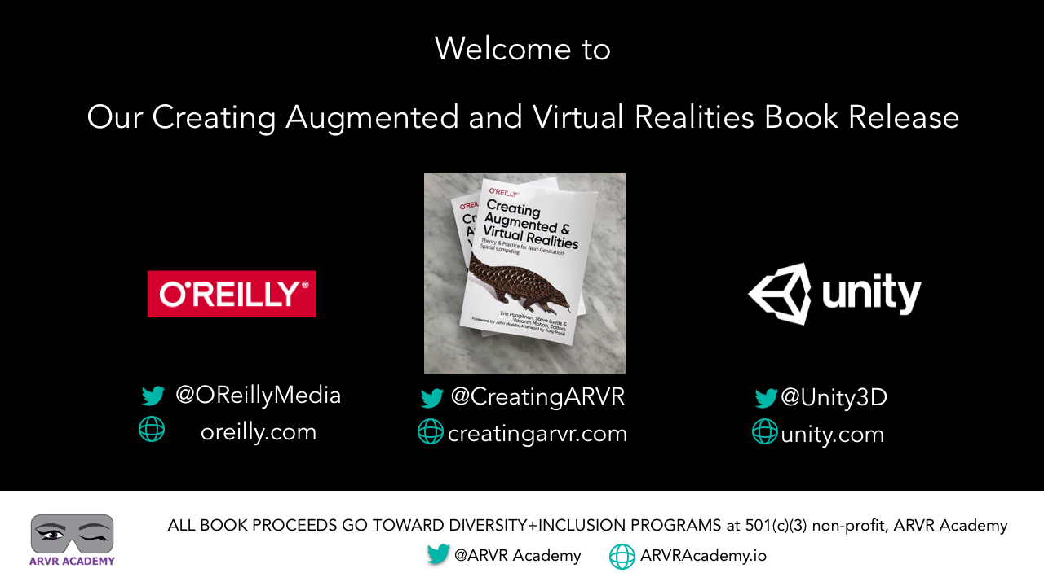

Slide 2
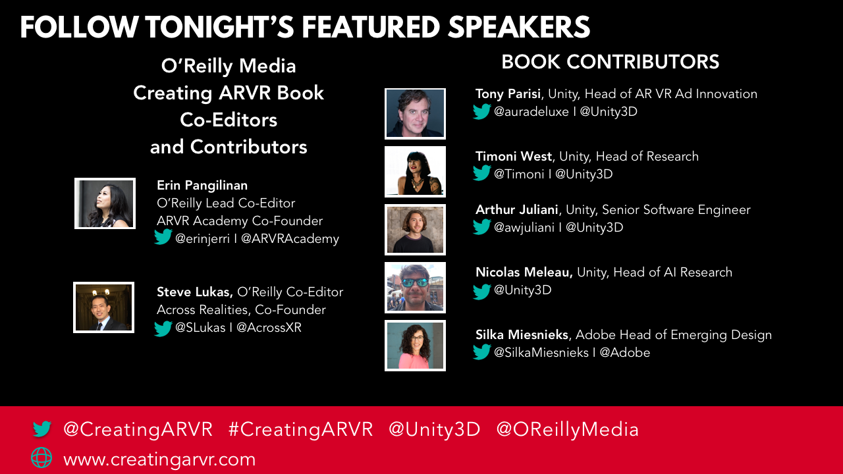

Slide 3
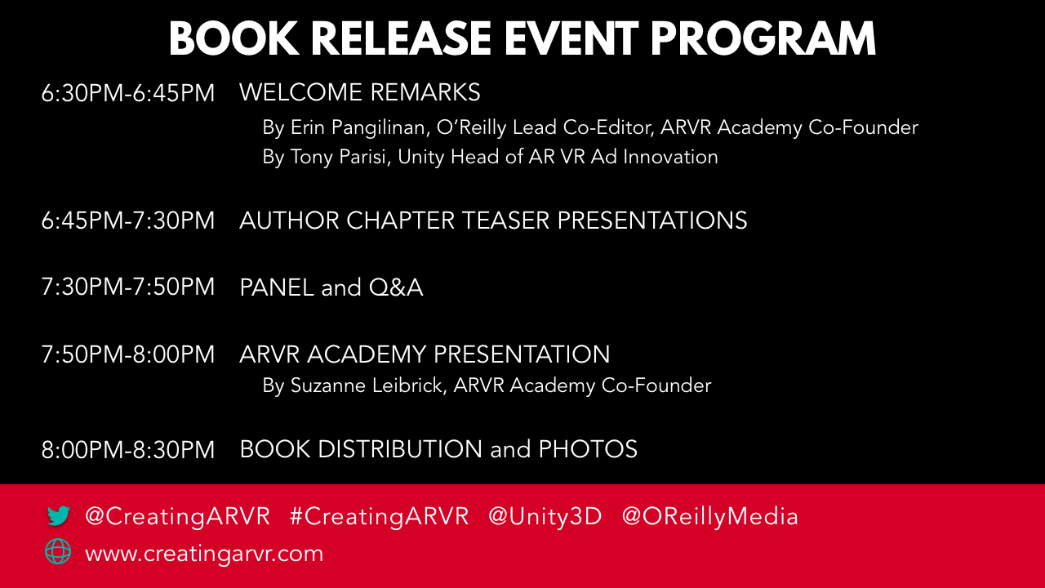

Slide 4
WELCOME
REMARKS
Notes:
Arthur slides

Slide 5
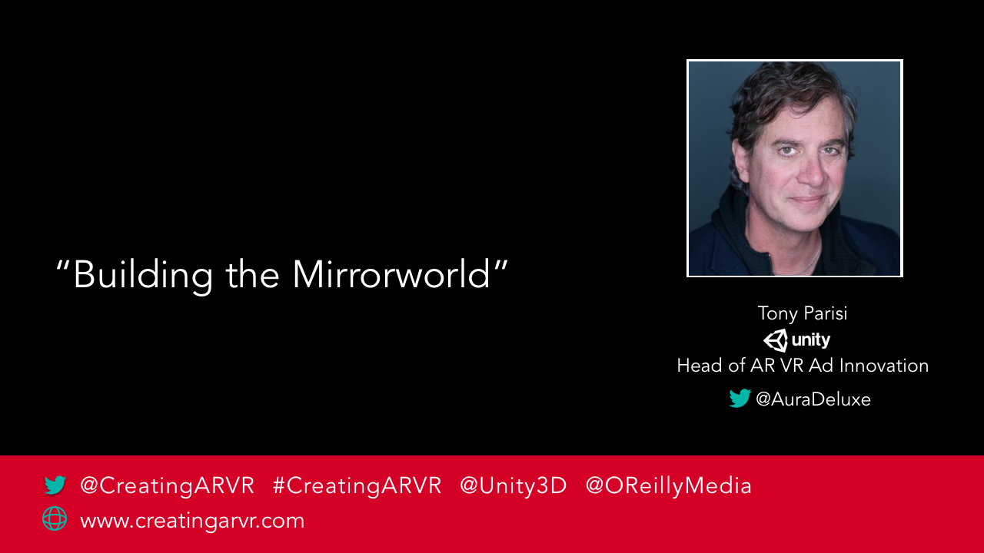
Notes:
Tony’s slides

Slide 6
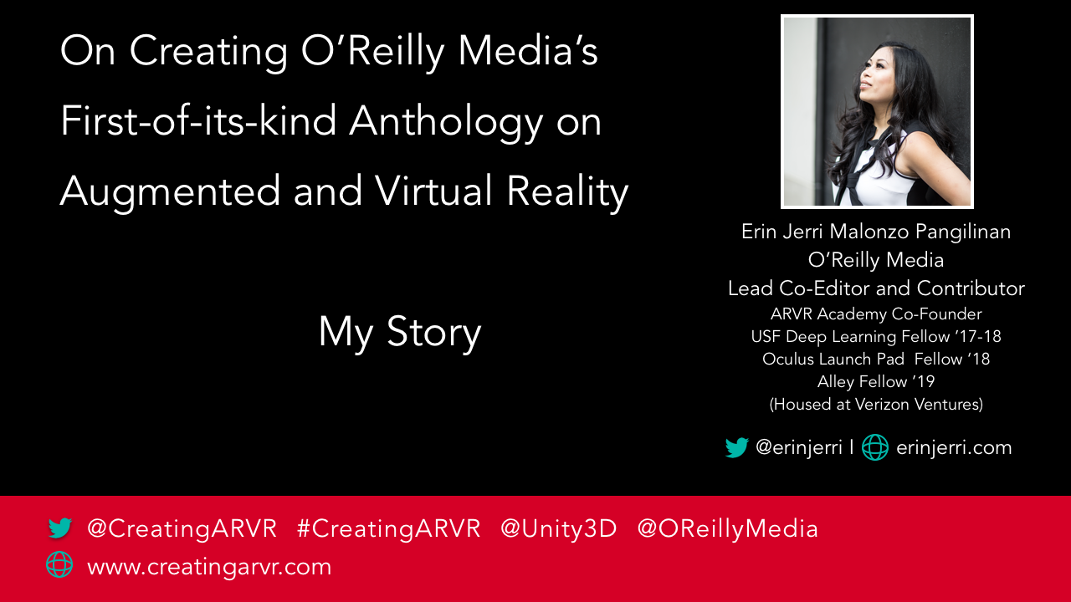

Slide 7
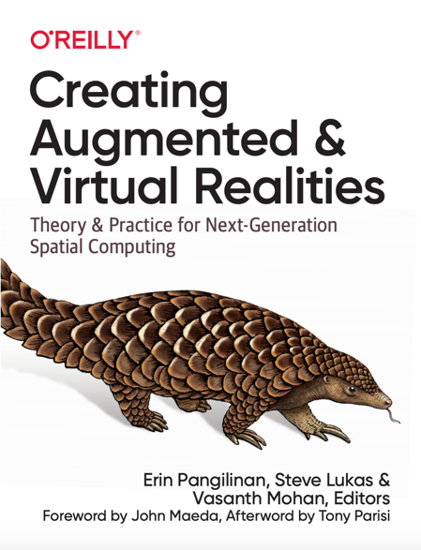
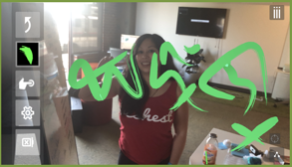
MY STORY
NOTE: My last name is NOT pronounced “Pangolin”
I am majority Filipino, not Chinese. I also co-founded FilipinX Americans in STEAM (FASTER) 501(c)(3) non-profit organization.
My name in mobileAR below in pre-Philippine sanskrit, Baybayin.
Notes:
Arthur slides

Slide 8
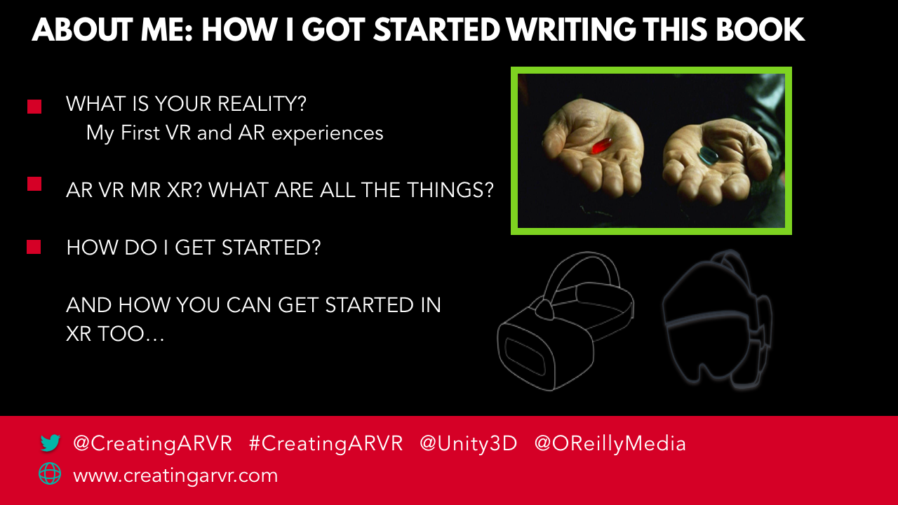

Slide 9
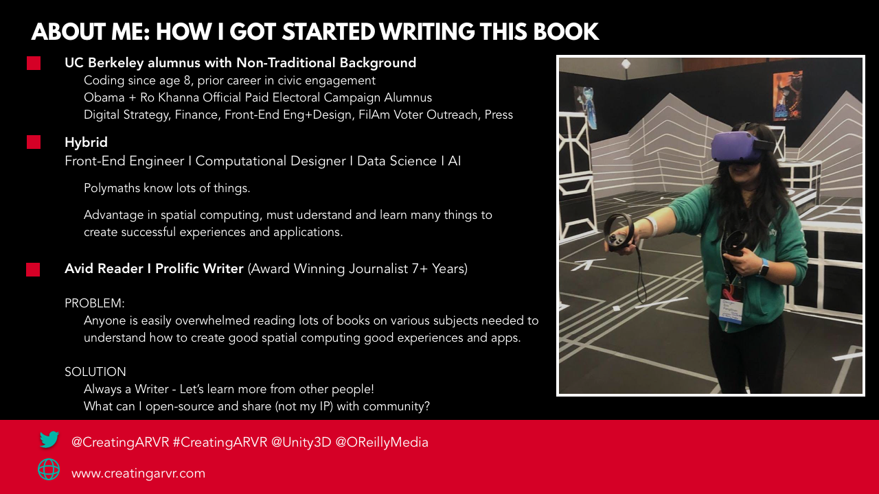

Slide 10
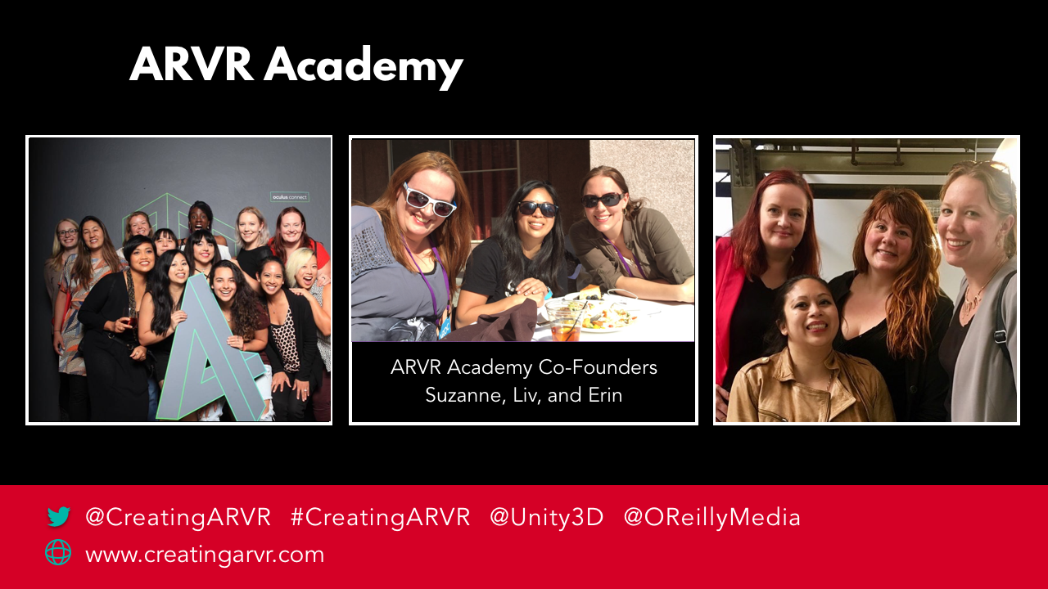

Slide 11
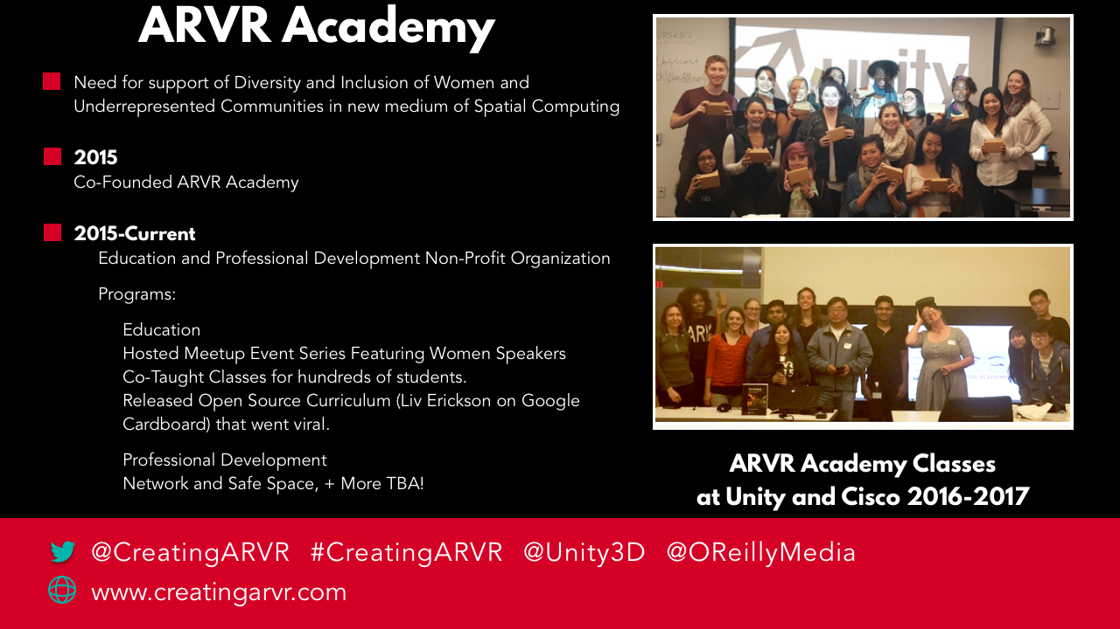

Slide 12
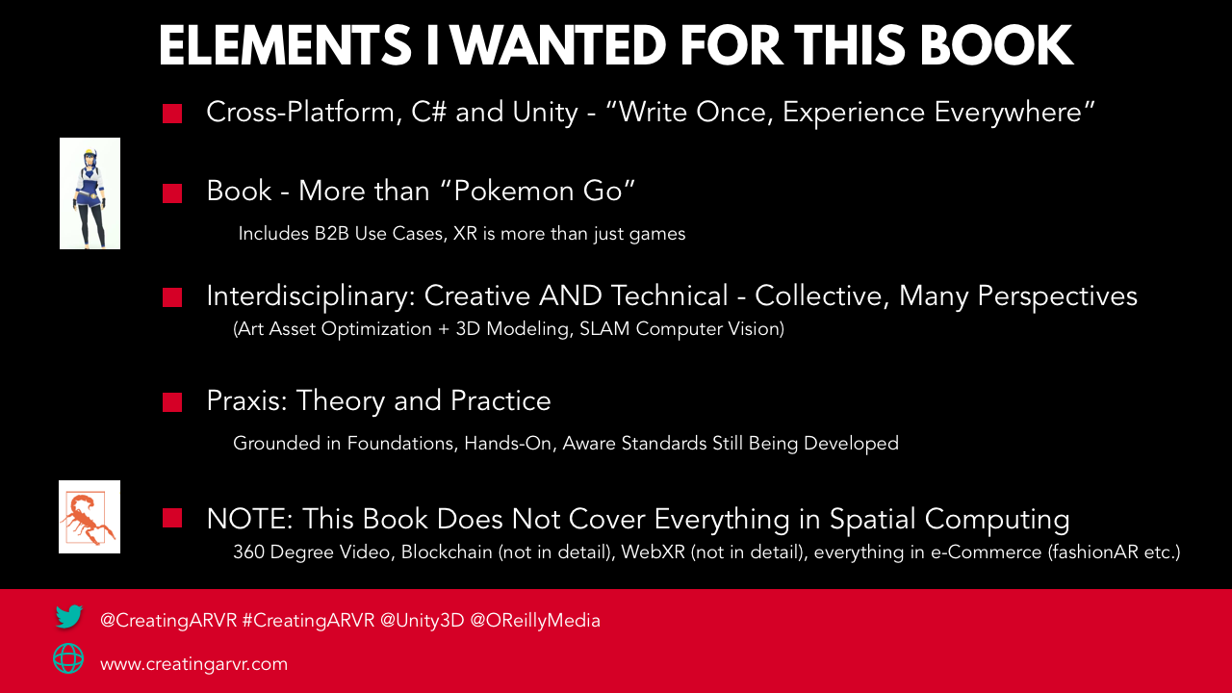

Slide 13
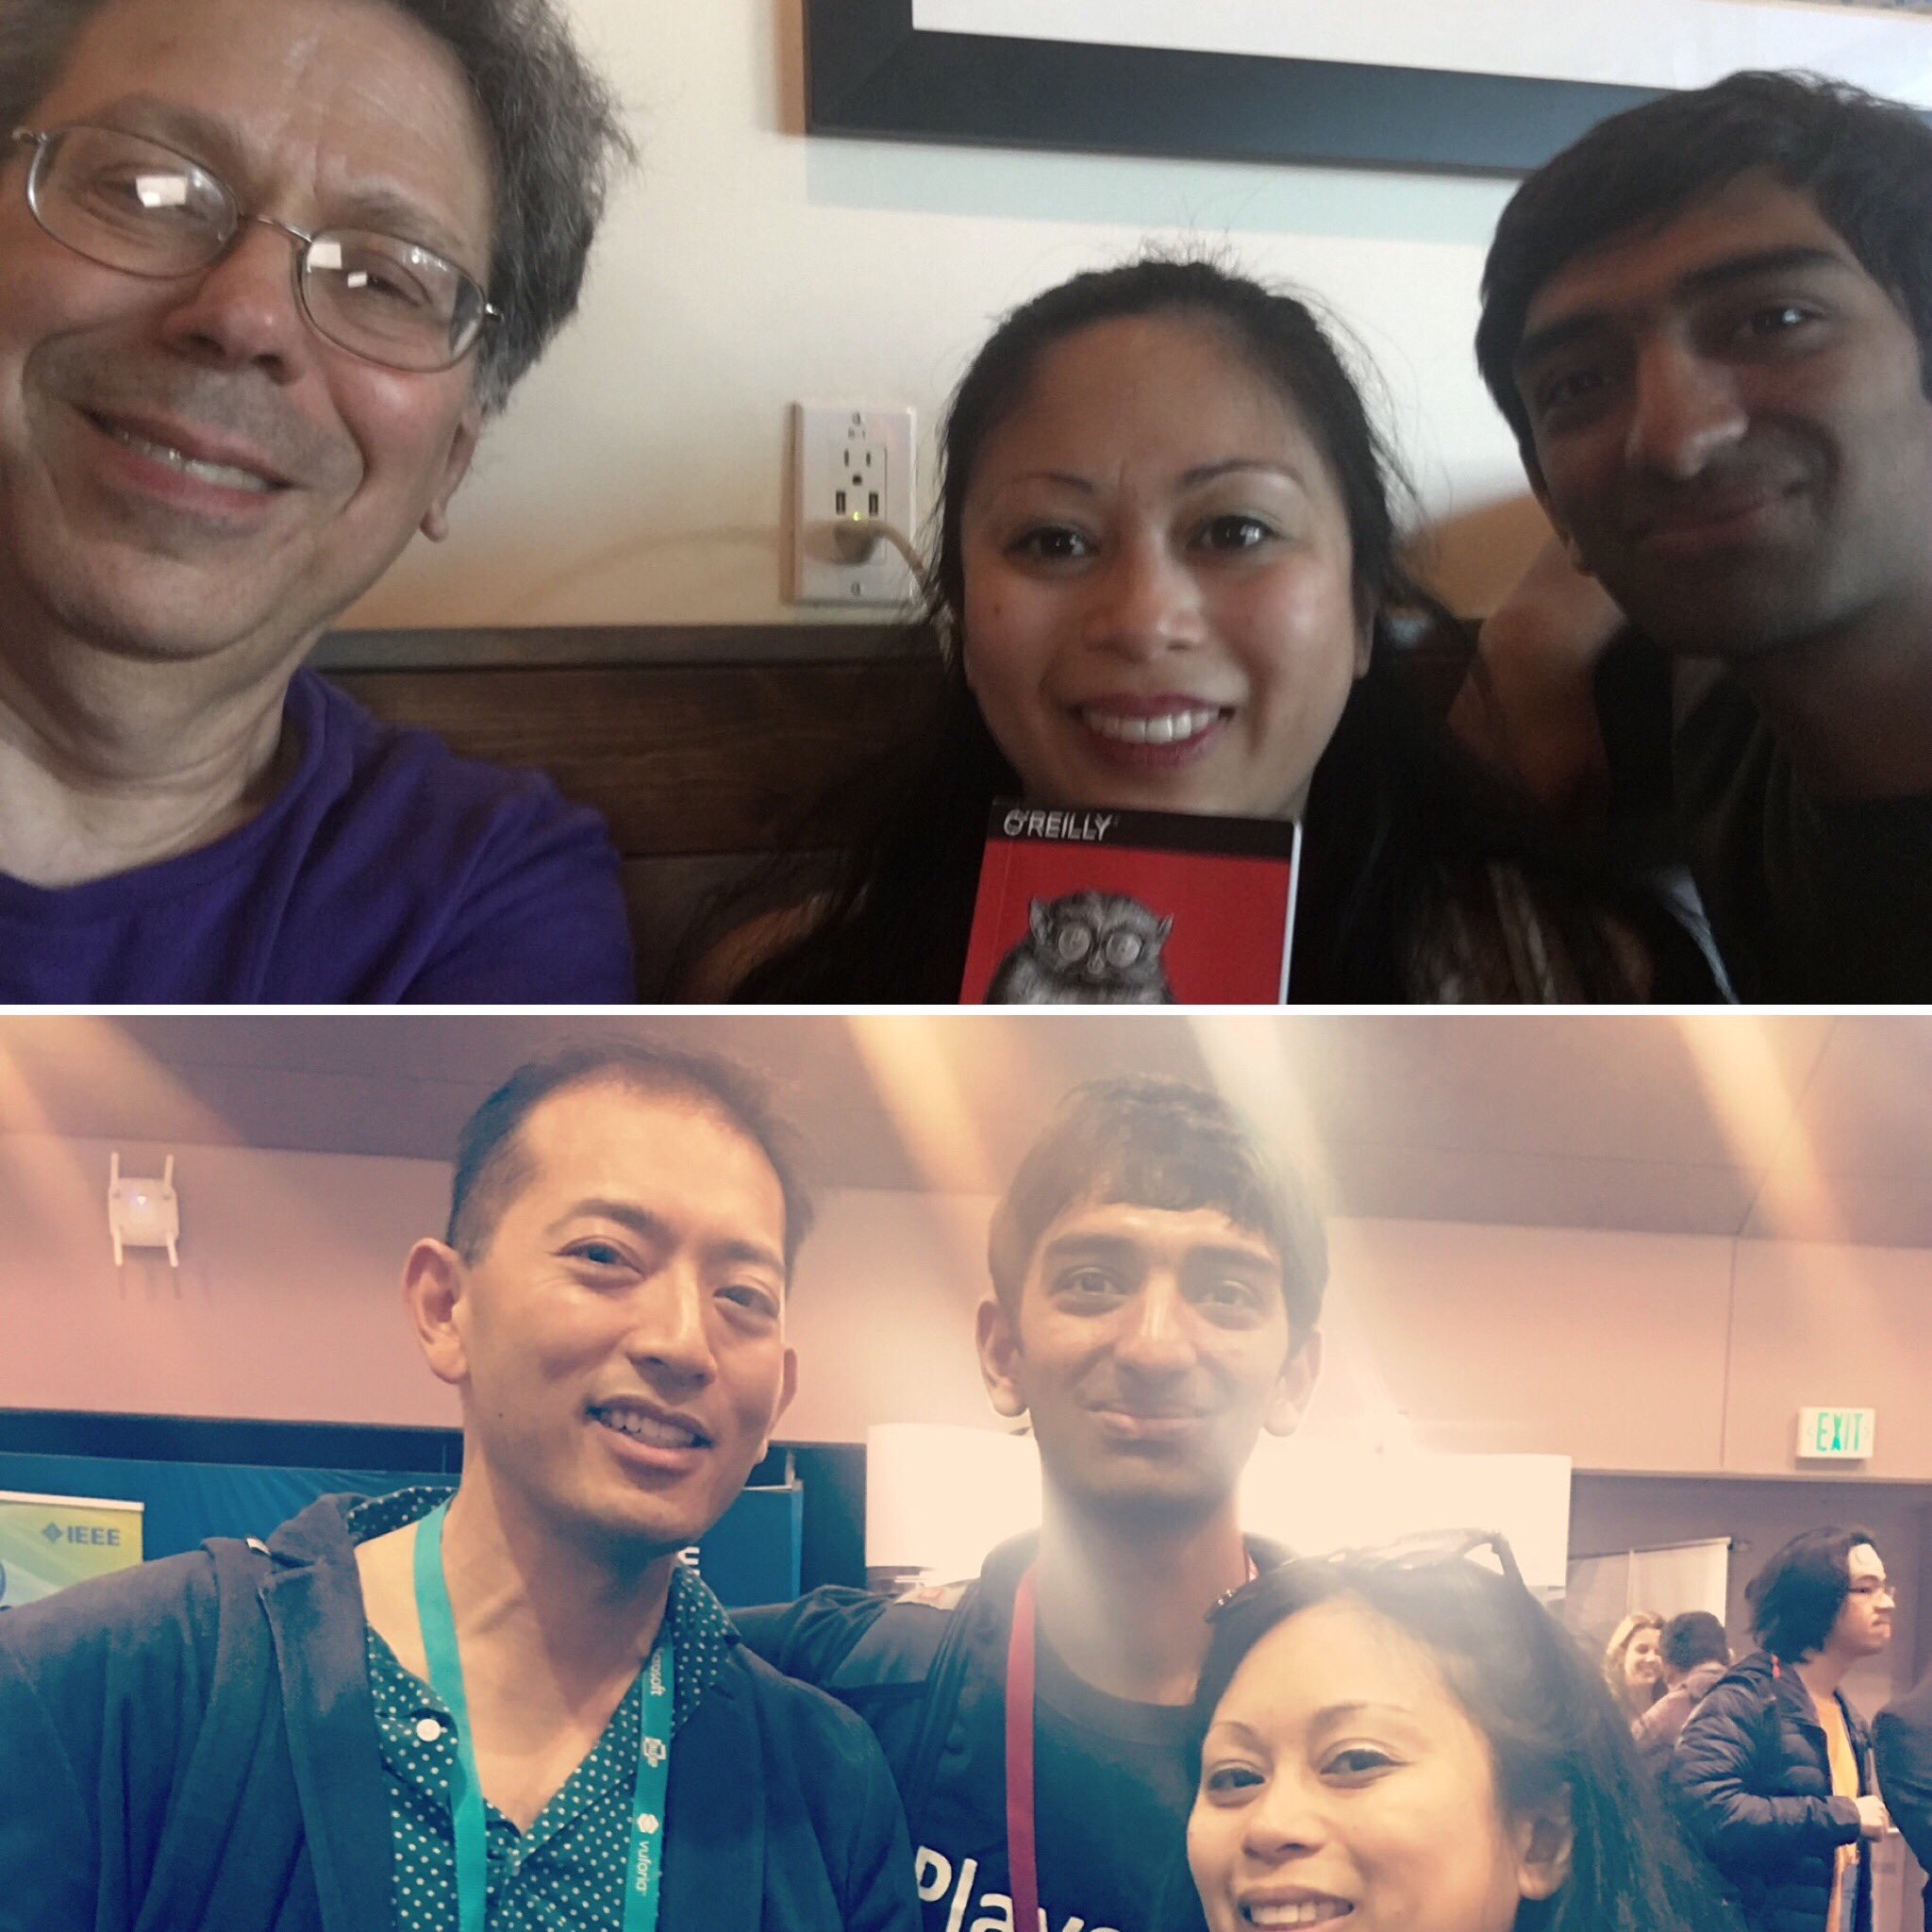

Slide 14
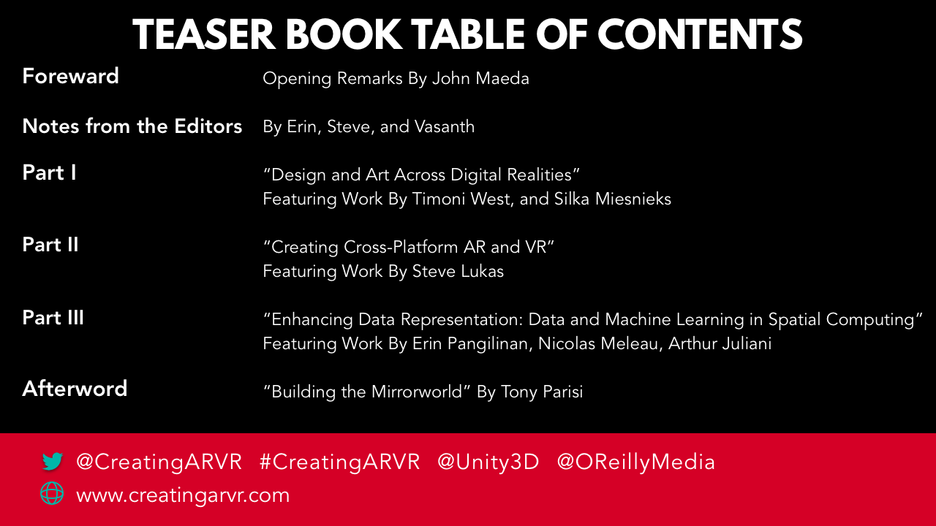

Slide 15
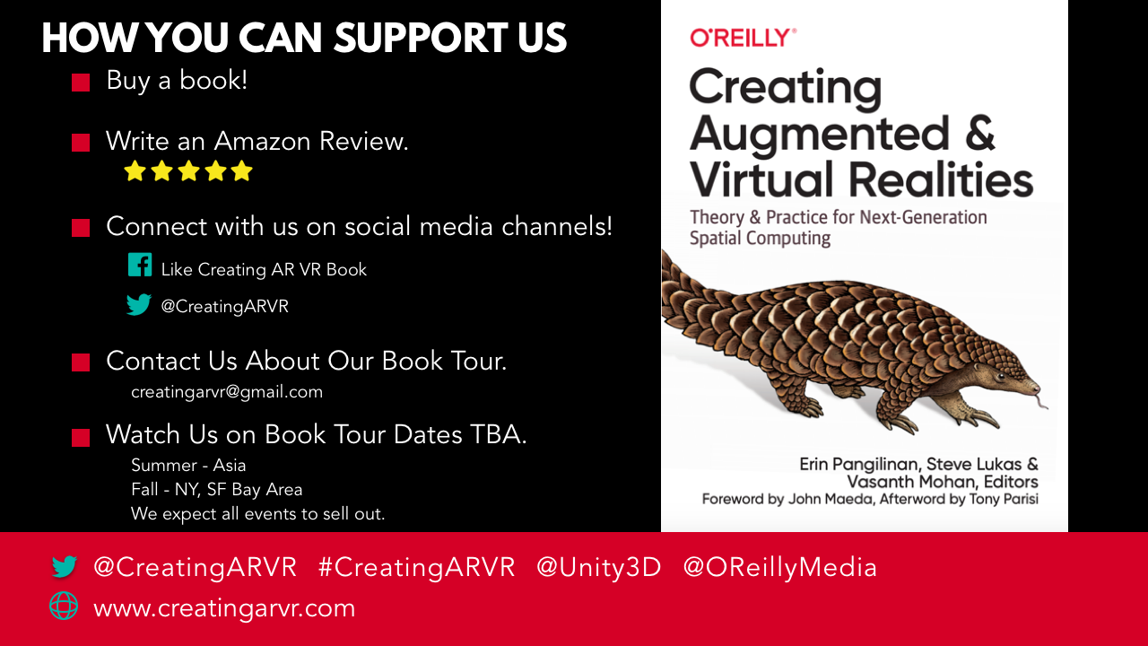

Slide 16
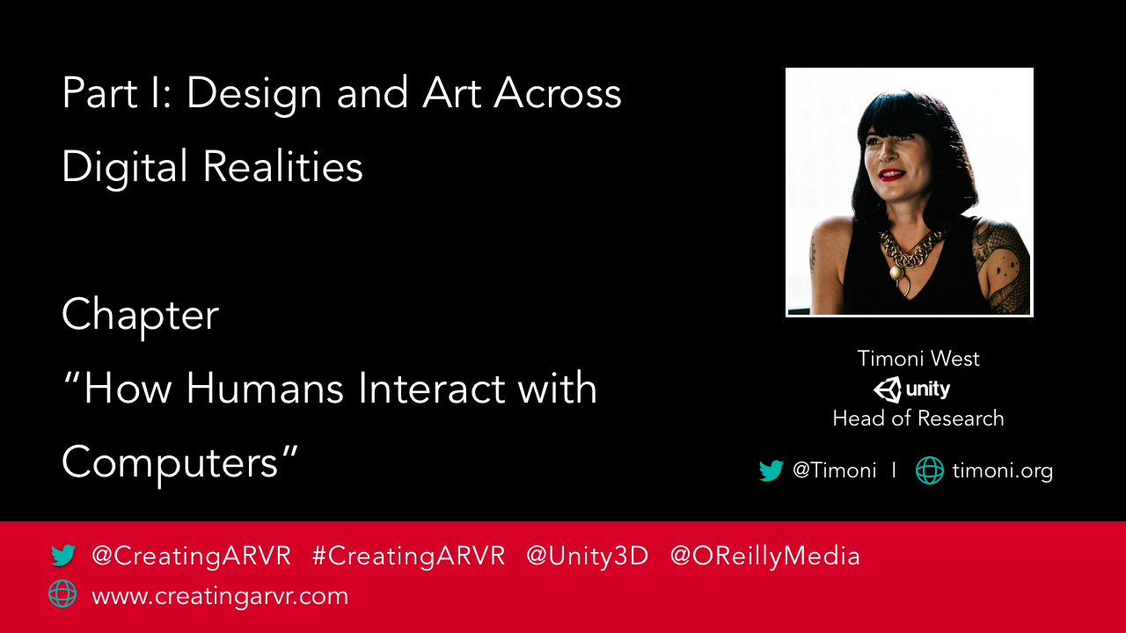
Notes:
Timoni’s Slides

Slide 17
How Humans Interact with Computers
Notes:
Silka’s slides

Slide 18
Background
Notes:
Important so we know why we interact the way we do with computers today.

Slide 19
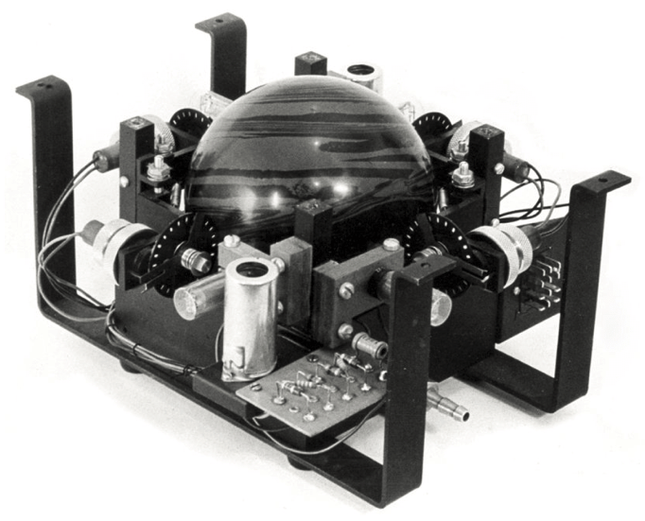
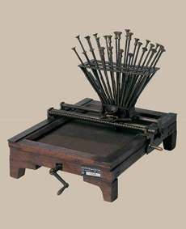
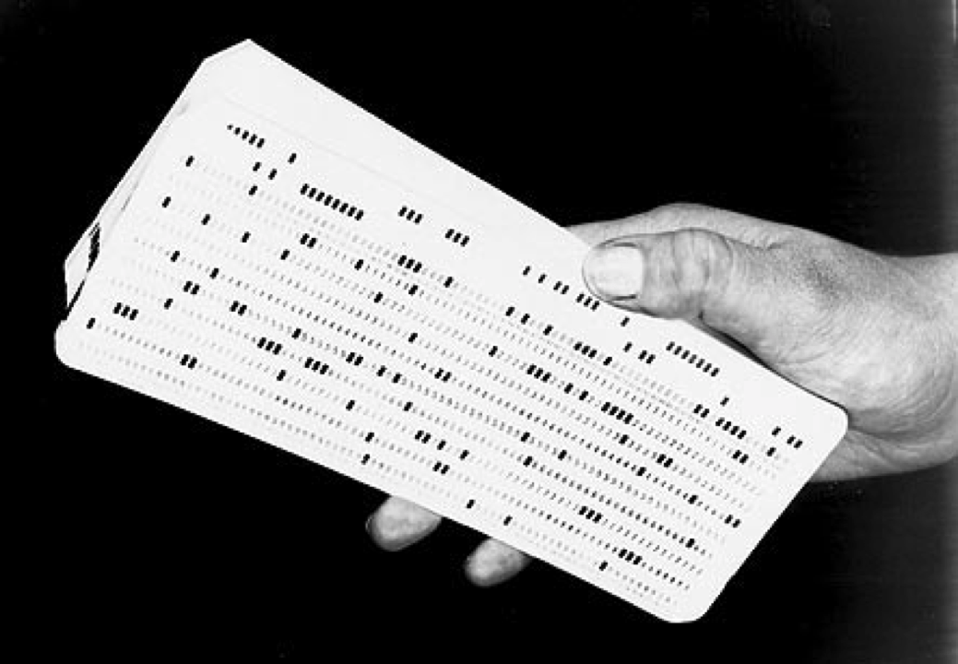
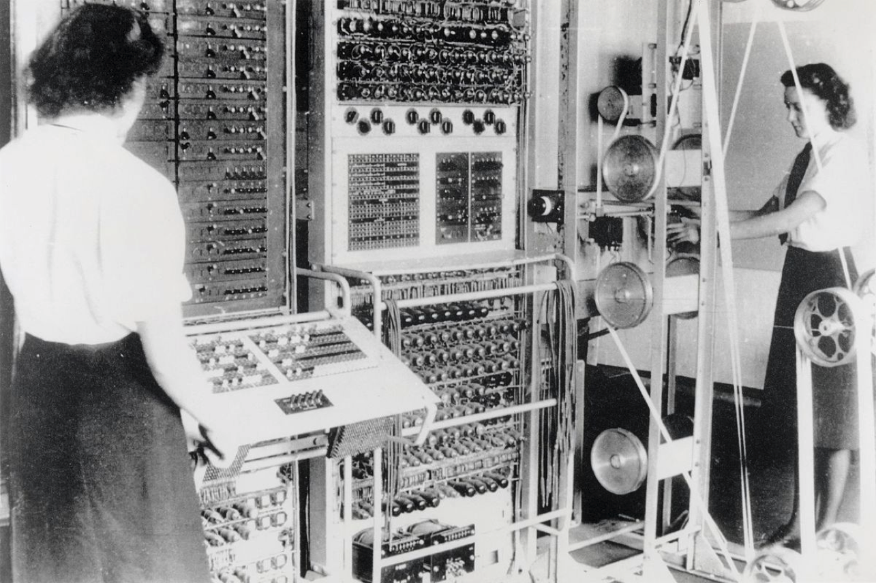
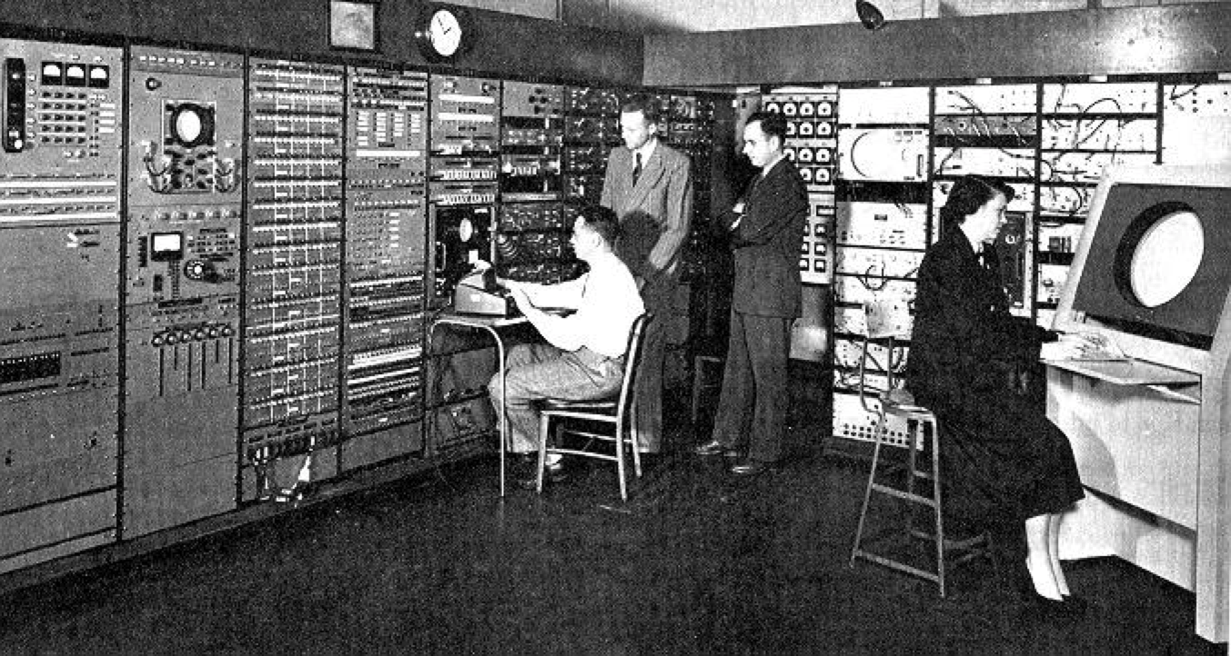
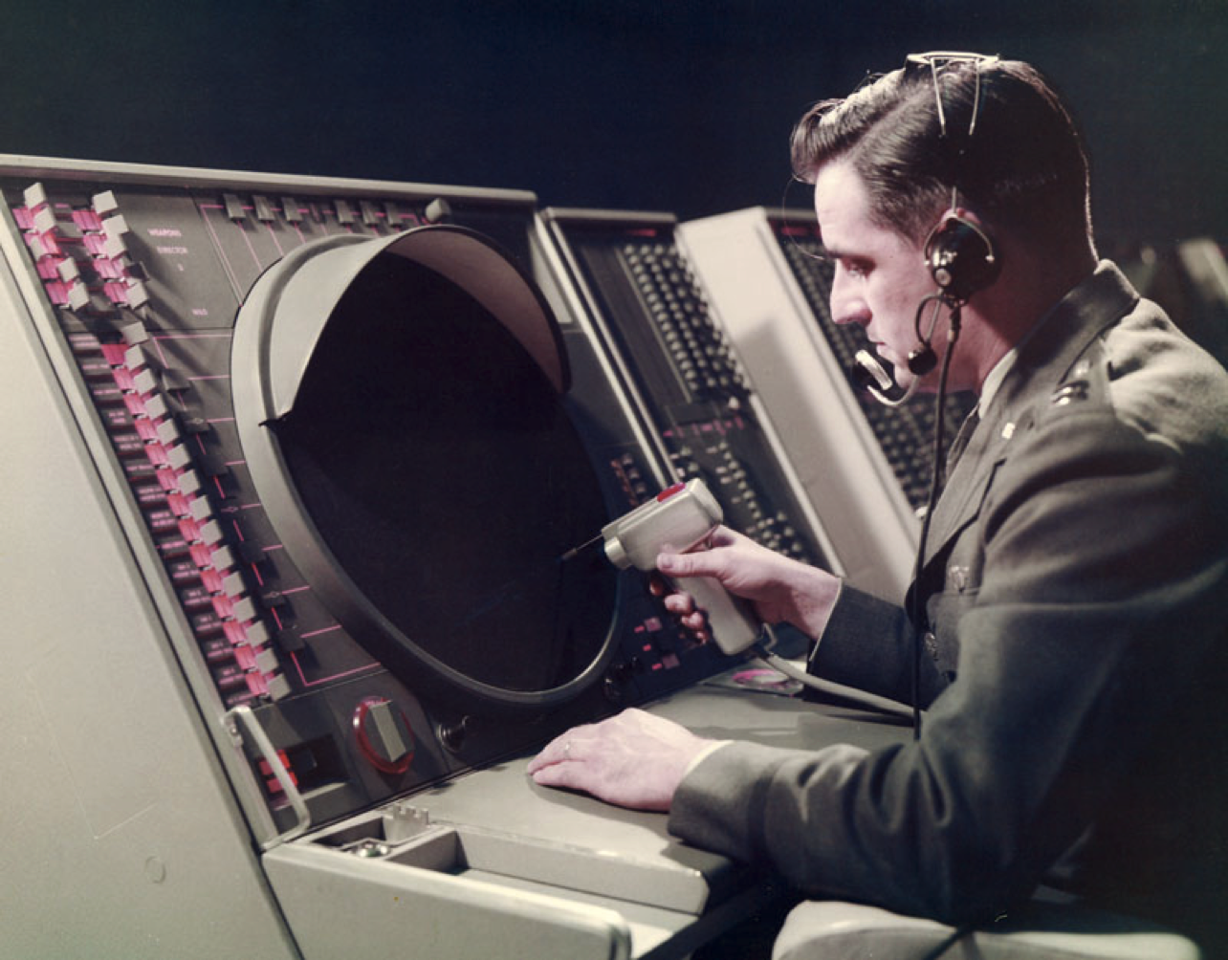
Notes:
Important so we know why we interact the way we do with computers today.

Slide 20
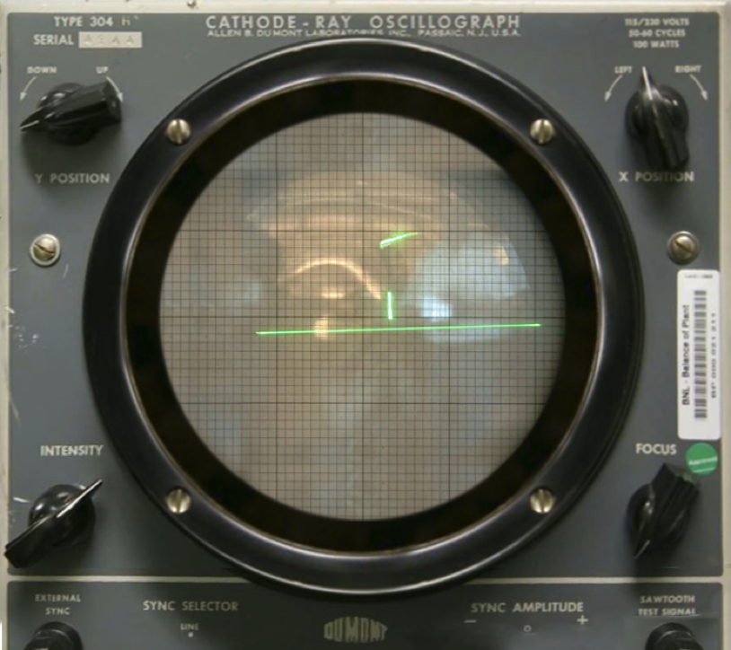
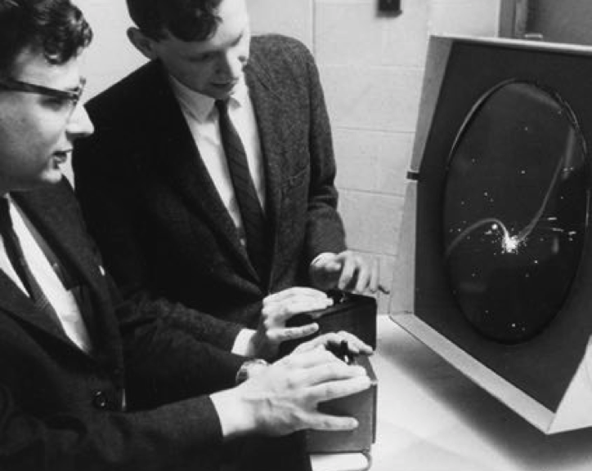
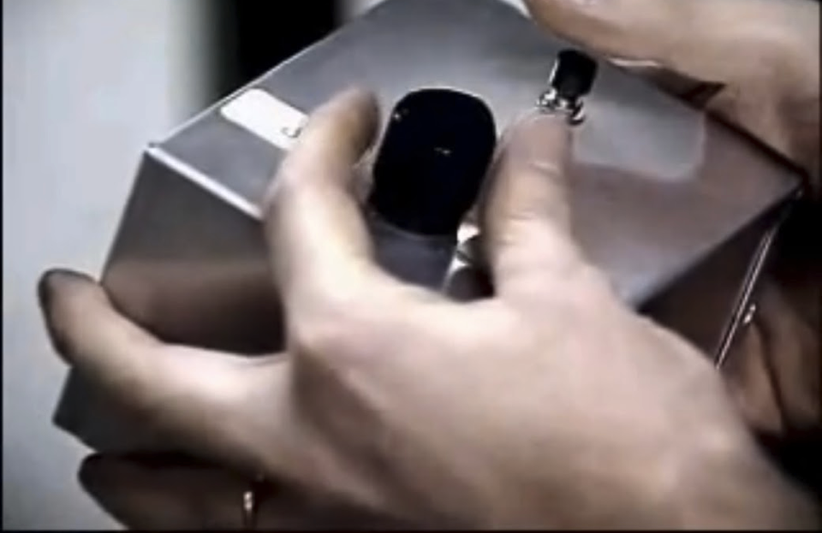
Notes:
Important so we know why we interact the way we do with computers today.

Slide 21
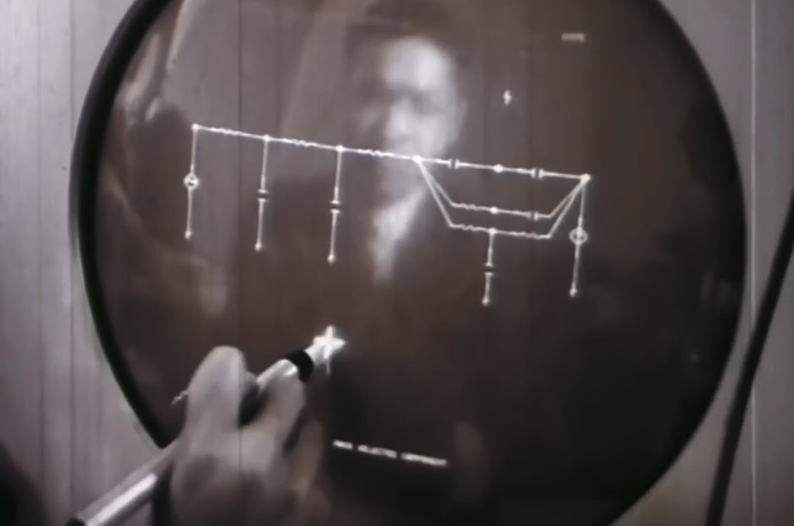
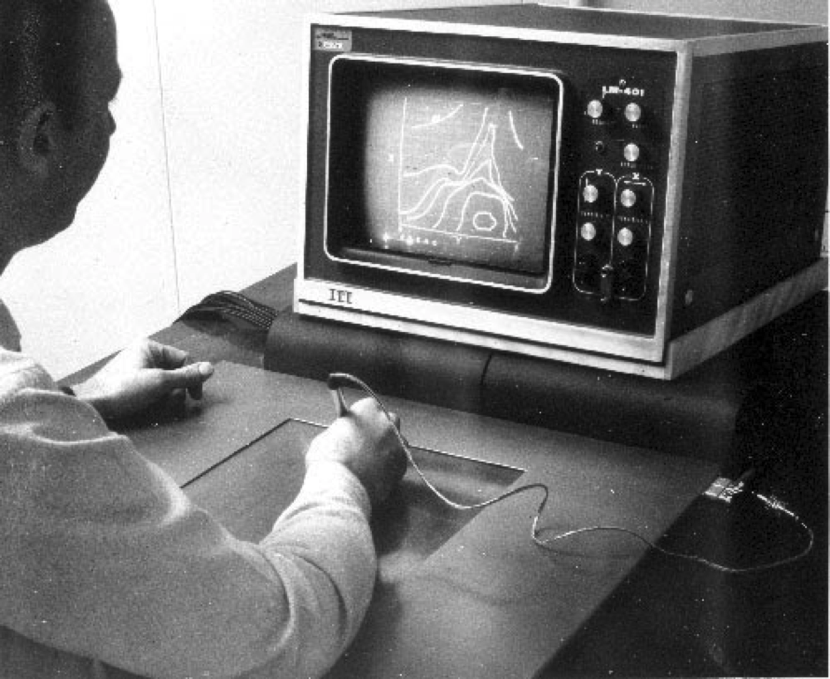
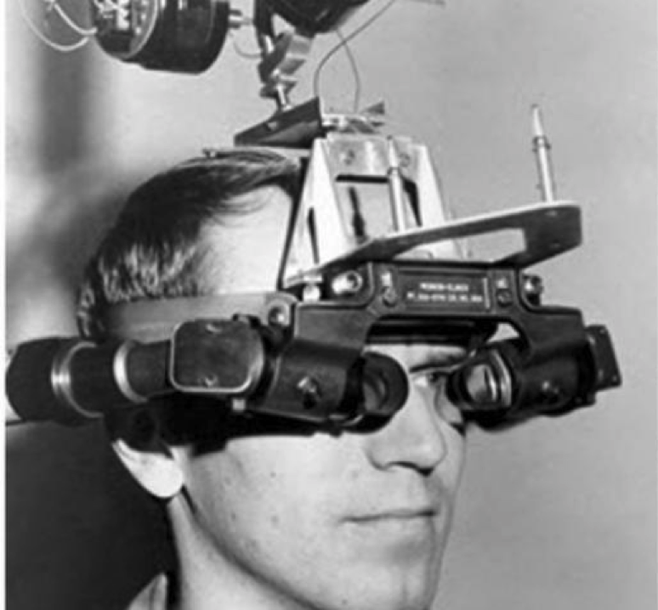
Notes:
Important so we know why we interact the way we do with computers today.

Slide 22
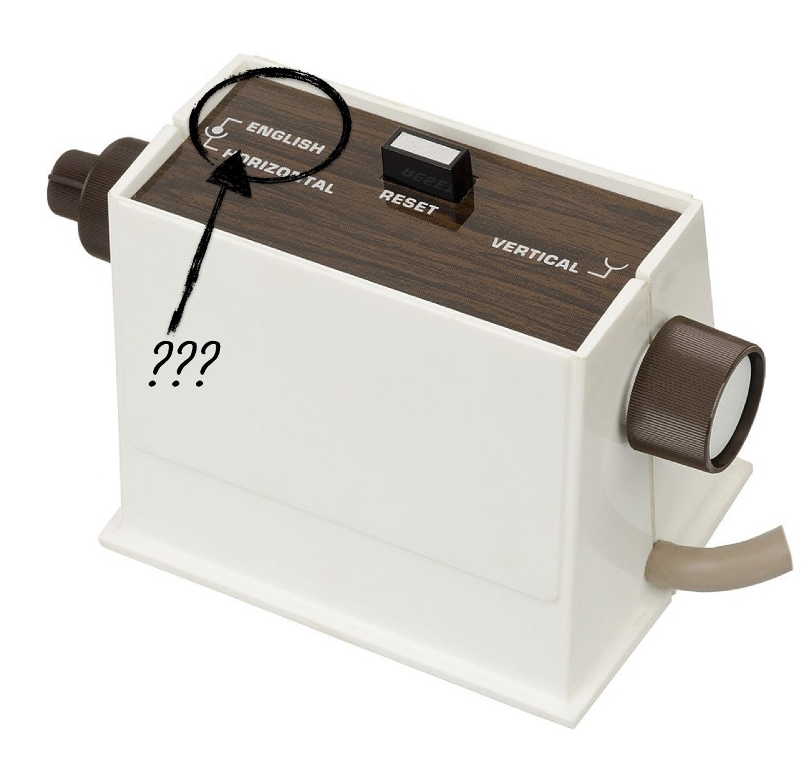
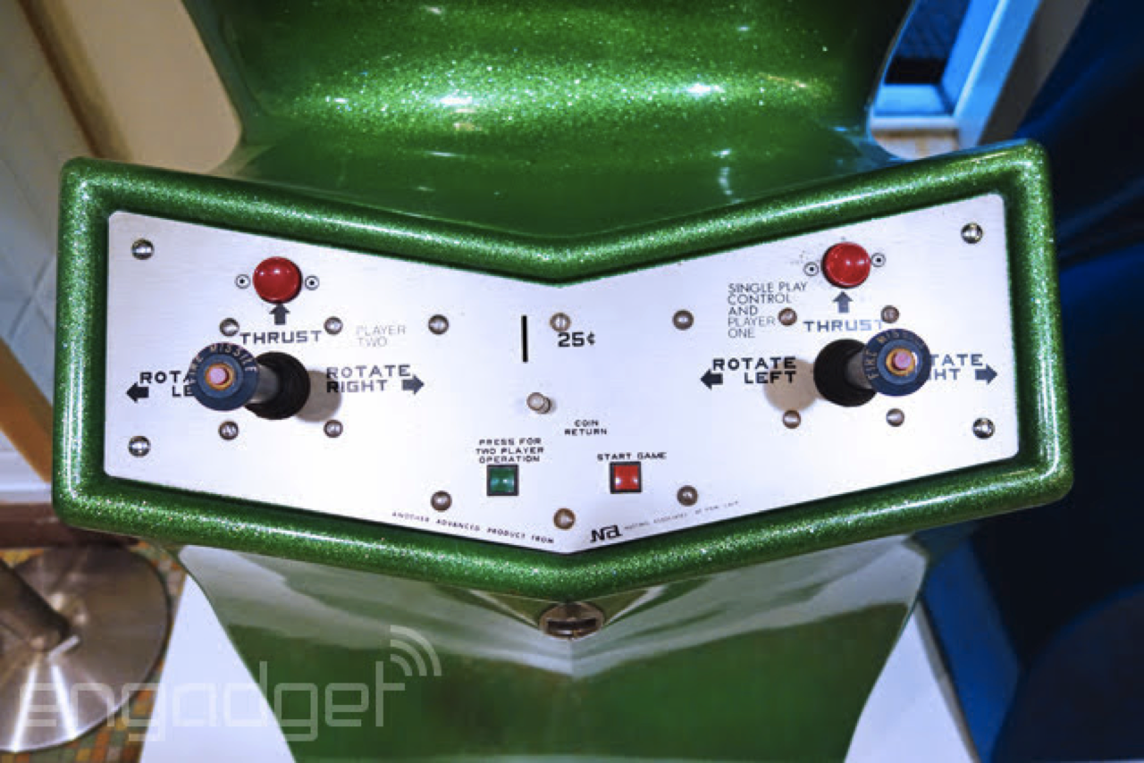
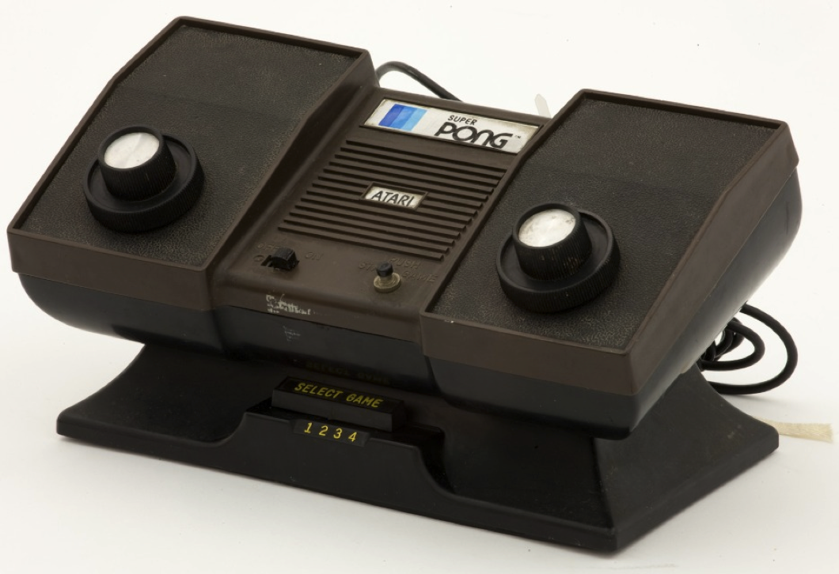
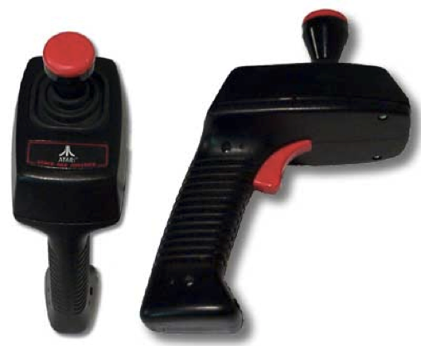
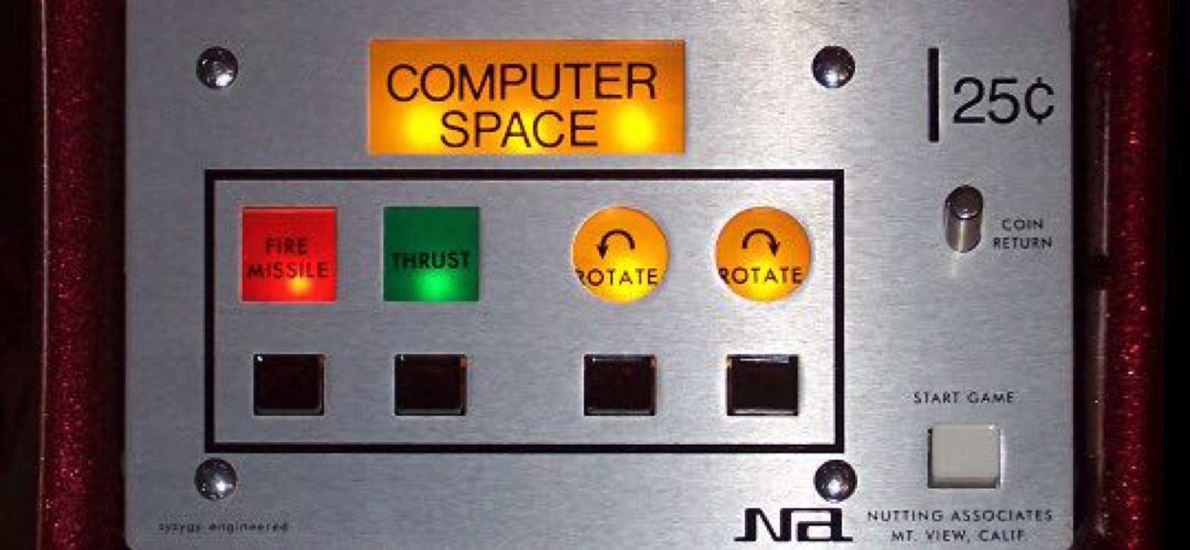
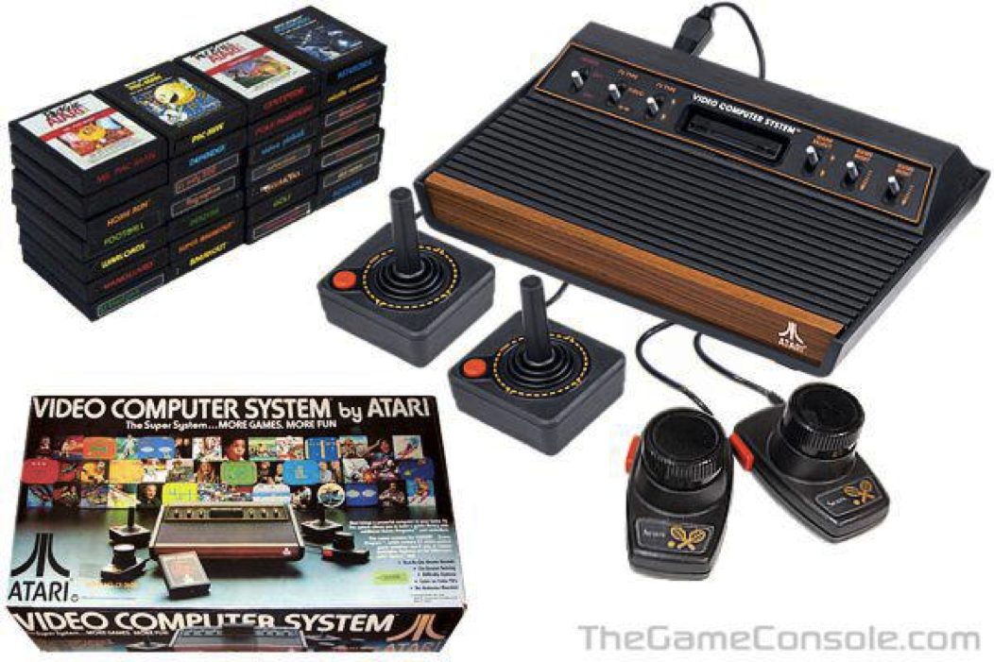
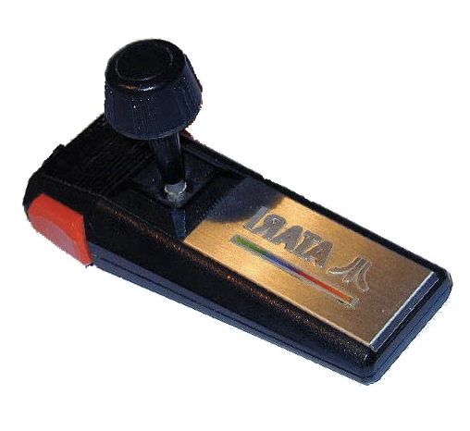
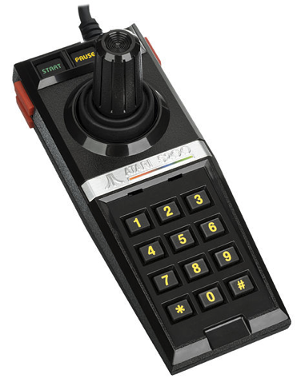
Notes:
Important so we know why we interact the way we do with computers today.

Slide 23
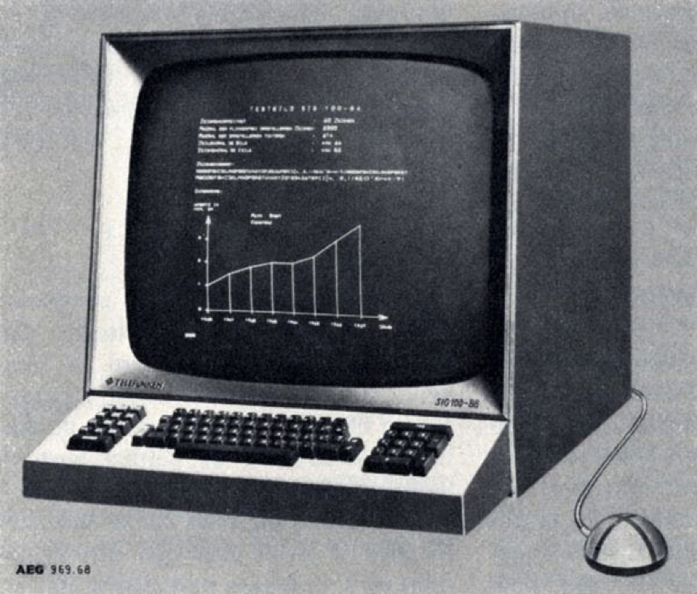
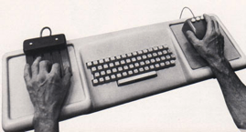
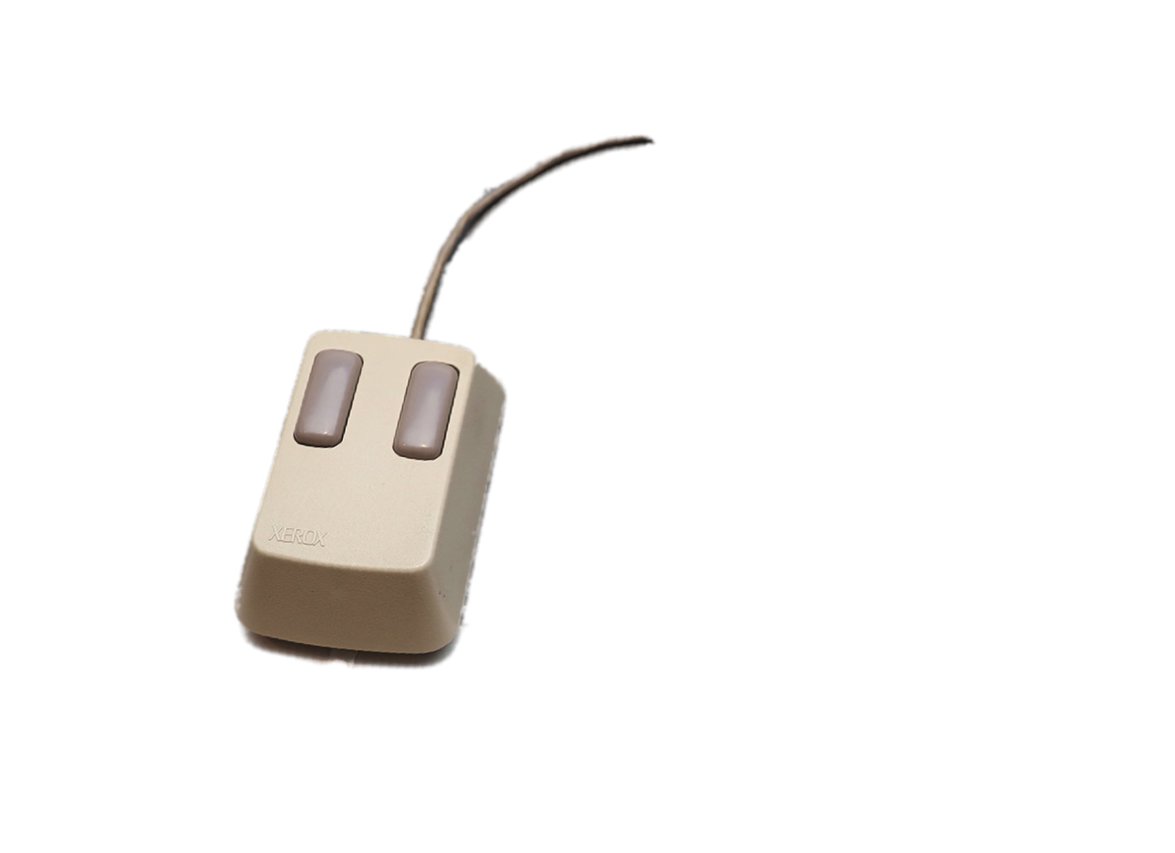
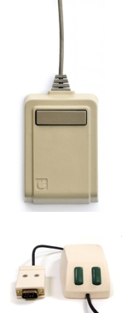
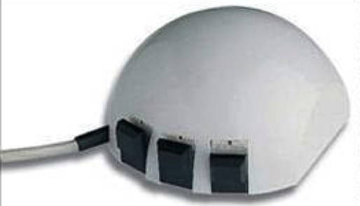
Notes:
Important so we know why we interact the way we do with computers today.

Slide 24
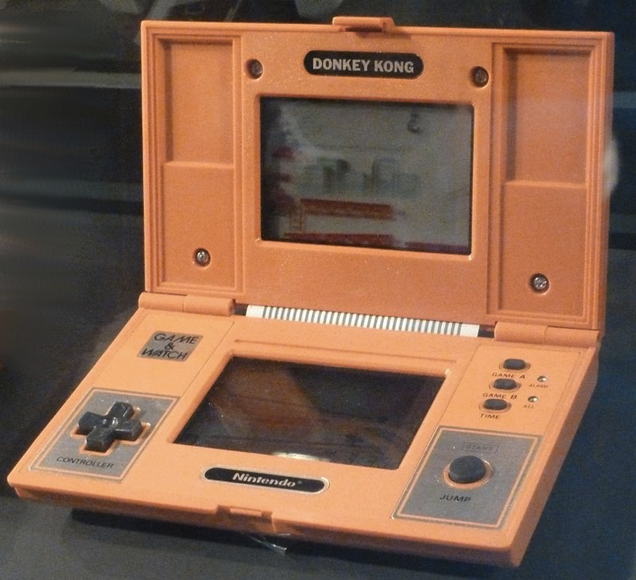
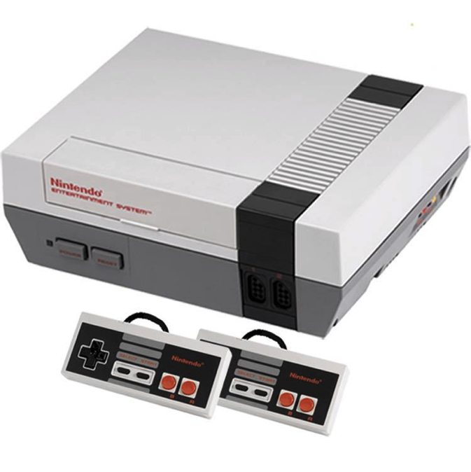
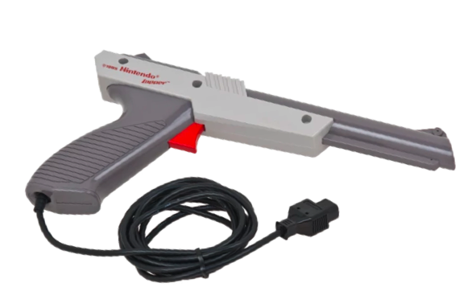
Notes:
Important so we know why we interact the way we do with computers today.

Slide 25


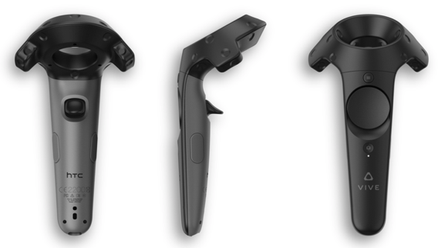
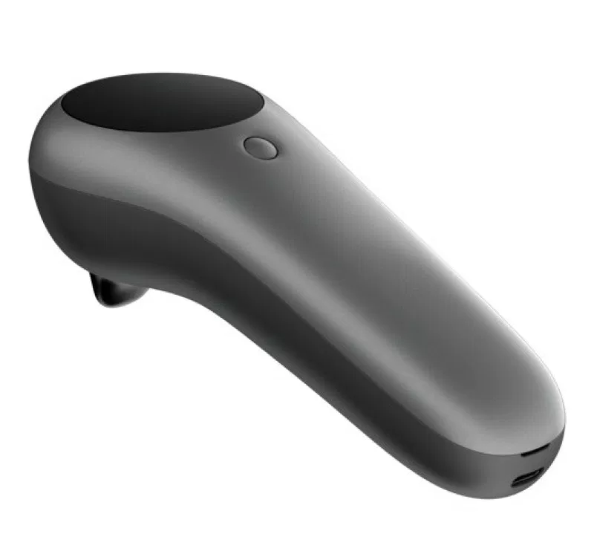

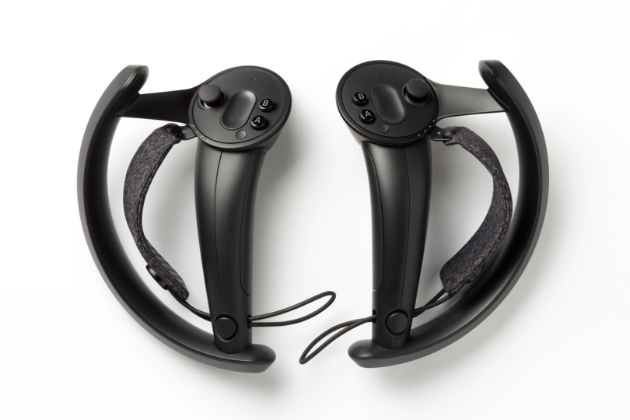
Notes:
Important so we know why we interact the way we do with computers today.

Slide 26
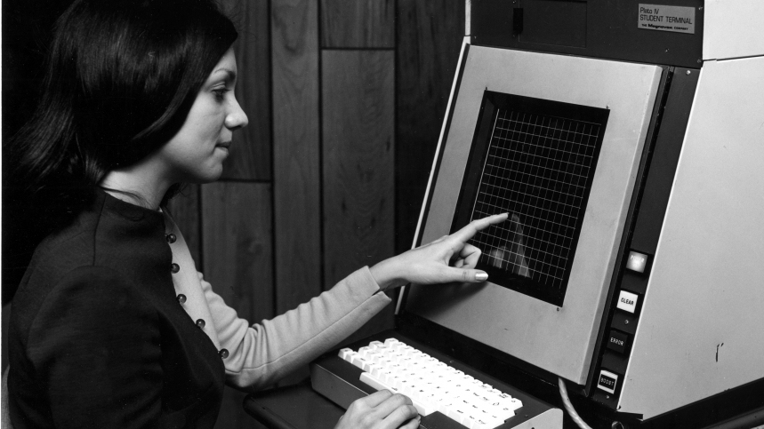
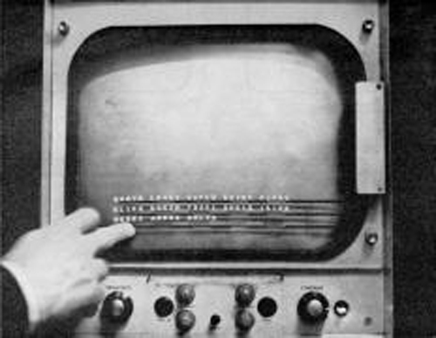
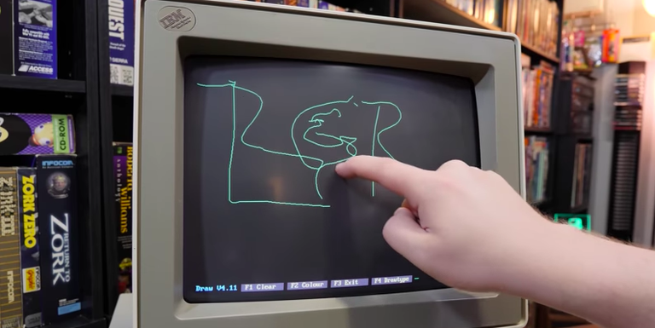
Notes:
Important so we know why we interact the way we do with computers today.

Slide 27







Notes:
Important so we know why we interact the way we do with computers today.

Slide 28



Notes:
Important so we know why we interact the way we do with computers today.

Slide 29


Notes:
Important so we know why we interact the way we do with computers today.

Slide 30



Notes:
Important so we know why we interact the way we do with computers today.

Slide 31
Background
Common modalities
Notes:
Important so we know why we interact the way we do with computers today.

Slide 32
Physical
= buttons / haptics
Visual
= gestures / UI
Audio
= voice / beeps
Notes:
Important so we know why we interact the way we do with computers today.

Slide 33
Background
Common modalities
Feedback cycles
Notes:
Important so we know why we interact the way we do with computers today.

Slide 34

Notes:
Important so we know why we interact the way we do with computers today.

Slide 35
Background
Common modalities
Feedback cycles
New modalities
Notes:
Important so we know why we interact the way we do with computers today.

Slide 36
Location
Breath rate
Voice tone, pitch, and frequency
Eye movement
Pupil dilation
Heart rate
Tracking unconscious limb movement
Notes:
Important so we know why we interact the way we do with computers today.

Slide 37
Location
Breath rate
Voice tone, pitch, and frequency
Eye movement
Pupil dilation
Heart rate
Tracking unconscious limb movement
Notes:
Important so we know why we interact the way we do with computers today.

Slide 38
Background
Common modalities
Feedback cycles
New modalities
The Future
Notes:
Important so we know why we interact the way we do with computers today.

Slide 39
Customized hardware
Better NLP
Trainable voice and UI
Persistent session across all devices
It’s all your computer
Notes:
Important so we know why we interact the way we do with computers today.

Slide 40

Notes:
Silka’s slides

Slide 41


DESIGN FOR OUR SENSES,
not our devices!
SILKA MIESNIEKS
Notes:
Head of Emerging Design…
Asked to contribute to this book because…
Empathic Mark Billinghurst &
Inclusivity Farai Madzima Shopify's UX u
Design leaders, Jamie Myrold & Tea Uglow.
Diversity for people I work with everyday from artists, UI designers and cognitive scientists.
My passion have focused on improving communication and collaboration.

Slide 42
1:0
Notes:
For 30 yrs we’ve had a 1:0 relationship with computers.

Slide 43
1:0
1:1
Notes:
Spatial Computing gives us a 1:1 relationship with computers for the first time.
Mimicking human abilities: AR for sight, Voice Recognition for speech, Bio-sensors for health & emotional reactions, haptics for touch & gestures for proprioception.

Slide 44

REAL
WORLD
Me & peeps,
Places &
Things
Notes:
Spatial computing is the digitally glue that connects everyday things, you and me in space, time and function.

Slide 45
Phones,
Wearables & IoT
SENSORS
REAL
WORLD
Peeps,
Places &
Things
Multiplayer,
ML/CV &
Data
ECOSYSTEM
Notes:
Data from sensors are able to understand us, our intent.
They give us superpowers teleportation, x-ray vision, collective intelligence, and time travel.
The most successful experiences will be ones that tap into our human need of deep connection, collaboration and purpose.

Slide 46
PERCEPTION
PIXEL
Notes:
Our role as design have fundamentally changed.
Pixel for few. Back bench.
Products for many. C-suit.
Design human perception that can affect societies. We need to be at the policy front lines.

Slide 47


A NEW DESIGN SYSTEM
for Spatial Computing
Notes:
As our digital interactions in the digital- physical world, need to change.
We need a design language that supports that.

Slide 48
We call it,
SENSORY DESIGN
Notes:
So you be able to read about 7 principles of Sensory Design in my chapter.

Slide 49
“Spatial Computing is
the juiciest design problem on the planet.”
Robin Hunicke, CEO Funomena
SILKA MIESNIEKS

Slide 50

Notes:
Erin Asks Questions to Steve

Slide 51



2014

Slide 52






2016

Slide 53

Cross-Platform Theory in AR/VR
Accessibility
Scales user base
Future-proofs for new hardware
Time & financial cost
SDK upgrades
Compatibility inconsistencies
Source: vrheads.com

Slide 54






Slide 55

Notes:
Nico’s Slides
Tony Asks Questions to Nico

Slide 56





Behaviors
Game world (storytelling, interactive narration)
Squad of NPCs and PCs
NPC and PC
Game objects
(smart assets)
Player Assistant

Slide 57
Behaviors
CODE:
Reactive AI
Ex: State machines, behavior trees, rule-based systems, utility AI…
SOLVE:
Deliberative AI
Ex: A*, GOAP, HTNs, planners…
LEARN:
Machine Learning
Ex: Imitation learning, reinforcement learning…
Controllability
Autonomy

Slide 58
State-of-the-Art in Gaming
Strategy & Tactics
Rule-Based Systems
Finite State Machines
Behavior
Trees
Utility
AI
GOAP, HTNs
Steering Behaviors
A* on grids and roadmaps
Navigation
NavMesh
Control & Animation
Finite State Machines
Code
Solve
Learn

Slide 59
Behaviors
CODE:
Need to know the environment in advance
> limited application to AR
There s so much complexity we can handle by hand
> limited application to VR

Slide 60
State-of-the-Art
Strategy & Tactics
Rule-Based Systems
Finite State Machines
Behavior
Trees
Utility
AI
GOAP, HTNs
AI Planner
Steering Behaviors
A* on grids and roadmaps
ML- Agents
Navigation
NavMesh
Control & Animation
Finite State Machines
Code
Solve
Learn

Slide 61

Unity Labs AI Planner

Slide 62
AI Planner
Planner Action
Cost
Planner State
Planner State
Planner Action
Cost
Planner Action
Cost
Planner Action
Cost
Planner State
Planner Action
Cost
Planner State
Planner State
Planner Action
Cost
Planner Action
Cost
Planner State
Planner Action
Cost
Planner Action
Cost
Planner Action
Cost
Planner State

Slide 63
Search
For Navigation
TRAVEL (loc. 0, loc. 3)
cost = 15
AT (Location 0)
AT (Location 3)
TRAVEL (start, loc. 0)
cost = 10
TRAVEL (loc. 3, goal)
cost = 2
TRAVEL …
cost…
TRAVEL (loc. 0, loc. 2)
cost = 9
AT (Start)
TRAVEL …
cost…
TRAVEL …
cost…
AT (location 2)
AT (goal)
TRAVEL …
cost…
TRAVEL (start, loc. 1)
cost = 5
AT (Location 1)
TRAVEL (loc. 4, goal)
cost = 4
TRAVEL (loc. 1, loc. 4)
cost = 3
AT (Location 4)

Slide 64
Search
For Navigation
TRAVEL (loc. 0, loc. 3)
cost = 15
AT (Location 0)
AT (Location 3)
TRAVEL (start, loc. 0)
cost = 10
TRAVEL (loc. 3, goal)
cost = 2
TRAVEL …
cost…
TRAVEL (loc. 0, loc. 2)
cost = 9
AT (Start)
TRAVEL …
cost…
TRAVEL …
cost…
AT (location 2)
AT (goal)
TRAVEL …
cost…
TRAVEL (start, loc. 1)
cost = 5
AT (Location 1)
TRAVEL (loc. 4, goal)
cost = 4
TRAVEL (loc. 1, loc. 4)
cost = 3
AT (Location 4)

Slide 65
AI Planner:
Search for Behavior
AT(Home)
Key(Home)
Fatigue = 9
ENTER(Home)
Cost = 0
Fatigue += 0
TRAVEL (start, home)
Cost = 10
Fatigue += 1
AT(Start)
Key(Home)
Fatigue = 8
IN (Home)
Fatigue = 9
AT (Goal)
Fatigue = 2
SLEEP(Home)
Cost = 0
Fatigue = 0
TRAVEL (Home, Goal)
Cost = 4
Fatigue += 2
IN(Home)
Fatigue = 0

Slide 66
AI Planner:
Search for Behavior
AT(Home)
Key(Home)
Fatigue = 9
ENTER(Home)
Cost = 0
Fatigue += 0
TRAVEL (start, home)
Cost = 10
Fatigue += 1
AT(Start)
Key(Home)
Fatigue = 8
IN (Home)
Fatigue = 9
AT (goal)
Fatigue = 2
TRAVEL (Start, Goal)
Cost = 7
Fatigue += 9
SLEEP(Home)
Cost = 0
Fatigue = 0
✝
Exhausted
TRAVEL (Home, Goal)
Cost = 4
Fatigue += 2
IN(Home)
Fatigue = 0

Slide 67

Unity AI Planner

Slide 68

Notes:
Arthur’s Slides
Tony Asks Questions to Arthur

Slide 69
Solutions
CODE
SOLVE
LEARN: Machine Learning
You set up learning tasks
Learn from experience or player demonstration
Leverage game simulation to generate experiences
Executing learned behaviors is inexpensive
Notes:
You set up learning tasks
Learn from experience or player demonstration
Leverage game simulation to generate experiences
Executing learned behaviors is inexpensive

Slide 70


Machine Learning
Agents Toolkit
Notes:
Our objective is to formulate behavior engineering as a machine learning task and leverage Unity as our data source.
Creating the right behavior in a game can take days or even weeks. Not to mention, scripted behaviors are often predictable and less engaging.
With the Machine Learning Agents toolkit, we can explore alternatives ways to create behaviors in games by leveraging Machine Learning. By using cutting edge Deep Learning techniques, we can train agents to adopt the behaviors we want.
We know ML is powerful and can solve hard problems. So we want to bring it to you. That is Machine Learning Agents.
In this session, we will explore what we can do with Unity Machine Learning Agents, but first we must define what an Agent is.

Slide 71

What are ML-Agents?
Observations
Position
Velocity
Rotation
Camera
Ammunition
Policy
Actions
Move Forward
Jump
Turn
Shoot
LEARN

Slide 72
Training Methods
v
v
1
Reinforcement Learning
2
Imitation Learning
Agents learn from EXPERIENCE
A lot of trial and error until optimal
Simulation can be sped up greatly
“Super-human” abilities
Agents learn from DEMONSTRATIONS
Mimics behavior quickly
Real time interactions needed
“Human-like” abilities
Notes:
Read off slide
Mimic the behavior of the player. No need for reward

Slide 73



Unity ML-Agents Workflow
Integrate
Train
Embed
Notes:
2 LINER TO INTRODUCE PUPPO, the goal, the game, the reward
This is the workflow
Set-up the scene, just like in any other game but we add some ML-Agents components to it
[Script]
Unity then communicates with Python which is where the training happens. We use Python because it is the language used for state of the art Machine Learning. We use Tensorflow which is a popular library used to train NN model. All of that is encapsulated so there is no need to code anything in Python.
Once the model is trained we embed it in the game

Slide 74


Slide 75


Slide 76
Q&A PANEL
Notes:
Q&A Panel Tony Asks Questions to: Timoni, Nico, Arthur I Erin Asks Questions to: Steve, Silka

Slide 77
Question:
What does the future look like in 5 years?
Notes:
Arthur slides

Slide 78
Audience Q&A
Tweet your question!

Slide 79


Slide 80
ARVR Academy
Dedicated to diversity and inclusion in immersive and emerging technologies through education and professional development efforts.

Slide 81

Mission statement:
ARVR Academy is an organization dedicated to diversity and inclusion in immersive and emerging technologies through education and professional development efforts. We seek to increase the representation of people from underrepresented communities across entrepreneurial, technical, and creative roles in the industry. We are working towards an open sourced curriculum of immersive technologies, and aim to help anyone, regardless of prior experience or background, find their spot in the technology industries.

Slide 82

What we learned:
ARVR Academy
With over three years hands on experience teaching immersive technologies, we have a clear understanding of what really works - and what doesn’t.

Slide 83
Milestones
March 2016
June 2018
October 2018
September 2016
January 2017
First ARVR Academy class in SF at Unity
Reorganization of ARVR Academy
Pod Mentorship - 60+ students worldwide
Jan | Feb | Mar | Apr | May | Jun | Jul | Aug | Sept | Oct | Nov | Dec
Ad-hoc Classes
Launch classes in Silicon Valley at Cisco

Slide 84
Why Emerging
and Immersive Technologies?
Well established industries have well established communities.
Emerging technologies by their very nature disrupt established industry.
This leaves an opportunity for demographic disruption, too.
When nobody is an expert, the playing field is even.

Slide 85
How can you help?
Funding - the more financial support we have, the more students we can reach.
Hardware - VR and AR headsets, PCs, cloud compute services, software - all can give students a chance to get started in tech that they would not normally have access to.
Community support - mentors, access to events, HR representatives.
Signal boosting - social media campaigns, profiles at events, etc.
Buy Creating Augmented and Virtual Realities for everyone you know!

Slide 86
arvracademy.io
@arvracademy

Slide 87

BUY LIMITED SUPPLY OF SIGNED AND DISCOUNTED BOOKS!
Notes:
Arthur slides

Slide 88

Notes:
Arthur slides

Slide 89

THANK YOU!
Notes:
Arthur slides

