Slide 1

#FilipinasIC
@erinjerri

Slide 2

1
STORY OF SELF
STORY OF SELF
MY STORY

Slide 3


Slide 4
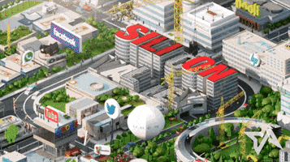
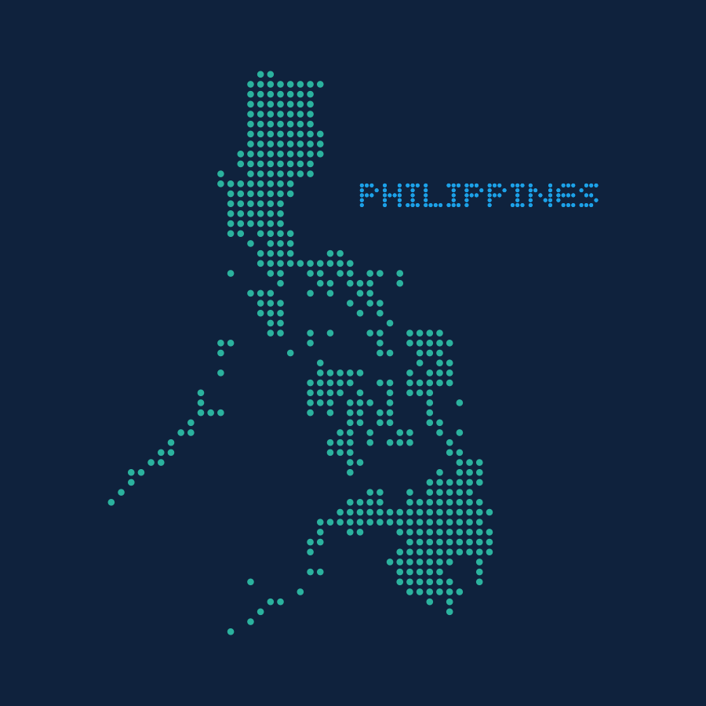
Silicon Valley born (in Santa Clara) and raised (in Fremont).
My Pilipinx Heritage: Mom is from Pampanga and Dad is from Manila
WHO WHAT WHERE WHEN
@erinjerri

Slide 5
What do you want to be when you grow up?
#TechIntersections
@erinjerri

Slide 6
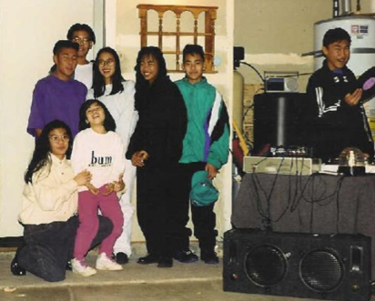
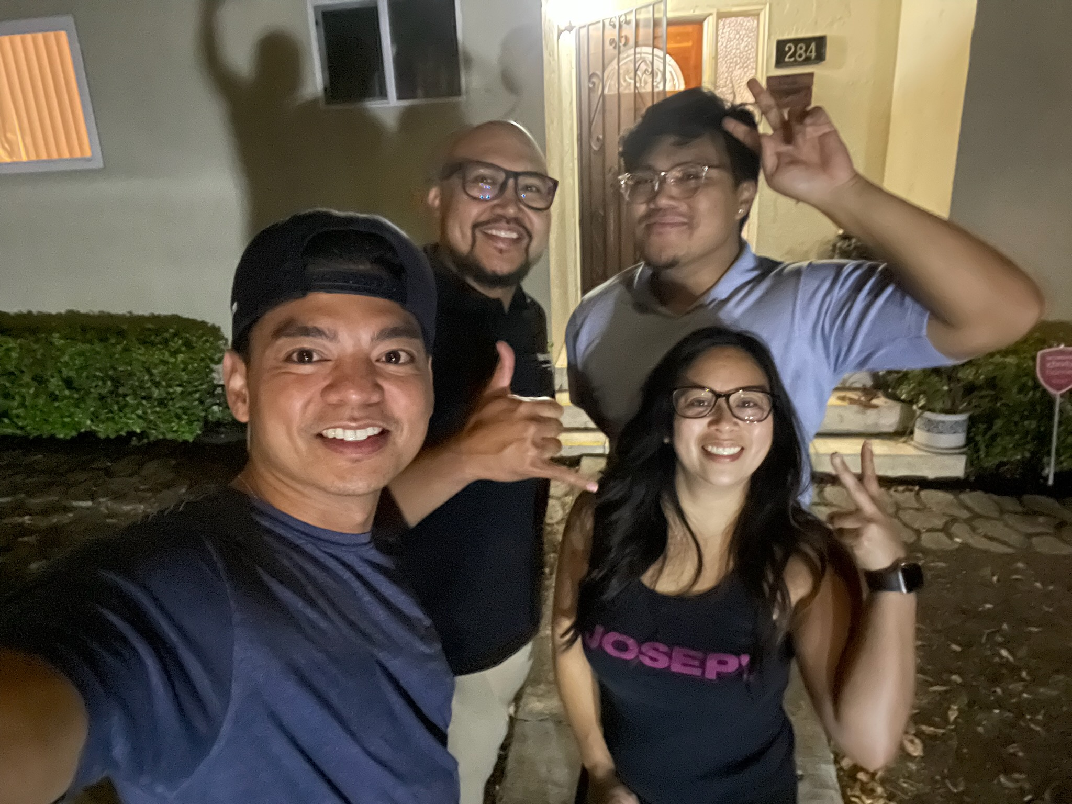
The 90s to Present
@erinjerri

Slide 7
How many people come from families who previously worked in tech prior to entering the industry?
#TechIntersections
@erinjerri
Notes:
Anyone who told you differently, is lying to you, or has not lived this life or was probably rich and famous before it due to privilege, or years of long and grueling hard work and has forgotten where they come from and that this period of a pandemic has sucked like no other.

Slide 8
👩🏻‍💻
I write code and design experiences for 👾metaverse I 🎮games I web3💎I 🤖AI
📚
I write books
🎥 📺
I write scripts for TV/film
WHO

Slide 9
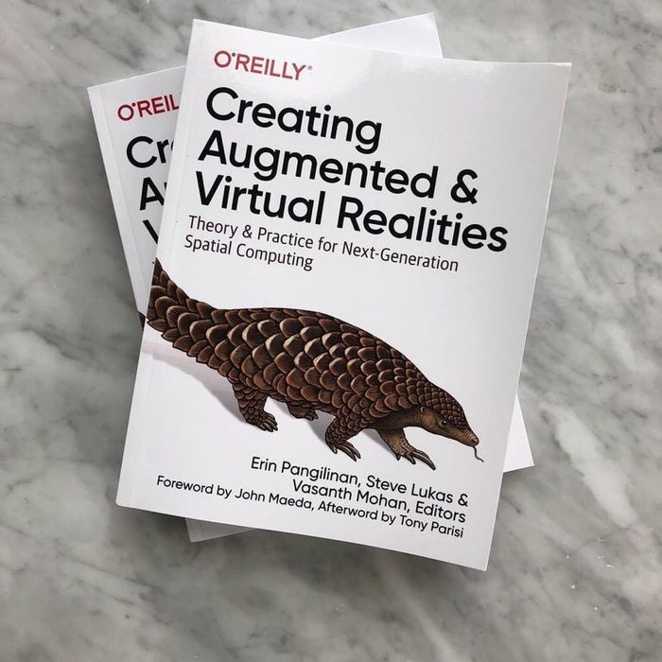
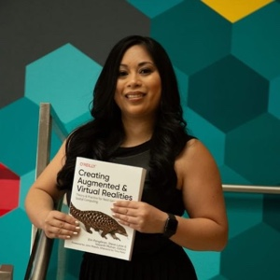
#TechIntersections
@erinjerri

Slide 10

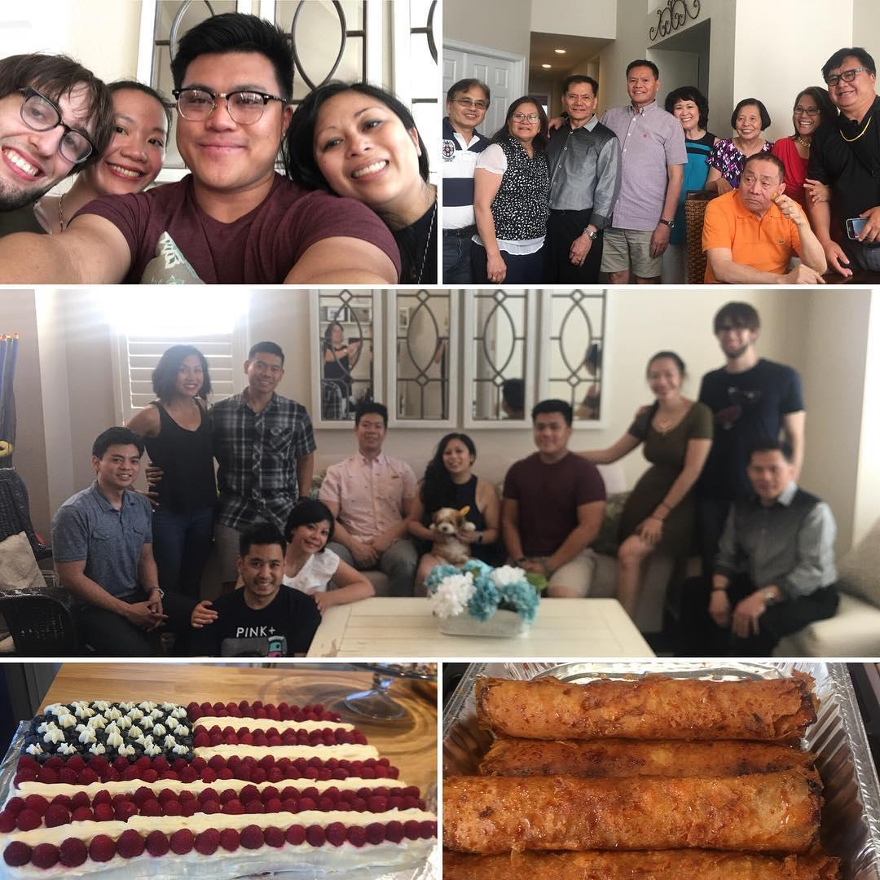
My cousin: previously worked at WordPress
Not pictured:
My brother was a game tester at EA and works in healthtech at UCLA Medical Center as a software engineer on EHR (electronic healthcare records).
My cousin: sold a company after 5 years at Salesforce and running things in the cloud
My Auntie worked at Oracle in hospitality
My Mom is a molecular biologist, veterinarian who previously worked in R&D for prostate cancer in tech startups in the 90s.
My Dad is toxicologist and currently works on COVID19 vaccines on FDA approvals.
My Auntie and Uncle worked in semiconductor manufacturing in the 1990s on the assembly line at Selectron.

Slide 11

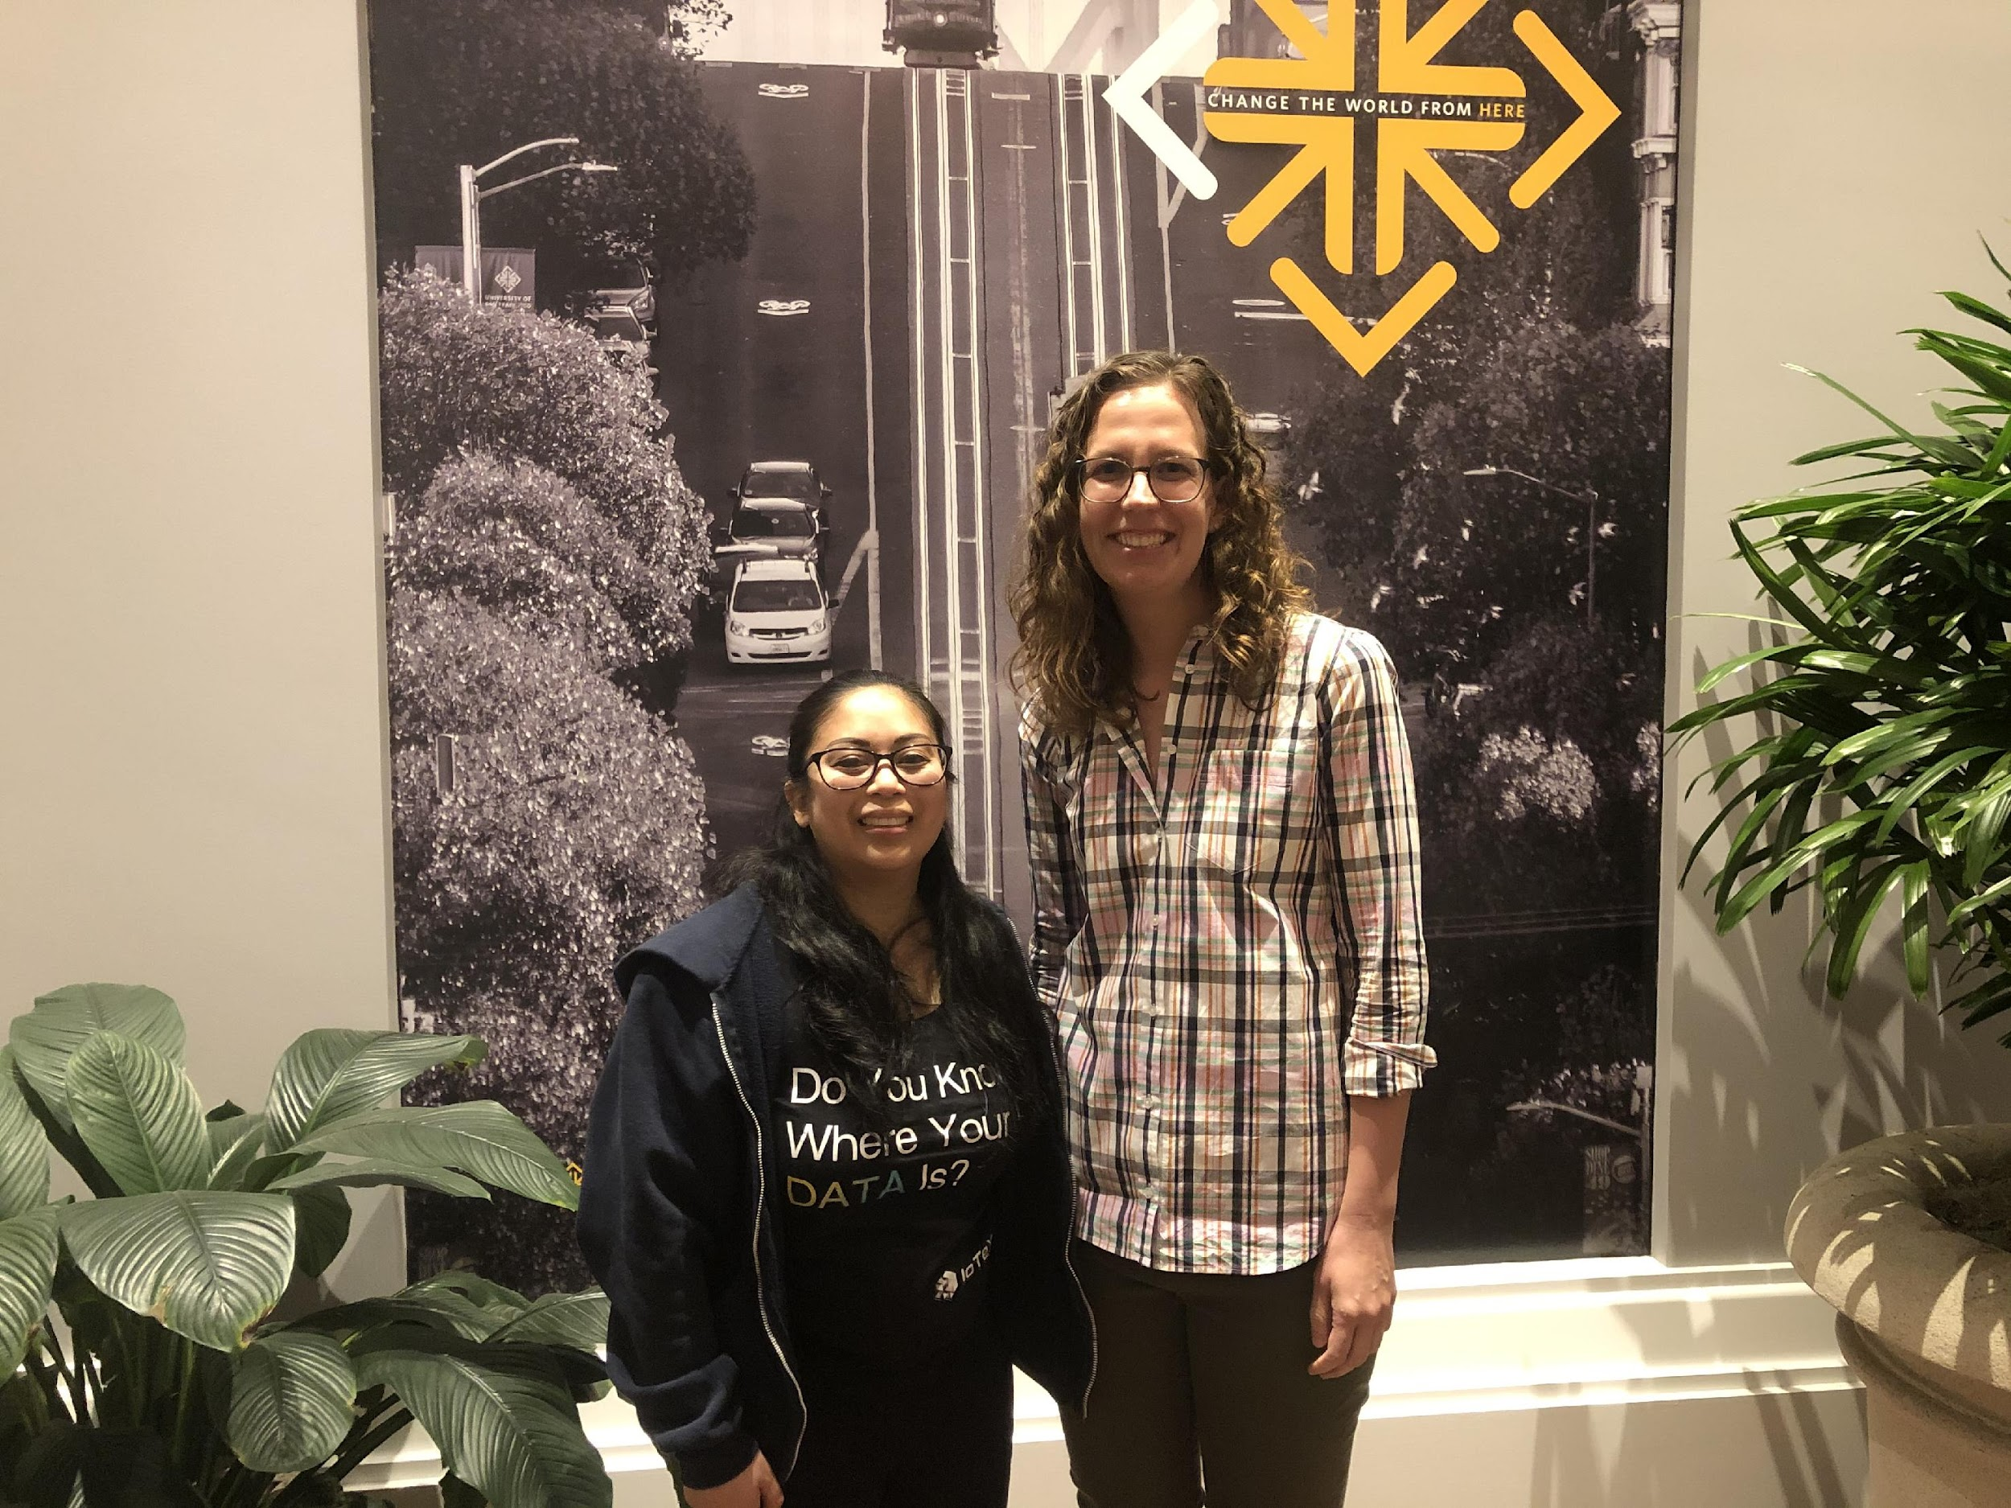

#TechIntersections
@erinjerri

Slide 12

@erinjerri

Slide 13
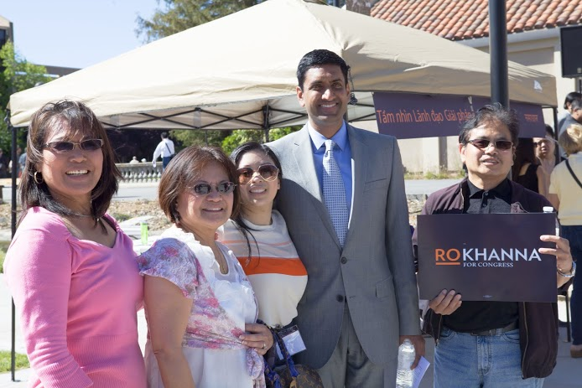
#TechIntersections
@erinjerri

Slide 14
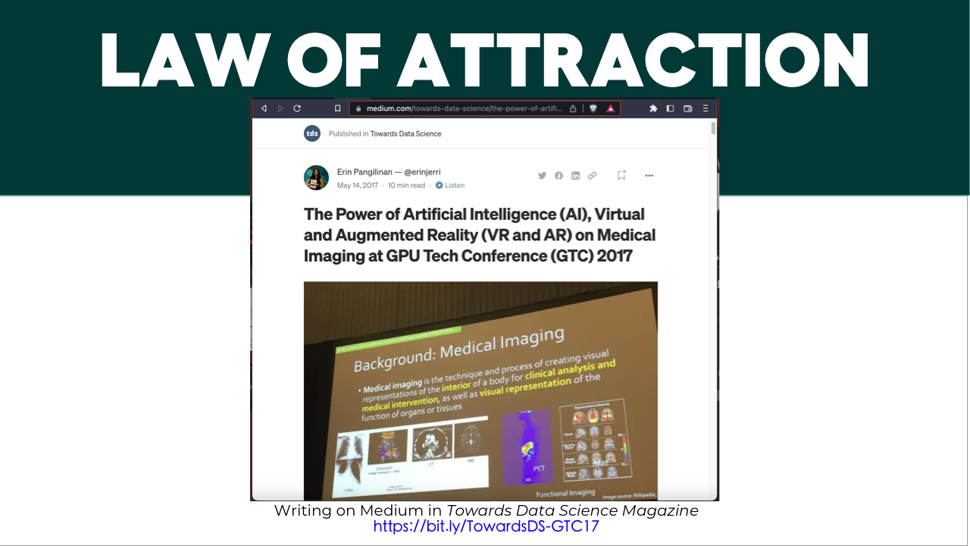
Notes:
Anyone who told you differently, is lying to you, or has not lived this life or was probably rich and famous before it due to privilege, or years of long and grueling hard work and has forgotten where they come from and that this period of a pandemic has sucked like no other.

Slide 15

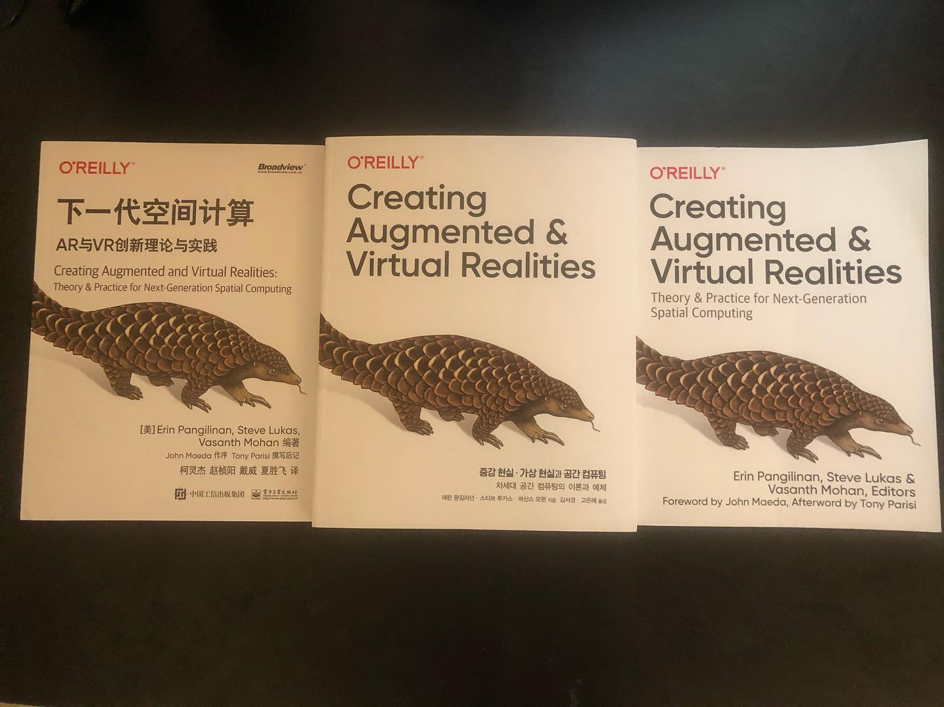
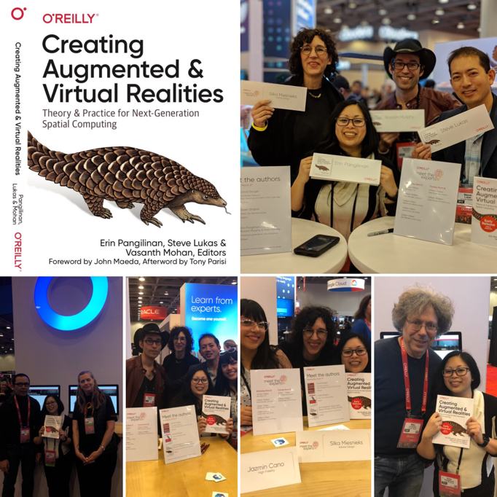
Me in 2008, 2018
Campaigns to Computer Science
Publishing my first book

Slide 16
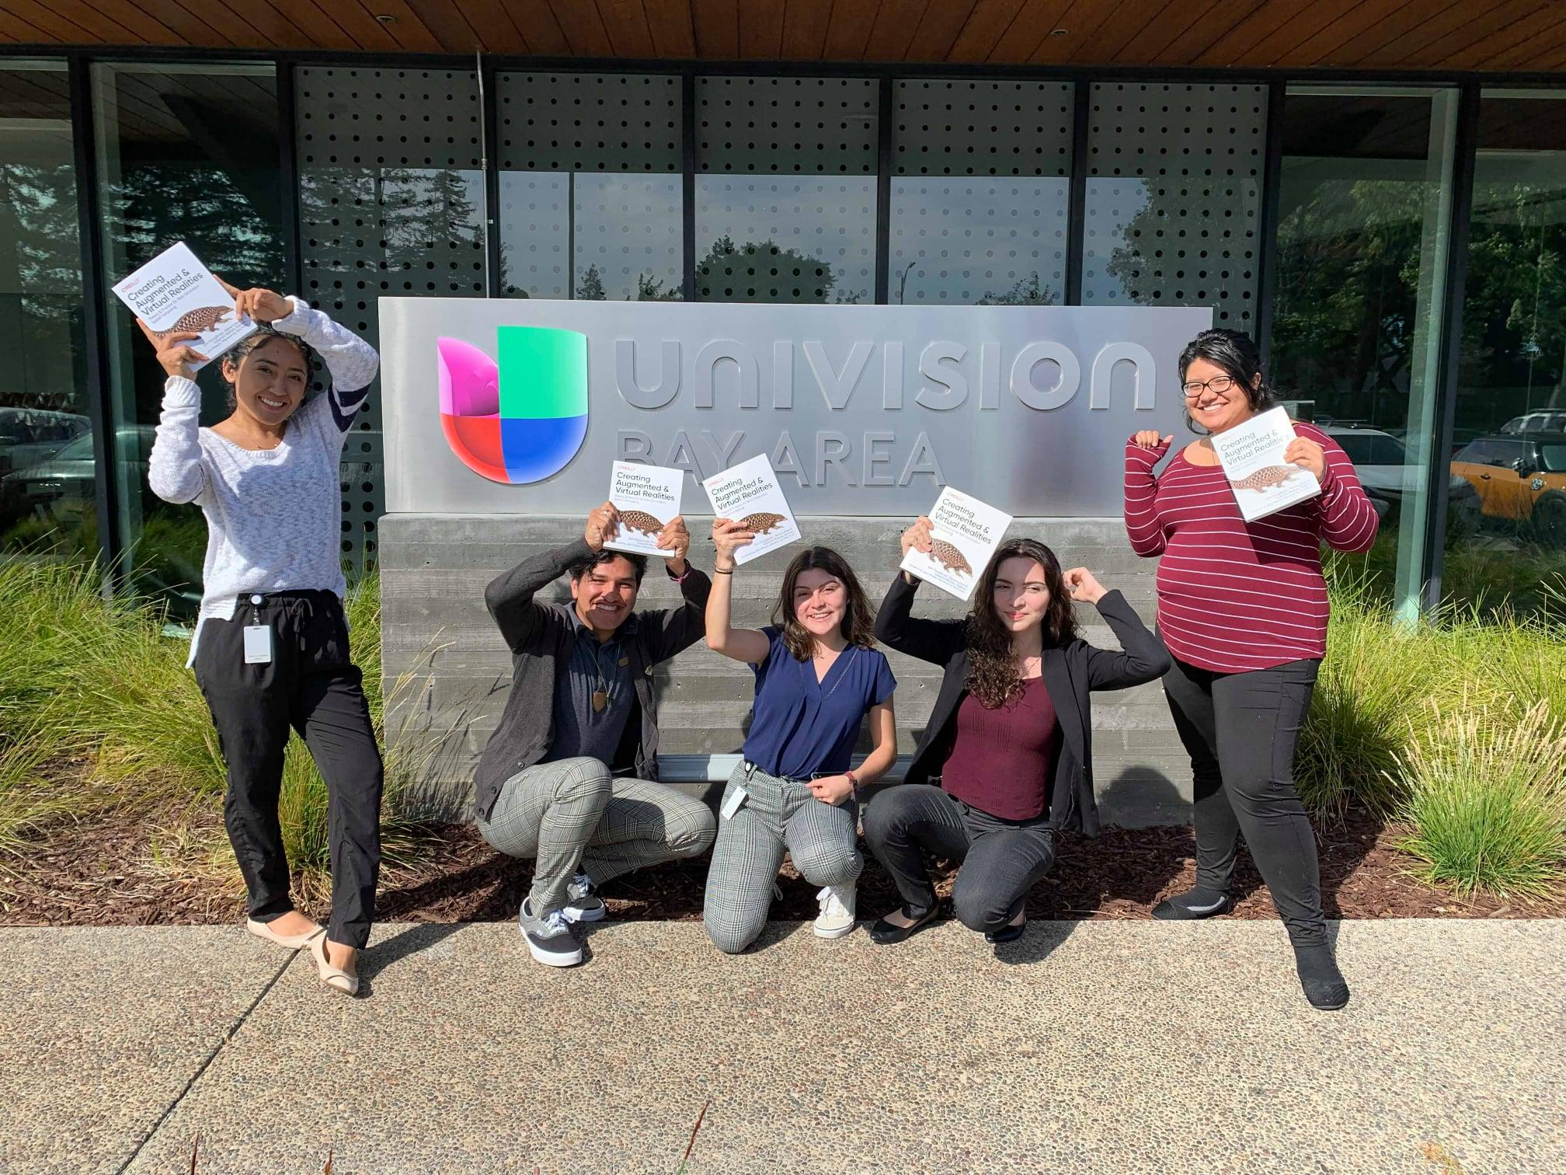
#TechIntersections
@erinjerri

Slide 17

FUTURE COMPUTING STACK
Experience layer
Automation layer
Ownership layer
#TechIntersections
@erinjerri

Slide 18
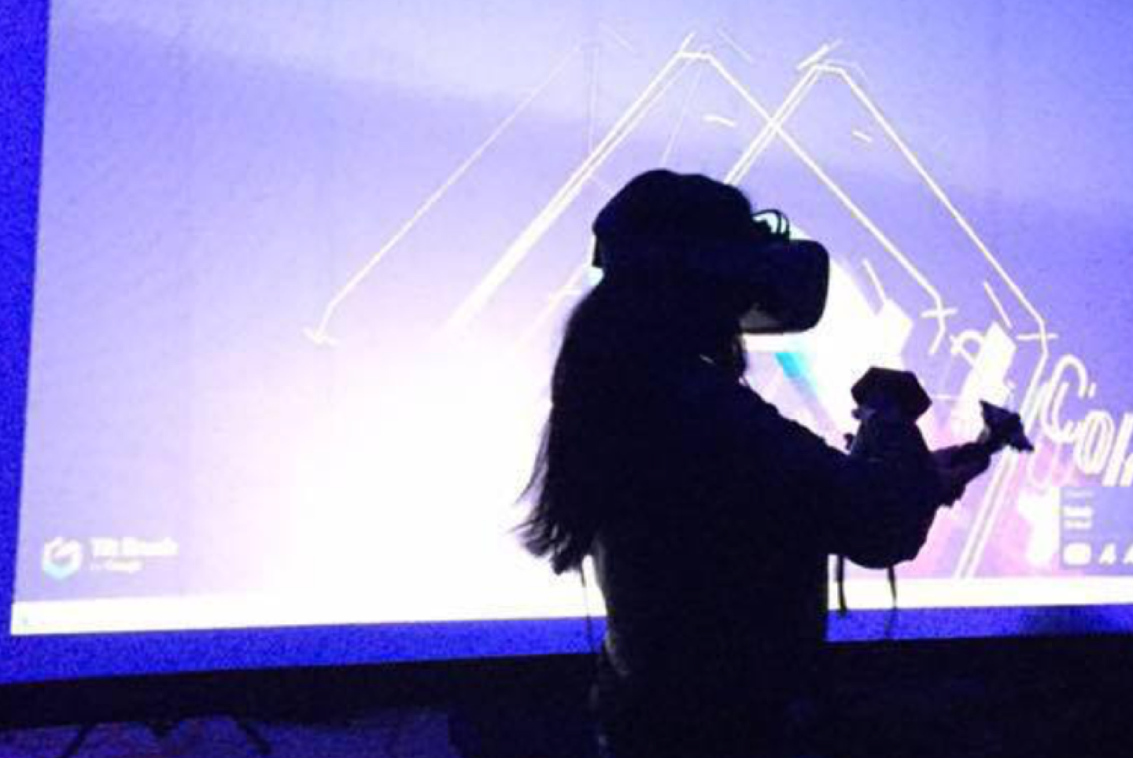
“
Enter the oasis
”
Ready Player One
#TechIntersections
@erinjerri

Slide 19
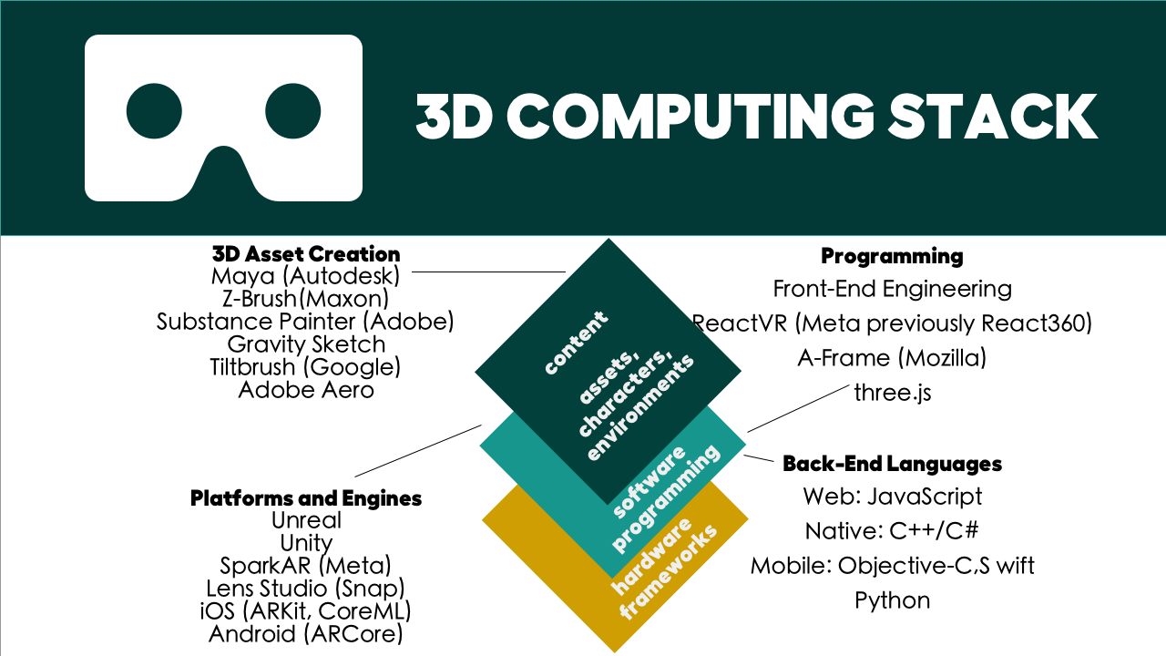
@erinjerri

Slide 20

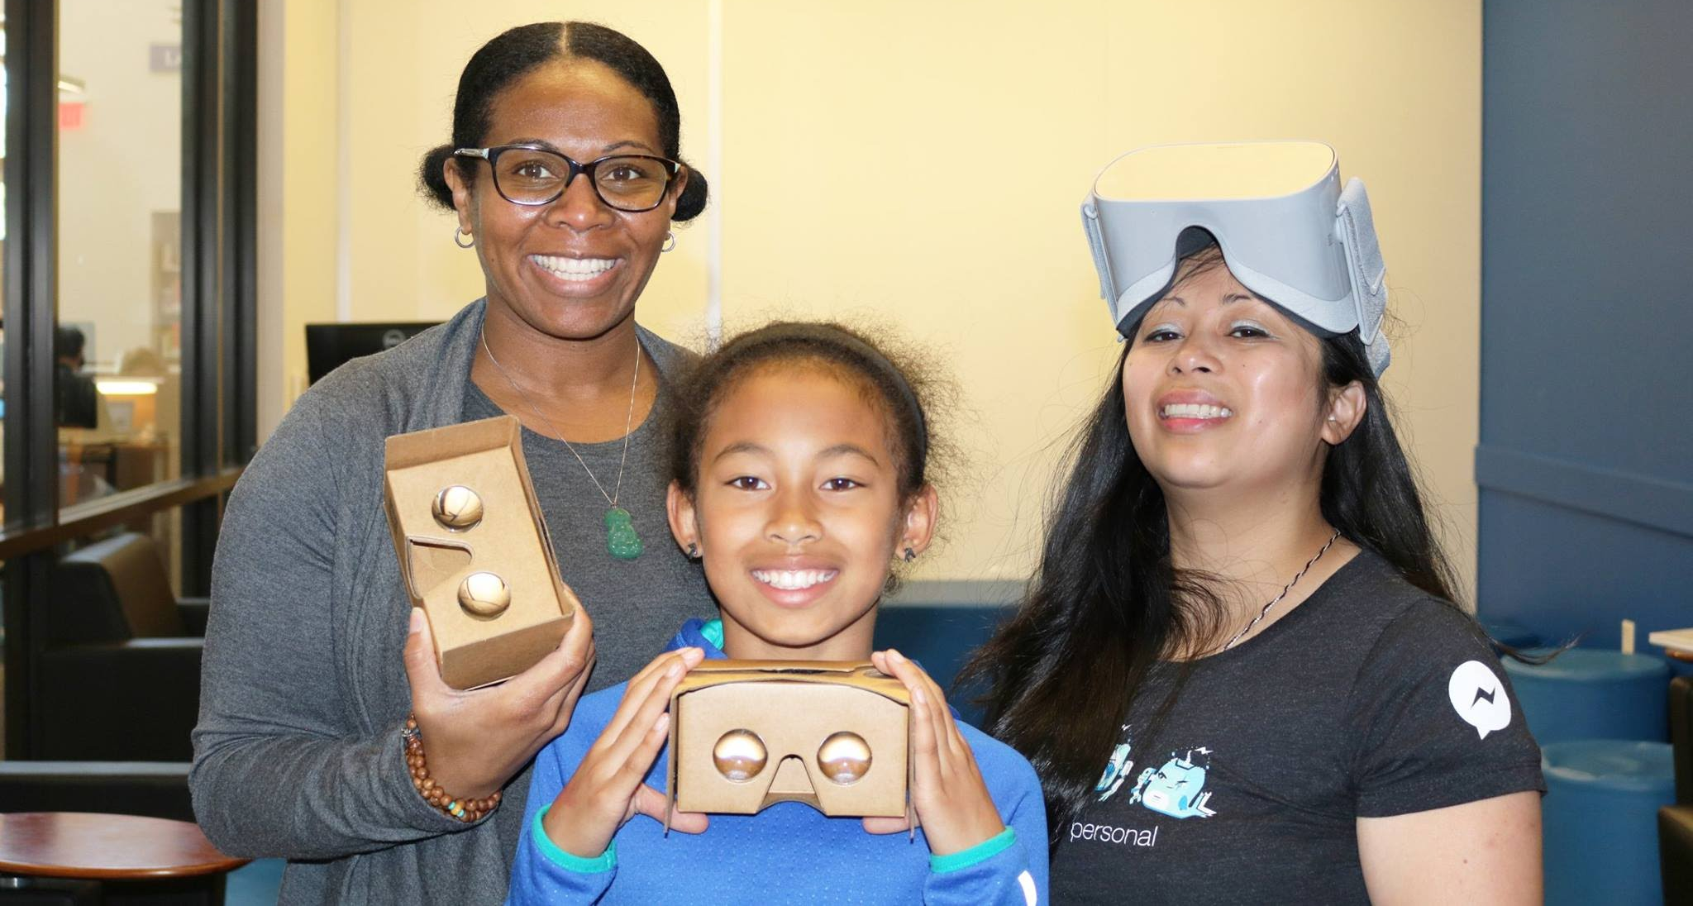
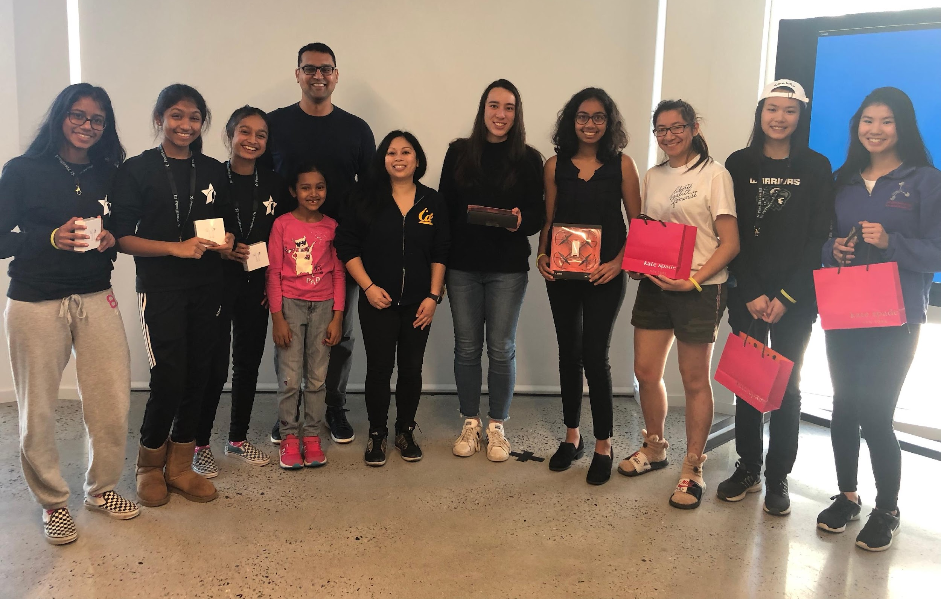
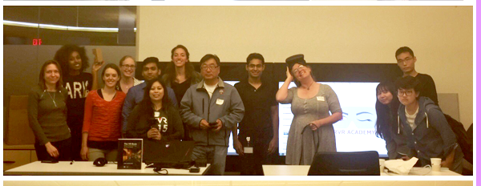
Teaching next generation spatial computing
Cisco 2016
Girls Who Code 2018
PixelHacks 2019
#TechIntersections
@erinjerri
Notes:
Anyone who told you differently, is lying to you, or has not lived this life or was probably rich and famous before it due to privilege, or years of long and grueling hard work and has forgotten where they come from and that this period of a pandemic has sucked like no other.

Slide 21
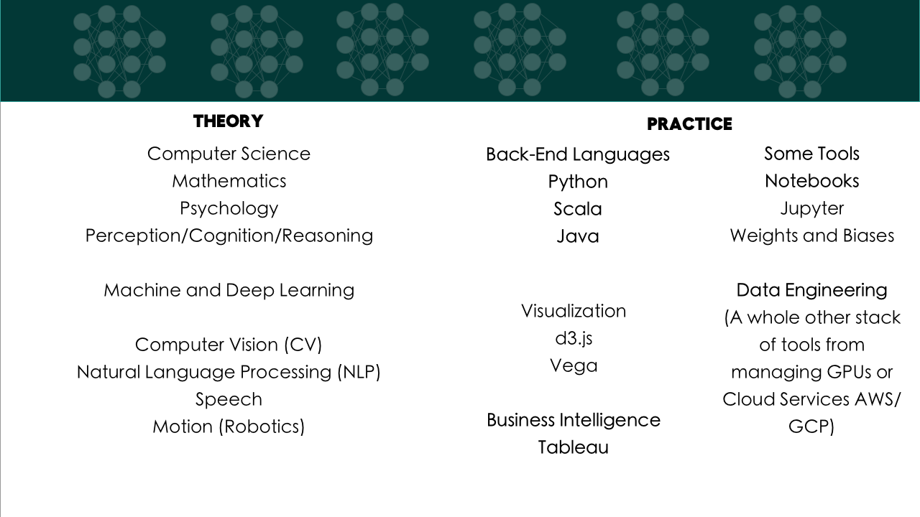
AI PRAXIS
#TechIntersections
@erinjerri

Slide 22
REFERENCES
Jerald, Jason. The VR Book: Human Centered Design for Virtual Reality. ACM. 2016.
Lynch, Shana “Andrew Ng: Why AI Is the New Electricity” 2017, 11 March.
https://www.gsb.stanford.edu/insights/andrew-ng-why-ai-new-electricity
Nakamoto, Satoshi. “BitCoin: A Peer-to-Peer Electronic Cash System.”2008, 31 October.
https://bitcoin.org/bitcoin.pdf
Oronce, Carlos. “US Health Care Relies on Filipinxs While Ignoring Their Health Needs Disguised Disparities and the COVID-19 Pandemic.” 2021, 23, July.
https://jamanetwork.com/journals/jama-health-forum/fullarticle/2782408
Sietsma, Silka. “ Designing for Our Senses, Not Our Devices.” Creating Augmented and Virtual Realities. O’Reilly Media. Pg 36. 2019.
Vanourek, Gregg.“The Power of Taking Full Responsibility for Your Life.”22 March 2022.
https://greggvanourek.com/full-responsibility/
Wang, Eva Marie.“Paglalayag sa Balangay as Methodology A Decolonial Journey of Re-Imaging Our Research, International Extramural Conference, University of the Philippines, Cebu. 2021 Oct 256. https://www.facebook.com/UPCebuSocSci/videos/329426628986894
#TechIntersections
@erinjerri

Slide 23

ISANG BAGSAK!
@erinjerri

Slide 24

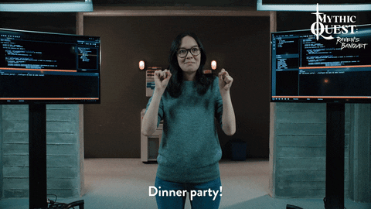
#TechIntersections
@erinjerri

Slide 25

#TechIntersections
@erinjerri

