Slide 1
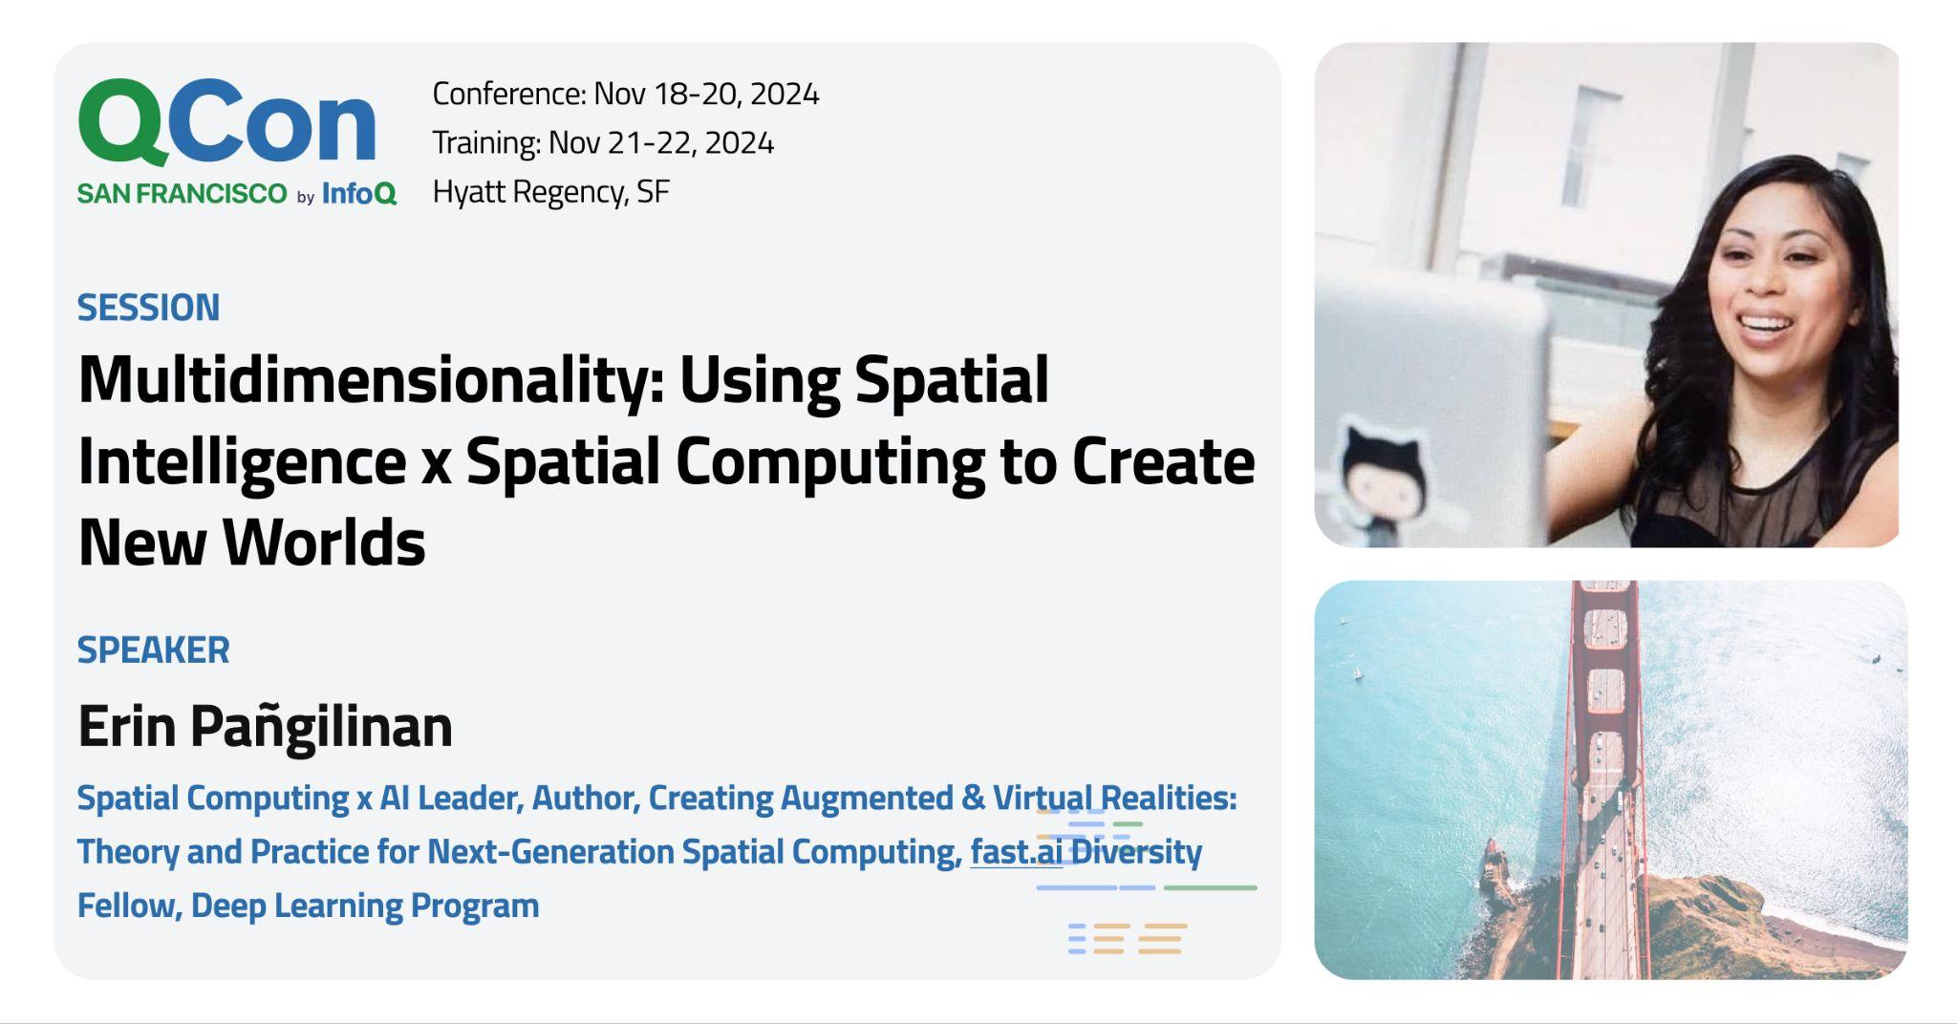

Slide 2
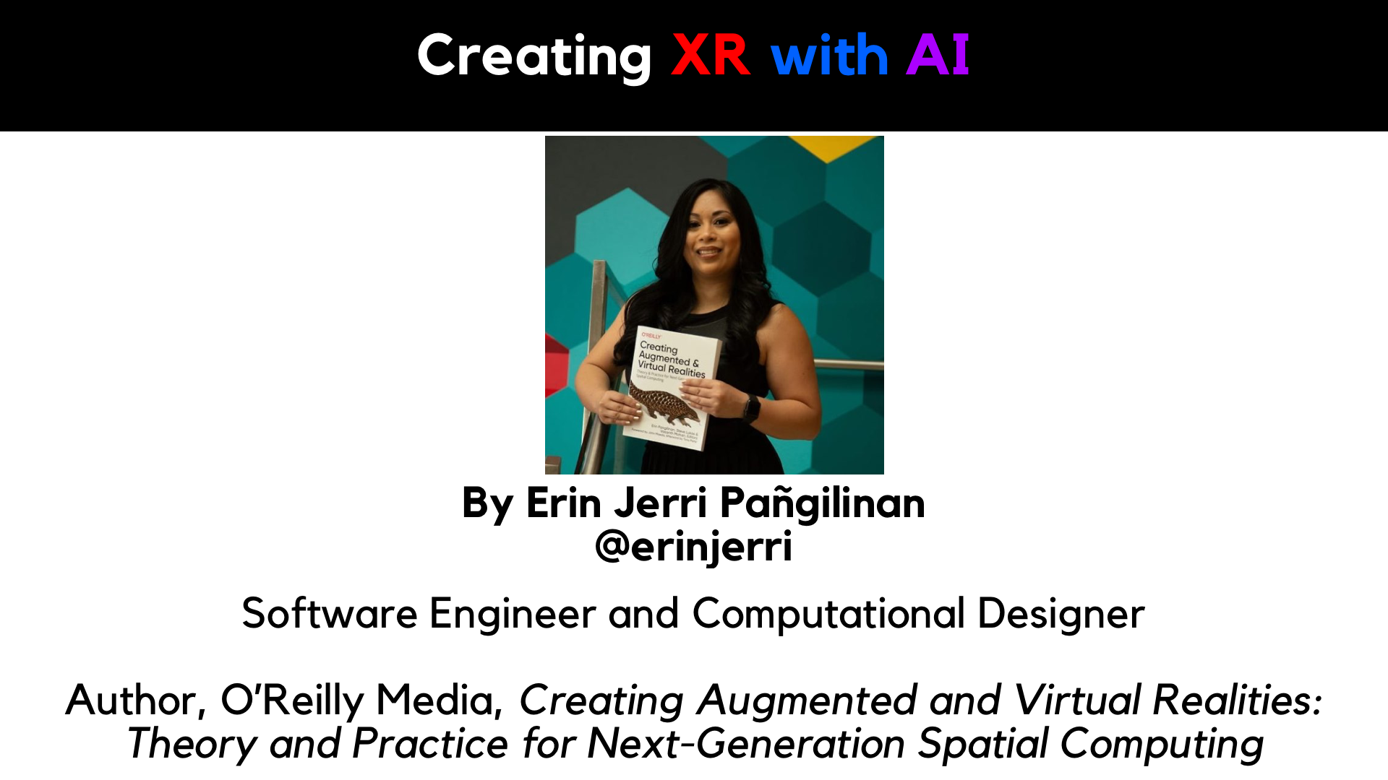

Slide 3
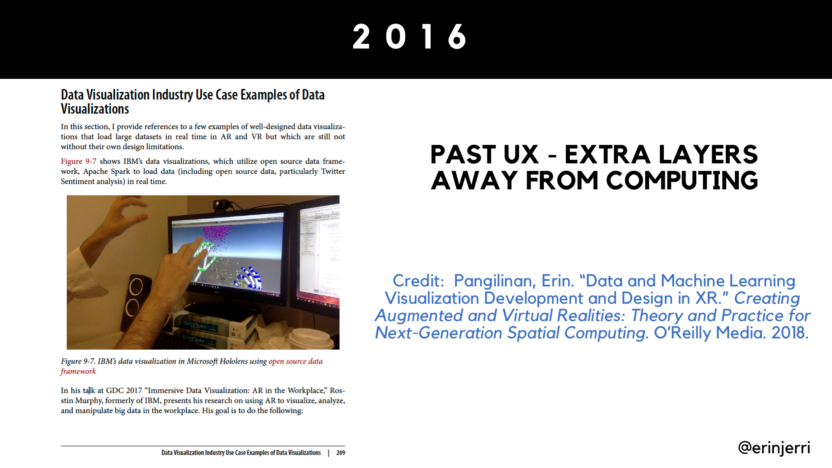
Notes:
VR to ER, Rosstin Murphy example at IBM, in order to view Jupyter Notebook in Python, it requires needing to remove Microsoft Hololens

Slide 4
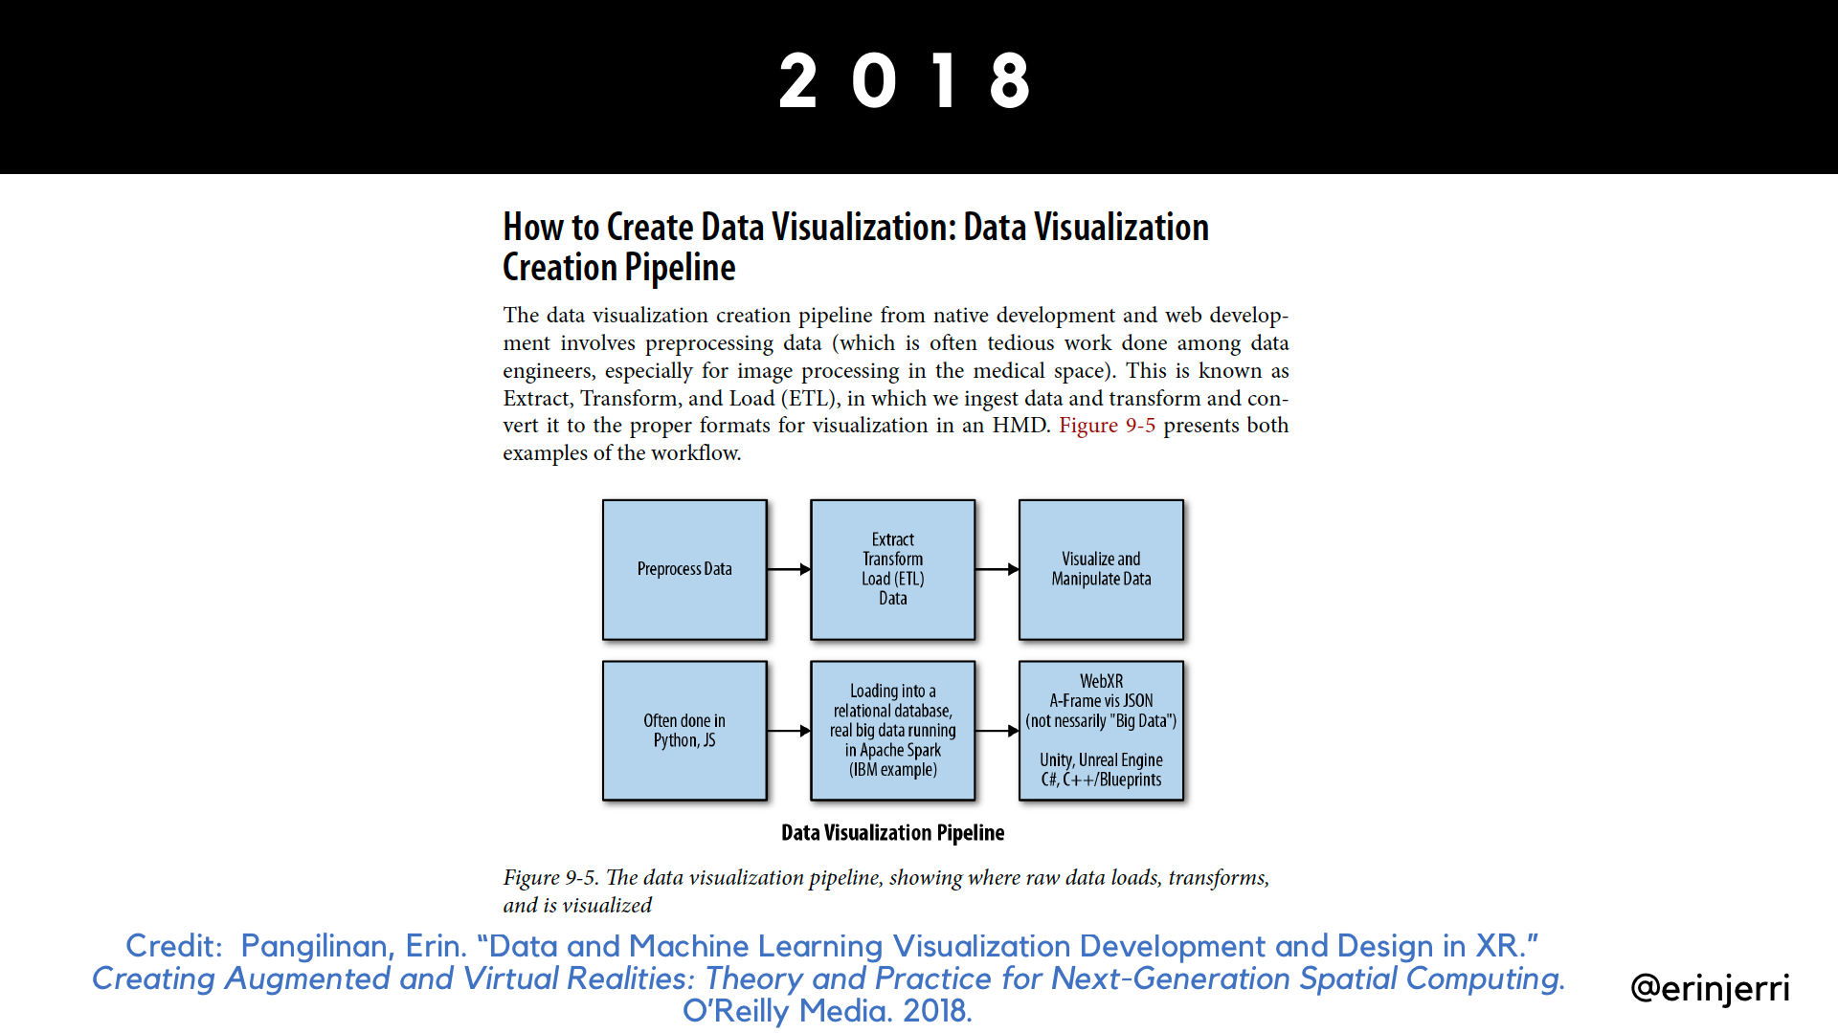
Notes:
Data Viz Pipeline - typically structured data, now a lot of AI uses structured data

Slide 5
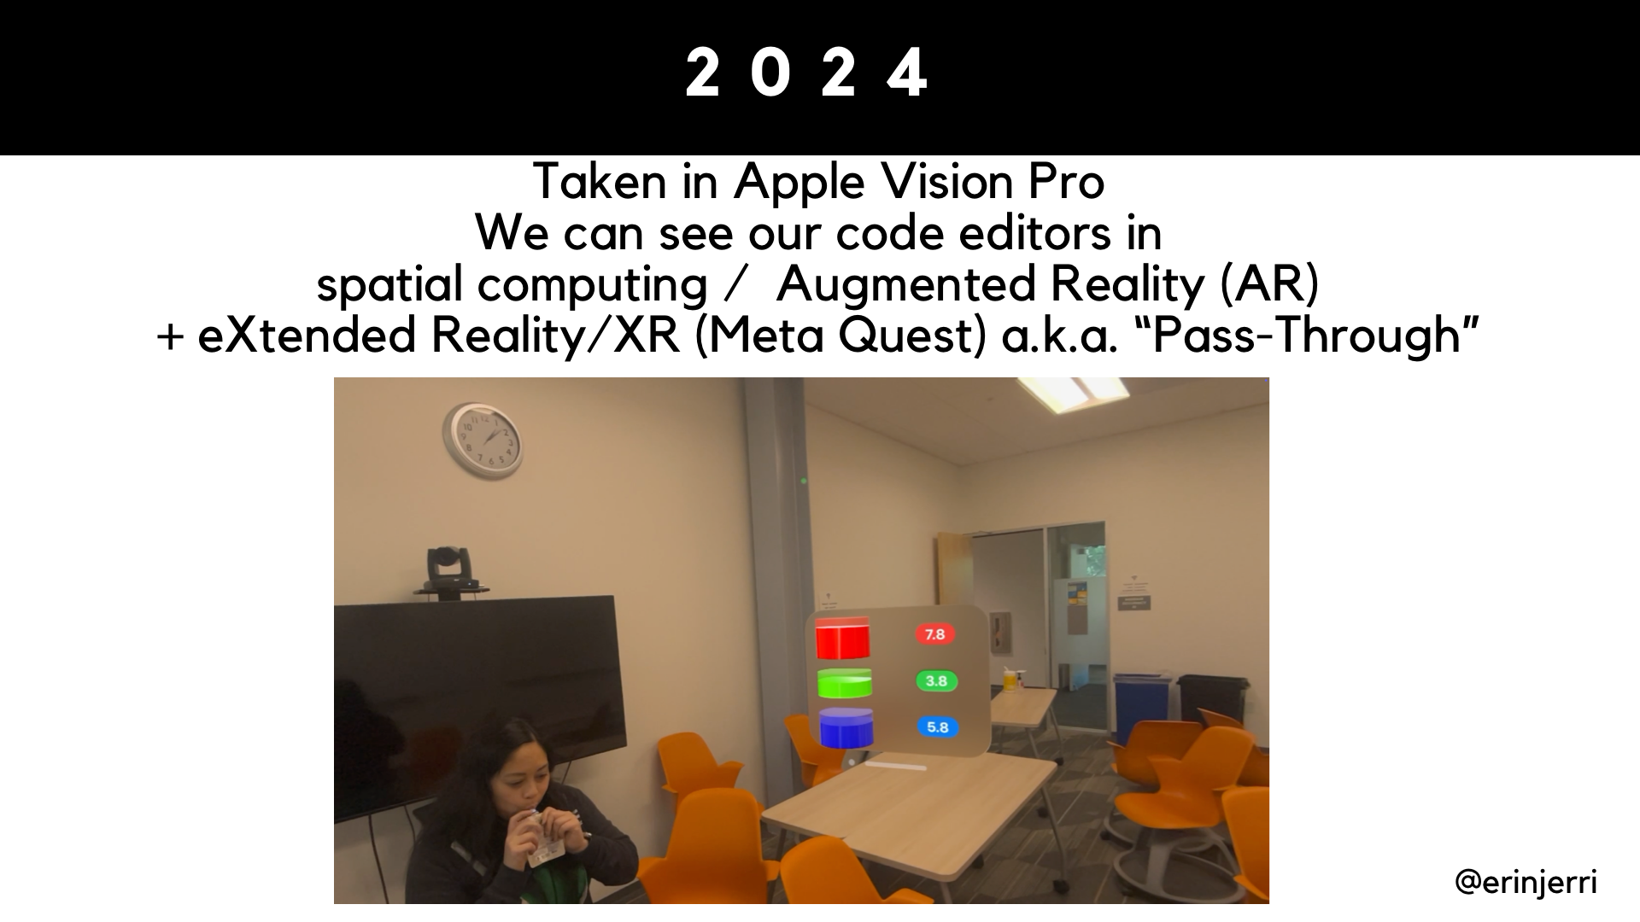

Slide 6
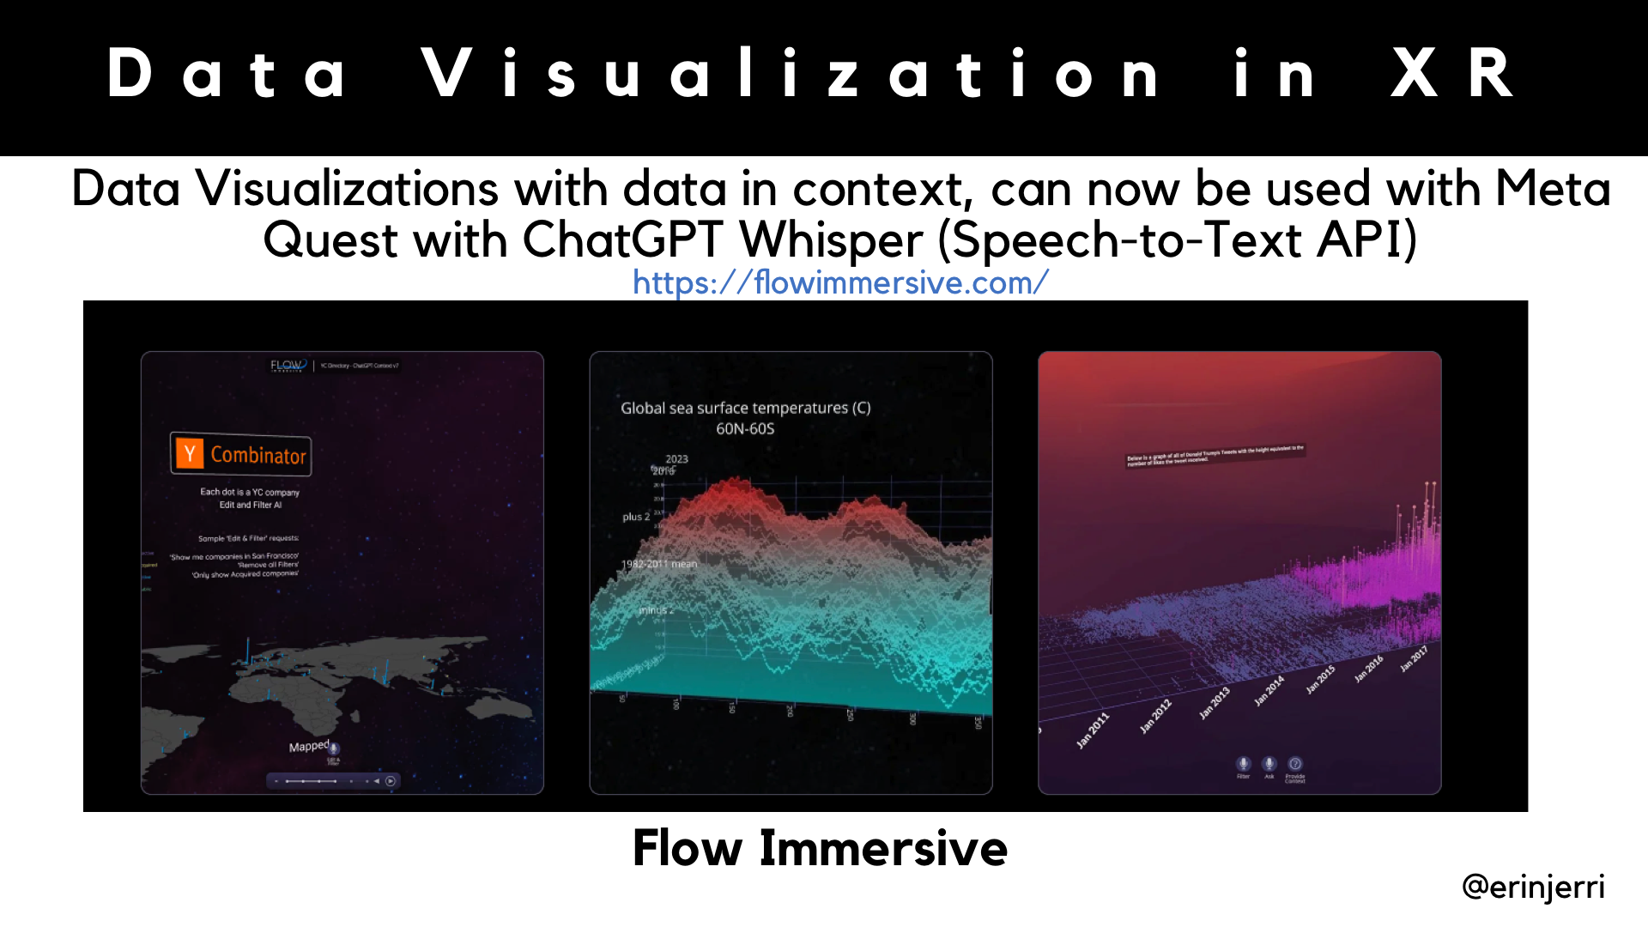

Slide 7
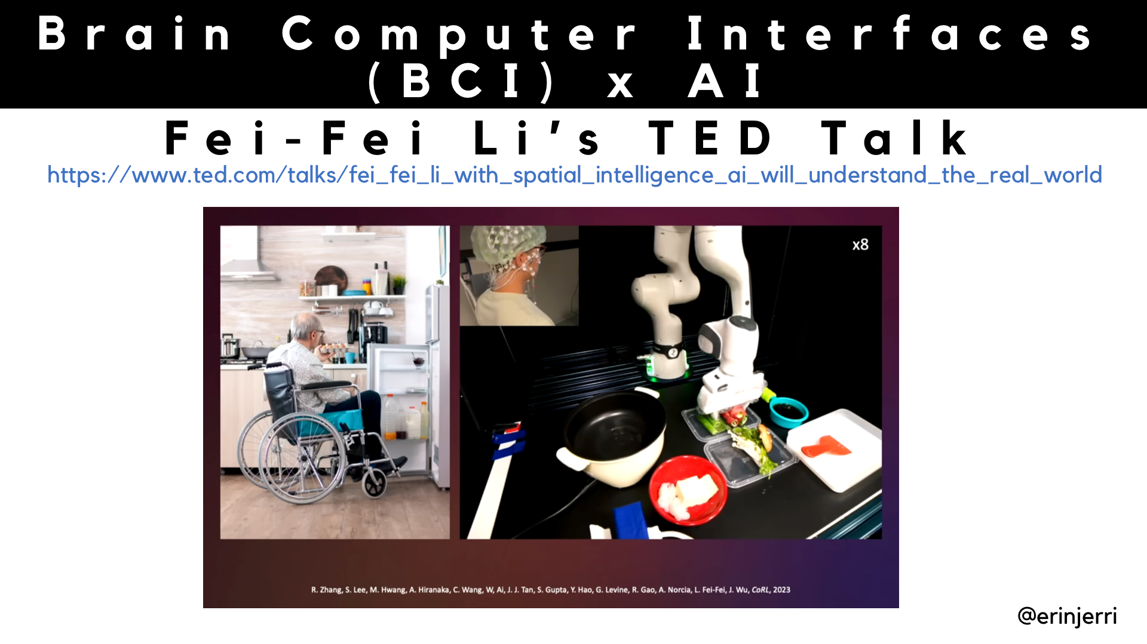
Notes:
Fei-Fei Li - World Labs - TED Talk Patient with ALS being able to utilize non-invasive BCI (EEG cap) with AI to control making a meal with robot hands

Slide 8
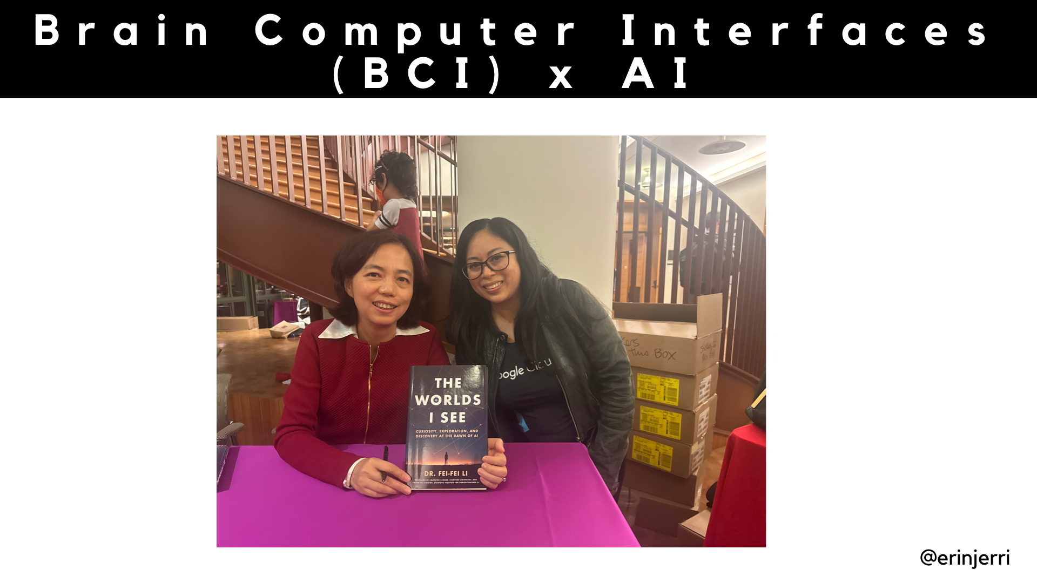
Notes:
Fei-Fei Li - World Labs - TED Talk Patient with ALS being able to utilize non-invasive BCI (EEG cap) with AI to control making a meal with robot hands

Slide 9
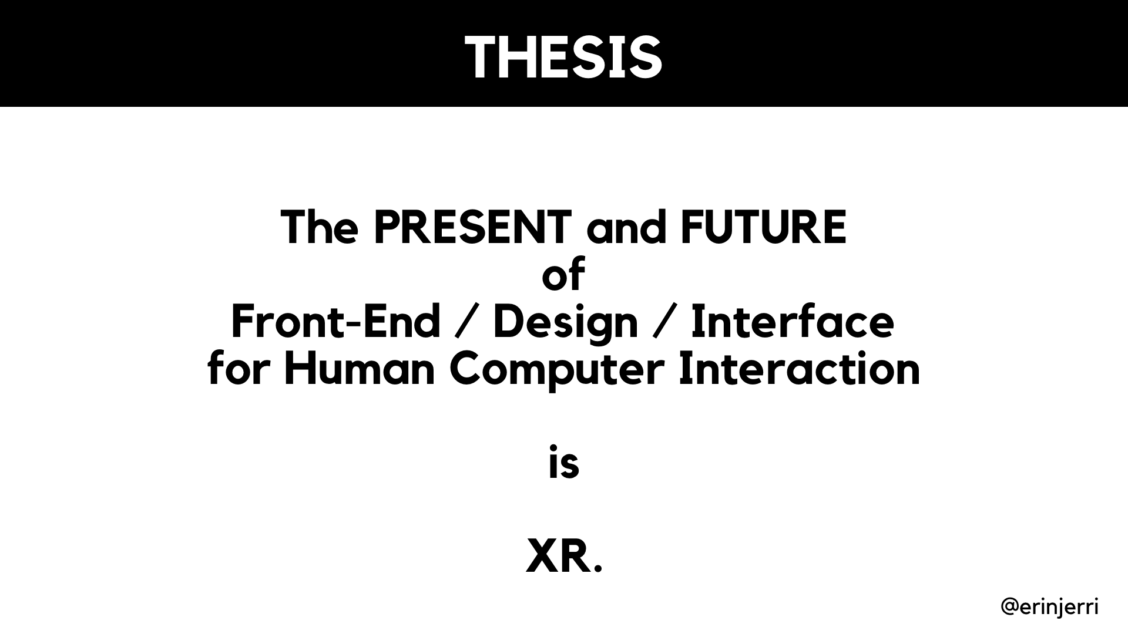

Slide 10
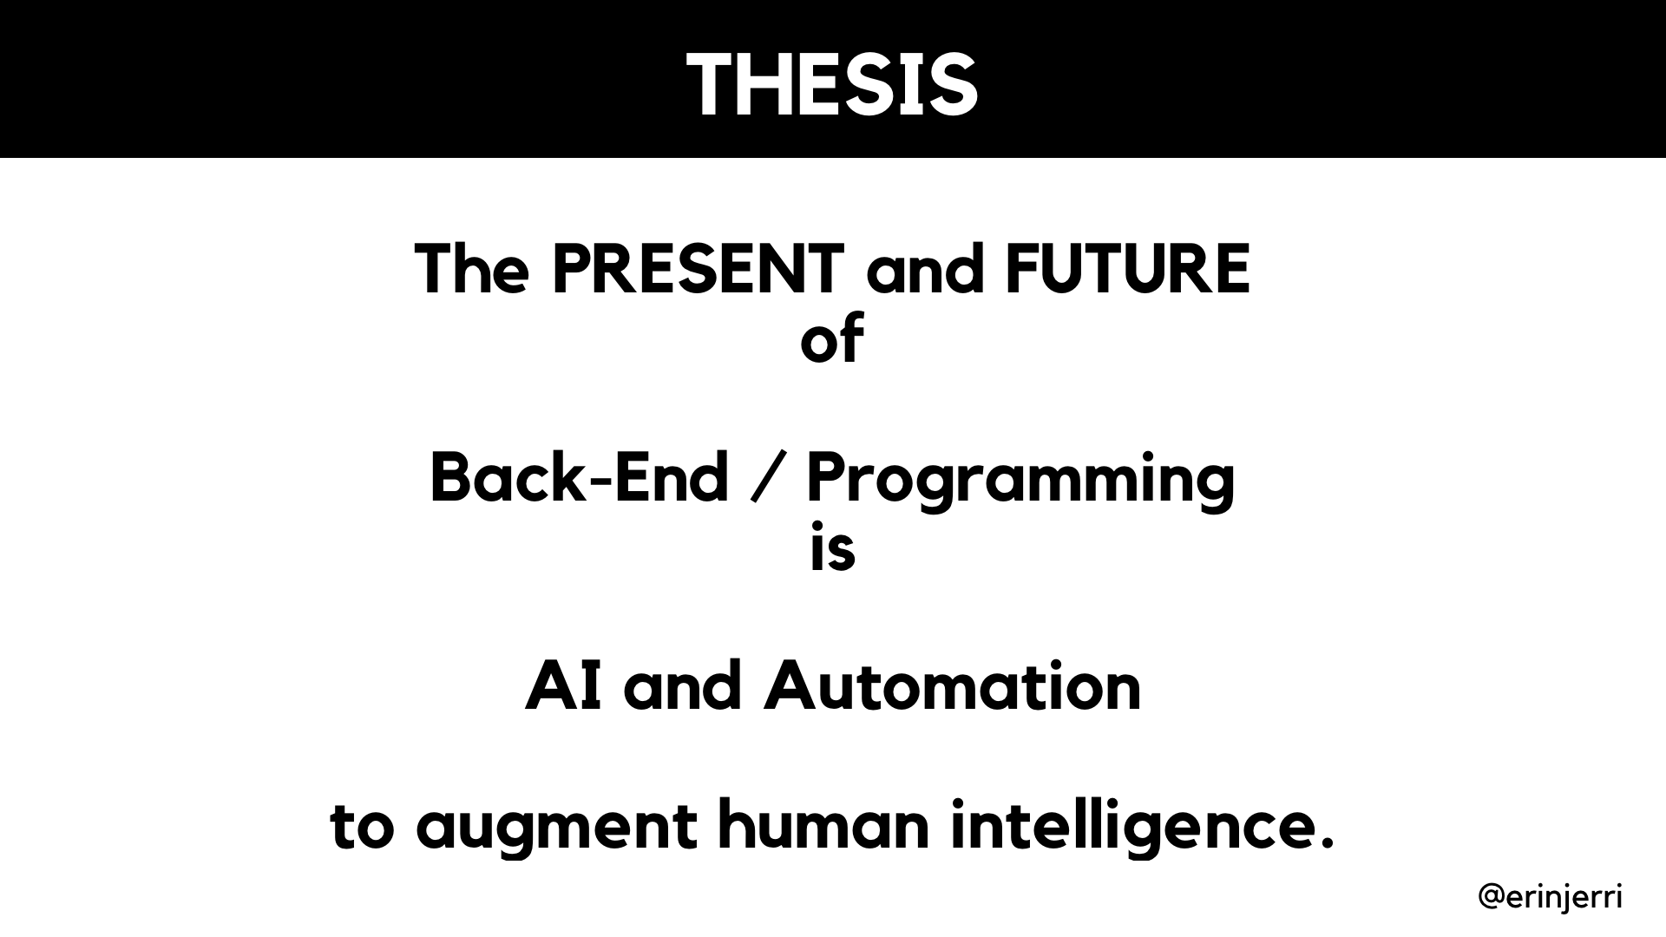

Slide 11
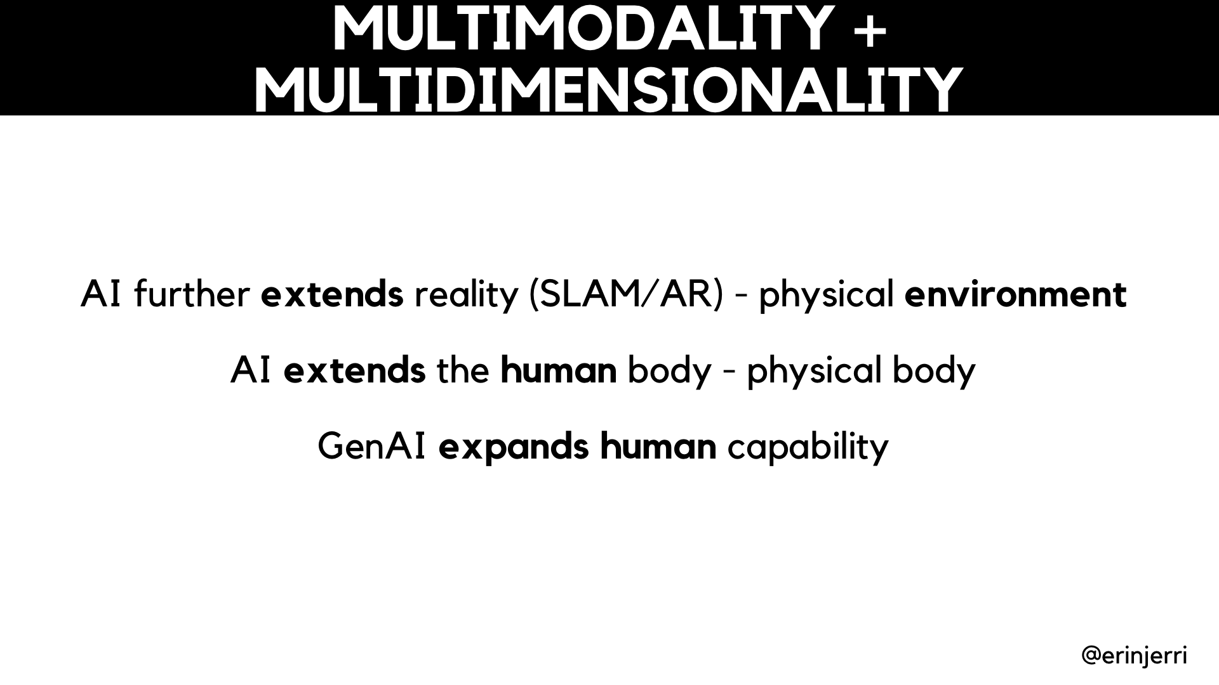

Slide 12
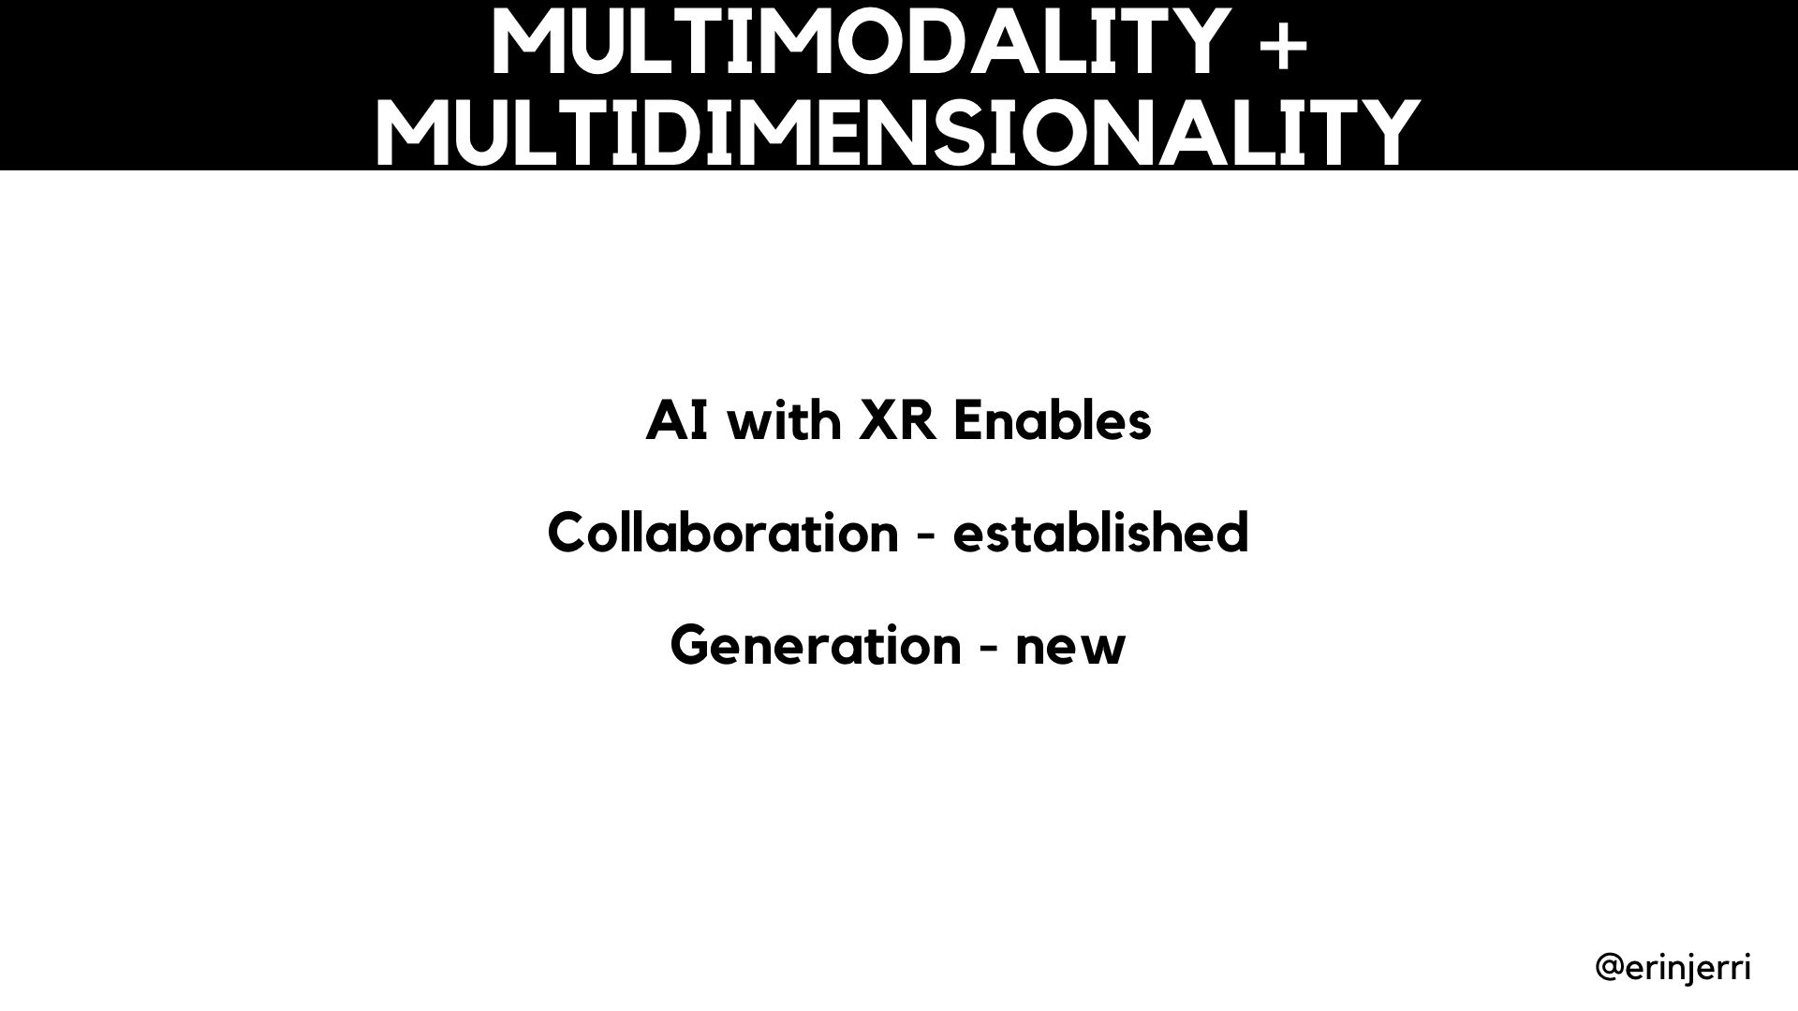

Slide 13
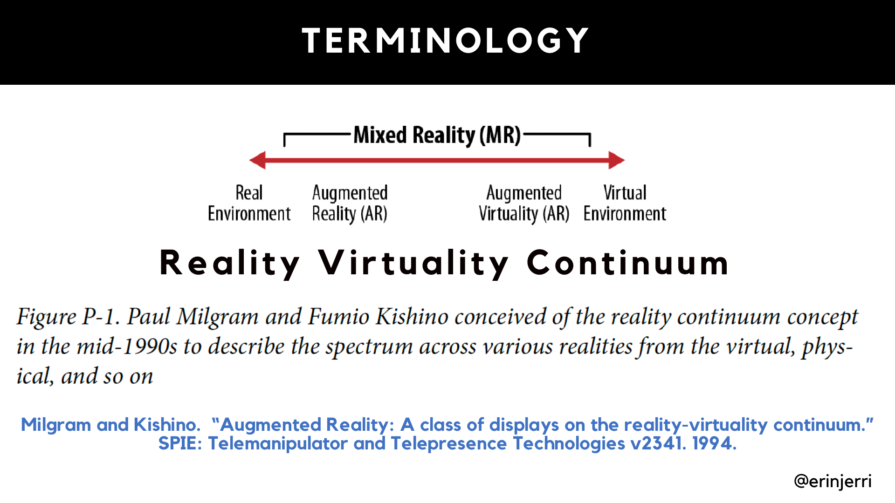

Slide 14
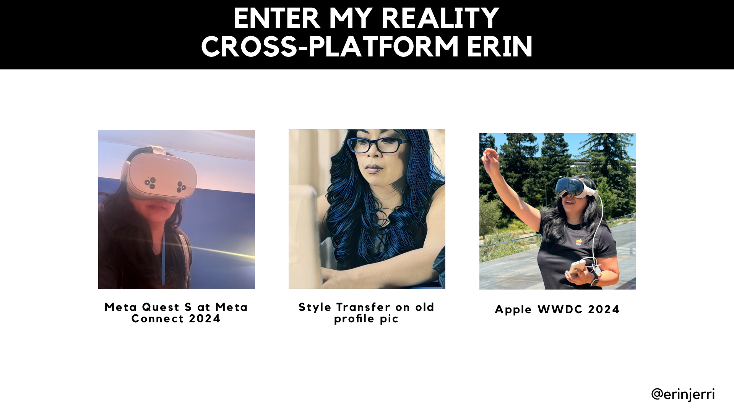

Slide 15
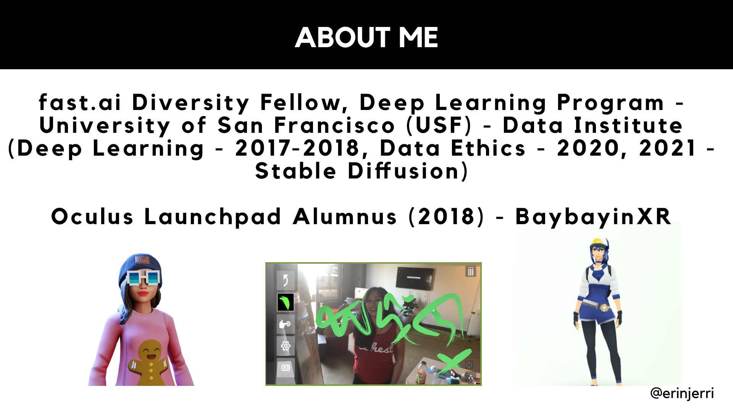

Slide 16
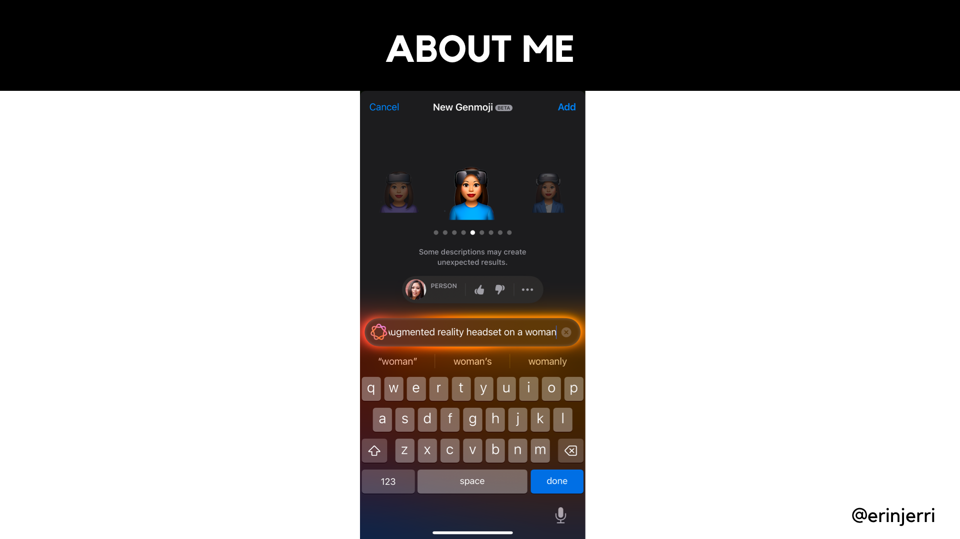

Slide 17
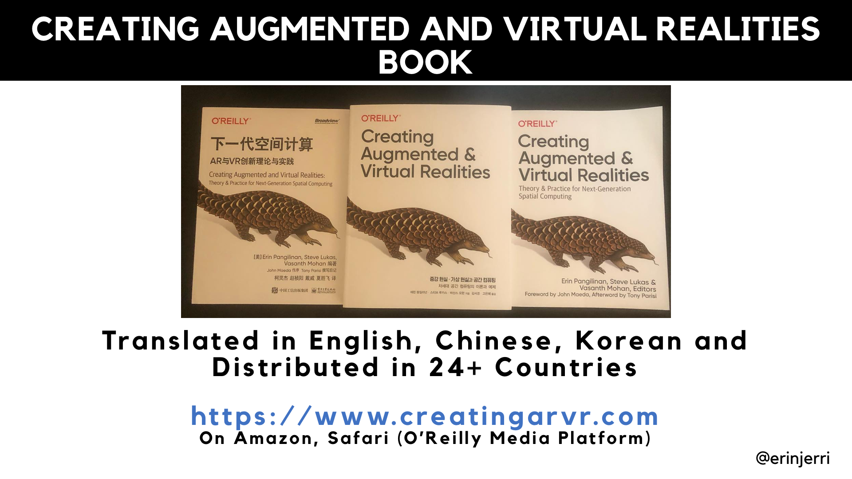

Slide 18
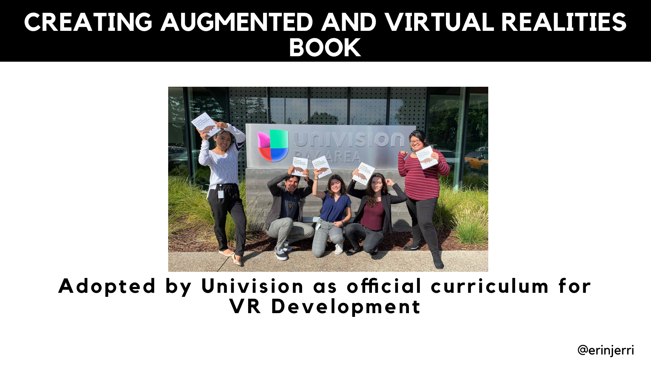

Slide 19
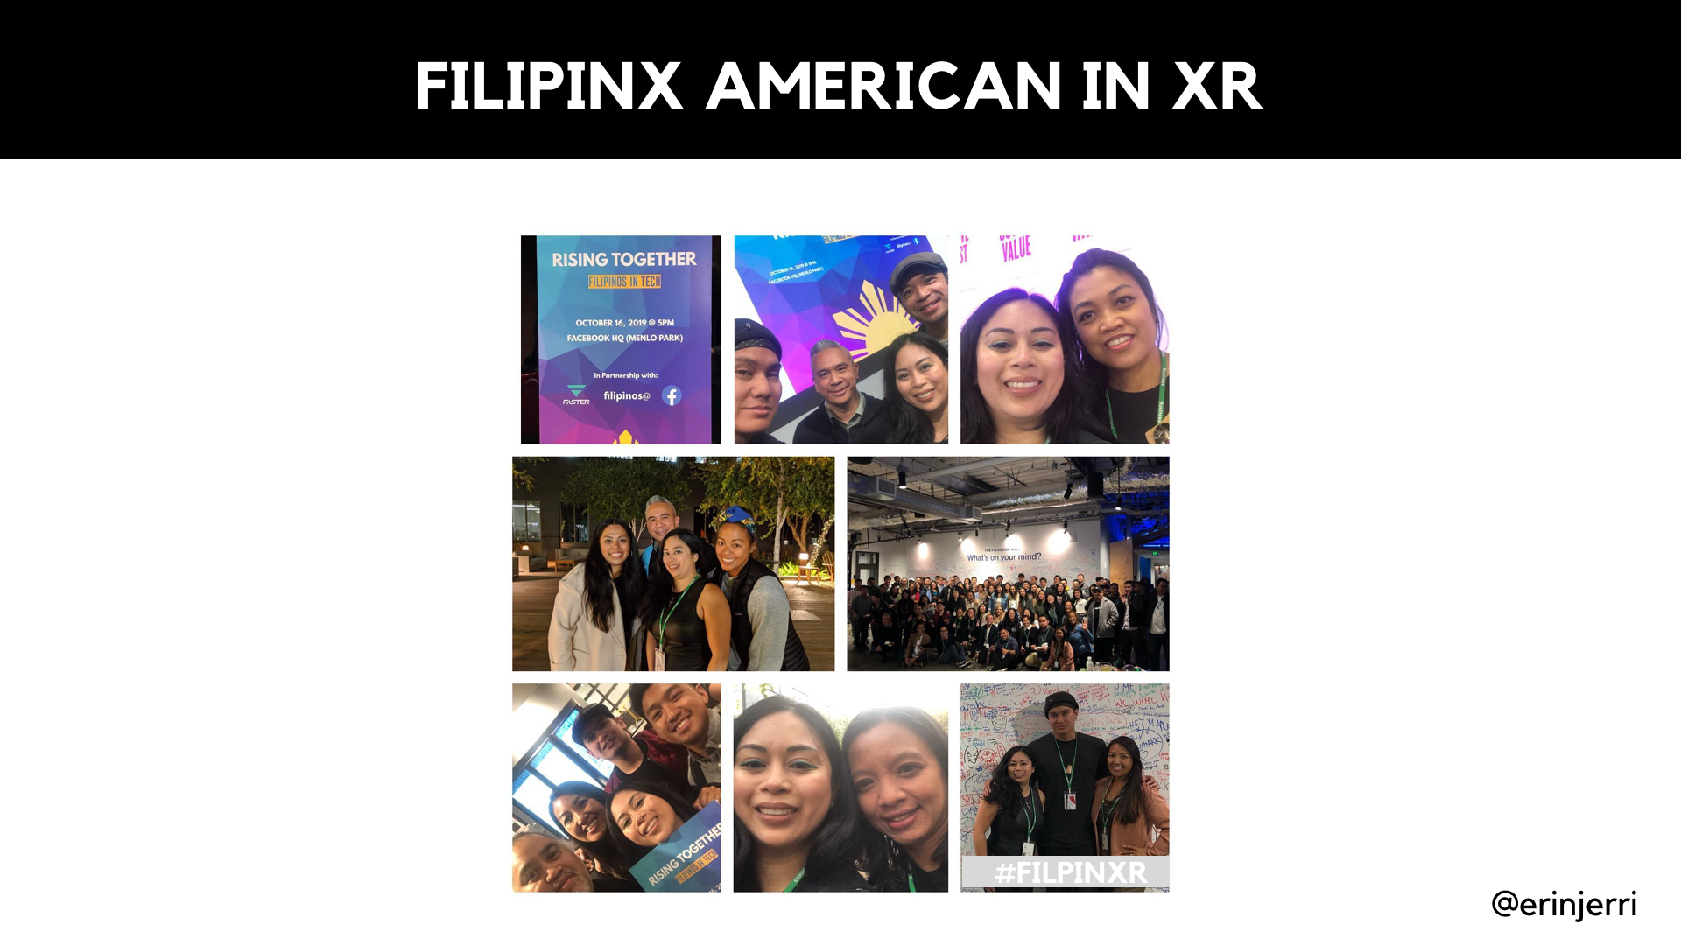

Slide 20
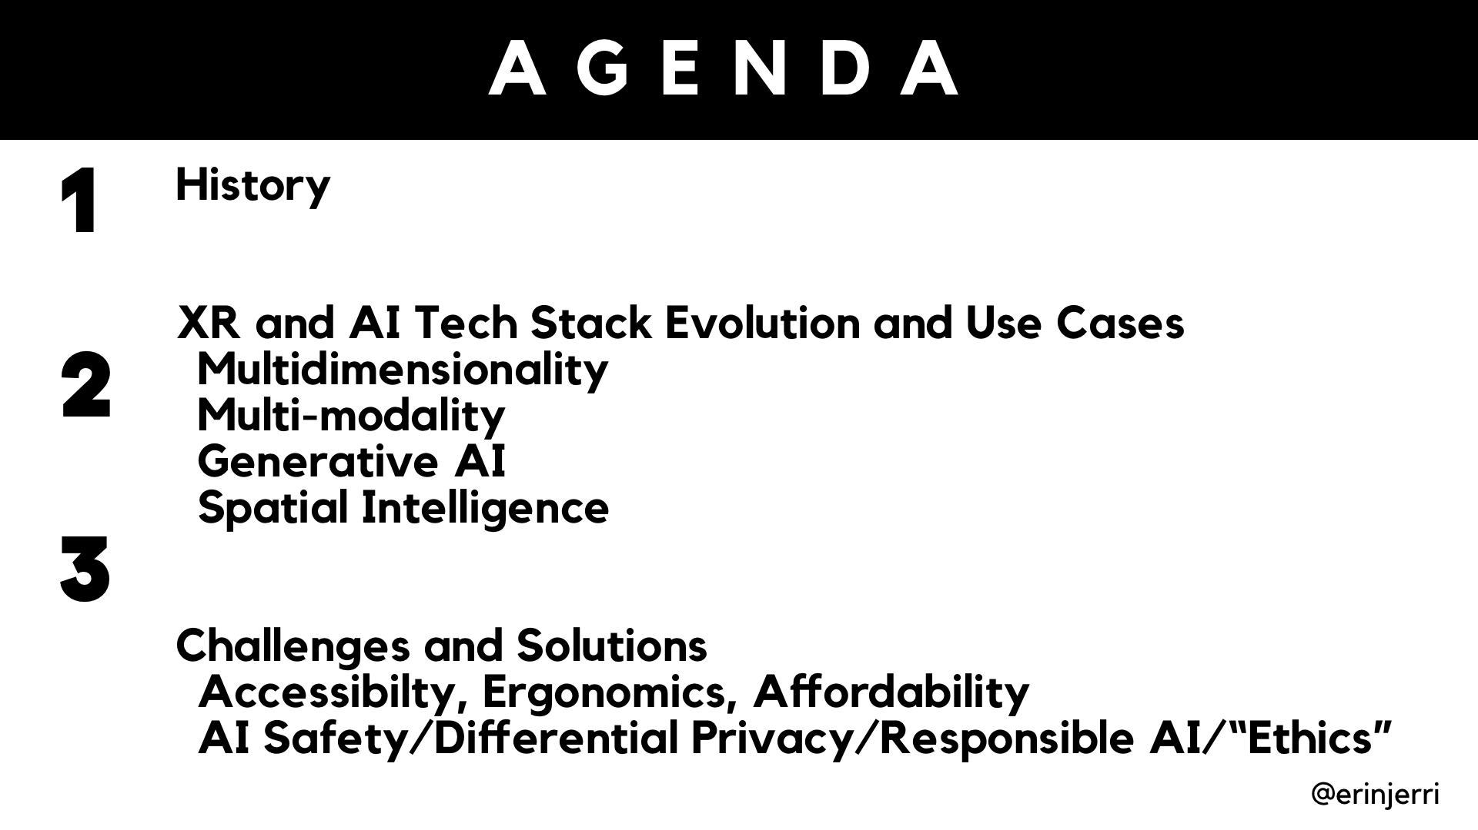

Slide 21
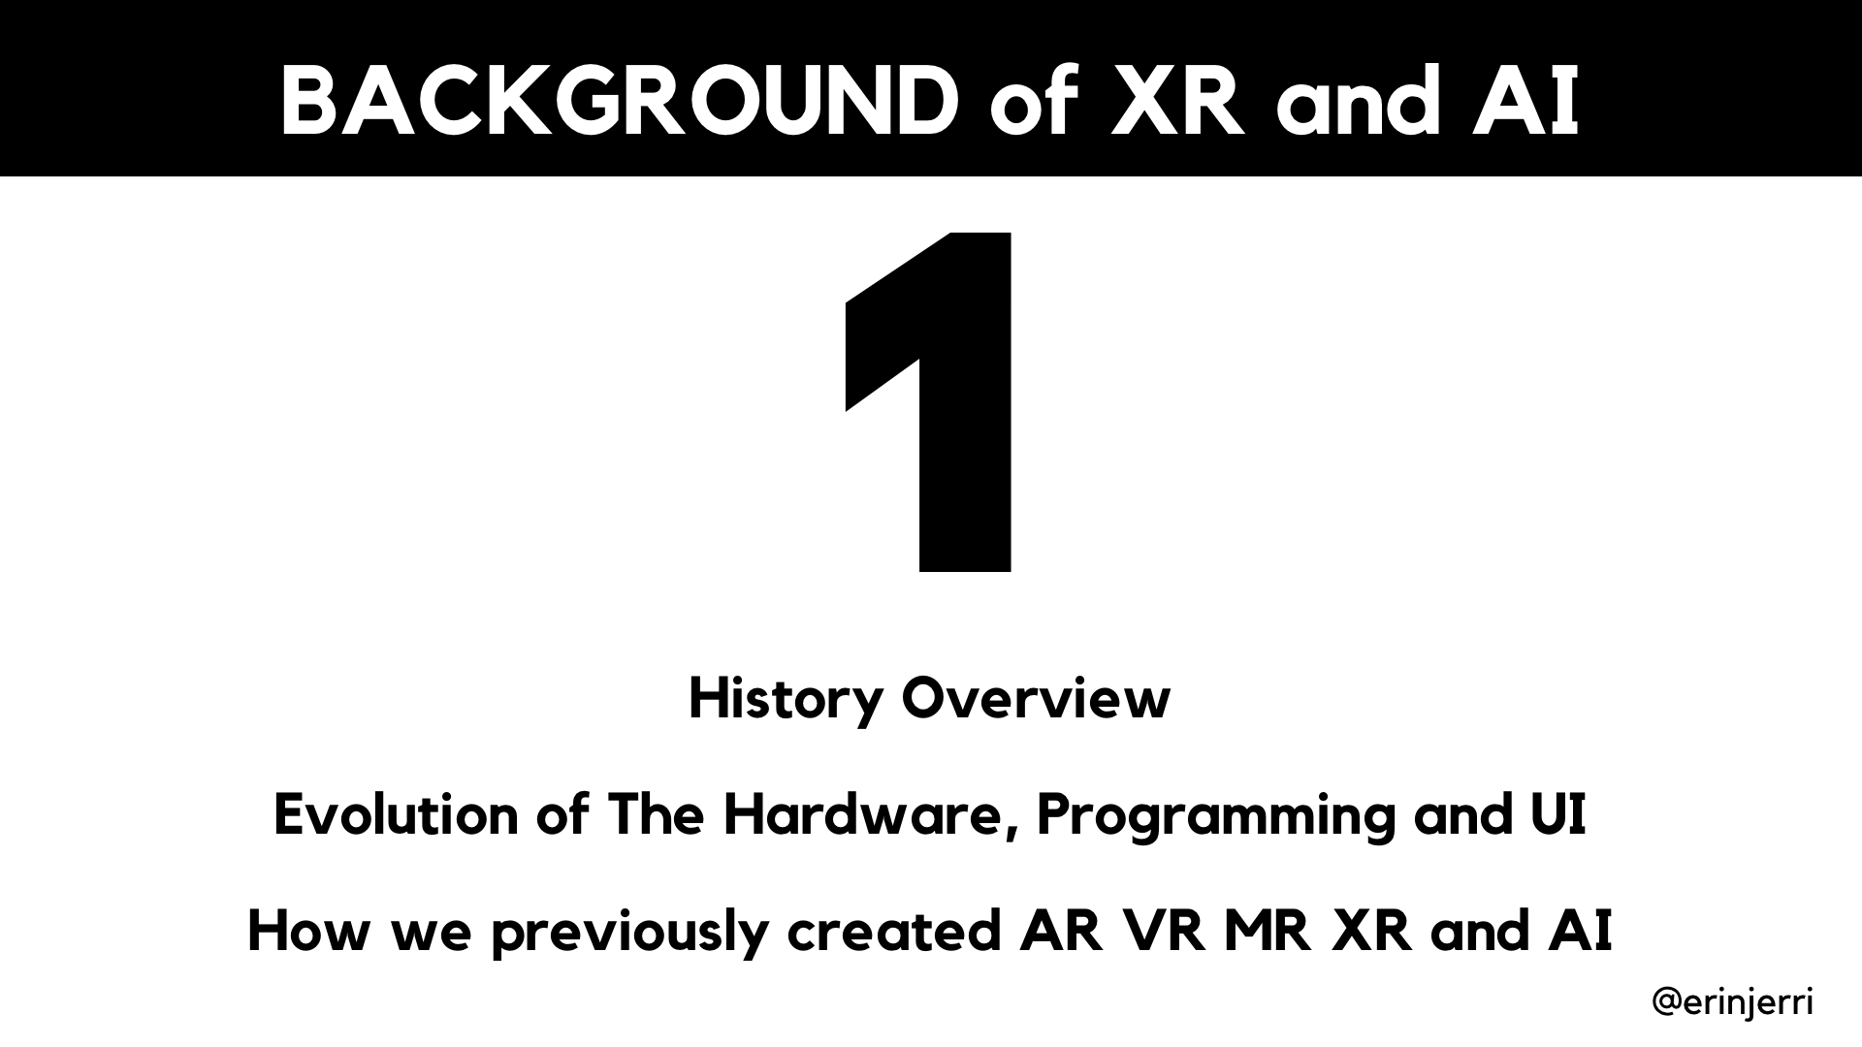

Slide 22
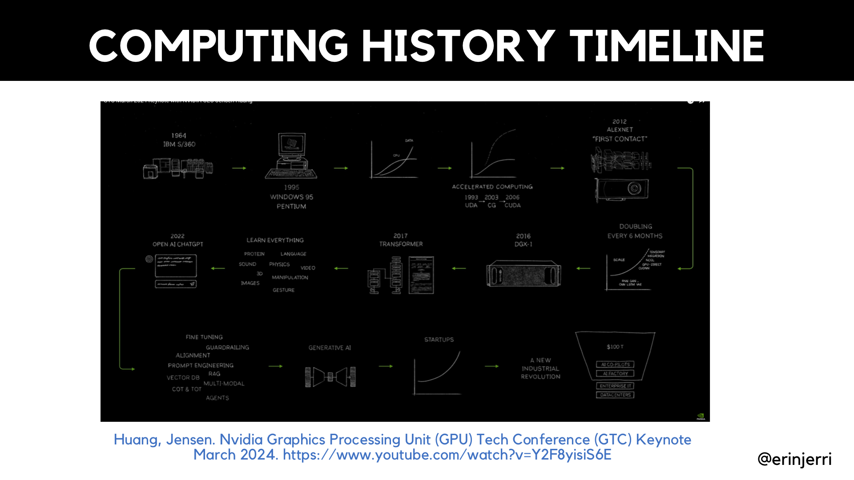
Notes:
Why Multidimensionality - Explain Dimensionality
2D
3D

Slide 23
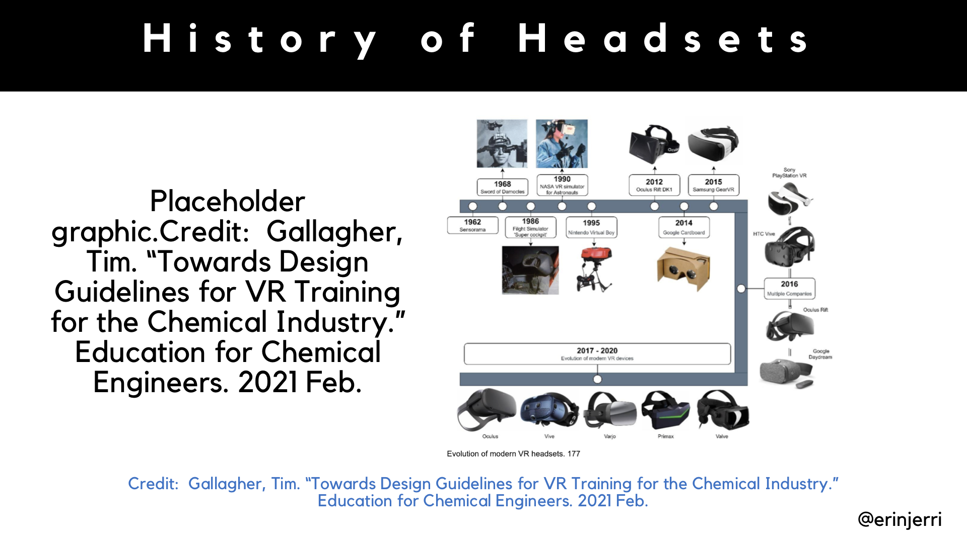
Notes:
AI further extends reality (SLAM/AR) - physical environment
AI extends the human body - physical body
GenAI expands human capability

Slide 24
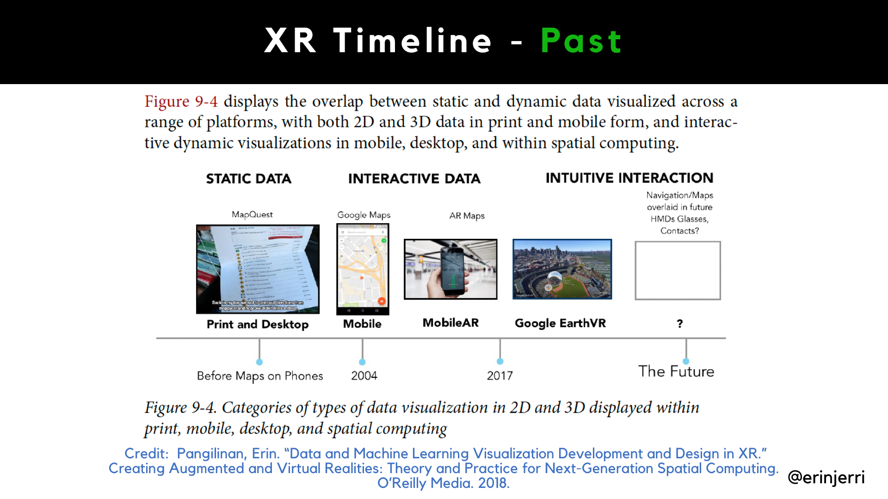
Notes:
AI further extends reality (SLAM/AR) - physical environment
AI extends the human body - physical body
GenAI expands human capability

Slide 25
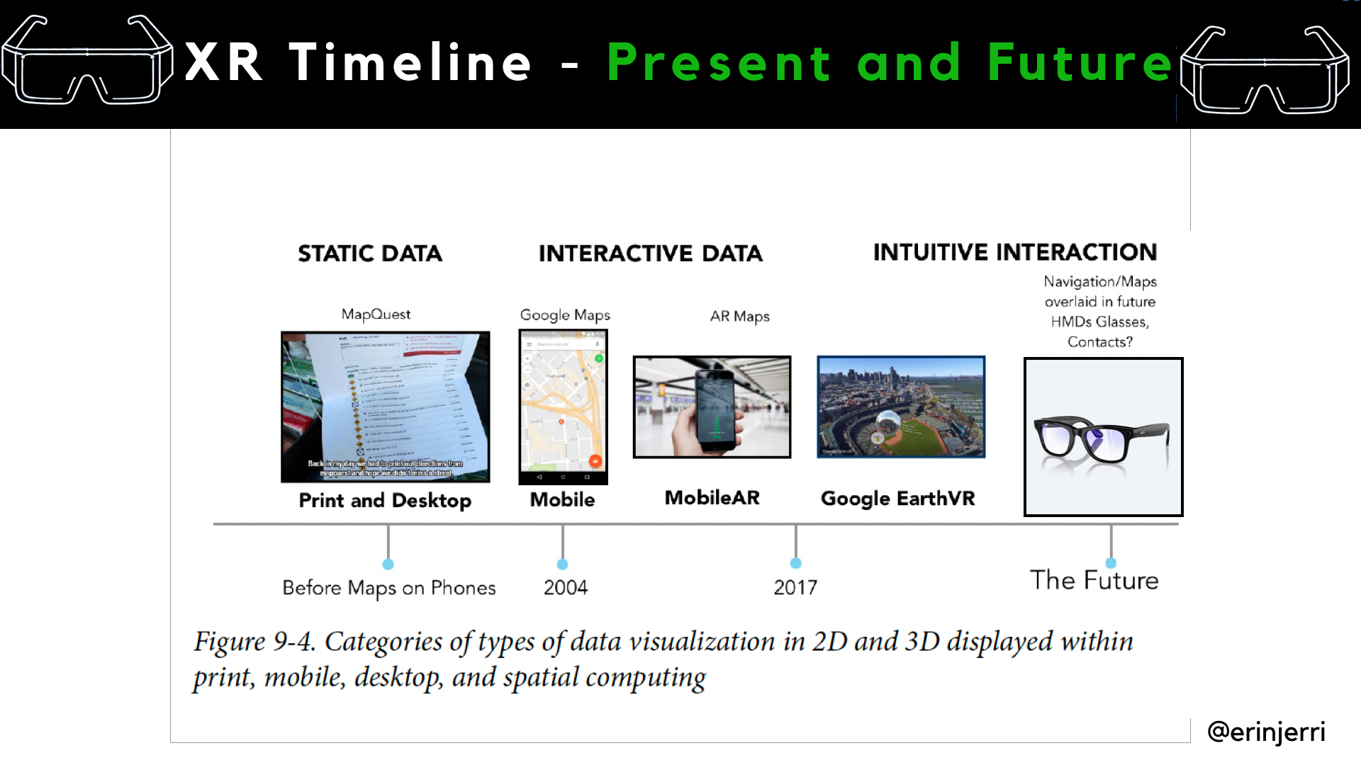

Slide 26
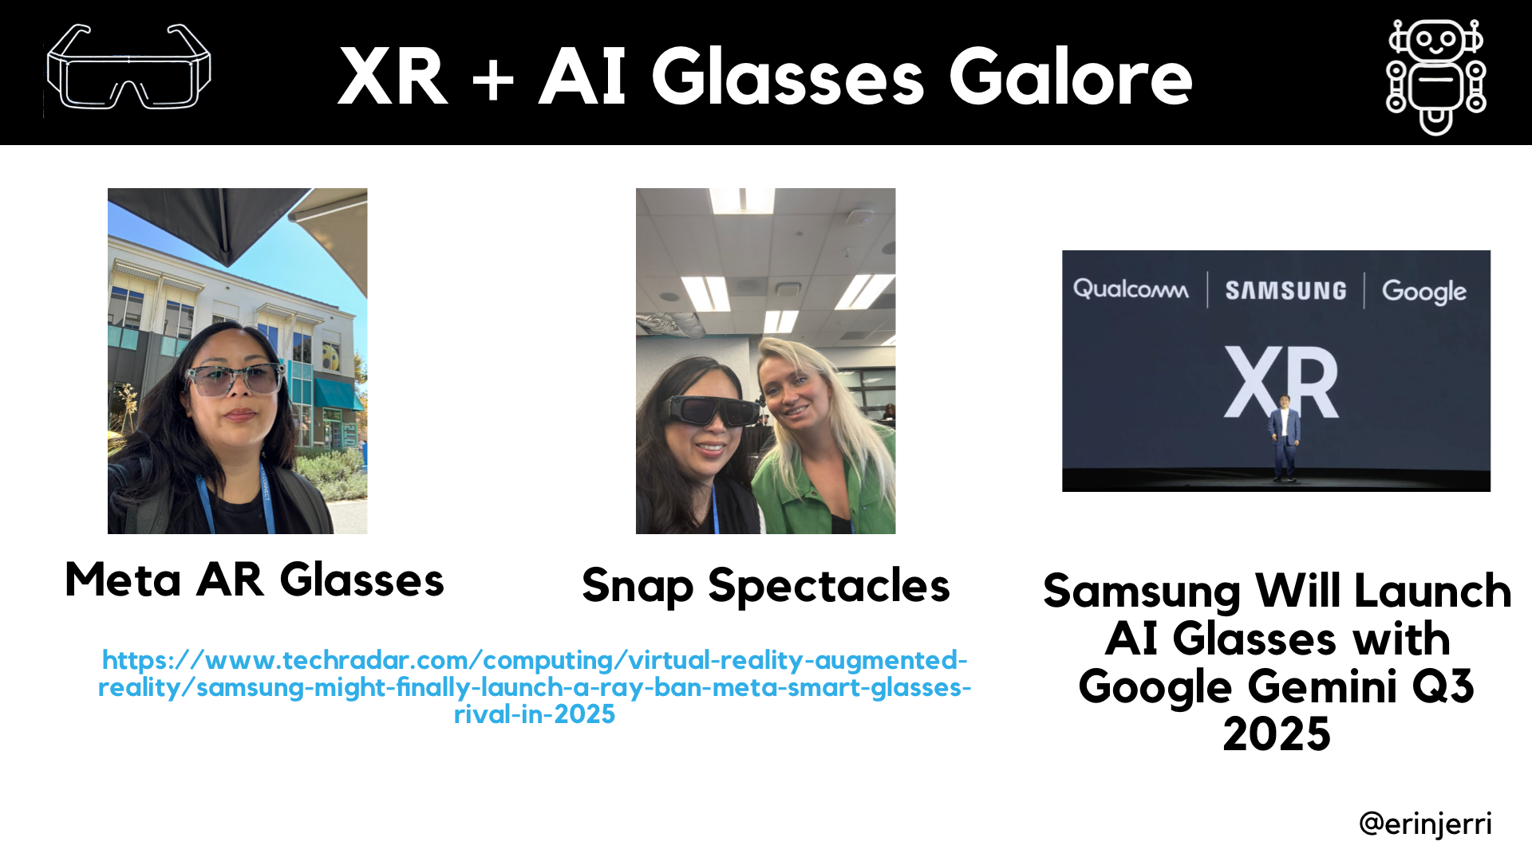

Slide 27
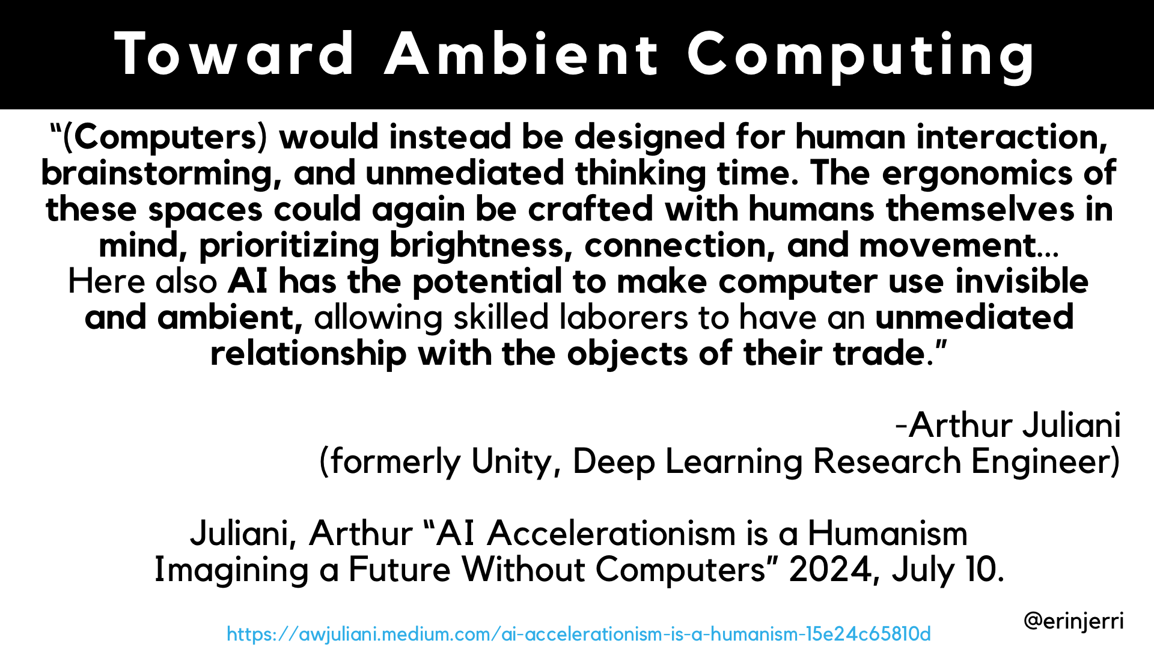
Notes:
AI further extends reality (SLAM/AR) - physical environment
AI extends the human body - physical body
GenAI expands human capability

Slide 28
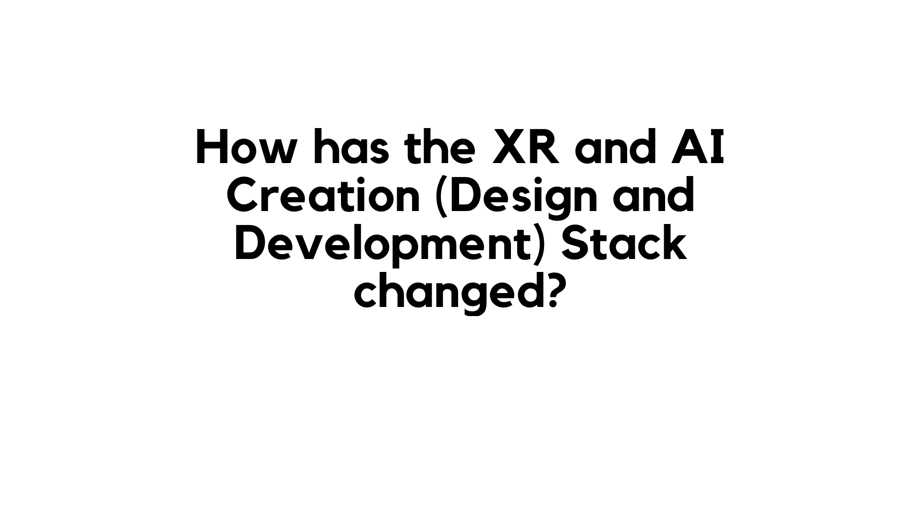
Notes:
AI further extends reality (SLAM/AR) - physical environment
AI extends the human body - physical body
GenAI expands human capability

Slide 29
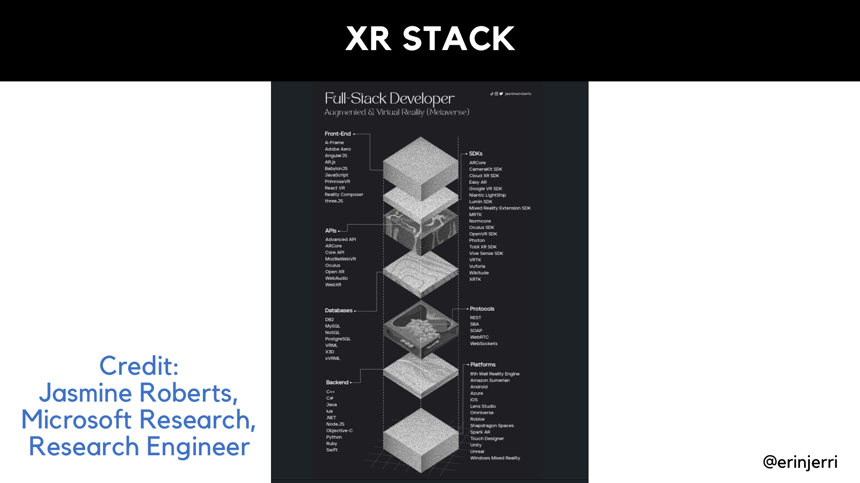
Notes:
AI further extends reality (SLAM/AR) - physical environment
AI extends the human body - physical body
GenAI expands human capability

Slide 30
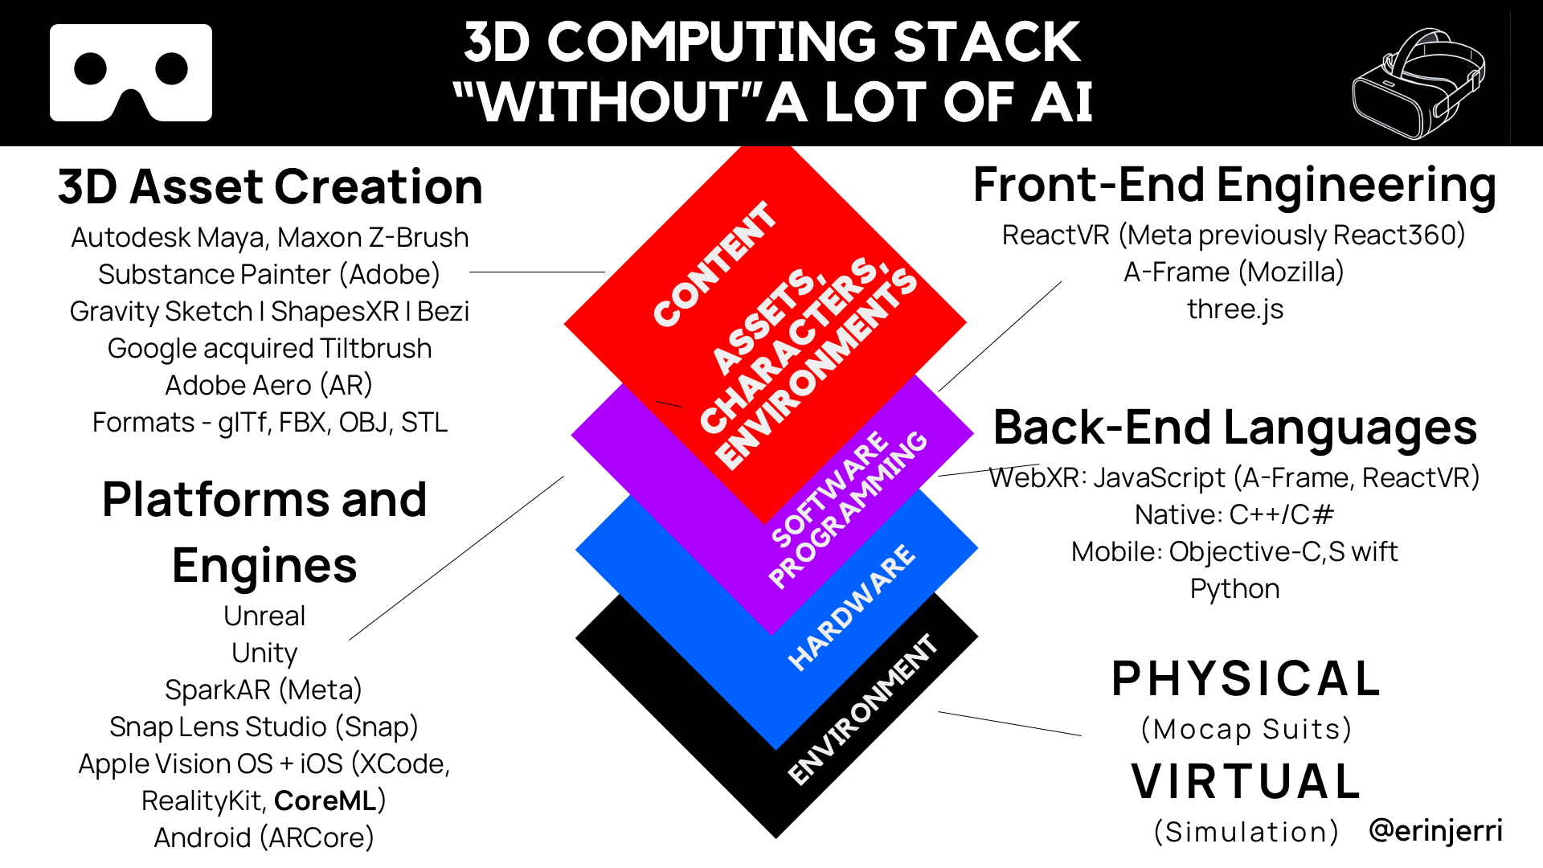
Notes:
AI further extends reality (SLAM/AR) - physical environment
AI extends the human body - physical body
GenAI expands human capability

Slide 31
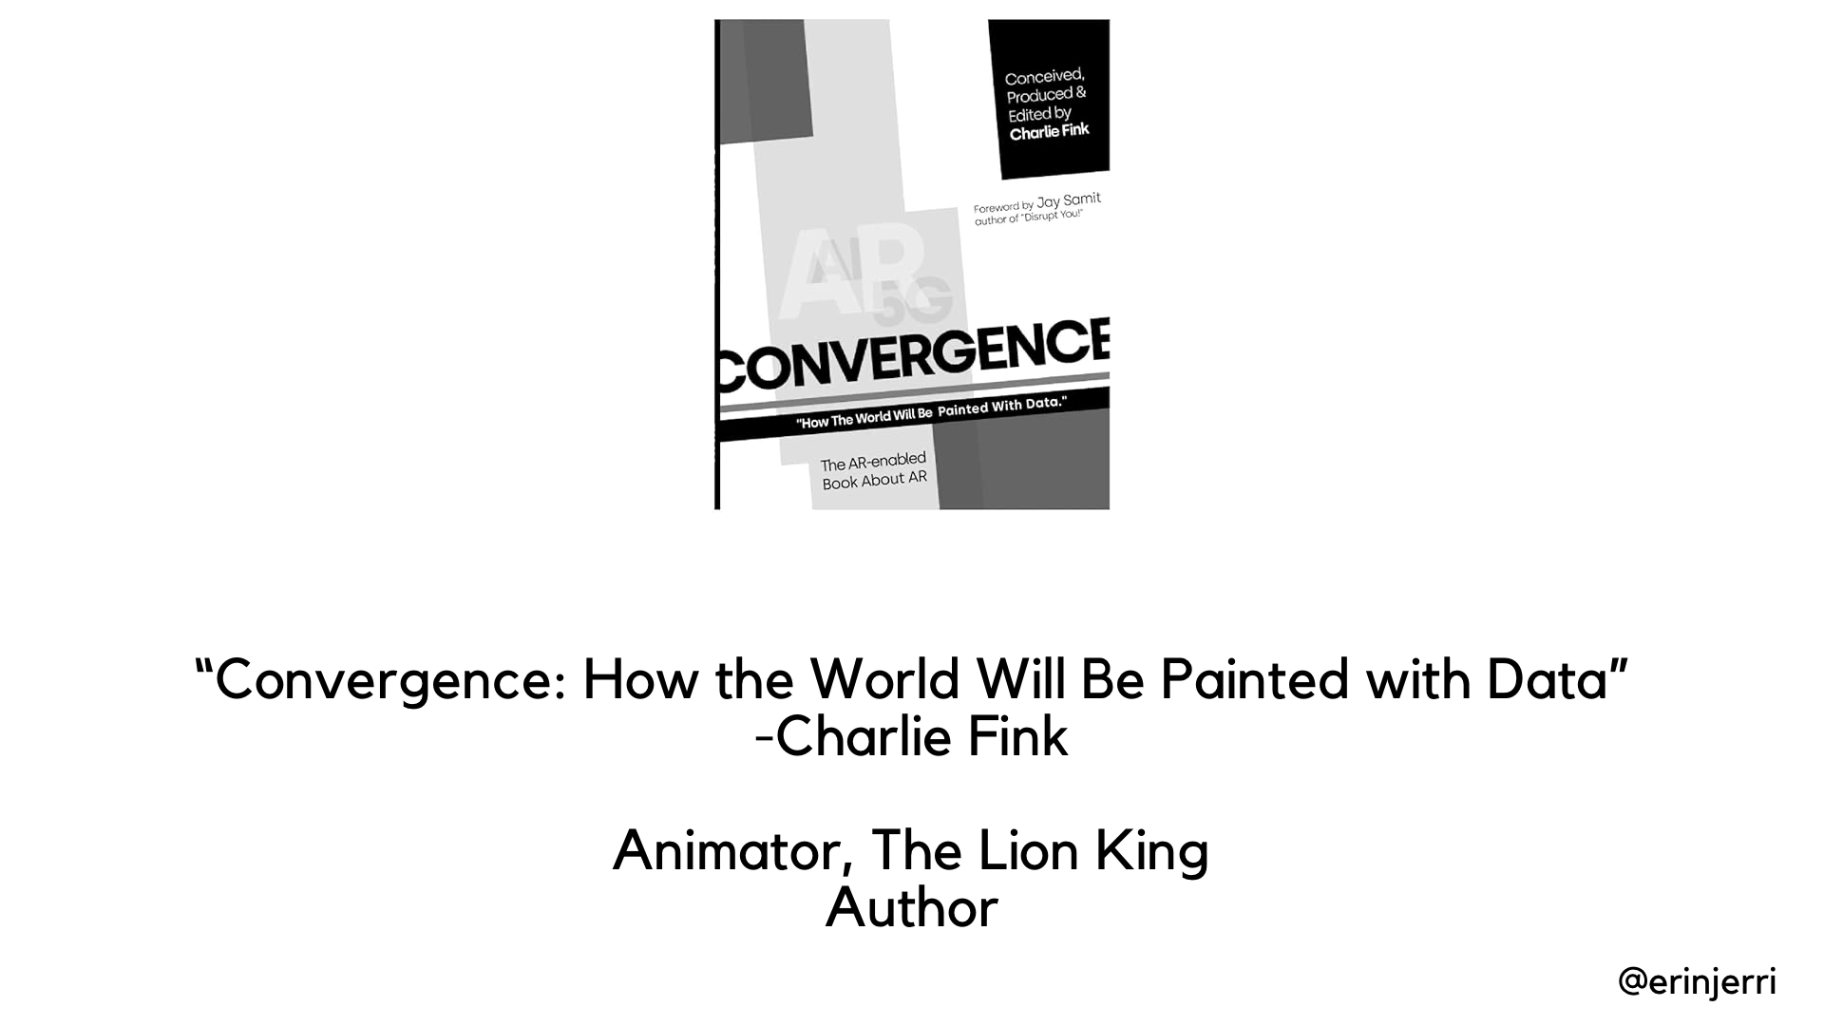
Notes:
AI further extends reality (SLAM/AR) - physical environment
AI extends the human body - physical body
GenAI expands human capability

Slide 32
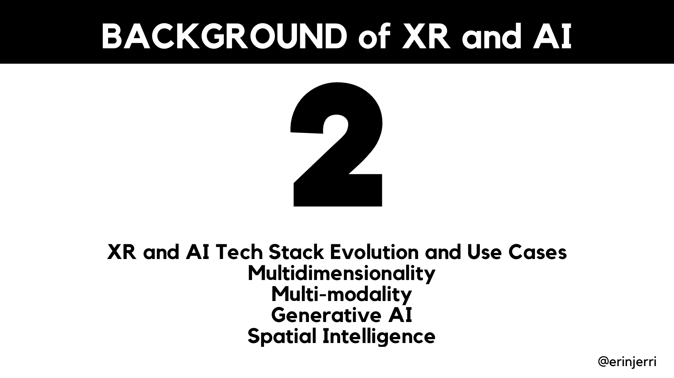
Notes:
AI further extends reality (SLAM/AR) - physical environment
AI extends the human body - physical body
GenAI expands human capability

Slide 33
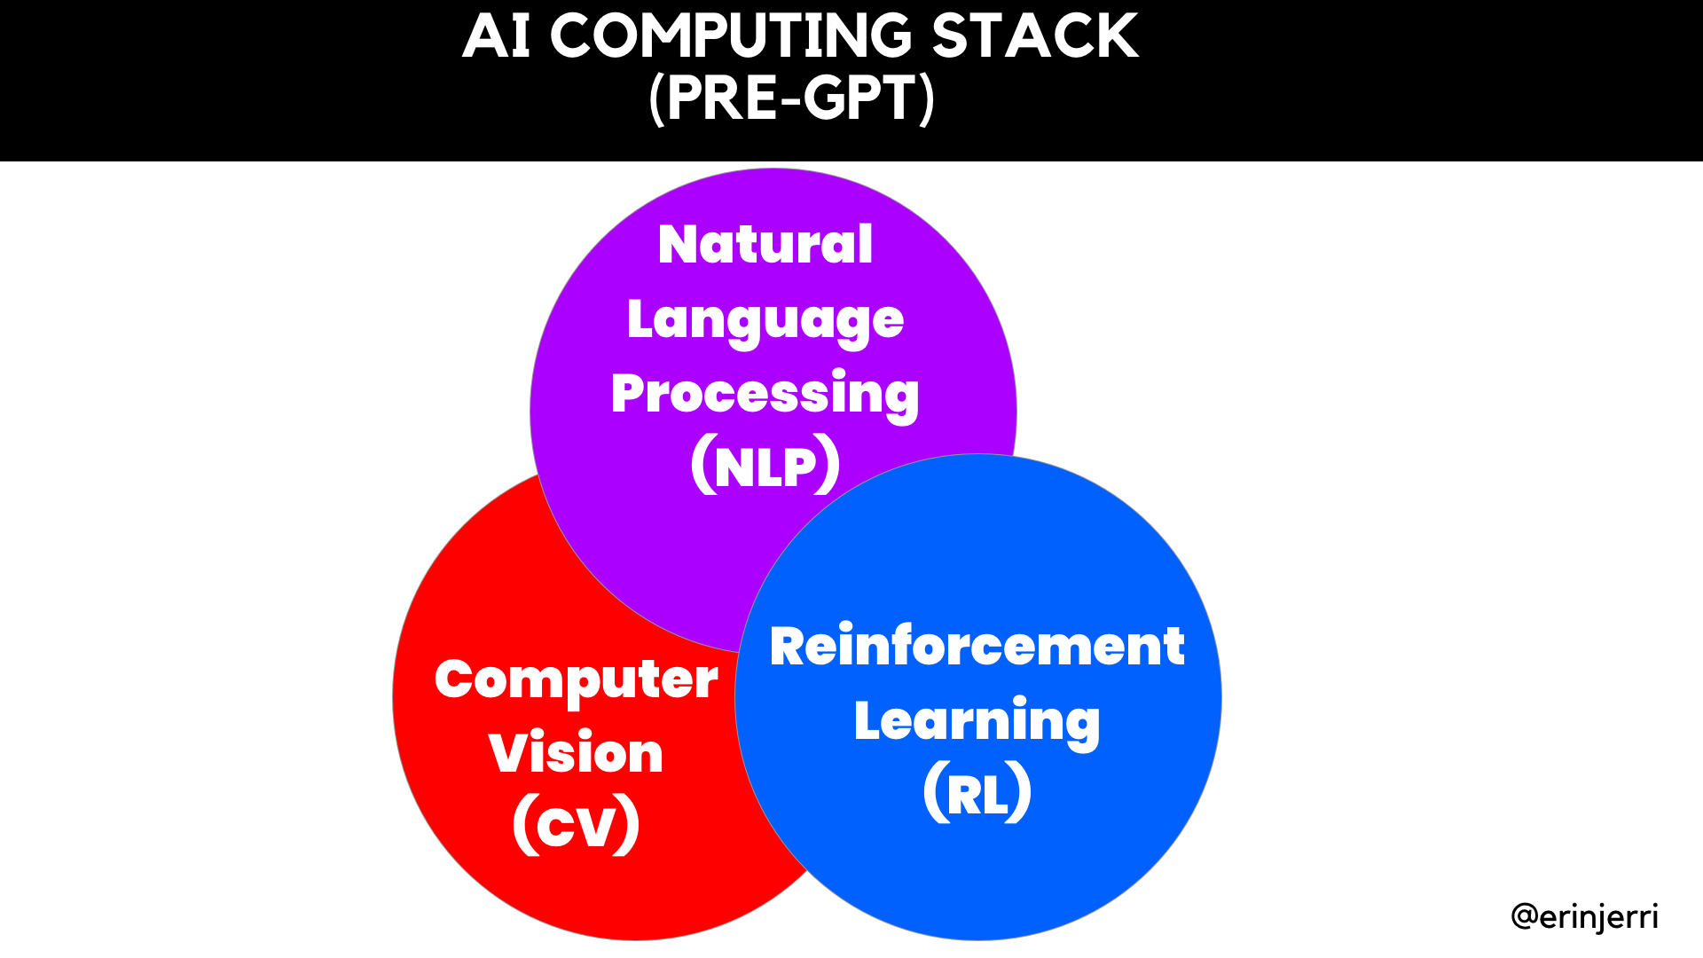
Notes:
AI further extends reality (SLAM/AR) - physical environment
AI extends the human body - physical body
GenAI expands human capability

Slide 34
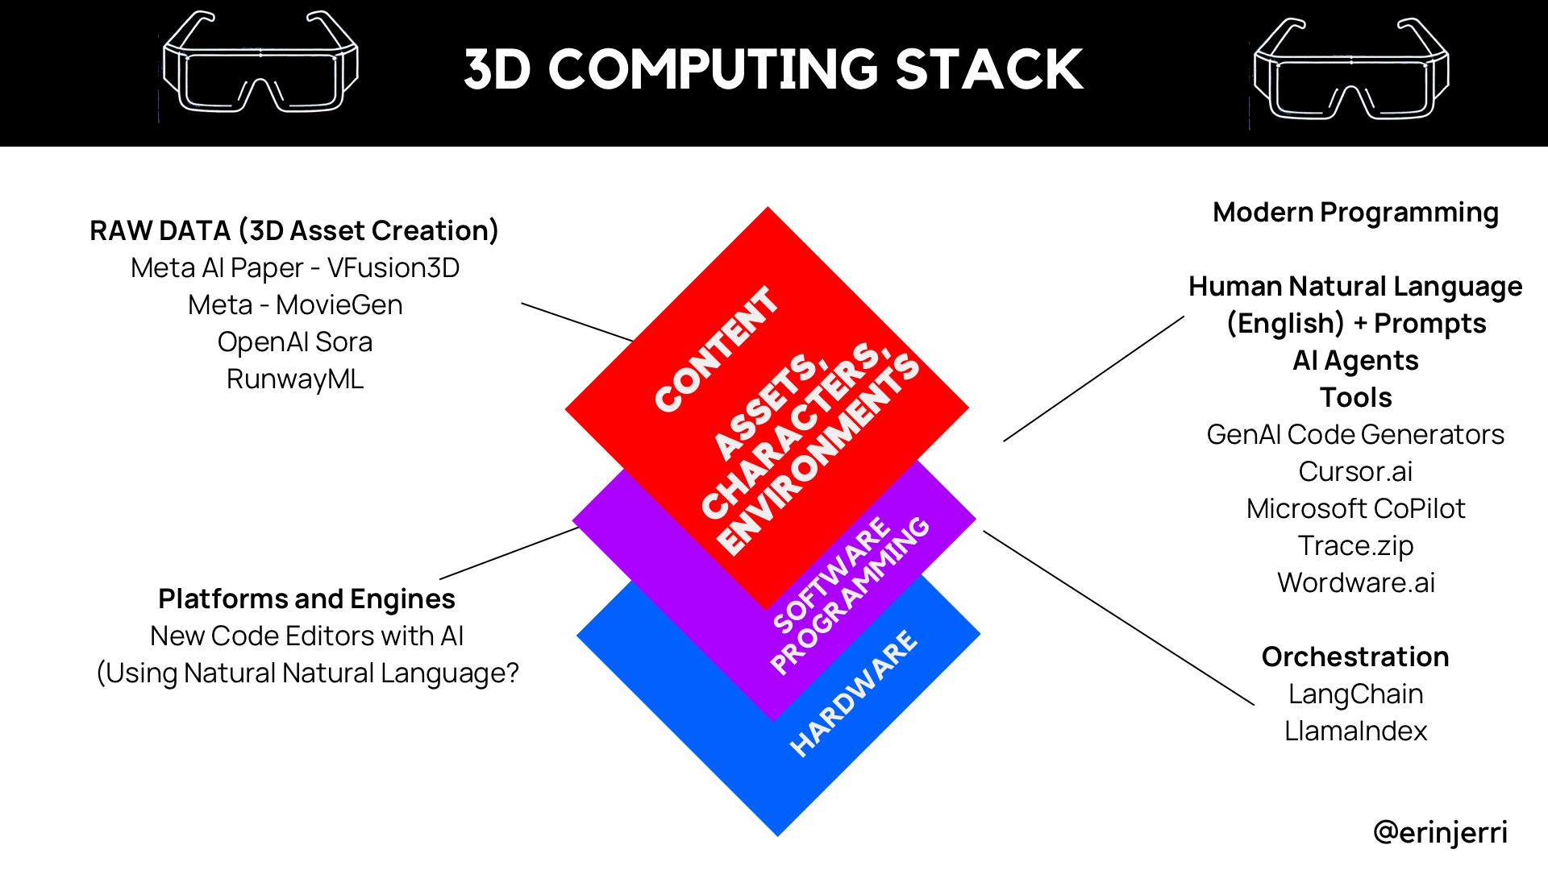
Notes:
AI further extends reality (SLAM/AR) - physical environment
AI extends the human body - physical body
GenAI expands human capability

Slide 35
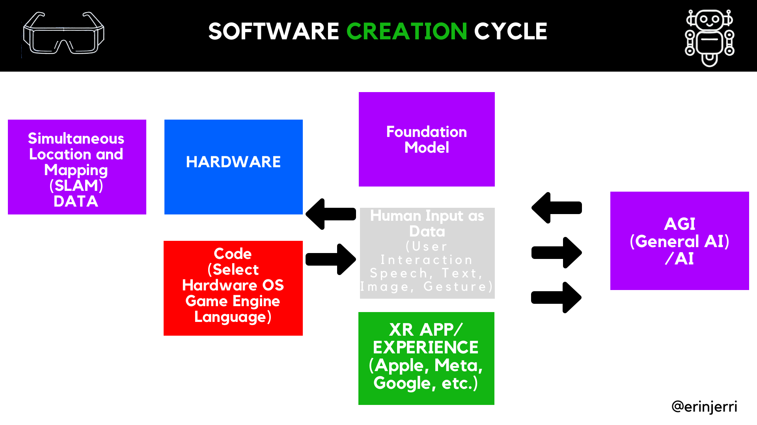
Notes:
AI further extends reality (SLAM/AR) - physical environment
AI extends the human body - physical body
GenAI expands human capability

Slide 36
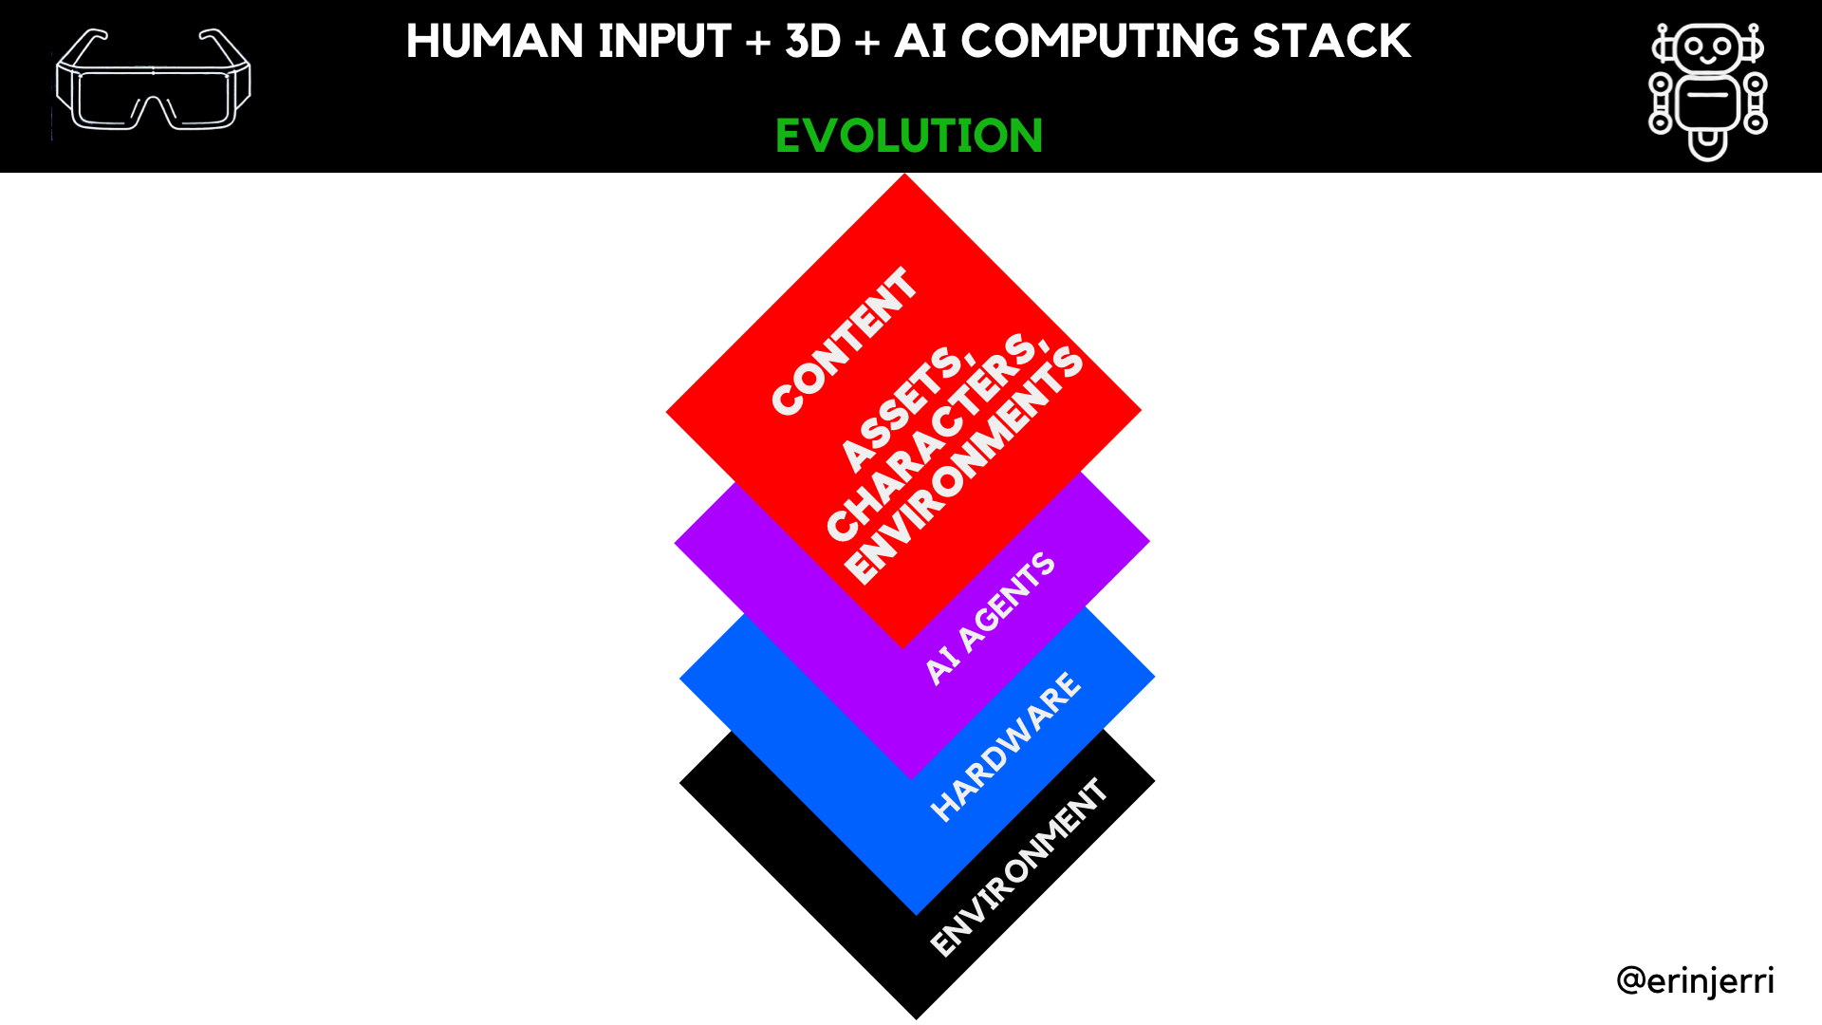

Slide 37
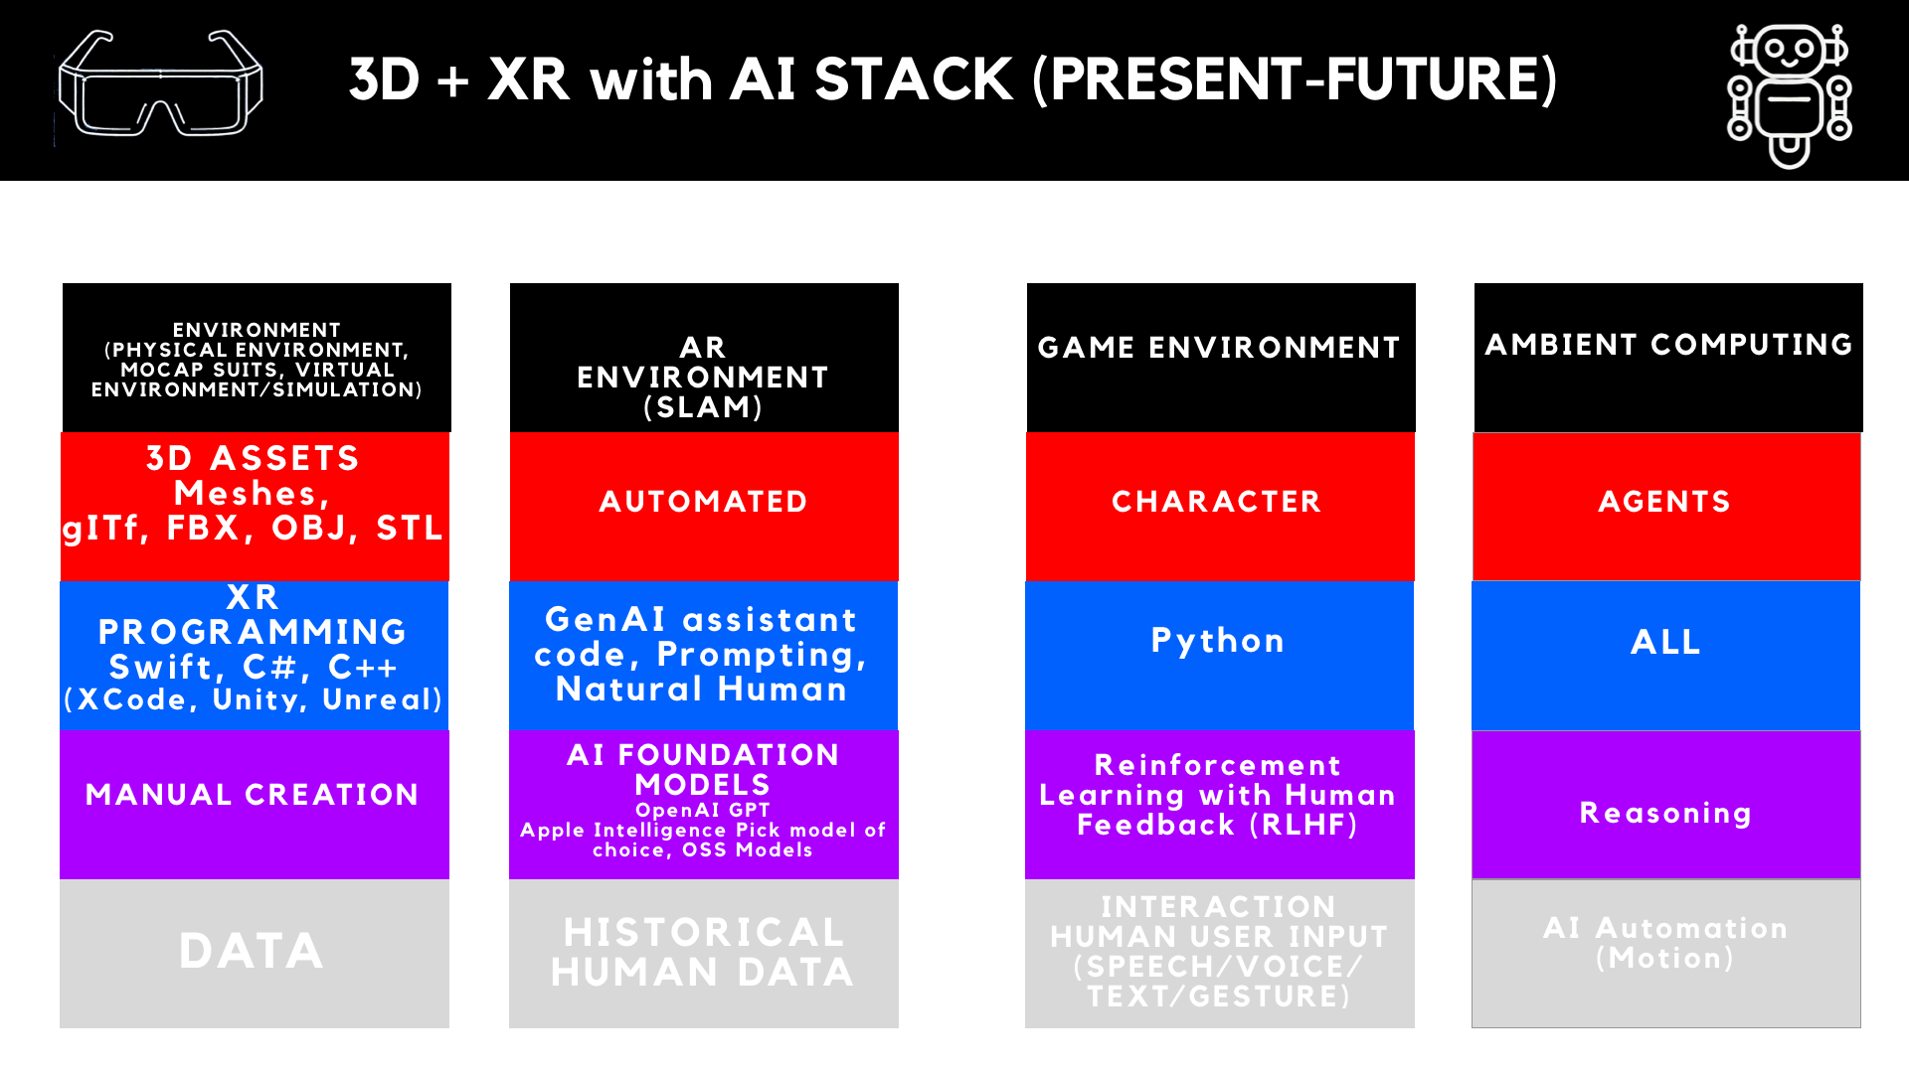
Notes:
AI further extends reality (SLAM/AR) - physical environment
AI extends the human body - physical body
GenAI expands human capability

Slide 38
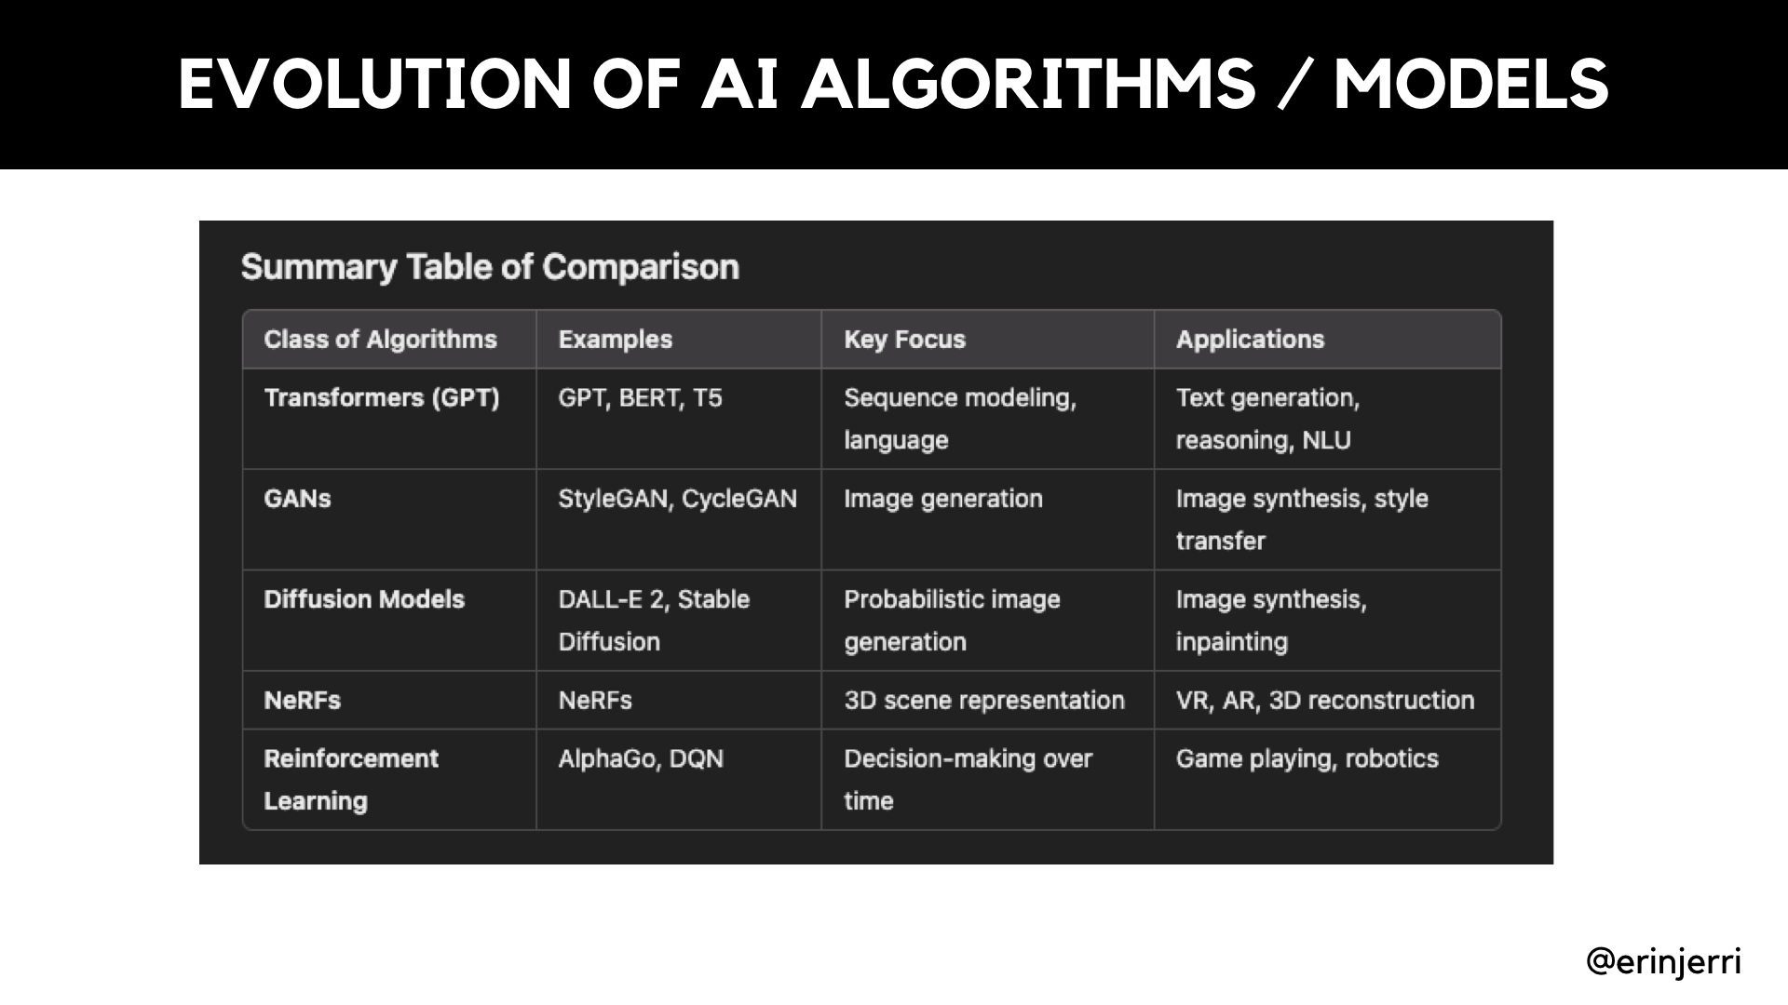
Notes:
AI further extends reality (SLAM/AR) - physical environment
AI extends the human body - physical body
GenAI expands human capability

Slide 39
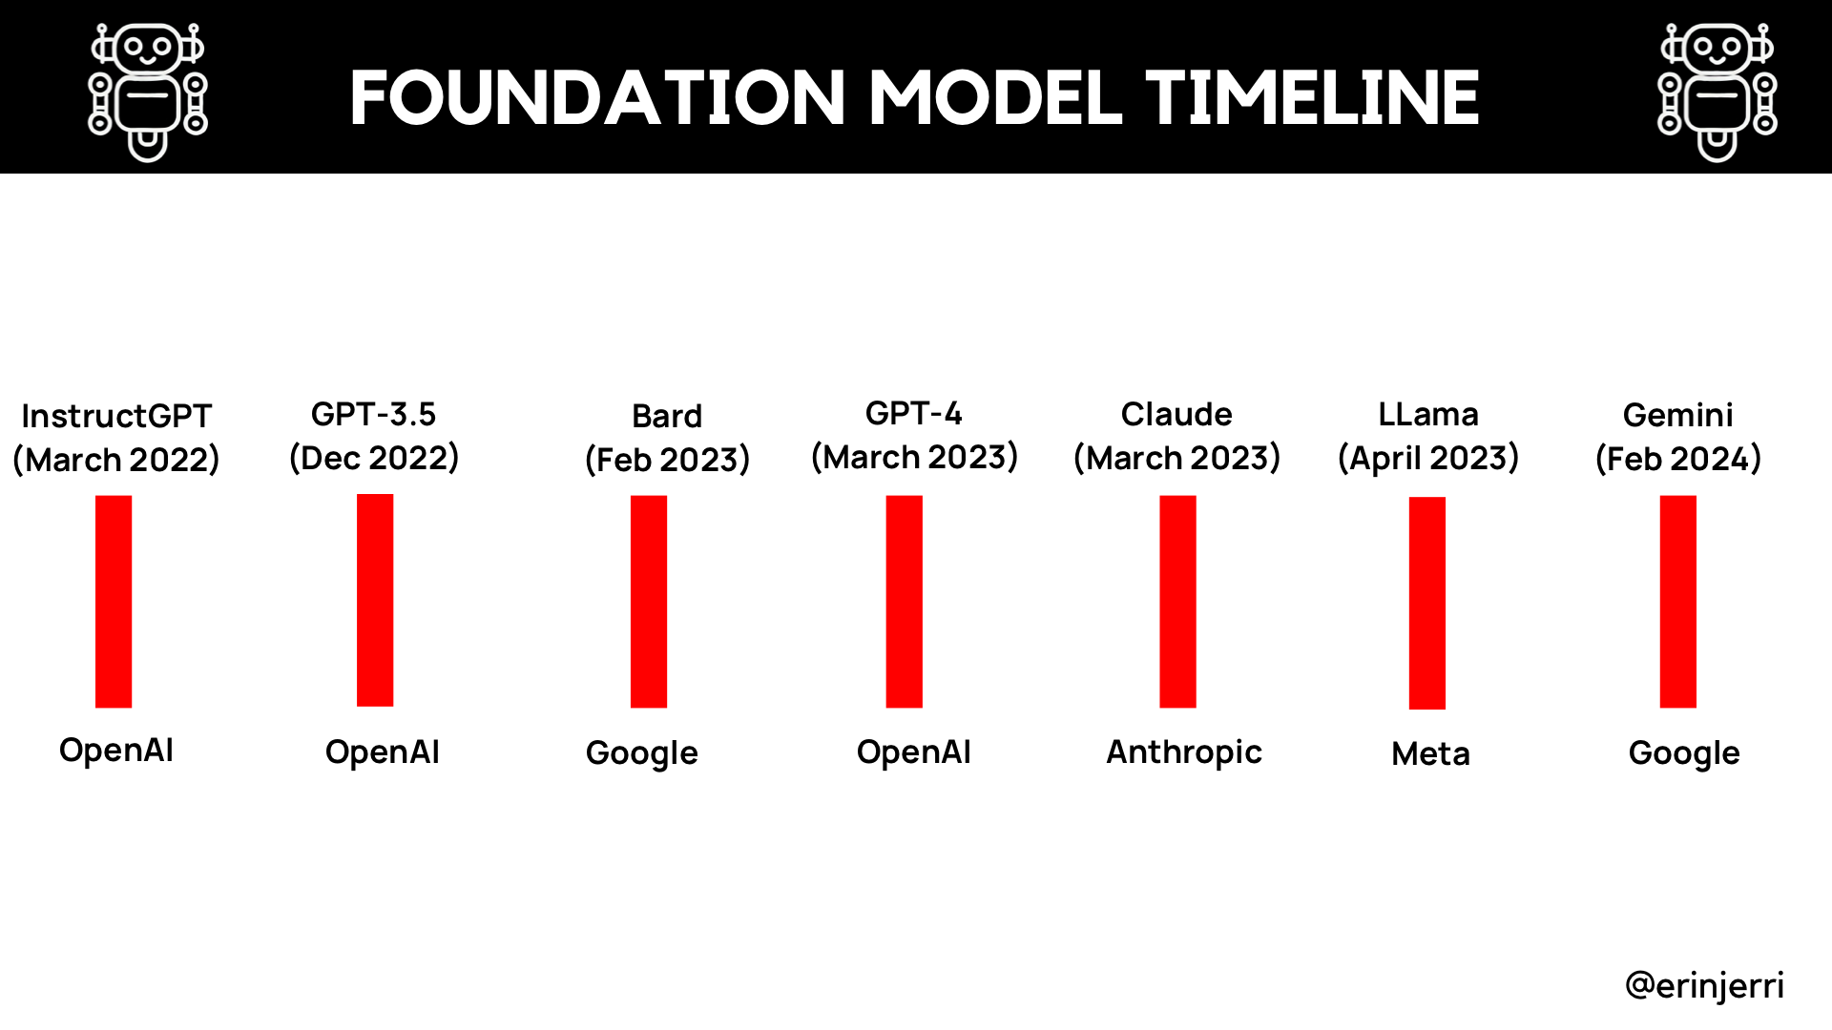
Notes:
Attention is All You Need - 1017
Releases by OpenAI
GPT 2
Google Bard

Slide 40
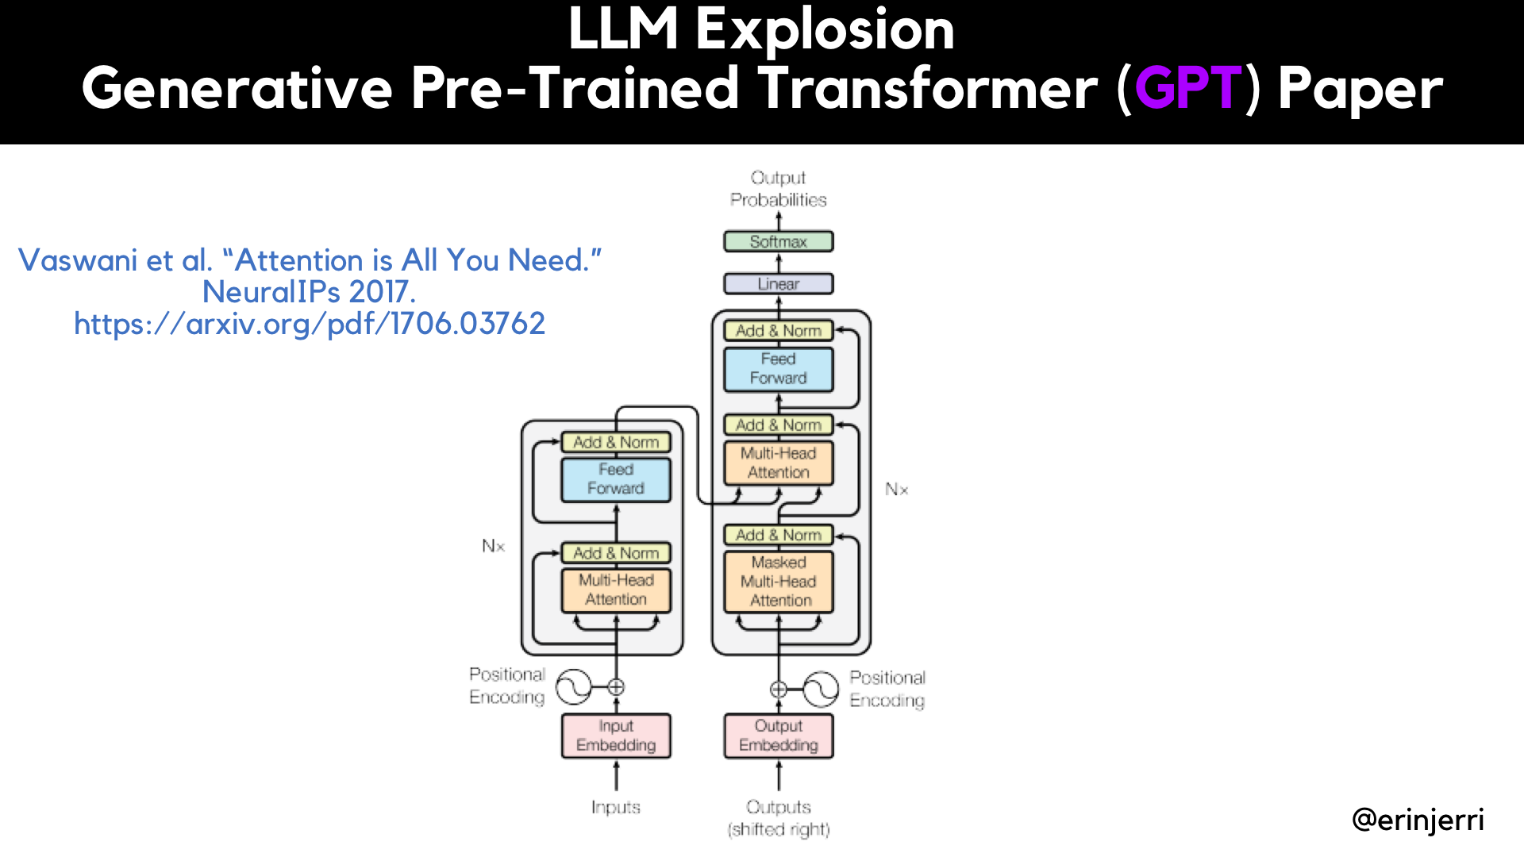
Notes:
AI further extends reality (SLAM/AR) - physical environment
AI extends the human body - physical body
GenAI expands human capability

Slide 41
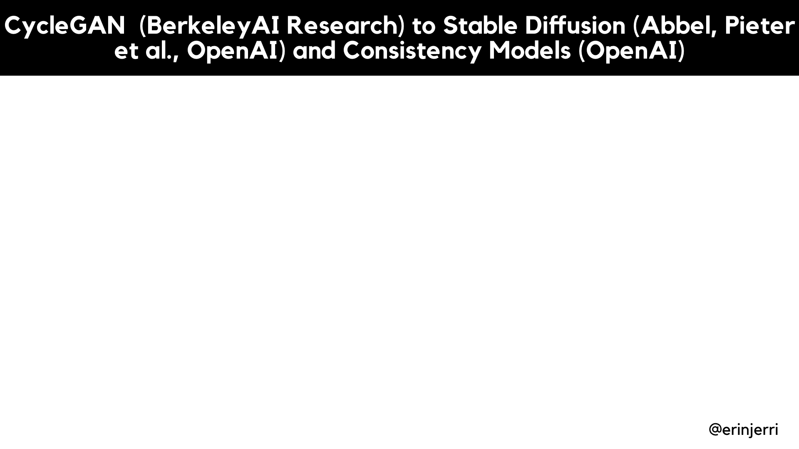
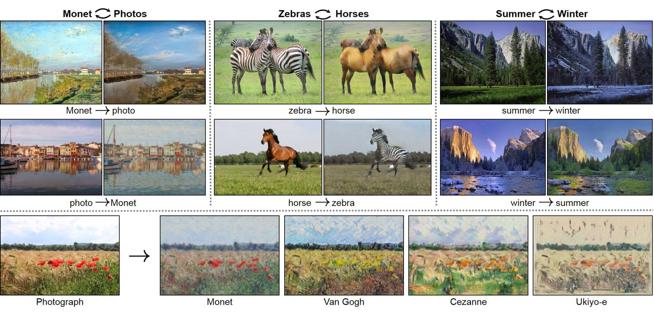
Notes:
AI further extends reality (SLAM/AR) - physical environment
AI extends the human body - physical body
GenAI expands human capability

Slide 42
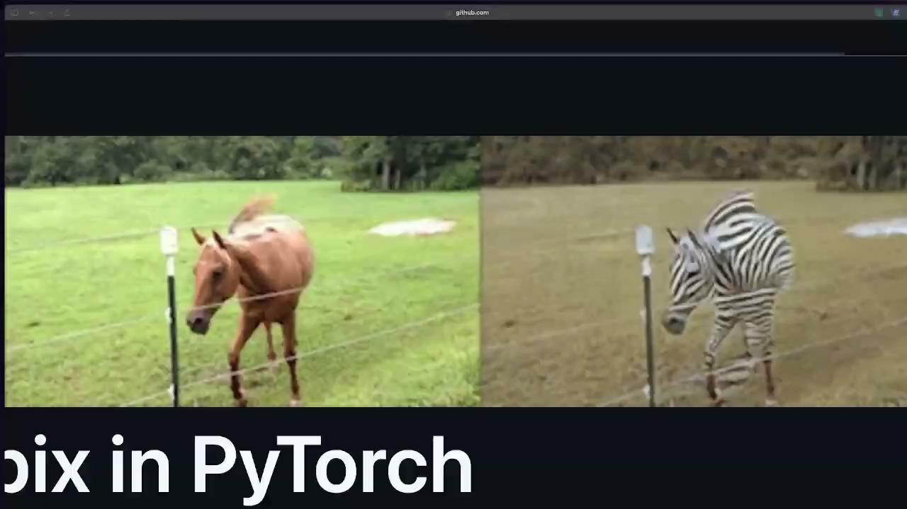
Notes:
AI further extends reality (SLAM/AR) - physical environment
AI extends the human body - physical body
GenAI expands human capability

Slide 43
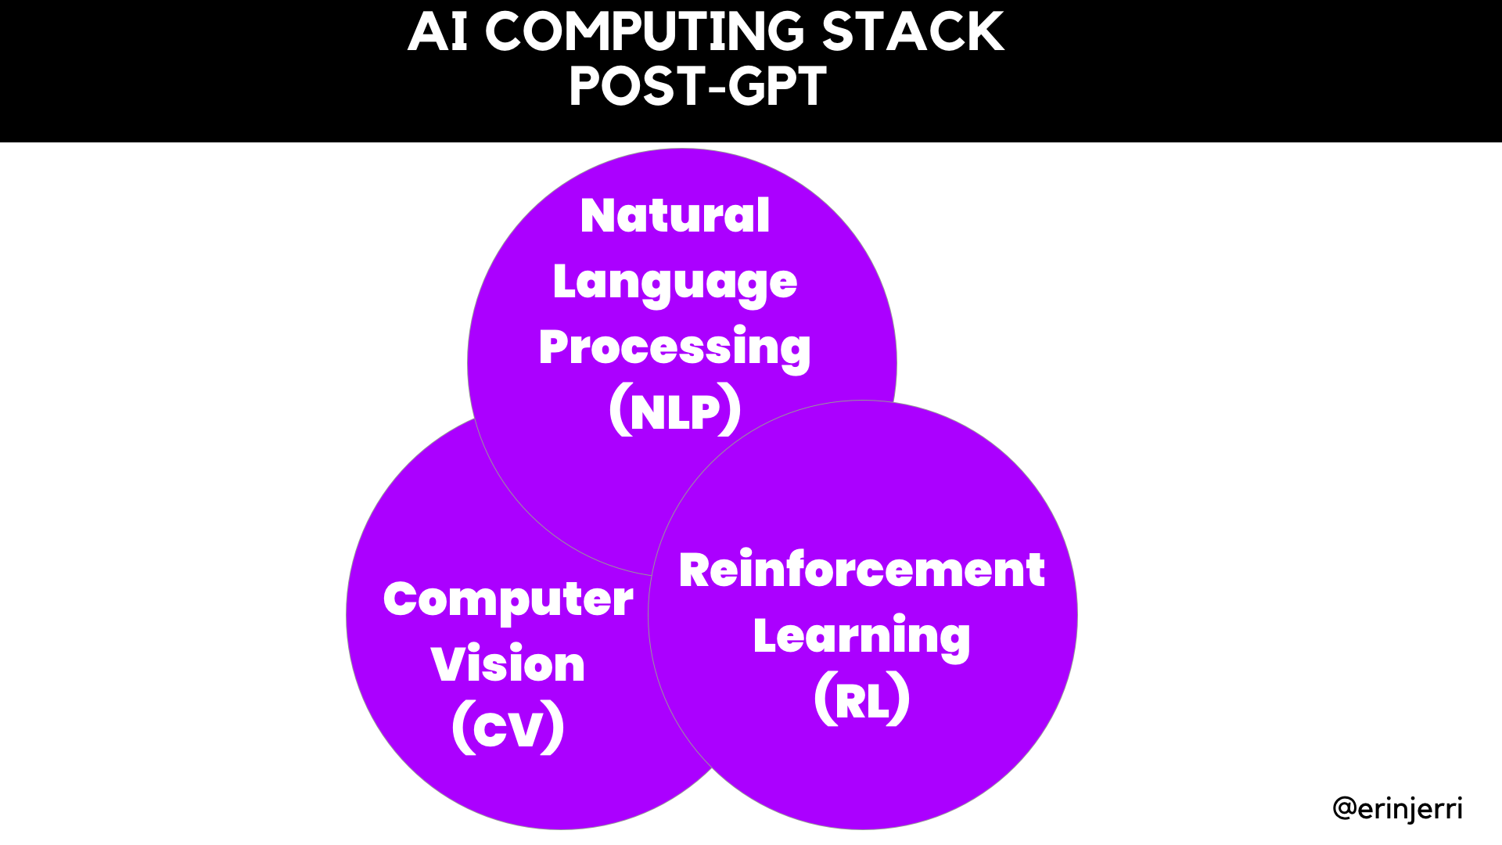
Notes:
AI further extends reality (SLAM/AR) - physical environment
AI extends the human body - physical body
GenAI expands human capability

Slide 44
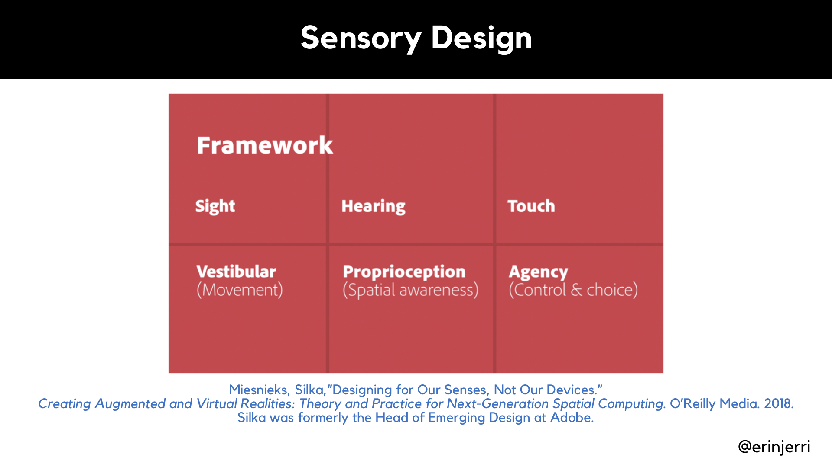
Notes:
Why Multidimensionality - Explain Dimensionality
2D
3D
Sensory Design - Silka

Slide 45
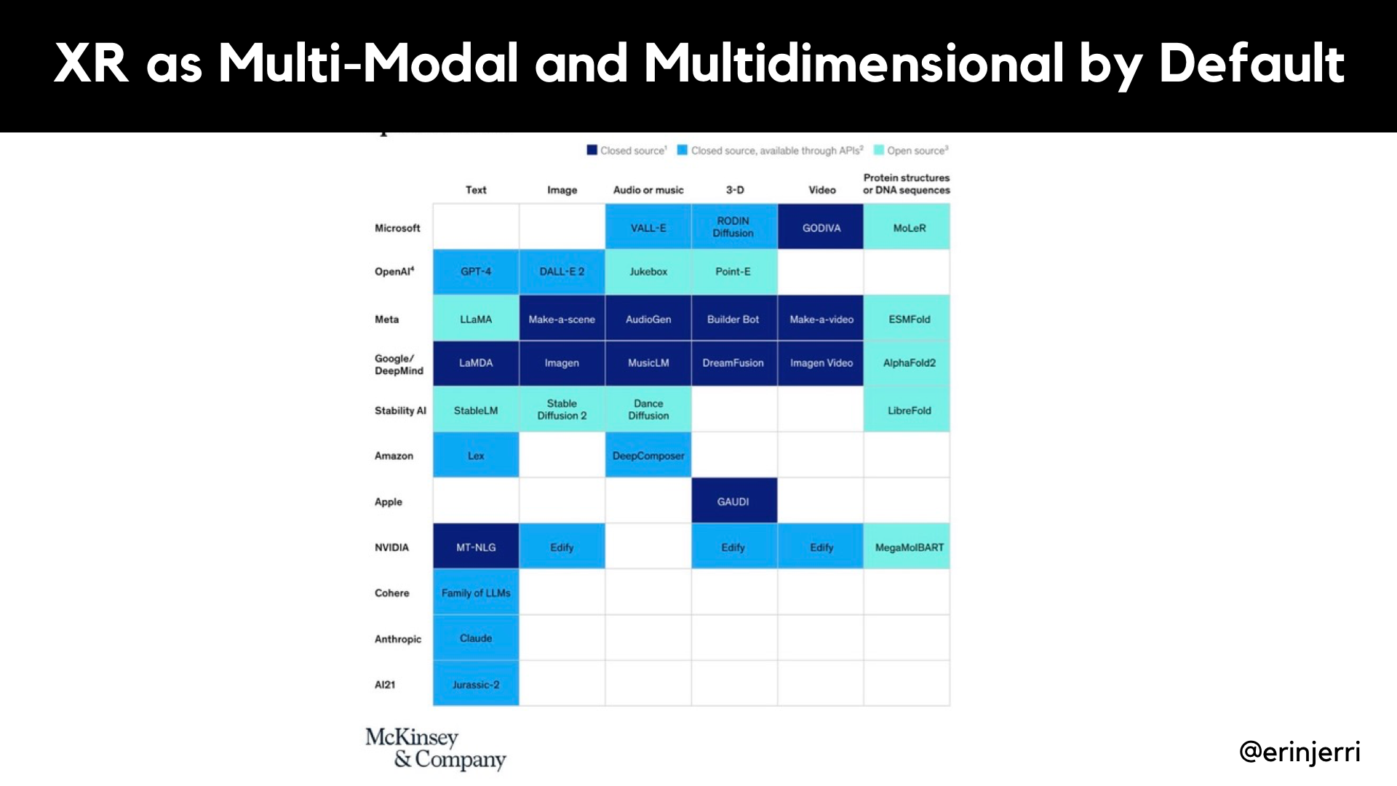
Notes:
Why Multidimensionality - Explain Dimensionality
2D
3D

Slide 46
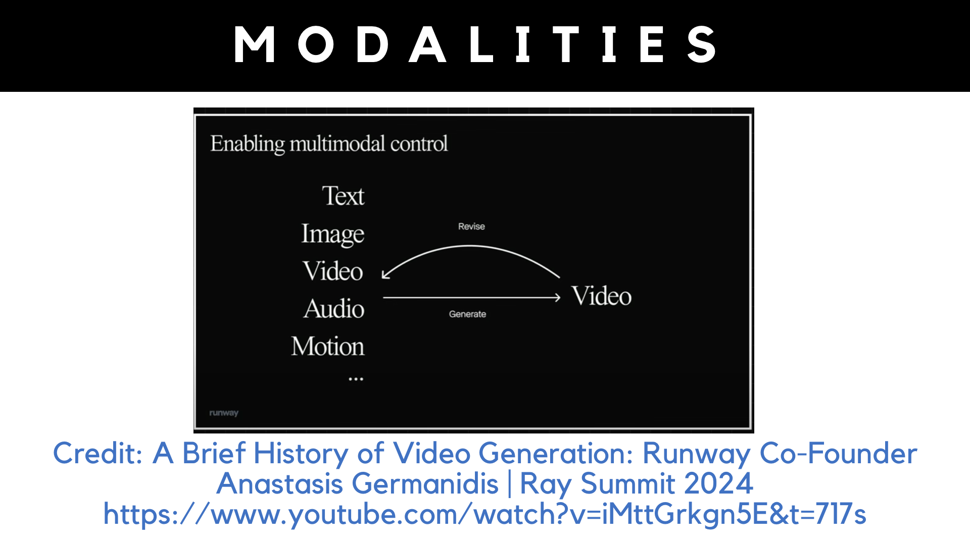

Slide 47
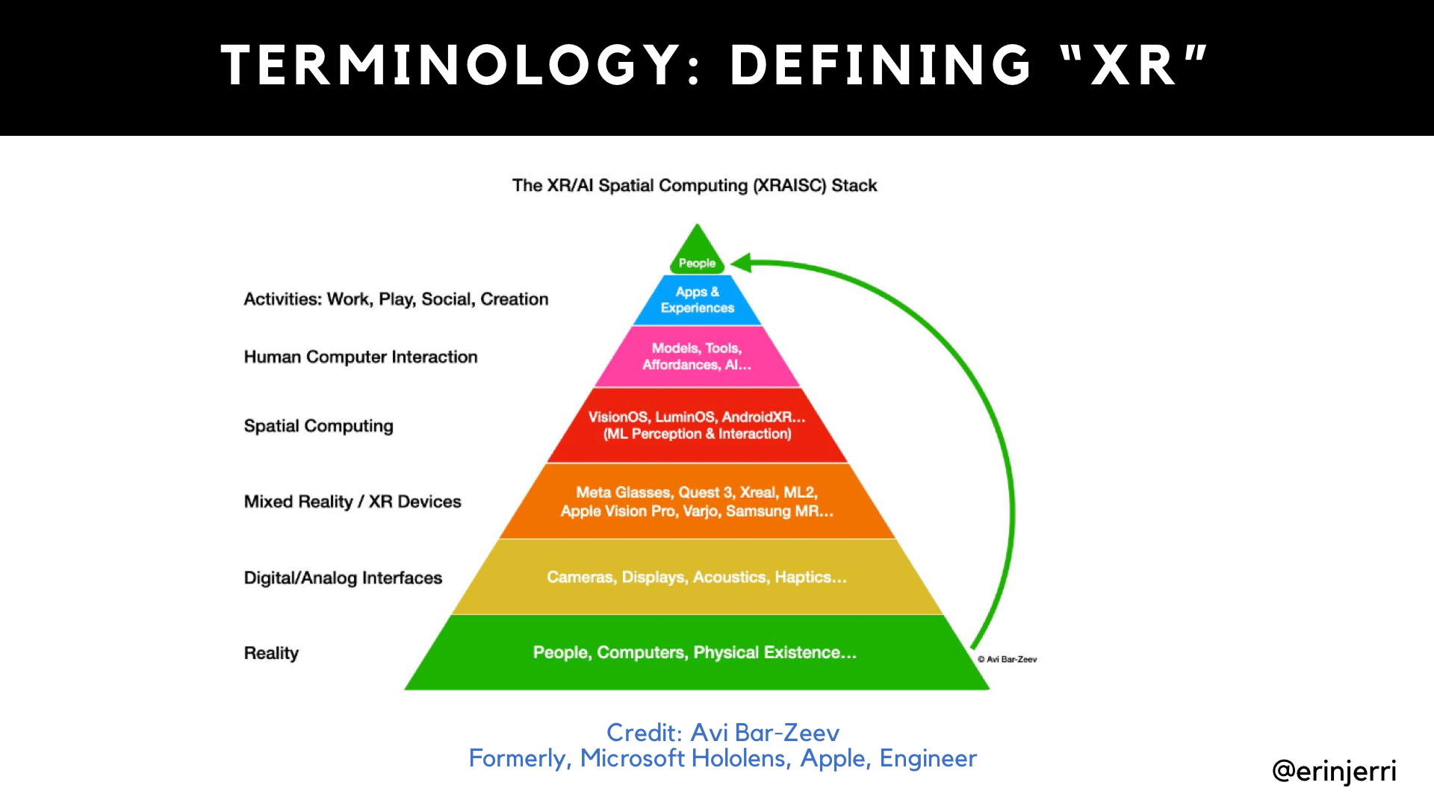

Slide 48
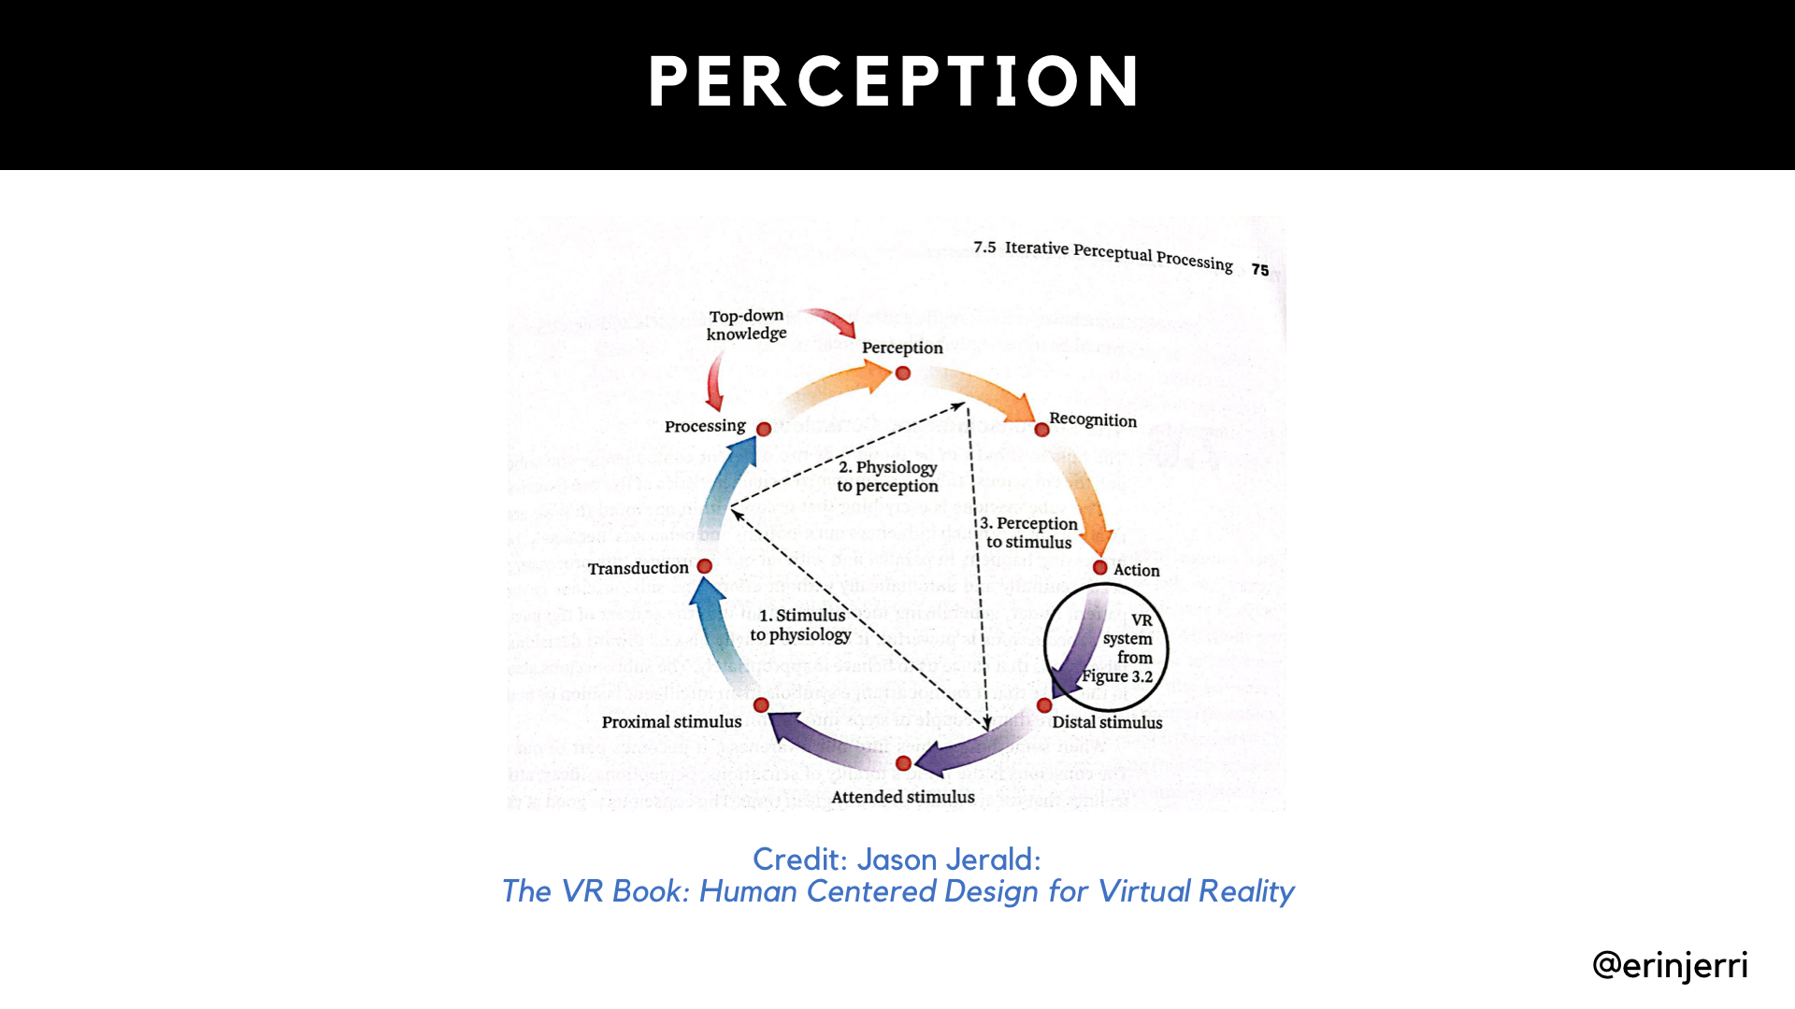
Notes:
Why Multidimensionality - Explain Dimensionality
2D
3D
Sensory Design - Silka

Slide 49
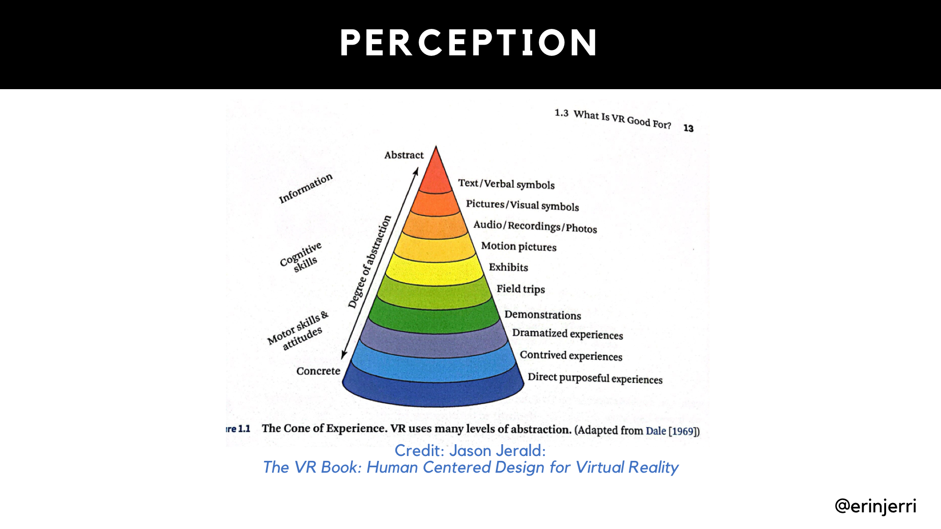
Notes:
Why Multidimensionality - Explain Dimensionality
2D
3D
Sensory Design - Silka

Slide 50


Slide 51

Notes:
Why Multidimensionality - Explain Dimensionality
2D
3D
Sensory Design - Silka

Slide 52

Notes:
Why Multidimensionality - Explain Dimensionality
2D
3D
Sensory Design - Silka

Slide 53

Notes:
AI Models
Explain Stable Diffusion and Style Transfer
Transformer Model
NeRFs
3D fit Model

Slide 54
Notes:
AI Models
Explain Stable Diffusion and Style Transfer
Transformer Model
NeRFs
3D fit Model

Slide 55

Notes:
AI Models
Explain Stable Diffusion and Style Transfer
Transformer Model
NeRFs
3D fit Model

Slide 56

Notes:
The future - capturing environment
Nvidia - Motion with Robotics - Embodied Intelligence
3D Model - Fei-Fei-Li
Meta, Apple, Google
Humans augmented with and blurring of reality/environment with technology

Slide 57
ASSETS AND ENVIRONMENT
GENERATION

Slide 58


Slide 59



Slide 60

Runway at Ray Summit 2024

Slide 61

Remix’s Teleporter Device
https://remix.ing/product
Notes:
(so instead of glasses, another physical device to scan your environment and let others directly manipulate the environment in Apple Vision Pro)

Slide 62
CHARACTERS, AVATARS, AND AGENTS

Slide 63


Notes:
Erin is still adding images/assets to this slide

Slide 64


Notes:
Meta VFusion3D, LumaLabs

Slide 65


Slide 66
Code Generation

Slide 67


Notes:
Erin is still adding images/assets to this slide

Slide 68

Notes:
Erin is still adding images/assets to this slide

Slide 69

Notes:
Erin is still adding images/assets to this slide

Slide 70
AUTOMATION

Slide 71

Notes:
AI Models
Explain Stable Diffusion and Style Transfer
Transformer Model
NeRFs
3D fit Model

Slide 72

Notes:
AI Models
Explain Stable Diffusion and Style Transfer
Transformer Model
NeRFs
3D fit Model

Slide 73
THE LAST FRONTIER: MOTION AND REASONING
Notes:
Modalities
text/speech to image/video/asset/motion/environment
Nvidia motor skills - talk from Jim Fan (UCB LLM Agent)

Slide 74

Notes:
AI further extends reality (SLAM/AR) - physical environment
AI extends the human body - physical body
GenAI expands human capability

Slide 75


Slide 76


Slide 77
Practical Tools

Slide 78


Slide 79


Slide 80
Philosophies

Slide 81



Slide 82


Slide 83


Slide 84


Slide 85


Slide 86
You have agency.

Slide 87

Stanford Cypher Policy Center
https://hai.stanford.edu/sites/default/files/2024-02/White-Paper-Rethinking-Privacy-AI-Era.pdf
Stanford Human-Centered Artificial Intelligence
https://hai.stanford.edu/
Markula Center for Applied Ethics
https://www.scu.edu/ethics/
Fast.ai Data Ethics (2020)
https://ethics.fast.ai/
Notes:
AI further extends reality (SLAM/AR) - physical environment
AI extends the human body - physical body
GenAI expands human capability

Slide 88

Thank you!
Follow me
@erinjerri

Slide 89
REFERENCES

Slide 90
Bar-Zeev, Avi. “The XR/AI Spatial Computing Stack” 2024 April. https://www.linkedin.com/posts/avi-bar-zeev_here-are-some-slides-extracted-from-my-most-activity-7178850819117604866-9vBN?utm_source=share&utm_medium=member_desktop
Barraza, Erika. “Univision students with Creating AR VR Book.” 3 March 2023.
Bye, Kent. “Privacy Pitfalls of Contextually-Aware AI: Sensemaking Frameworks for Context and XR Data Qualities.” Stanford Cyber Policy Center “Existing Law and Extended Reality: An Edited Volume of The 2023 Symposium Proceedings.” 2024 October.
https://fsi.stanford.edu/publication/existing-law-and-extended-reality
Bye, Kent. “Philosophical Frameworks for the Metaverse.” Stanford Cyber Policy Center. “https://www.youtube.com/watch?v=LzpbyRQ_GT4&t=919s
Fan, Jim. UC Berkeley LLM Agents Course Berkeley RDI Center on Decentralization & AI. https://www.youtube.com/watch?v=Qhxr0uVT2zs&t=2284s 4 Nov 2024.
Fink, Charlie. Convergence: The World Wil Be Painted with Data.” Convergence Press. 9 June 2019. https://www.amazon.com/Convergence-World-Will-Painted-Data-ebook/dp/B07SX5HXXW
Gallagher, Tim. “Towards Design Guidelines for VR Training for the Chemical Industry.” Education for Chemical Engineers. 2021 Feb. https://www.researchgate.net/publication/349077963_Towards_Design_Guidelines_for_Virtual_Reality_Training_for_the_Chemical_Industry
Germanisdis, Anastasis. “A Brief History of Video Generation: Runway Co-founder Anastasis Germanidis | Ray Summit 2024. https://www.youtube.com/watch?v=iMttGrkgn5E&t=1105s
Han et al. “VFusion3D: Learning Scalable 3D Generative Models from Video Diffusion Models.” ECCV 2024. https://junlinhan.github.io/projects/vfusion3d.html
Video from Twitter: https://x.com/Gradio/status/1821944006730723482
Huang, Jensen. Nvidia Graphics Processing Unit (GPU) Tech Conference (GTC) Keynote March 2024. 18 March 2024. https://www.youtube.com/watch?v=Y2F8yisiS6E
Jerald, Jason. The VR Book: Human Centered Design for Virtual Reality. ACM. 2015.
Juliani, Arthur “AI Accelerationism is a Humanism Imagining a Future Without Computers” 2024, July 10. https://awjuliani.medium.com/ai-accelerationism-is-a-humanism-15e24c65810d
Li, Fei-Fei. “With spatial intelligence, AI will understand the real world” TED. 2024 April. https://www.ted.com/talks/fei_fei_li_with_spatial_intelligence_ai_will_understand_the_real_world
Liang Percy. “ UC Berkeley, LLM Agents. Lecture 10.” 2024 November 18. https://www.youtube.com/watch?v=f3KKx9LWntQ&t=293s

Slide 91
REFERENCES (CONTINUED)
Mildenhall, Ben et al., “NeRF: Representing Scenes as Neural Radiance Fields for View Synthesis” CVPR 2020. https://arxiv.org/abs/2003.08934
Nvidia. “NVIDIA & Inworld AI demo on-device capabilities for AI agents in video games”
https://www.youtube.com/watch?v=e6UF6j9LwZ0 2024 June 2.
Marsh, Jason. “Better Understanding.” Flow Immersive. https://flowimmersive.com/ 13 Nov 2024.
McKinsey and Company. Exploring opportunities in the generative AI value chain. 26 April 2023. https://www.mckinsey.com/capabilities/quantumblack/our-insights/exploring-opportunities-in-the-generative-ai-value-chain?cid=other-soc----oth---&sid=soc-POST_ID&linkId=217287944
Milgram and Kishino. “Augmented Reality: A class of displays on the reality-virtuality continuum.” SPIE: Telemanipulator and Telepresence Technologies v2341. 1994.
Miesnieks, Silka,”Designing for Our Senses, Not Our Devices.” Creating Augmented and Virtual Realities: Theory and Practice for Next-Generation Spatial Computing. O’Reilly Media. 2018.
Pangilinan, Erin. “Data and Machine Learning Visualization Development and Design in XR.” Creating Augmented and Virtual Realities: Theory and Practice for Next-Generation Spatial Computing. O’Reilly Media. 2018.
Pangilinan, Erin. “Filipinos at Facebook/Meta and FASTER at Rising Together: Filipinos in Tech.” 16 October 2019.
Pangilinan, Erin. “Erin and Fei-Fei Li at Fei-Fei Li in Conversation with John Hennessy on Her New Book: The Worlds I See.” 8 November 2023.
Pangilinan, Erin. “Meta Connect.” September 28 2024.
Pease, Steven. Vision Dev Camp. 30 March 2024.
Roberts, Jasmine. Microsoft Research. “Full Stack Developer: Augmented and Virtual Reality.” 23 November 2021. https://www.instagram.com/p/CWn0SiHJXJN0D257ohoasBMnUbCcw97aYuR-ZU0/
Samung Galaxy. “Samsung Galaxy Unpacked July 2024: Official Replay. “ 10 July 20924.. https://www.youtube.com/live/DzjsdYZQ7ns?t=7612s
To, Meng. Dream editor with Claude. 23 Aug 2024. https://x.com/MengTo/status/1826955943311241611
To, Meng. 31 Aug 2024. Claude’s Three.js site https://x.com/MengTo/status/1830122851028123911
Zhu, Jun-Yan et al, Berkeley AI Research (BAIR).“ Unpaired Image-to-Image Translation using Cycle-Consistent Adversarial Networks” Pix2Pix. 4 Aug 2020.. https://github.com/junyanz/pytorch-CycleGAN-and-pix2pix

