Slide 1
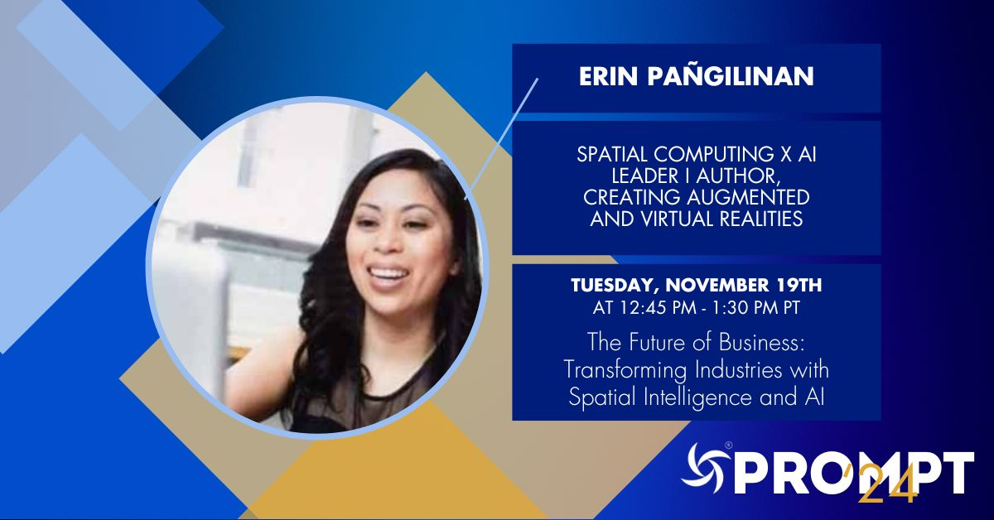

Slide 2
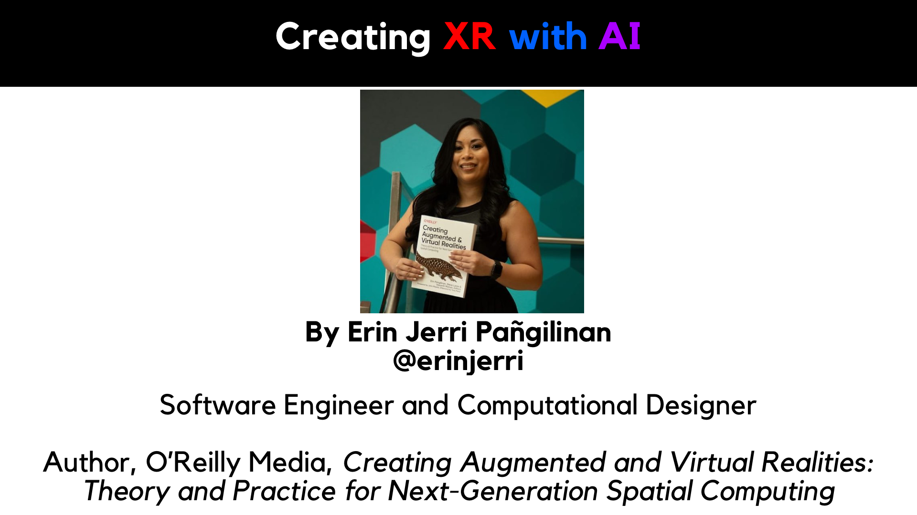

Slide 3
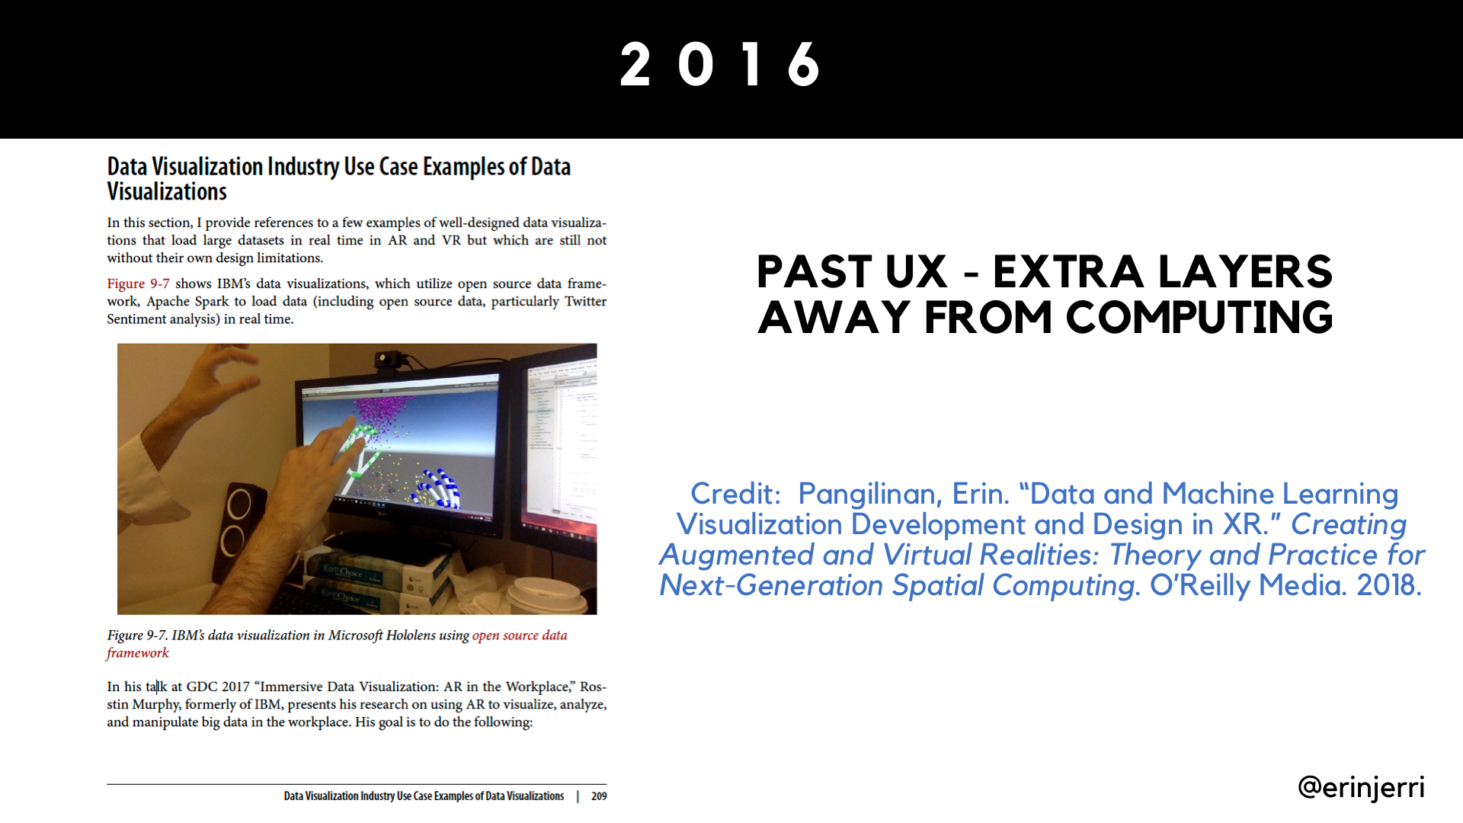
Notes:
VR to ER, Rosstin Murphy example at IBM, in order to view Jupyter Notebook in Python, it requires needing to remove Microsoft Hololens

Slide 4
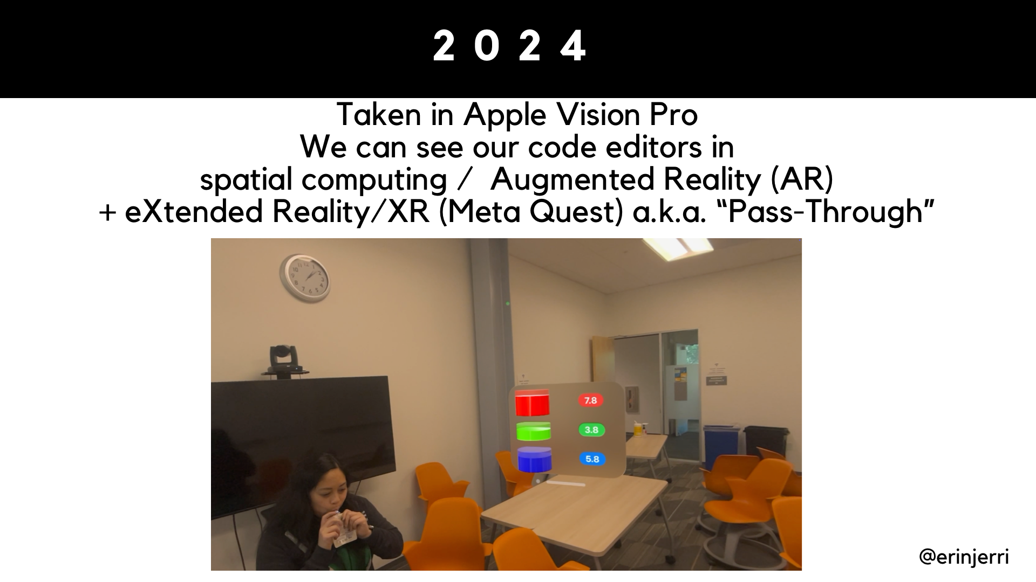

Slide 5
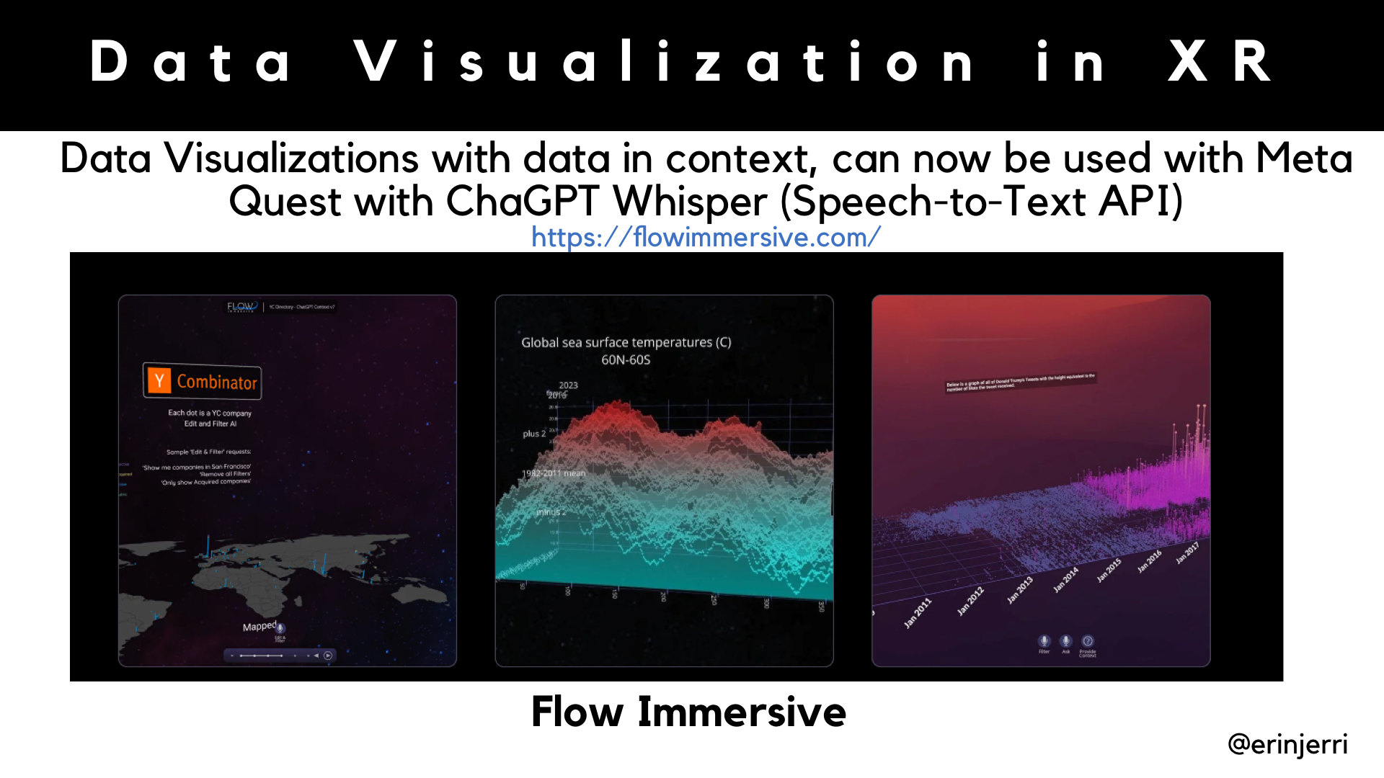

Slide 6
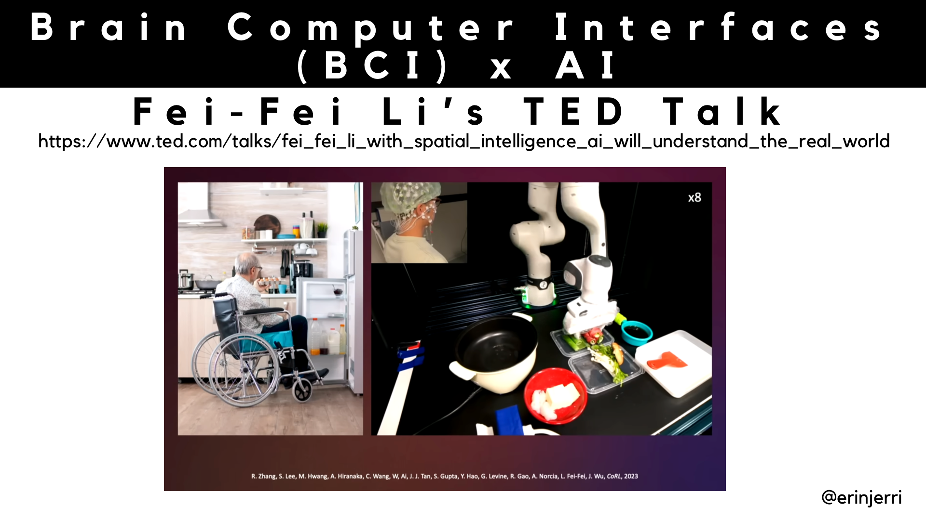
Notes:
Fei-Fei Li - World Labs - TED Talk Patient with ALS being able to utilize non-invasive BCI (EEG cap) with AI to control making a meal with robot hands

Slide 7
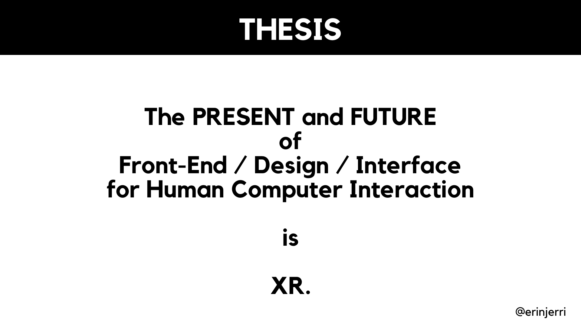

Slide 8
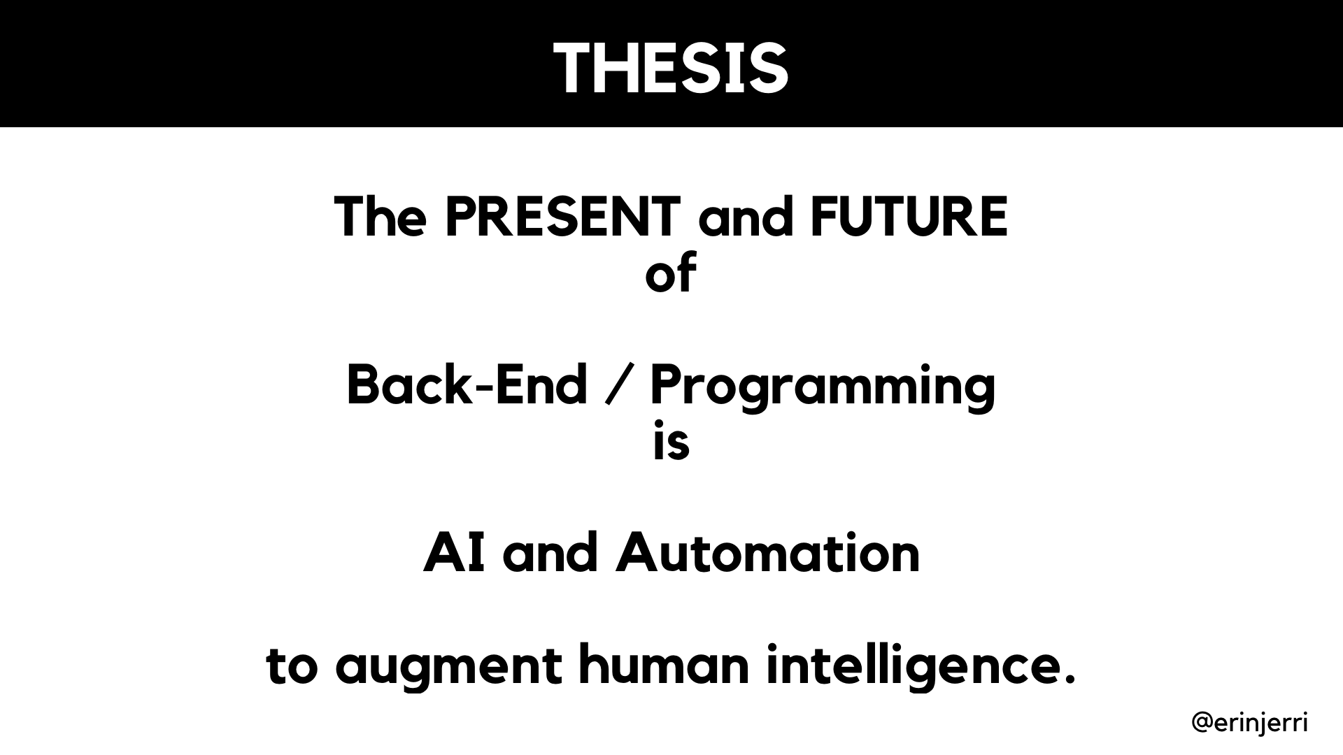

Slide 9
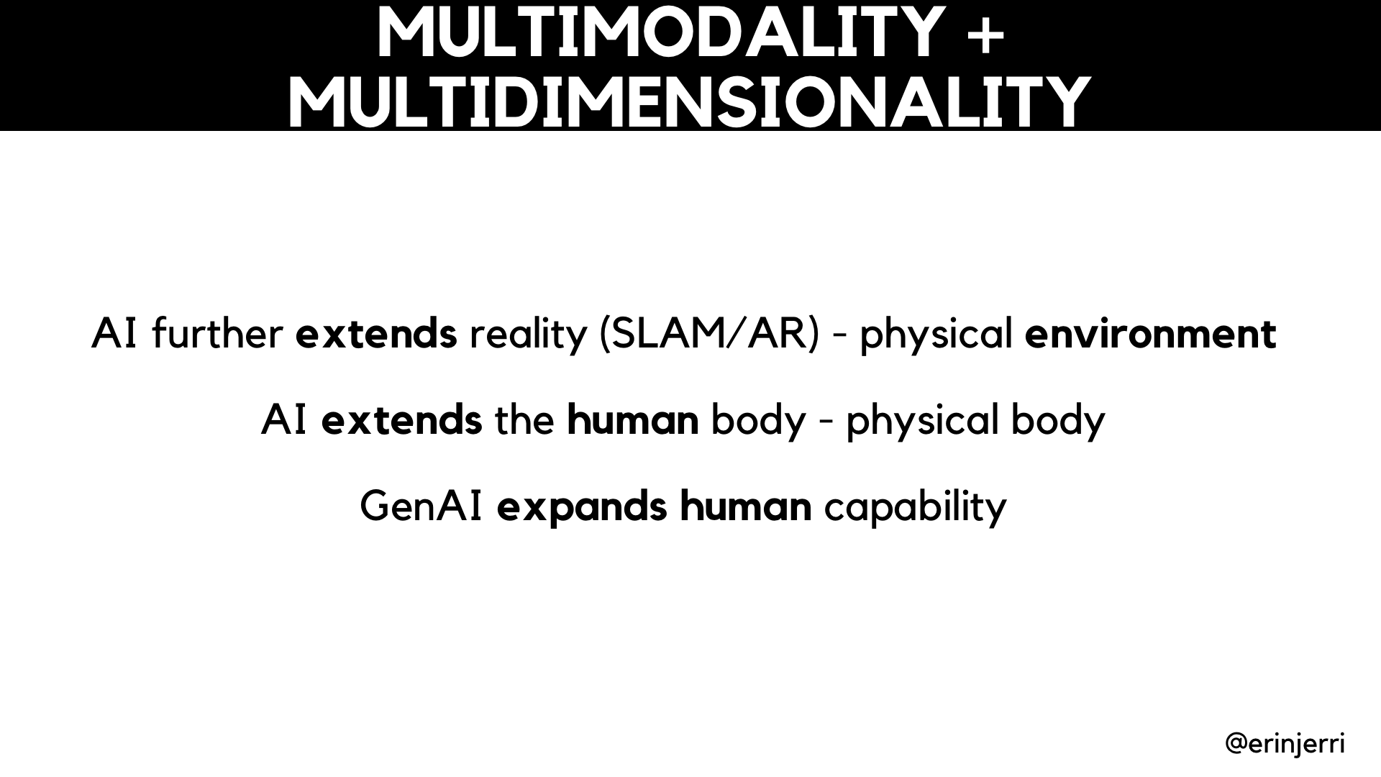

Slide 10
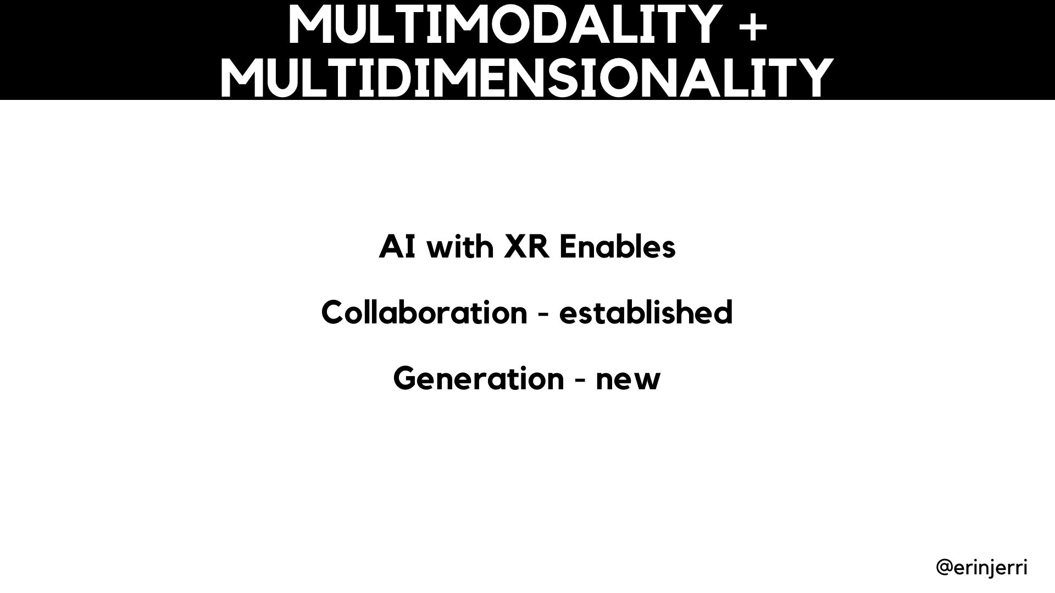

Slide 11
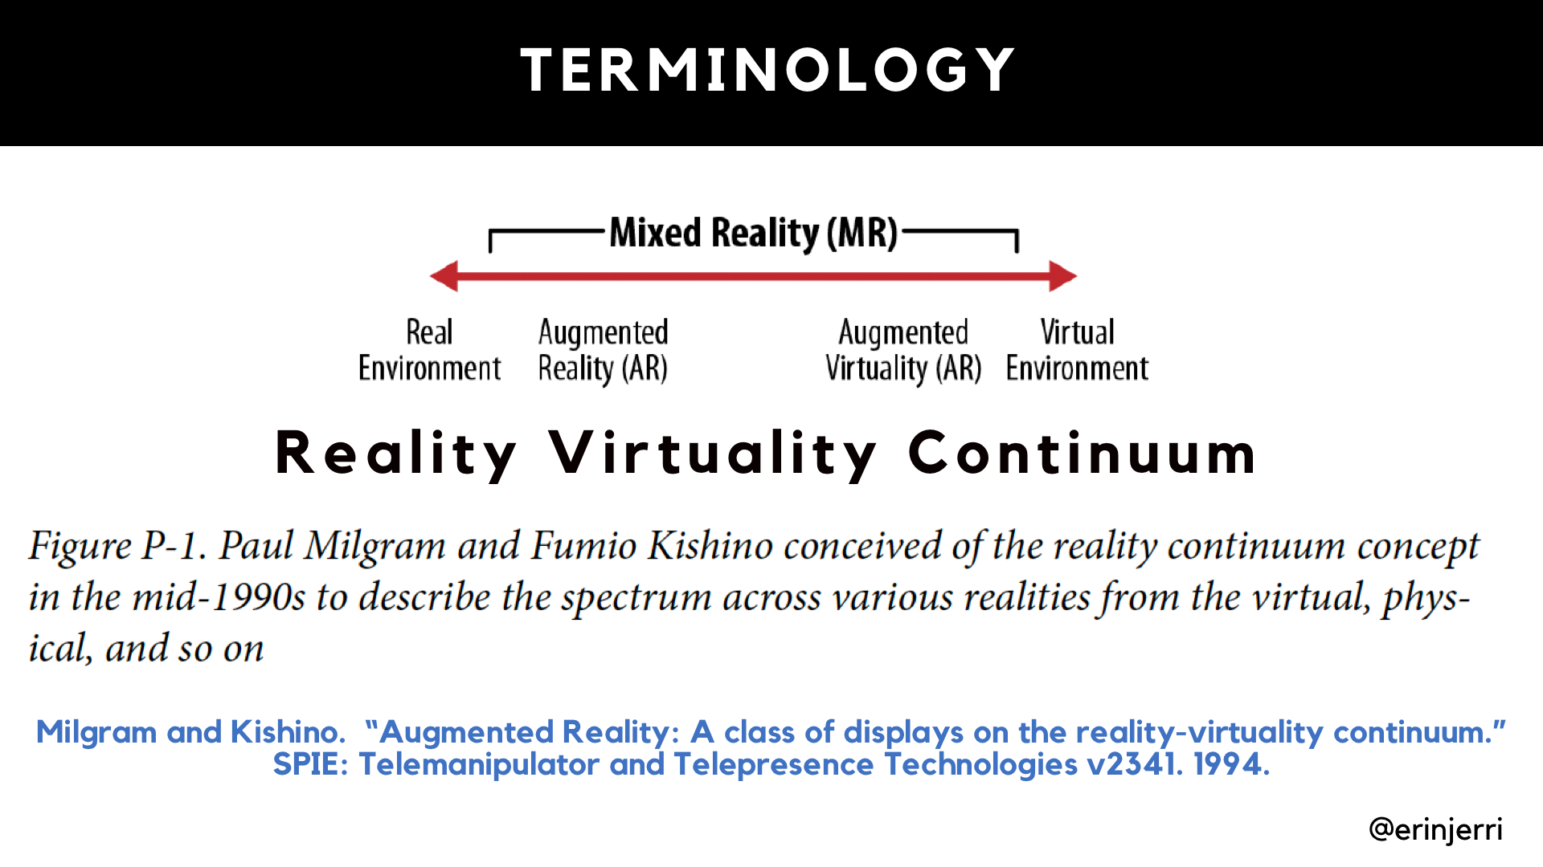

Slide 12
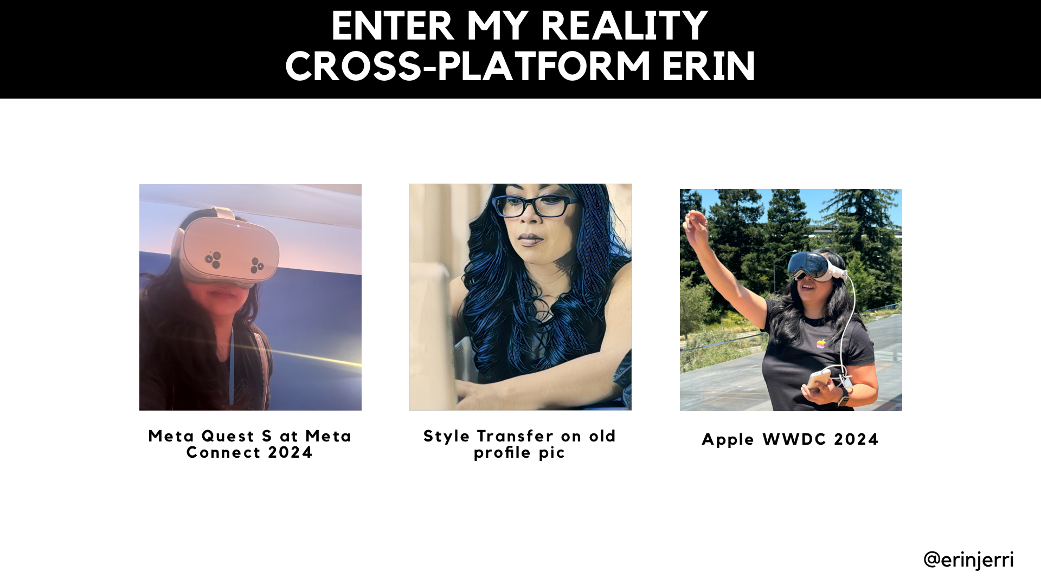

Slide 13
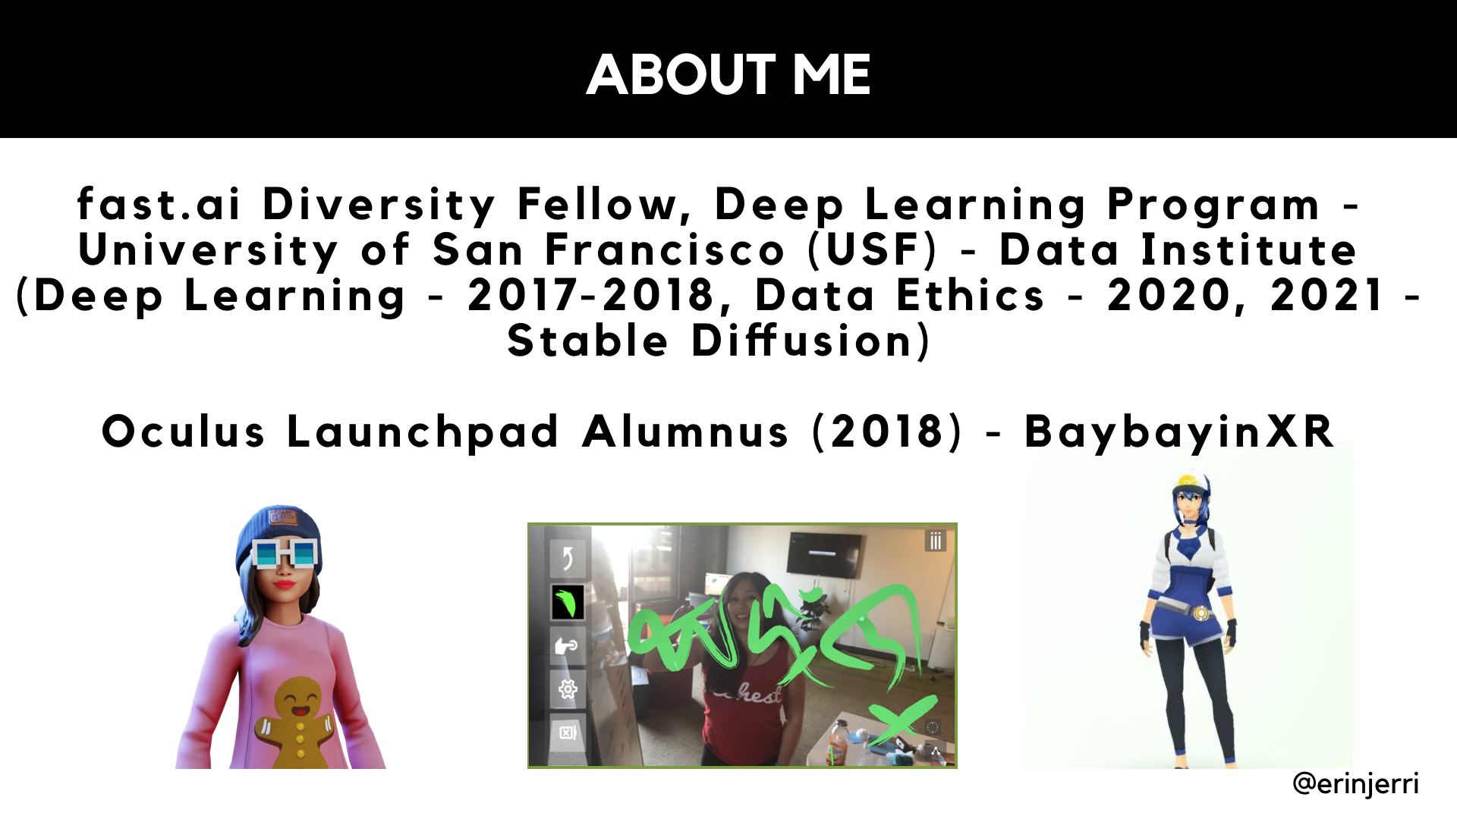

Slide 14
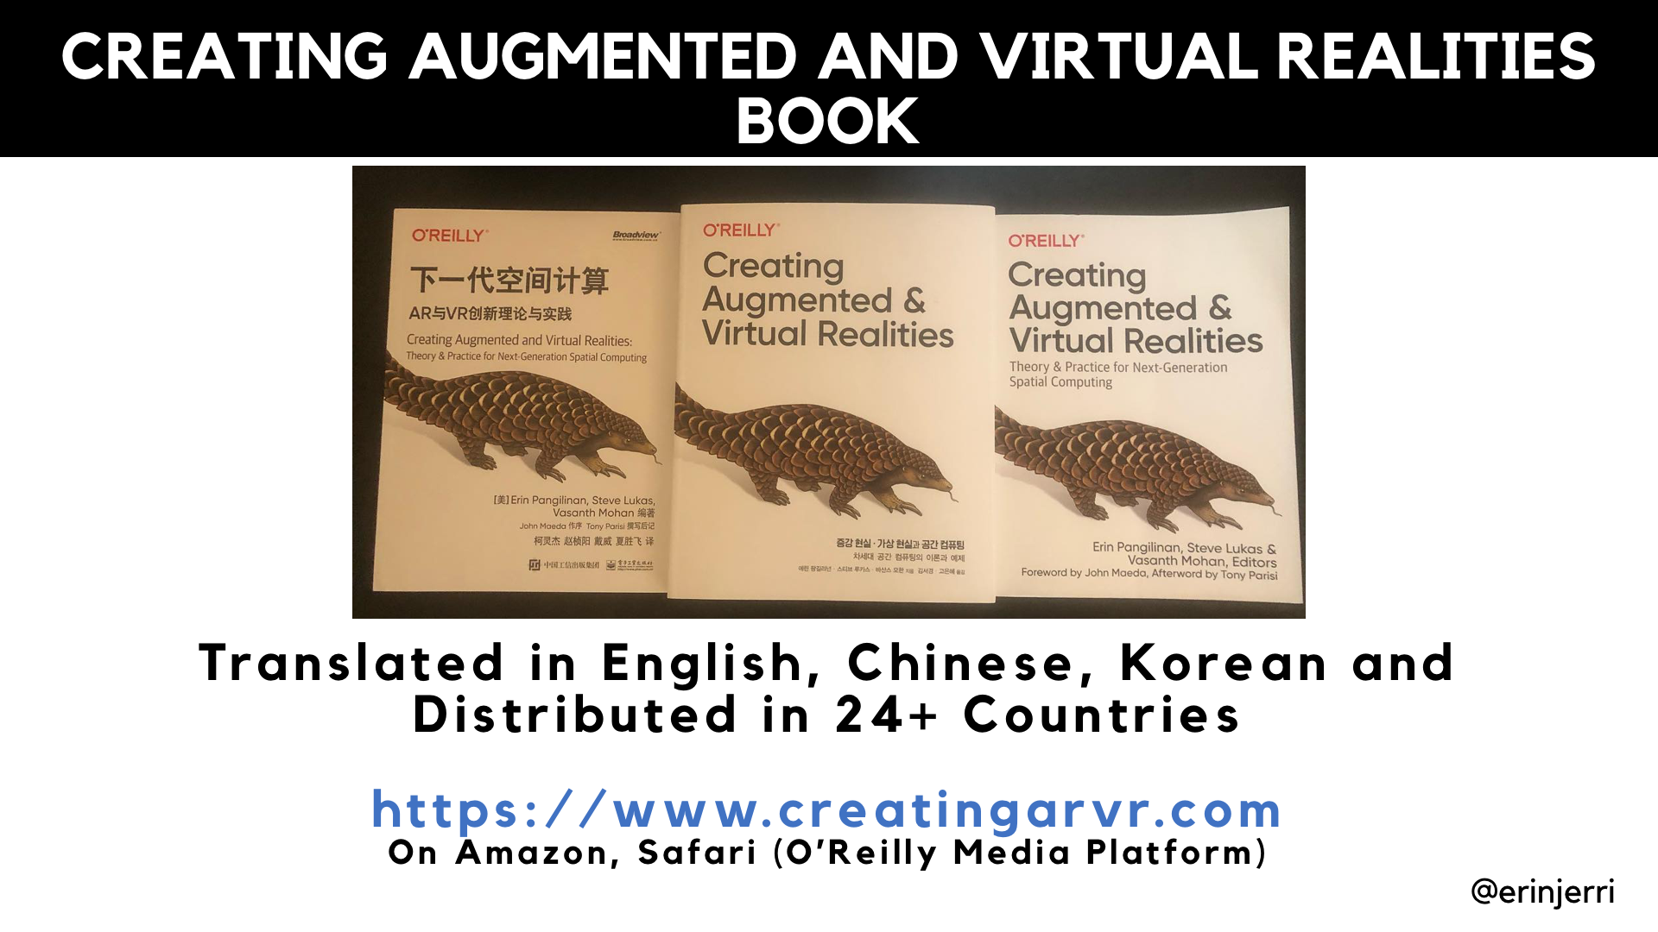

Slide 15
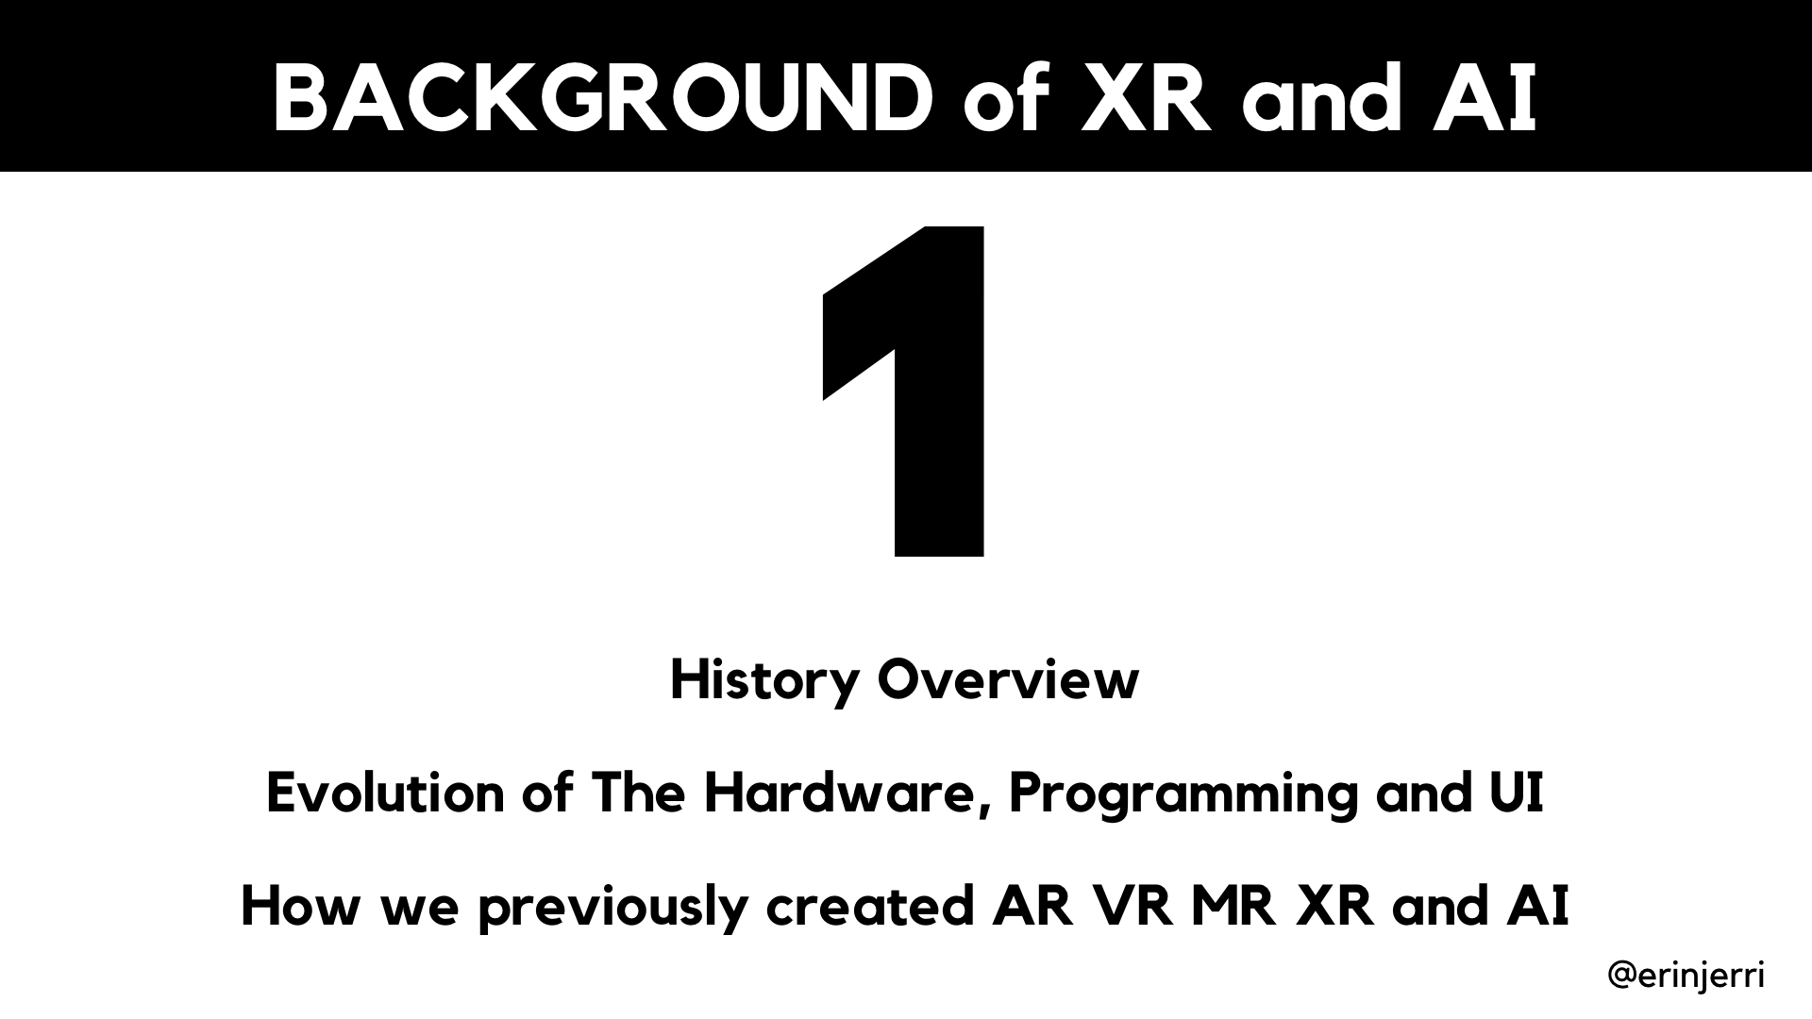

Slide 16
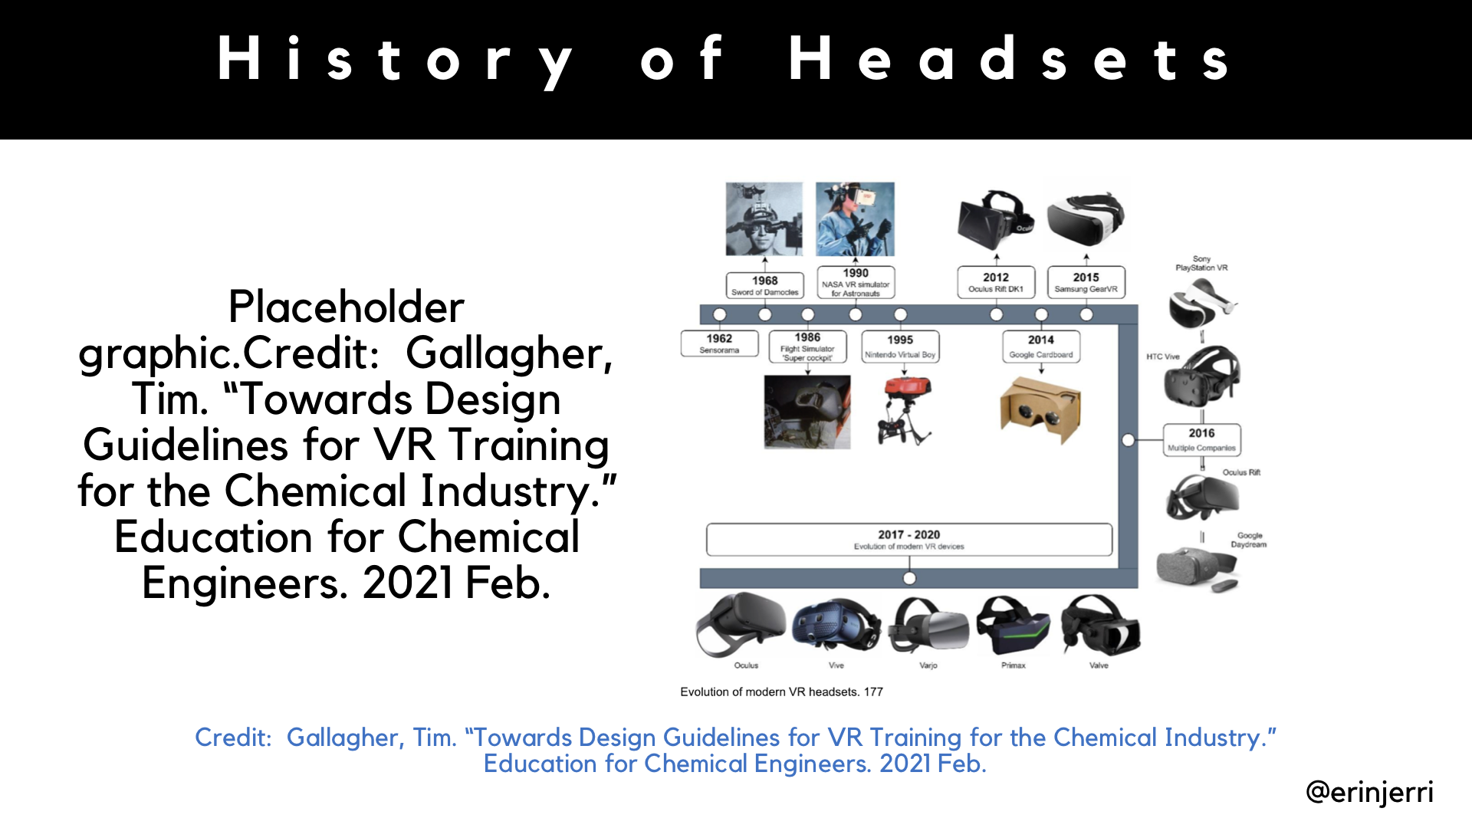
Notes:
AI further extends reality (SLAM/AR) - physical environment
AI extends the human body - physical body
GenAI expands human capability

Slide 17
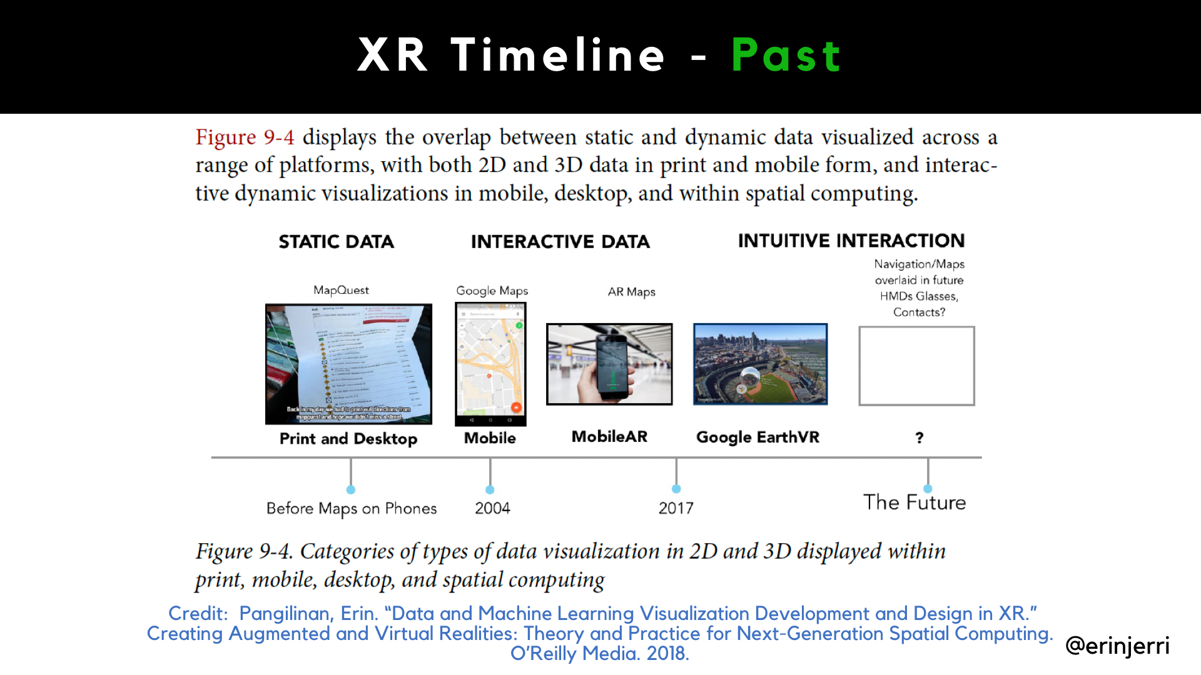
Notes:
AI further extends reality (SLAM/AR) - physical environment
AI extends the human body - physical body
GenAI expands human capability

Slide 18
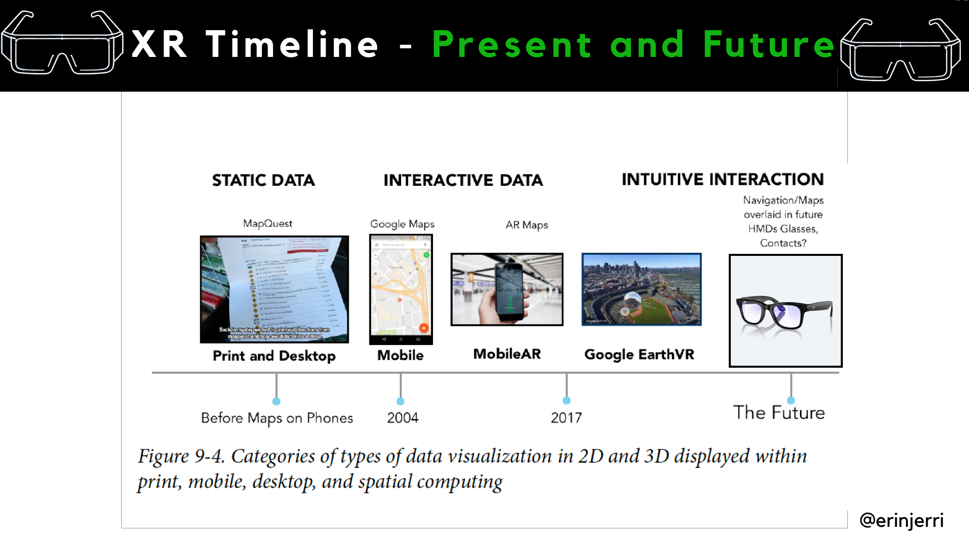

Slide 19
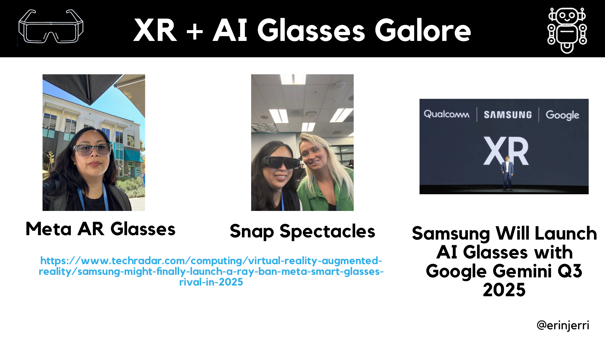

Slide 20
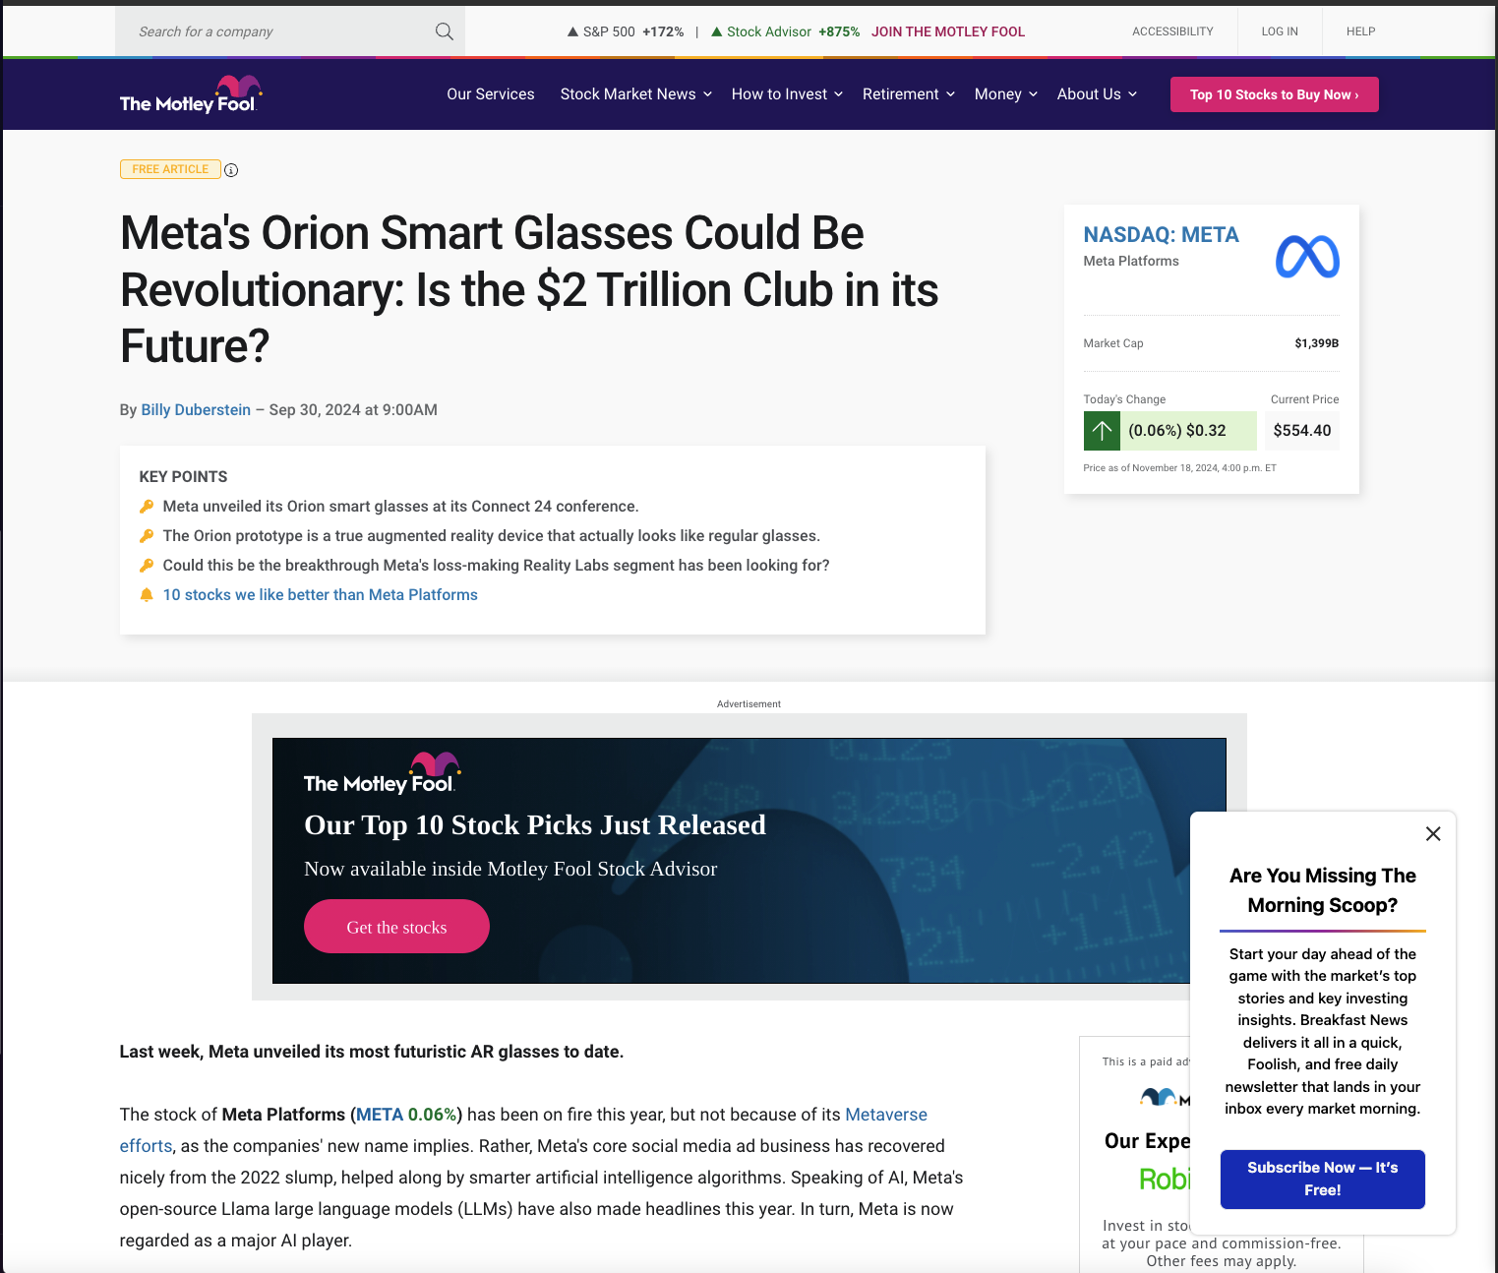

Slide 21
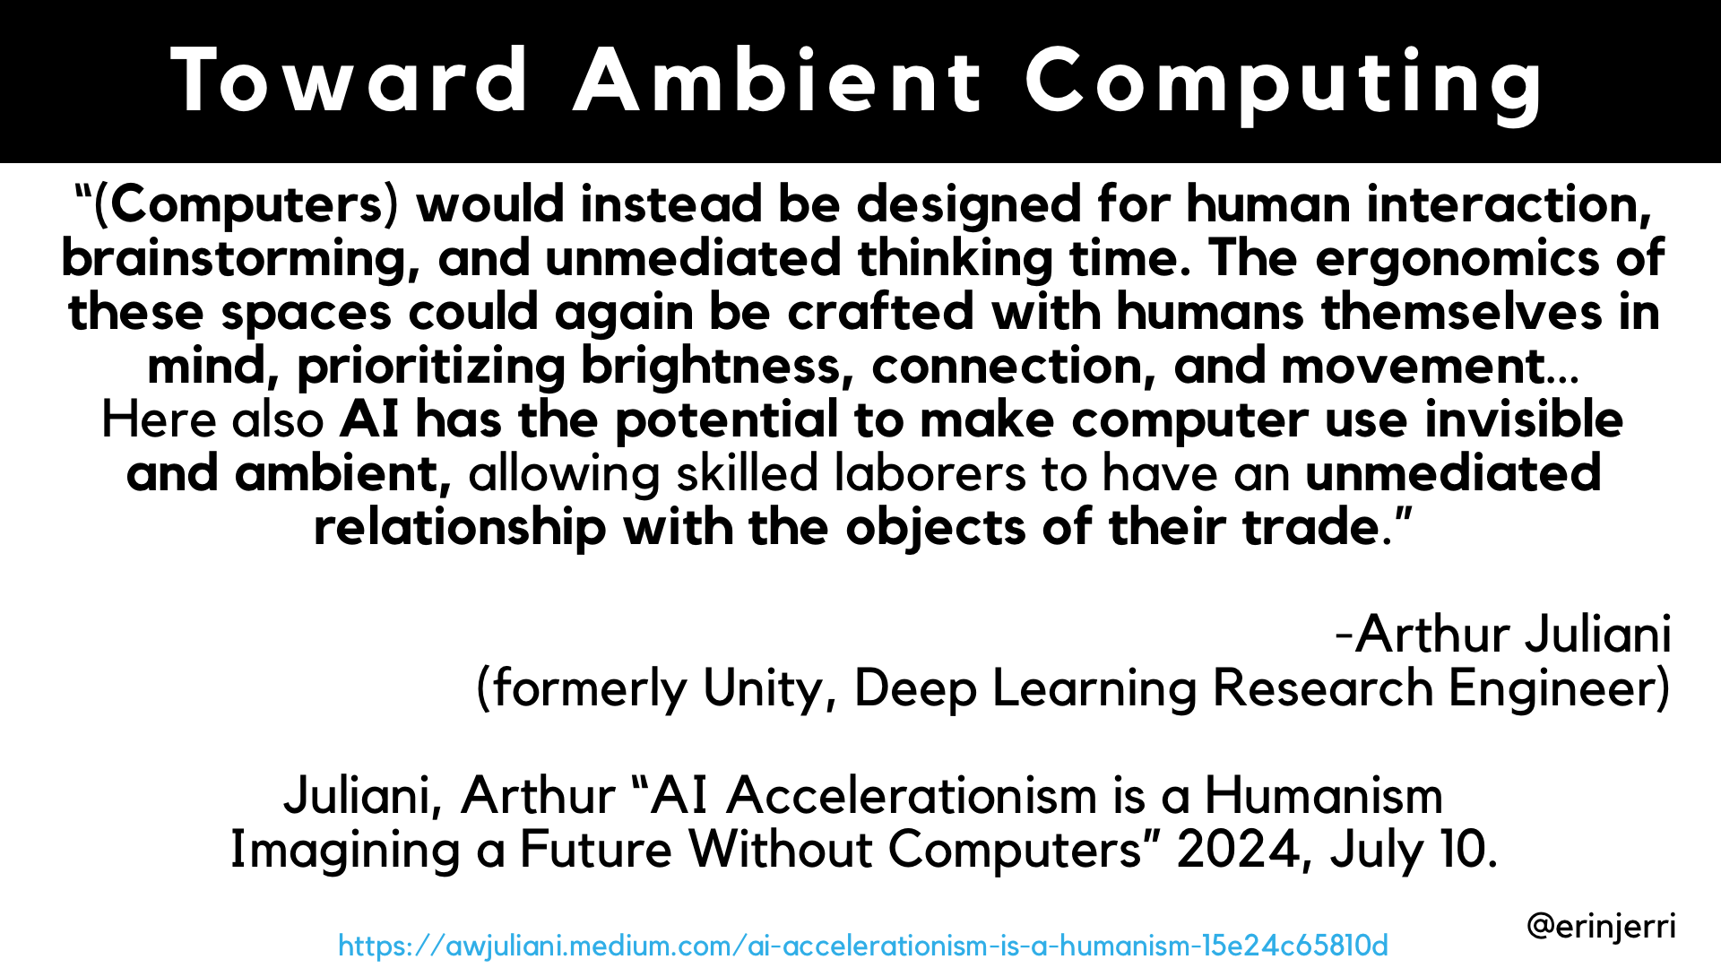
Notes:
AI further extends reality (SLAM/AR) - physical environment
AI extends the human body - physical body
GenAI expands human capability

Slide 22
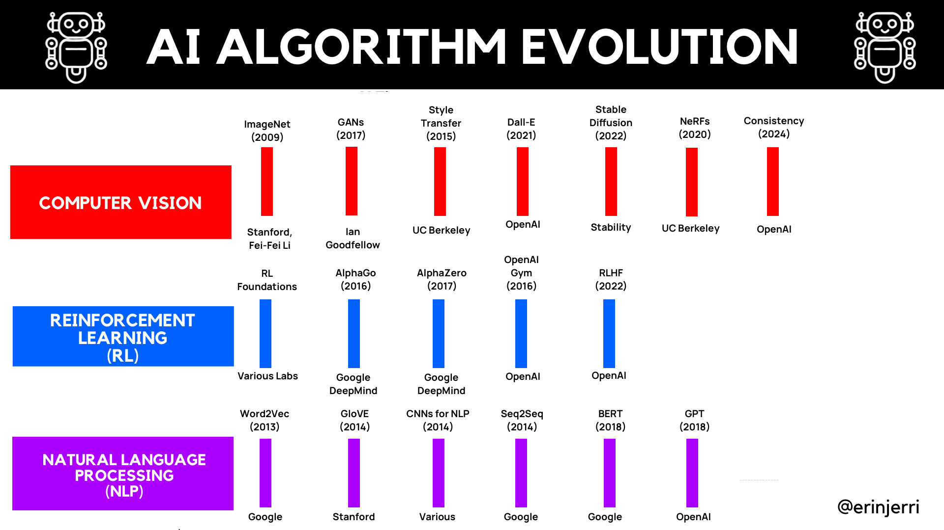

Slide 23
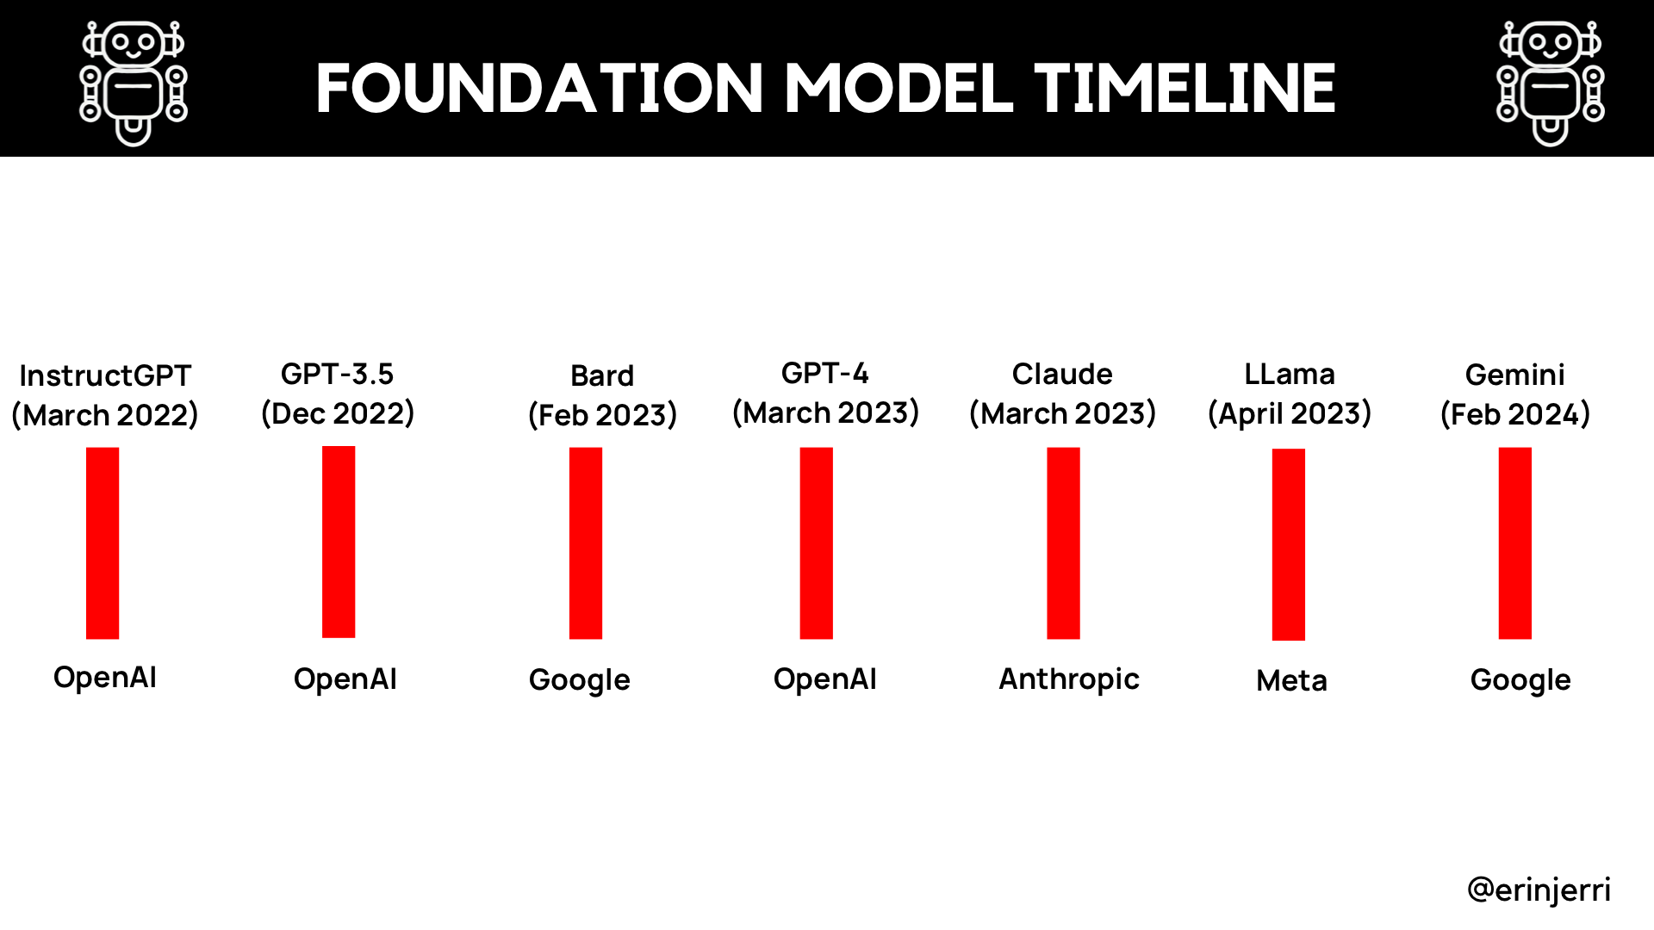
Notes:
Why Multidimensionality - Explain Dimensionality
2D
3D
Sensory Design - Silka

Slide 24
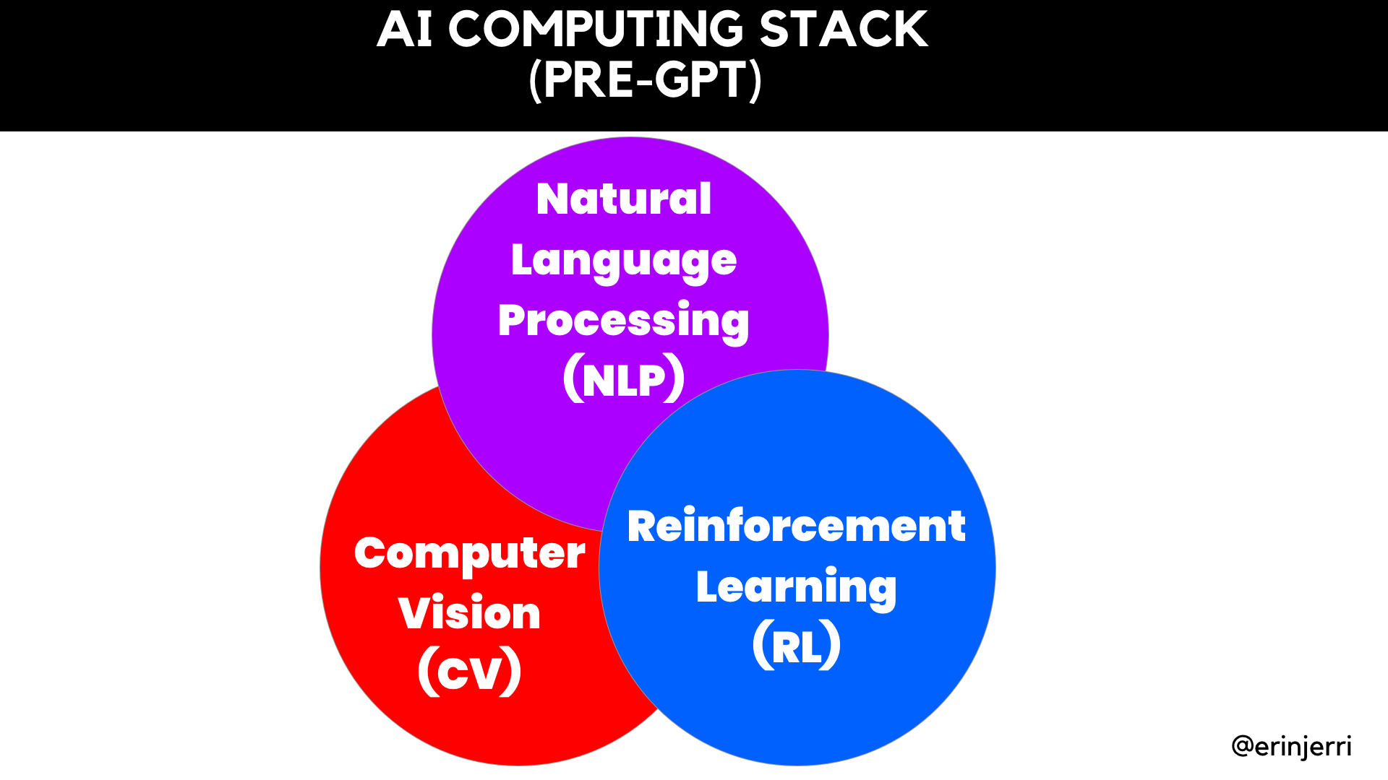
Notes:
AI further extends reality (SLAM/AR) - physical environment
AI extends the human body - physical body
GenAI expands human capability

Slide 25
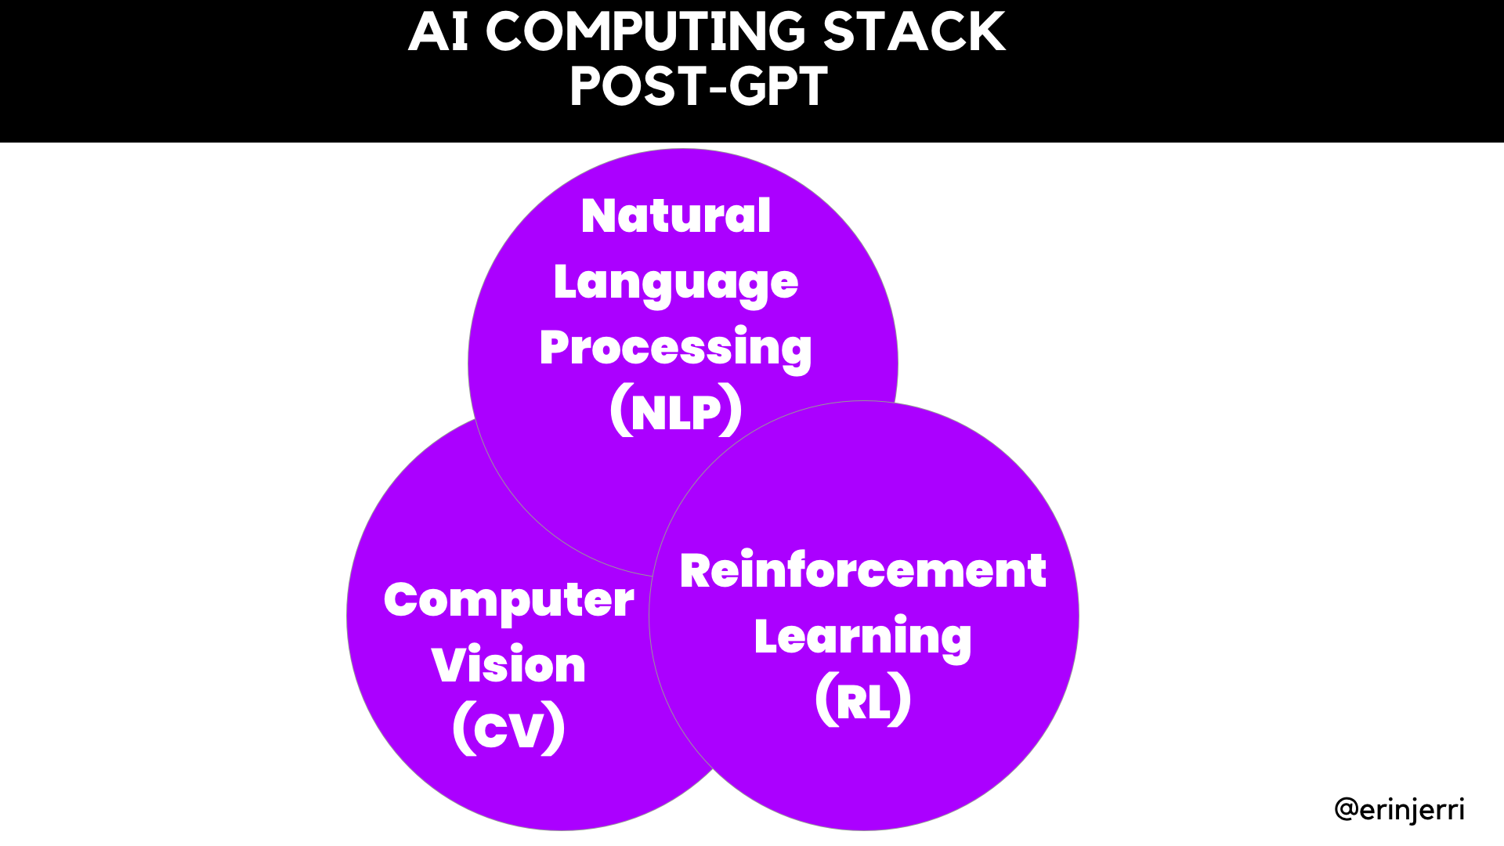
Notes:
AI further extends reality (SLAM/AR) - physical environment
AI extends the human body - physical body
GenAI expands human capability

Slide 26
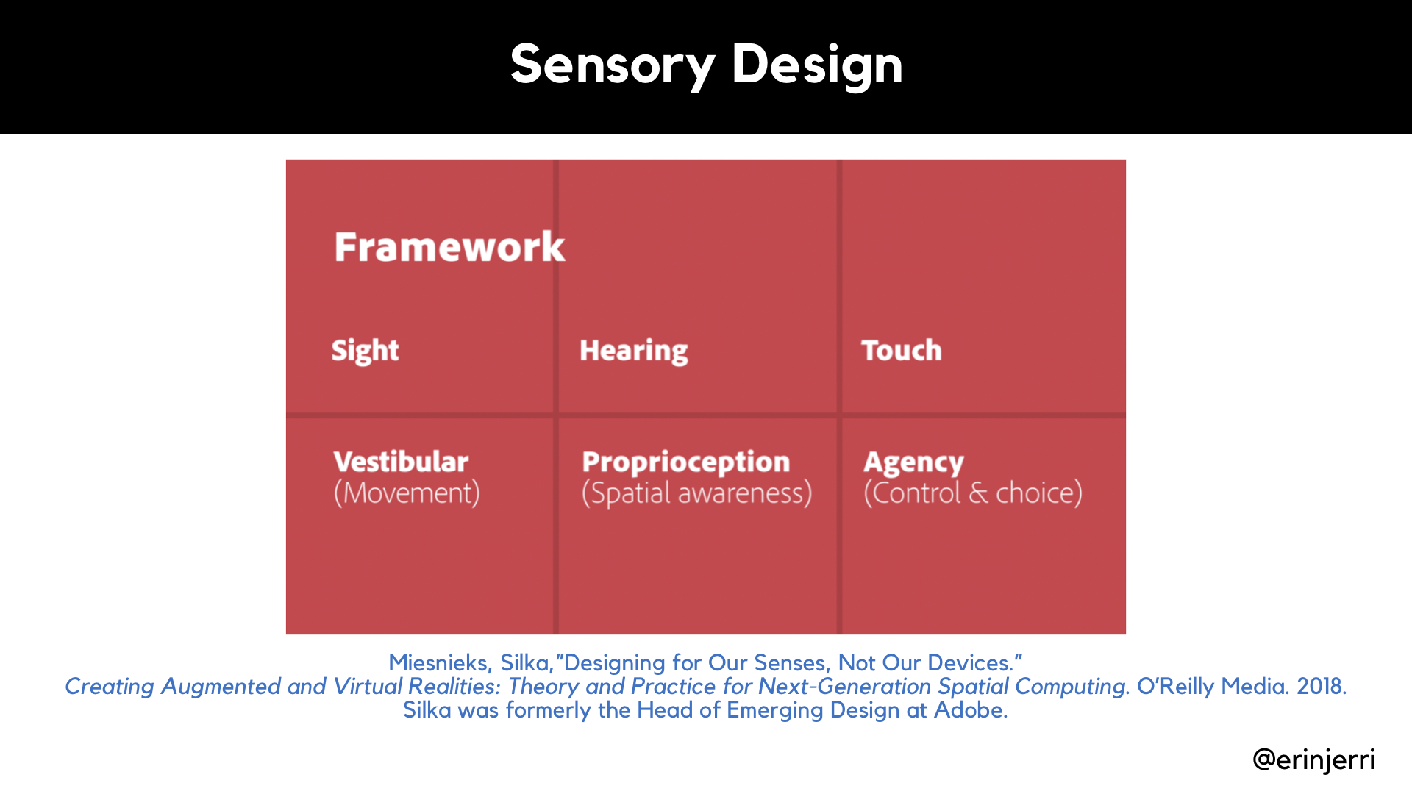
Notes:
Why Multidimensionality - Explain Dimensionality
2D
3D
Sensory Design - Silka

Slide 27
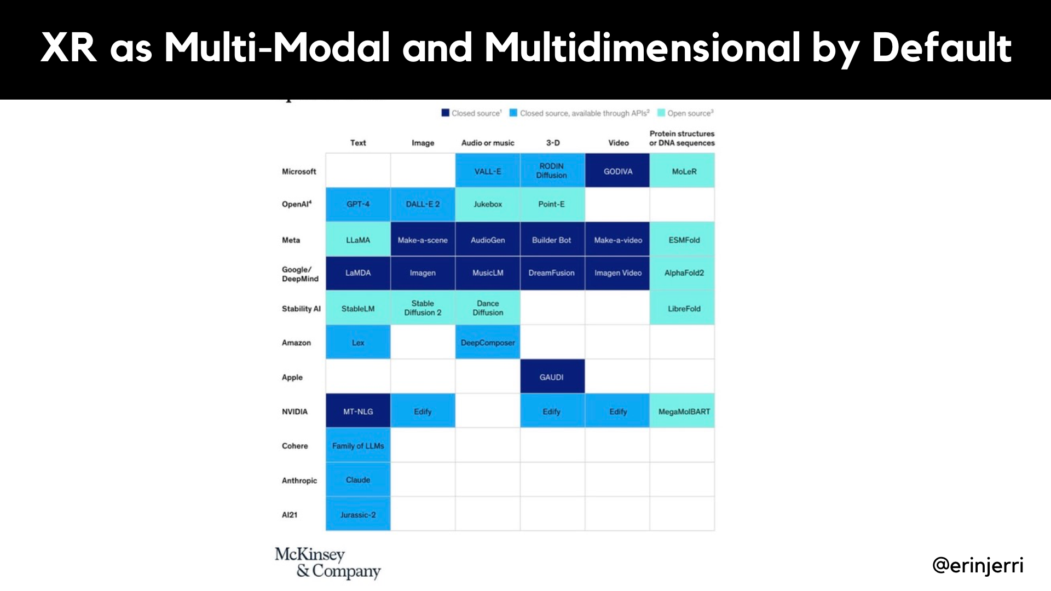
Notes:
Why Multidimensionality - Explain Dimensionality
2D
3D

Slide 28
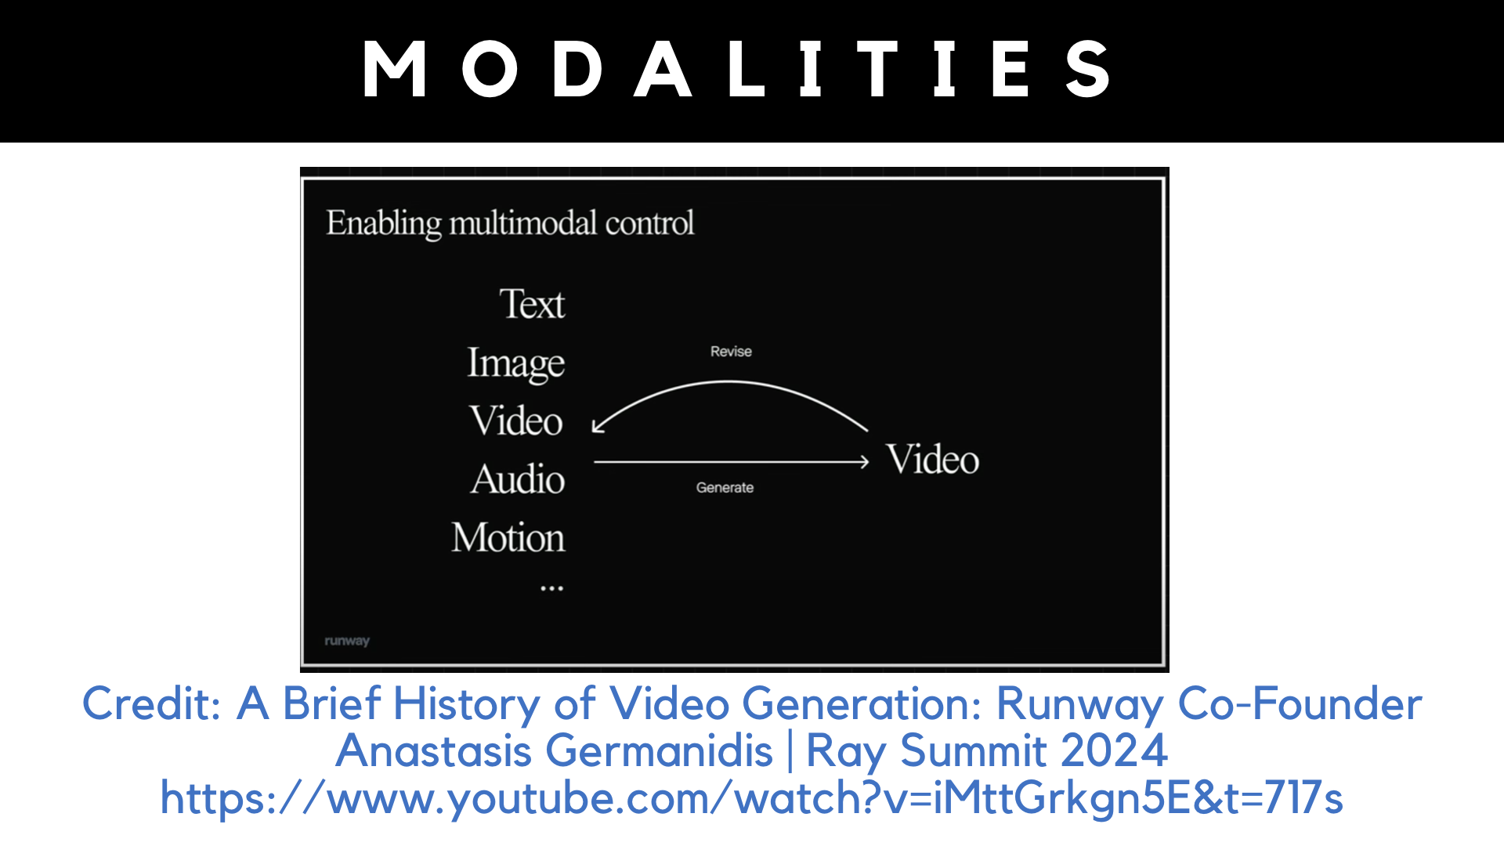

Slide 29
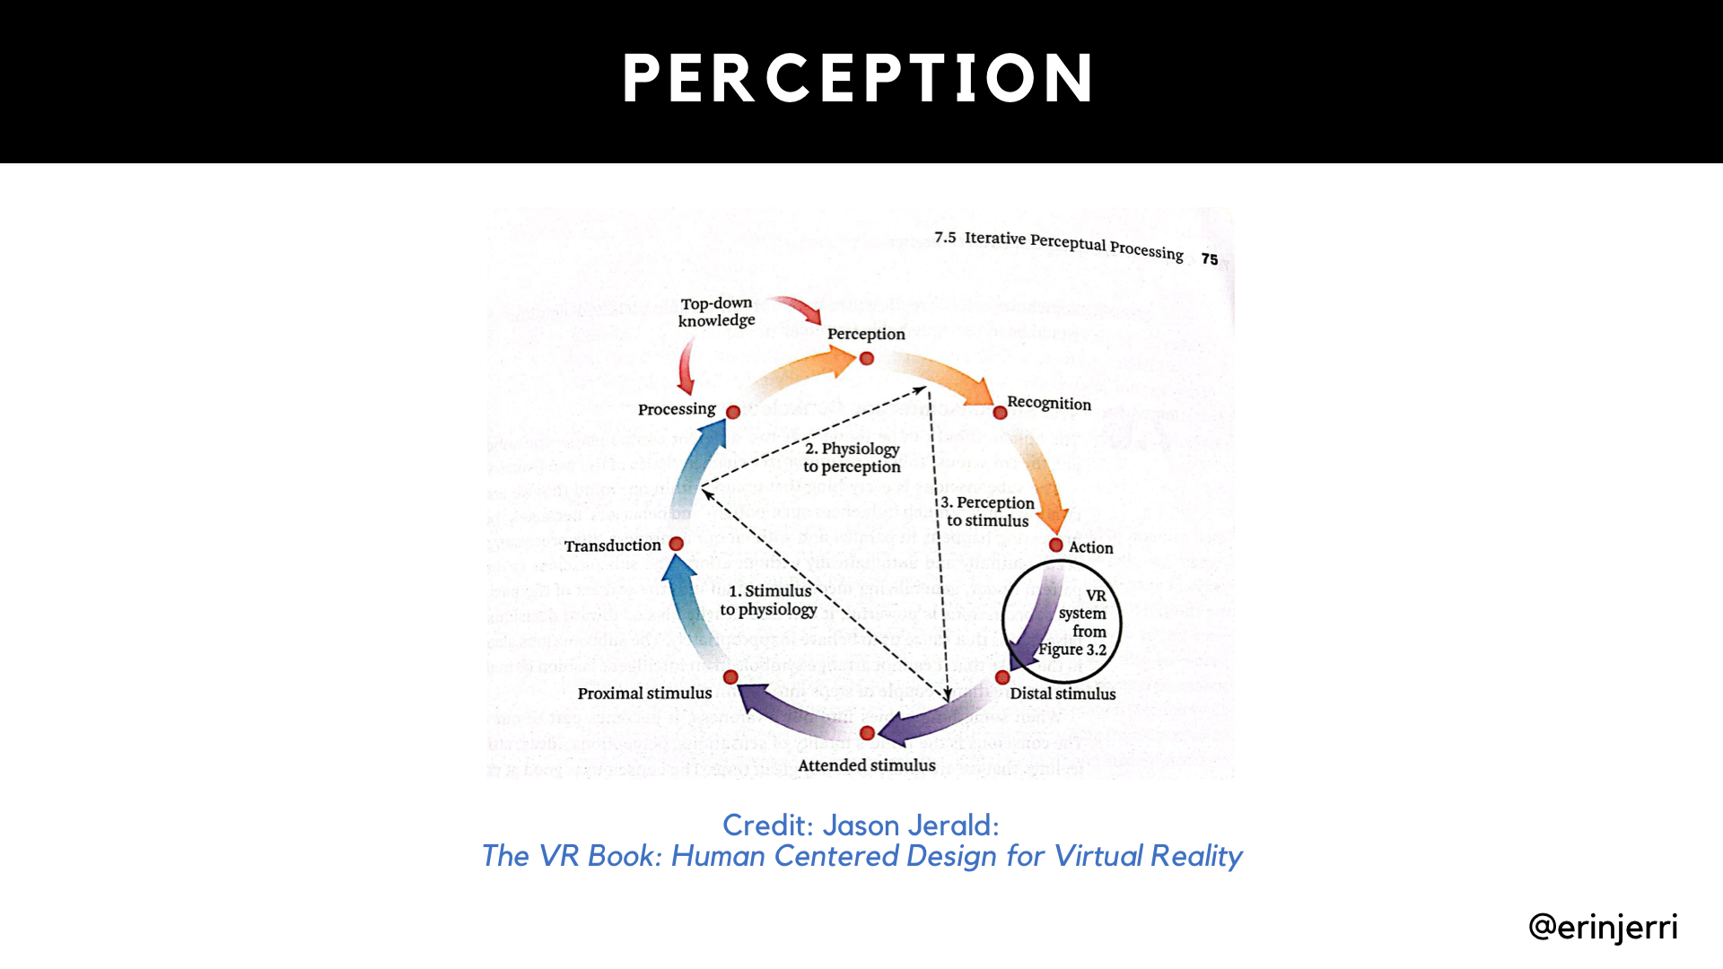
Notes:
Why Multidimensionality - Explain Dimensionality
2D
3D
Sensory Design - Silka

Slide 30
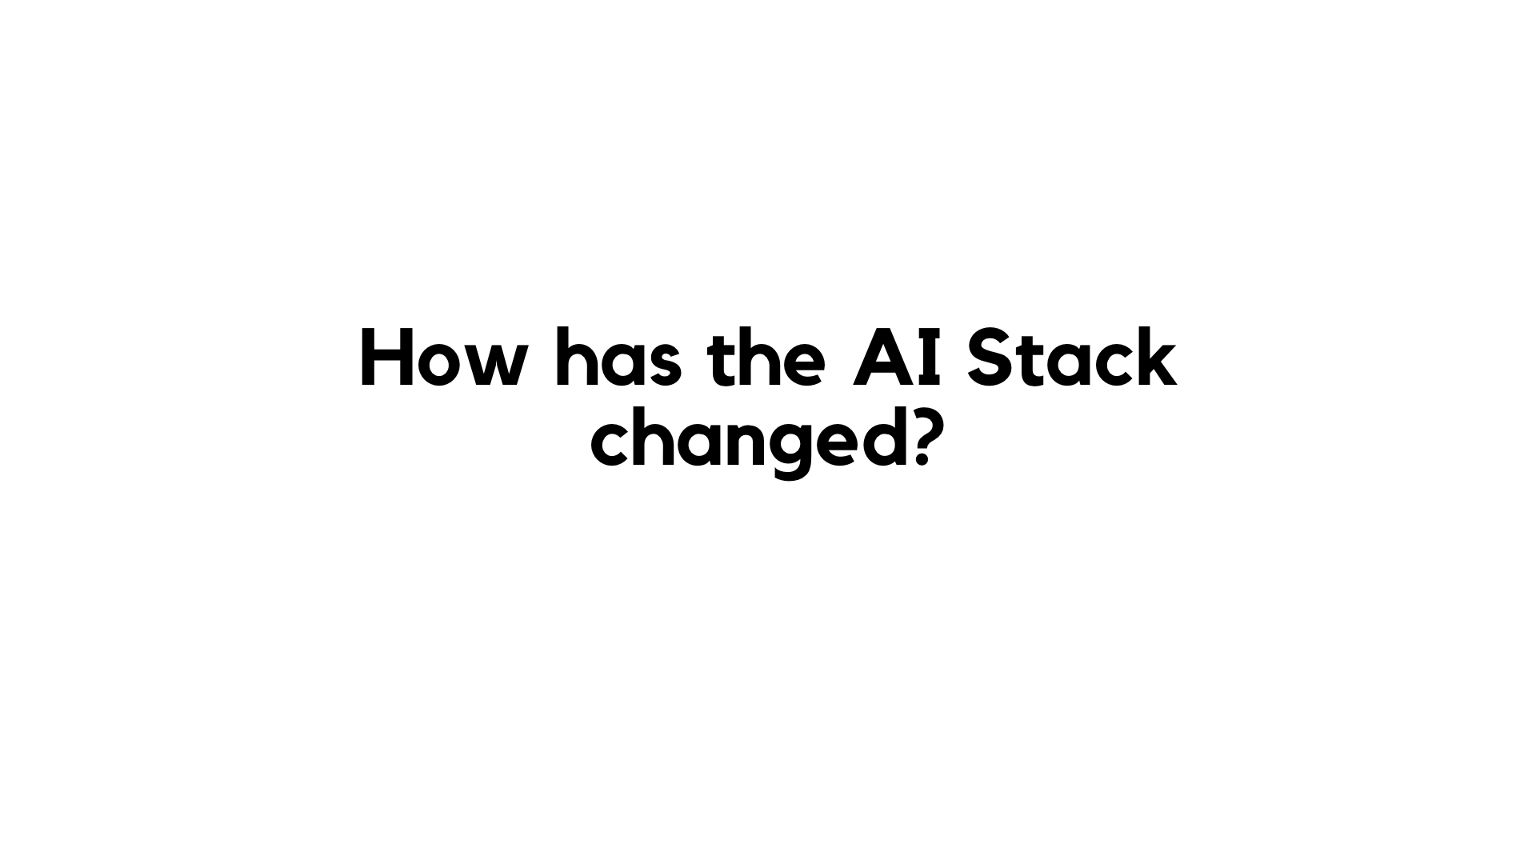
Notes:
AI further extends reality (SLAM/AR) - physical environment
AI extends the human body - physical body
GenAI expands human capability

Slide 31
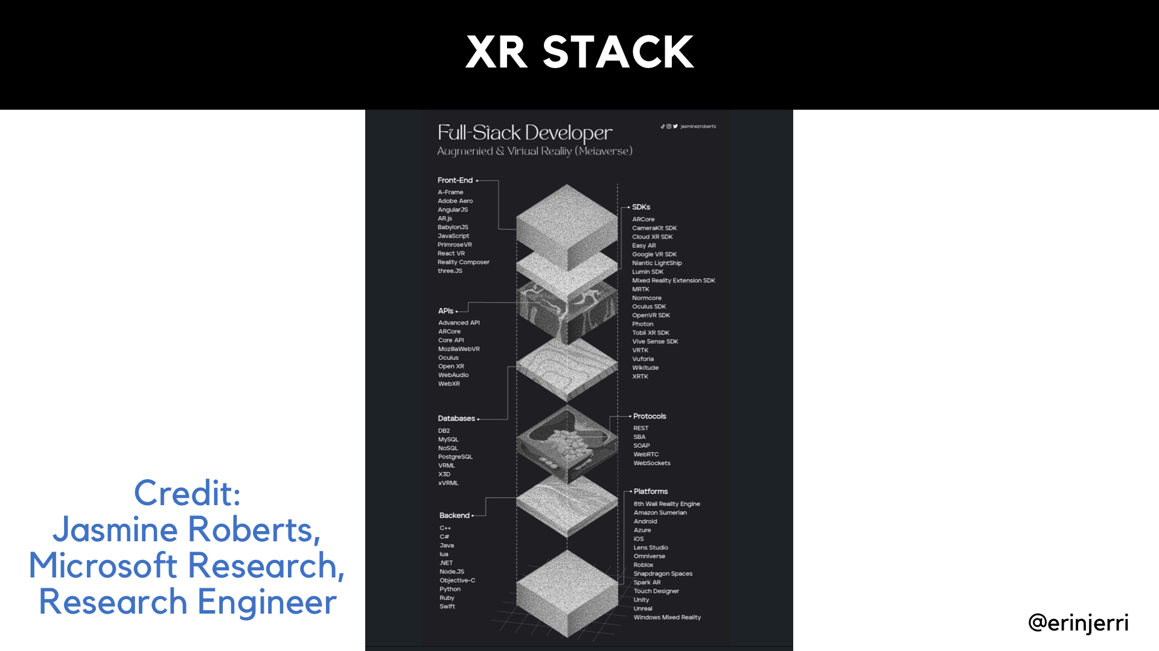
Notes:
AI further extends reality (SLAM/AR) - physical environment
AI extends the human body - physical body
GenAI expands human capability

Slide 32
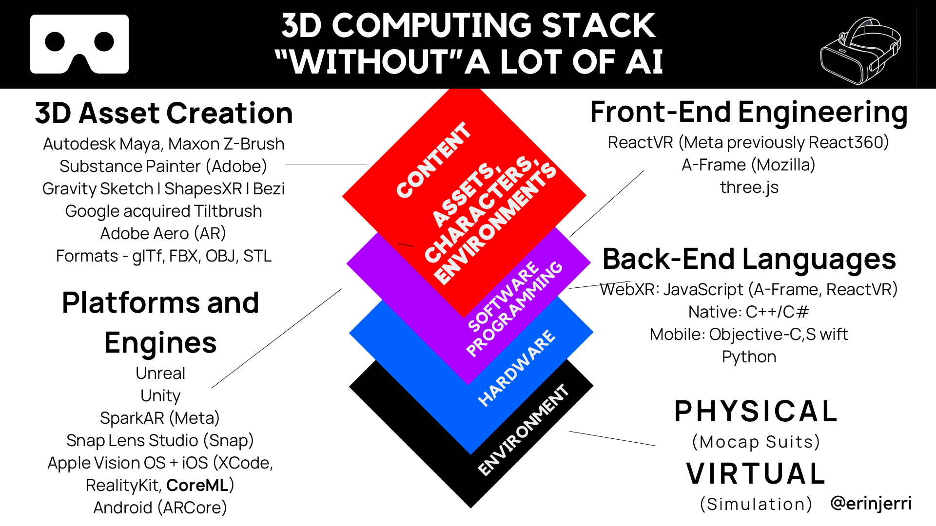
Notes:
AI further extends reality (SLAM/AR) - physical environment
AI extends the human body - physical body
GenAI expands human capability

Slide 33
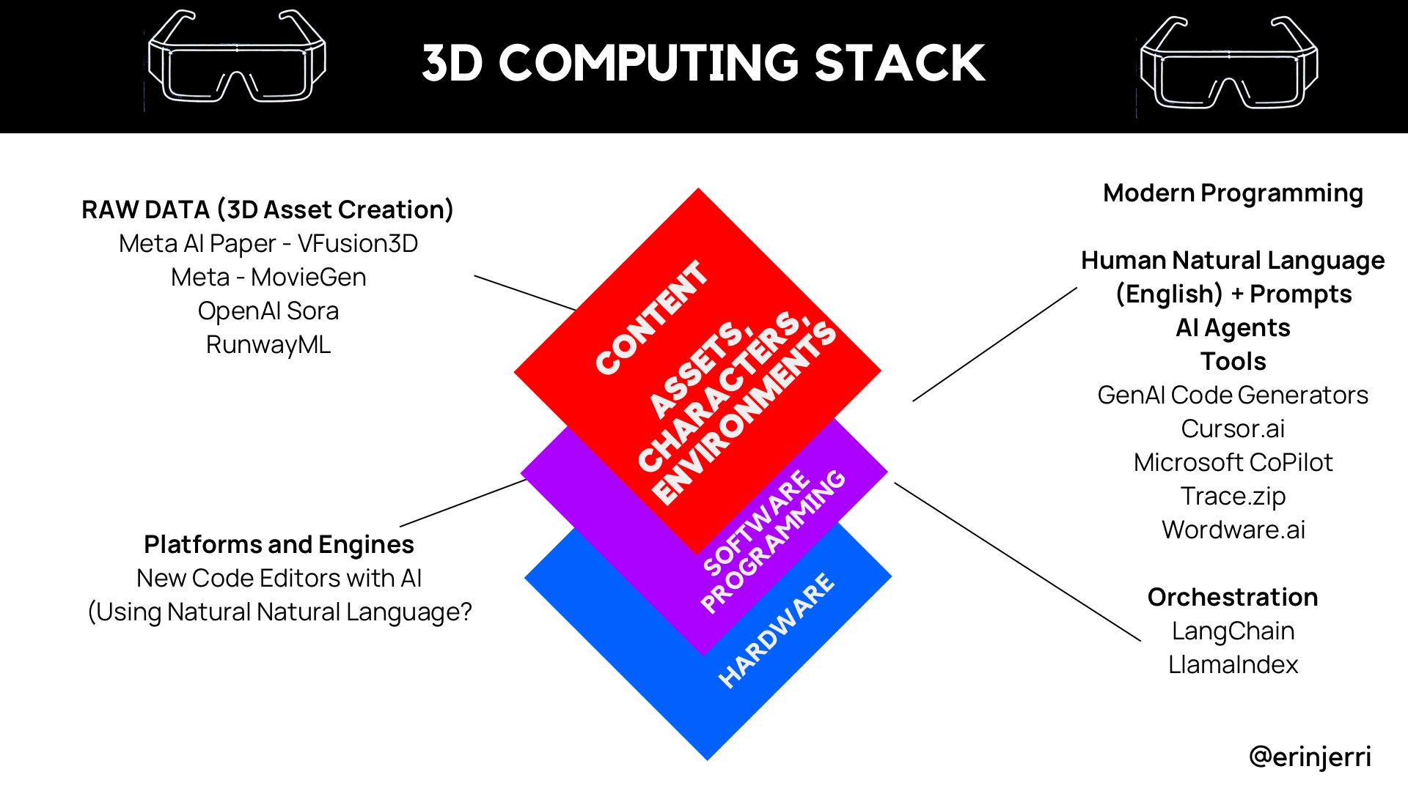

Slide 34
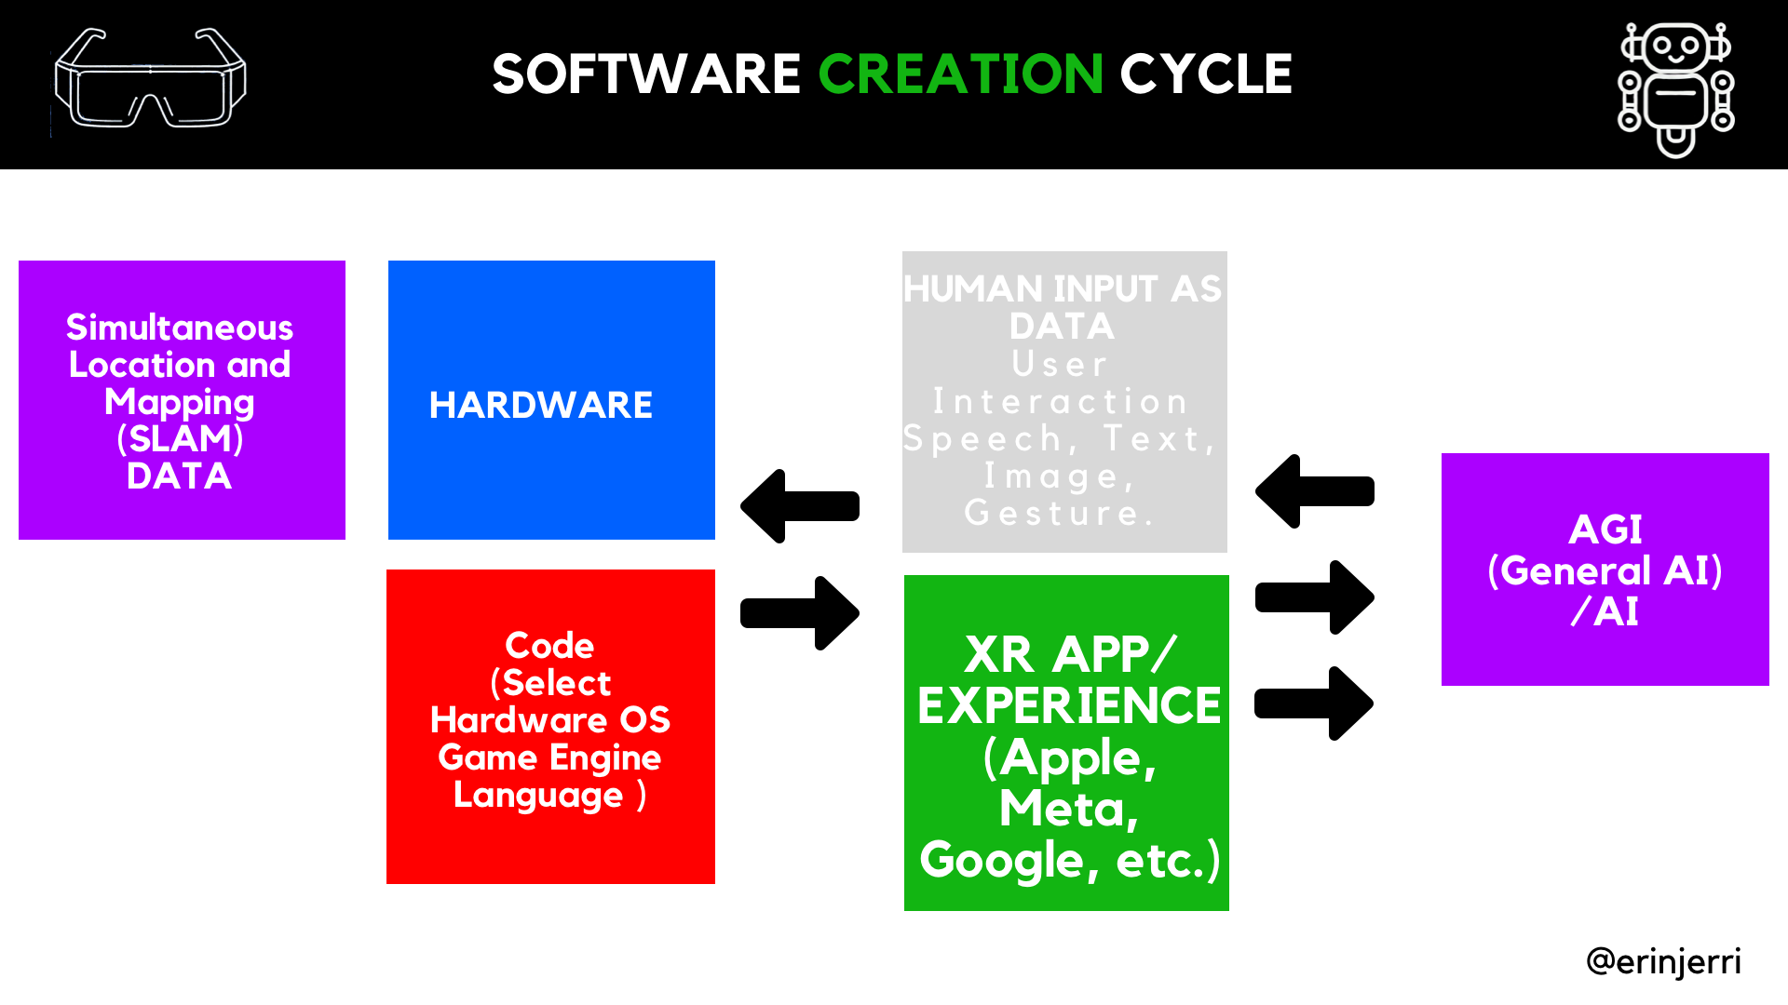
Notes:
History of AI Algos Timeline

Slide 35
Notes:
AI further extends reality (SLAM/AR) - physical environment
AI extends the human body - physical body
GenAI expands human capability

Slide 36
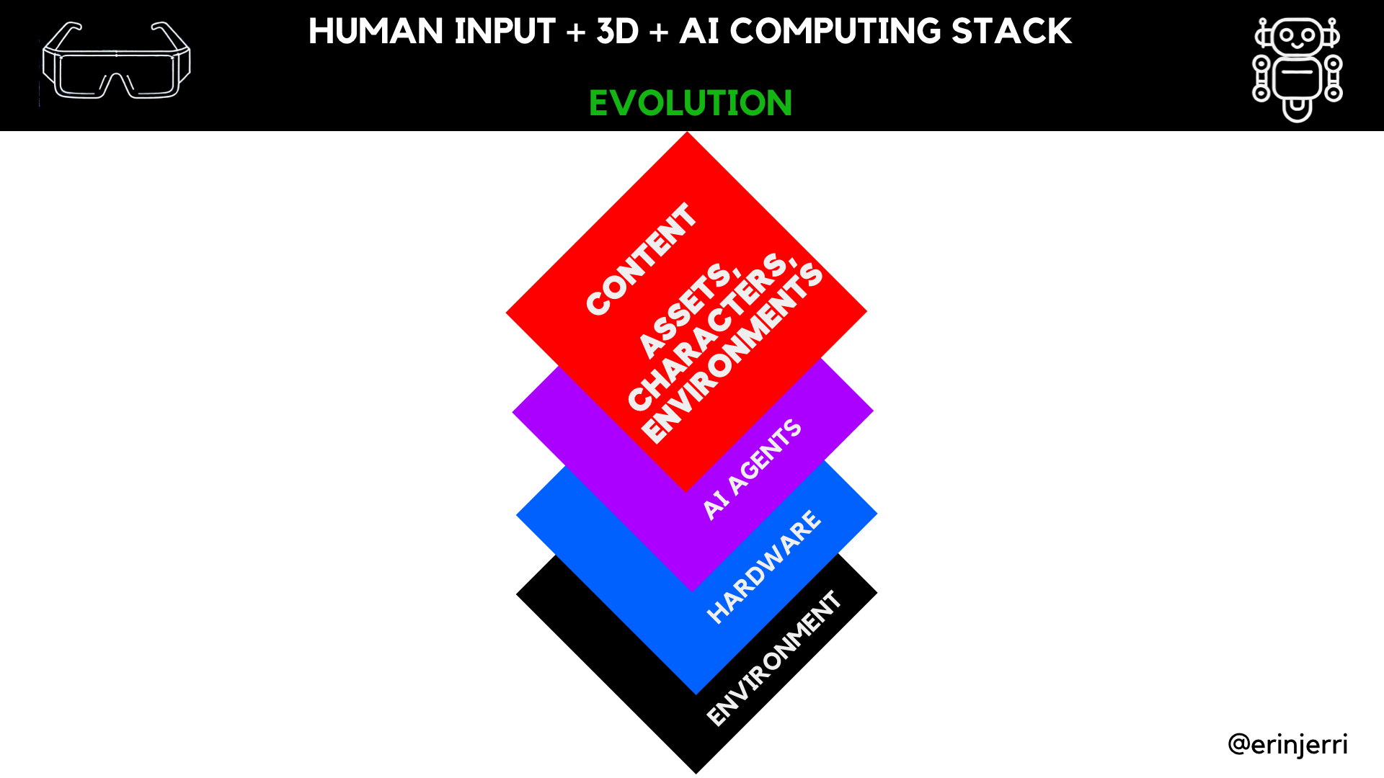

Slide 37
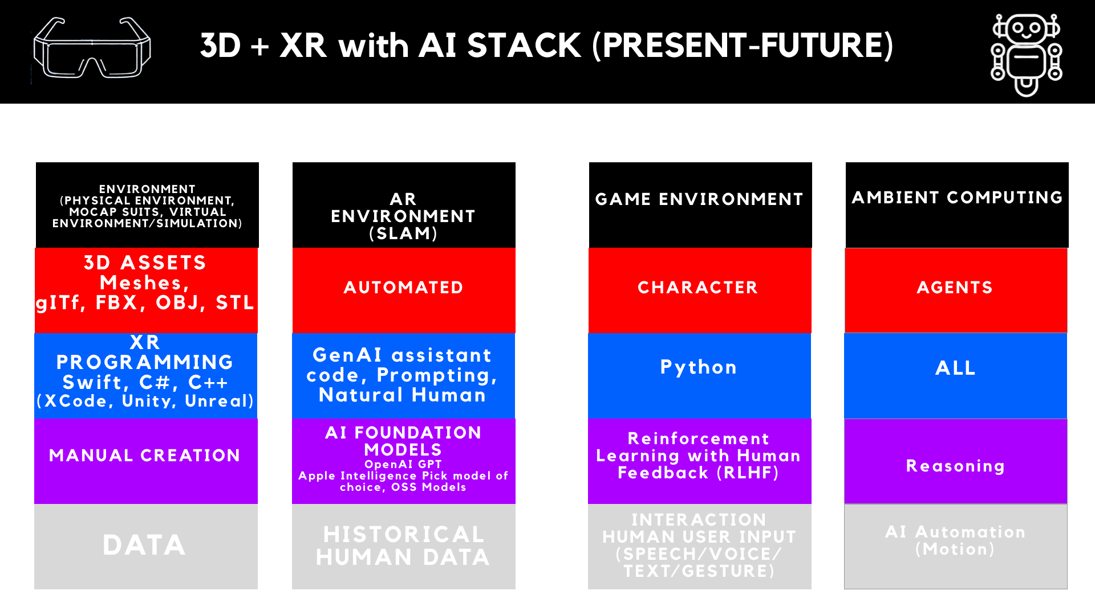
Notes:
AI further extends reality (SLAM/AR) - physical environment
AI extends the human body - physical body
GenAI expands human capability

Slide 38
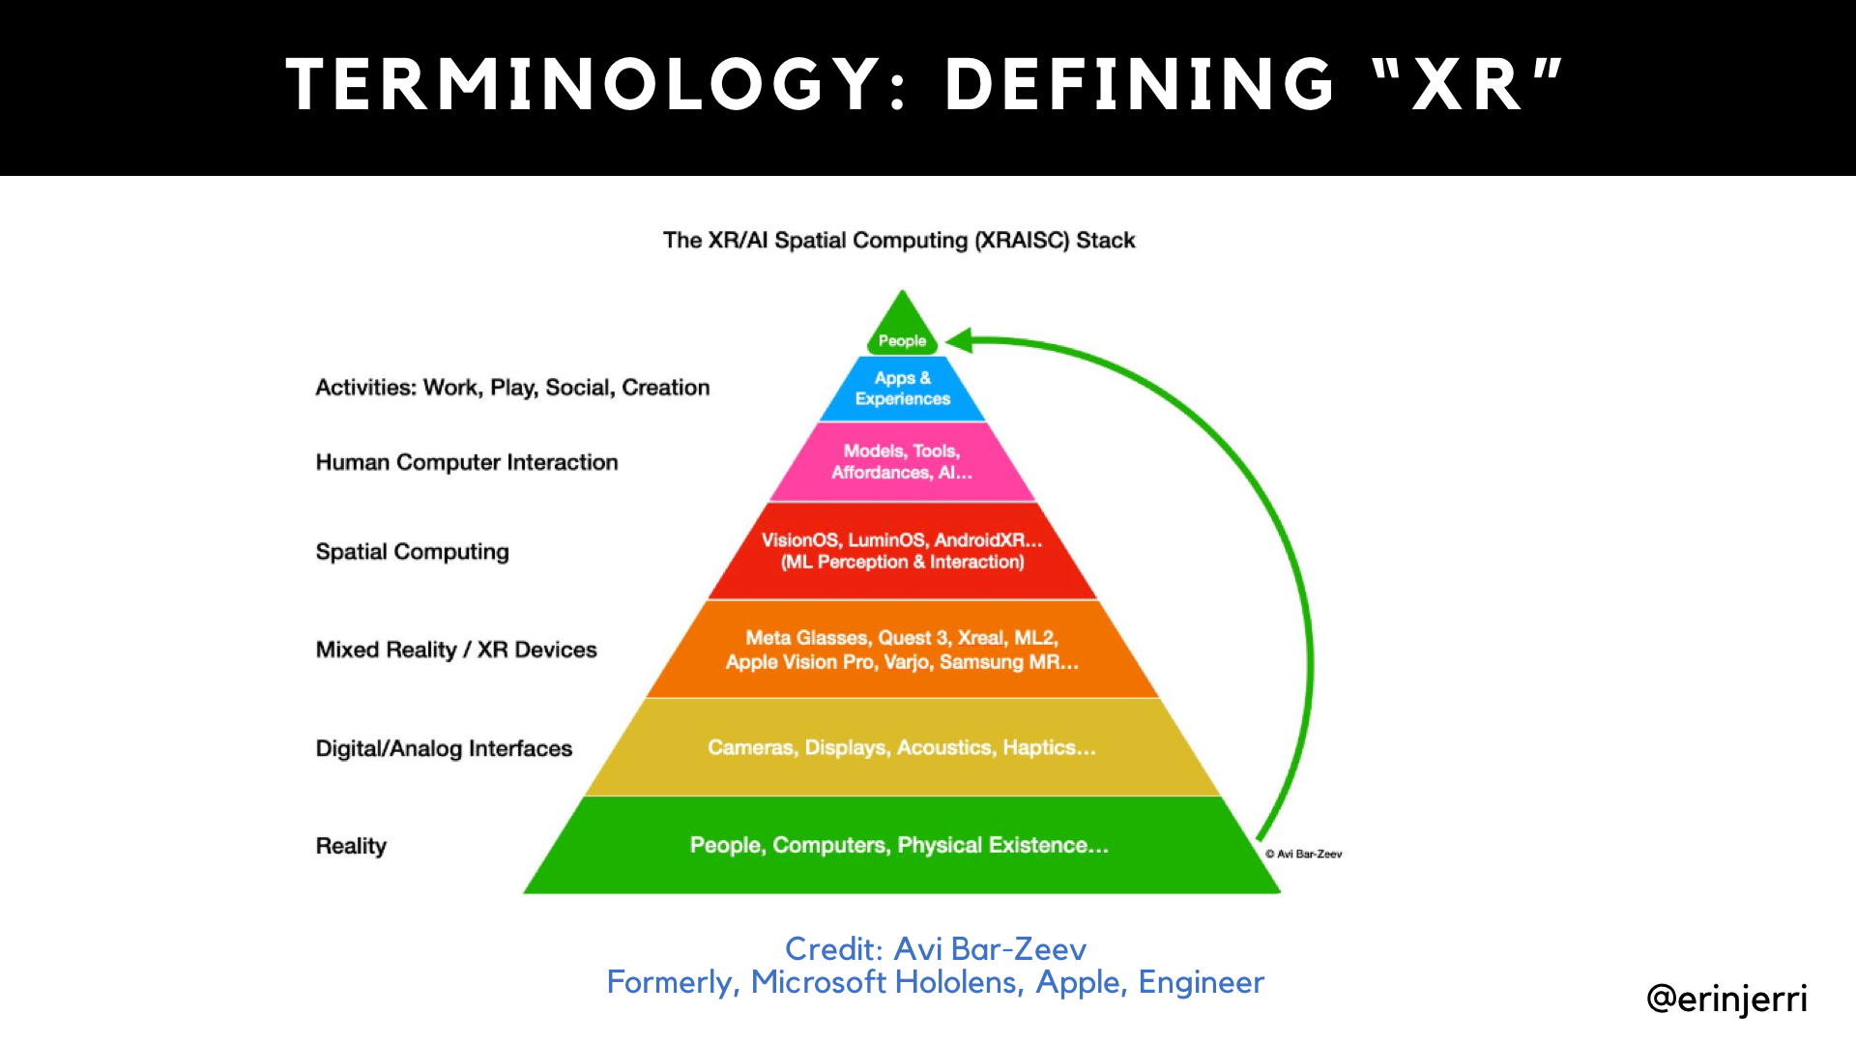

Slide 39
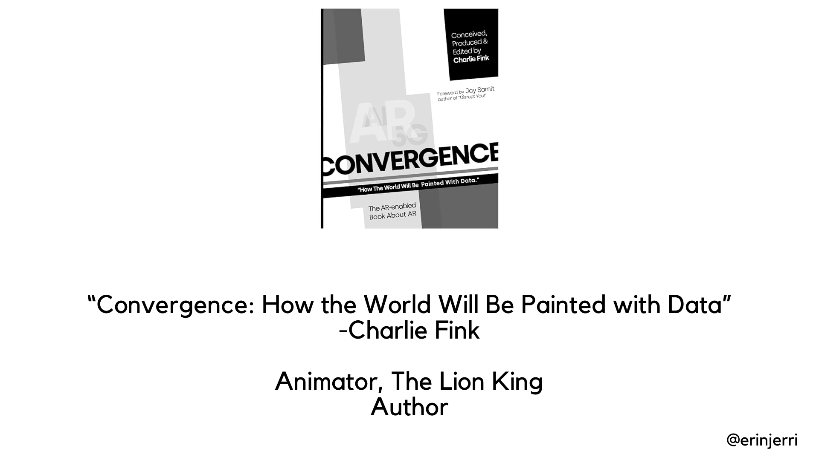
Notes:
AI further extends reality (SLAM/AR) - physical environment
AI extends the human body - physical body
GenAI expands human capability

Slide 40
How we create more expressively with AI and XR

Slide 41
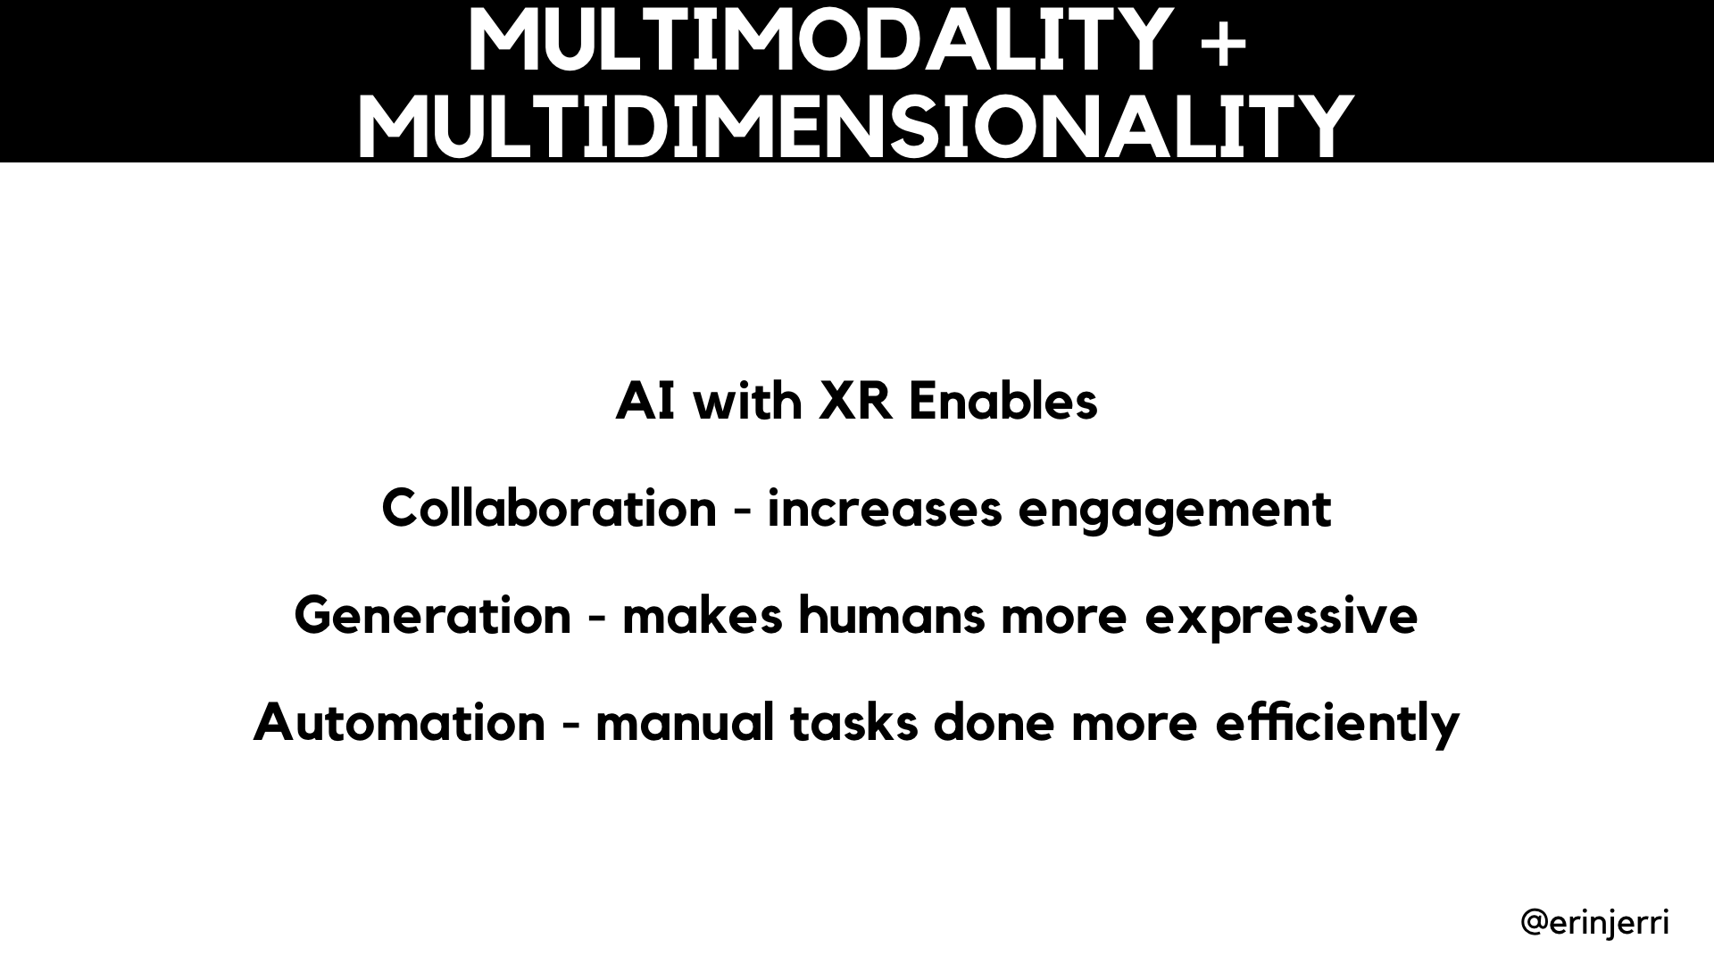

Slide 42
ASSETS AND ENVIRONMENT
GENERATION

Slide 43
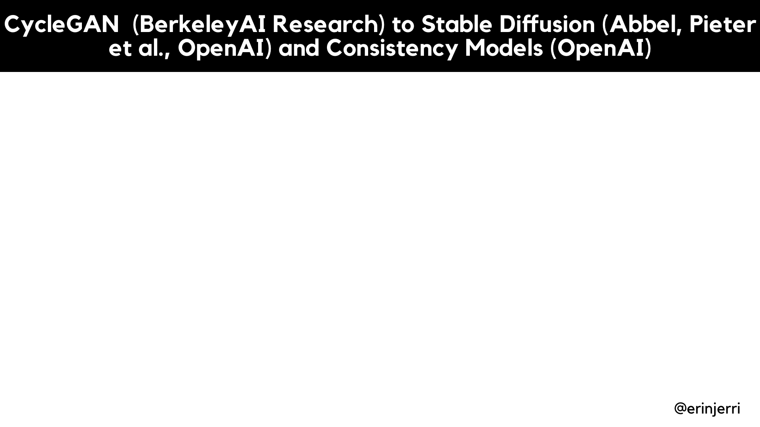
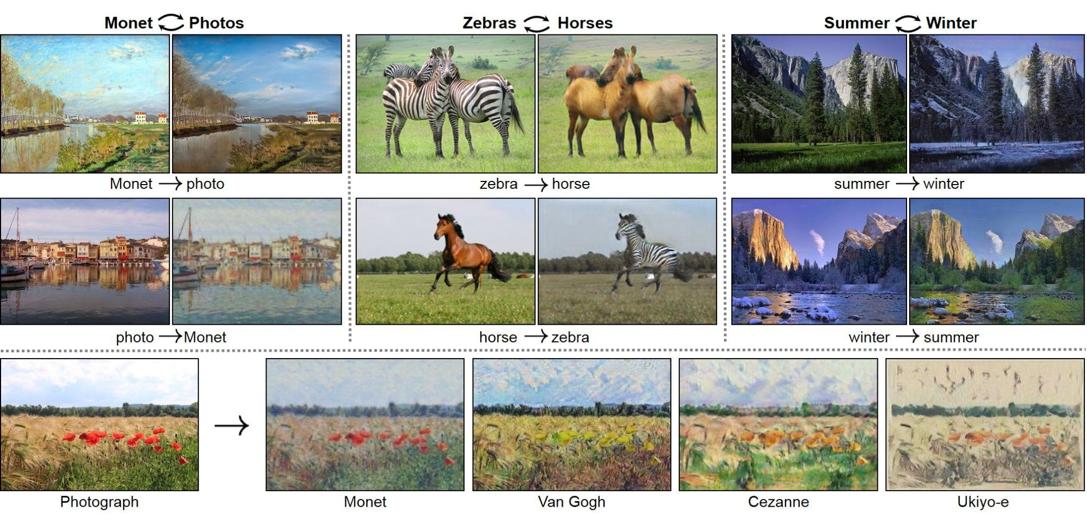
Notes:
AI further extends reality (SLAM/AR) - physical environment
AI extends the human body - physical body
GenAI expands human capability

Slide 44
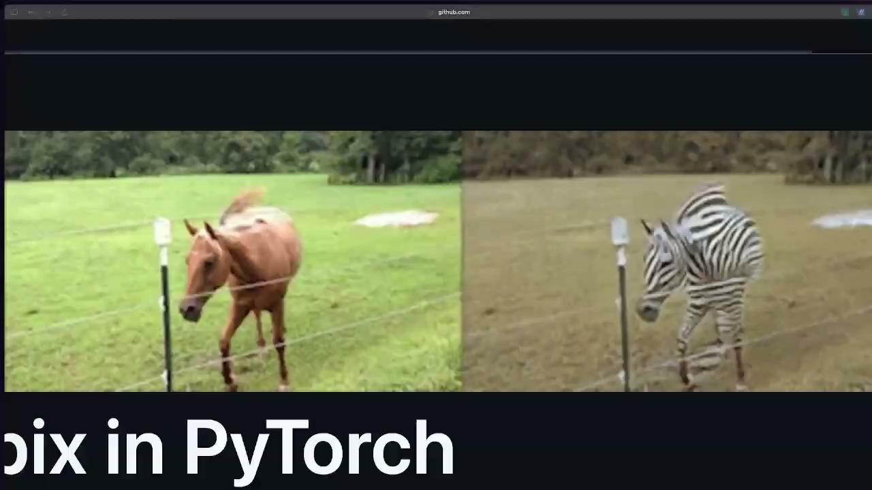
Notes:
AI further extends reality (SLAM/AR) - physical environment
AI extends the human body - physical body
GenAI expands human capability

Slide 45
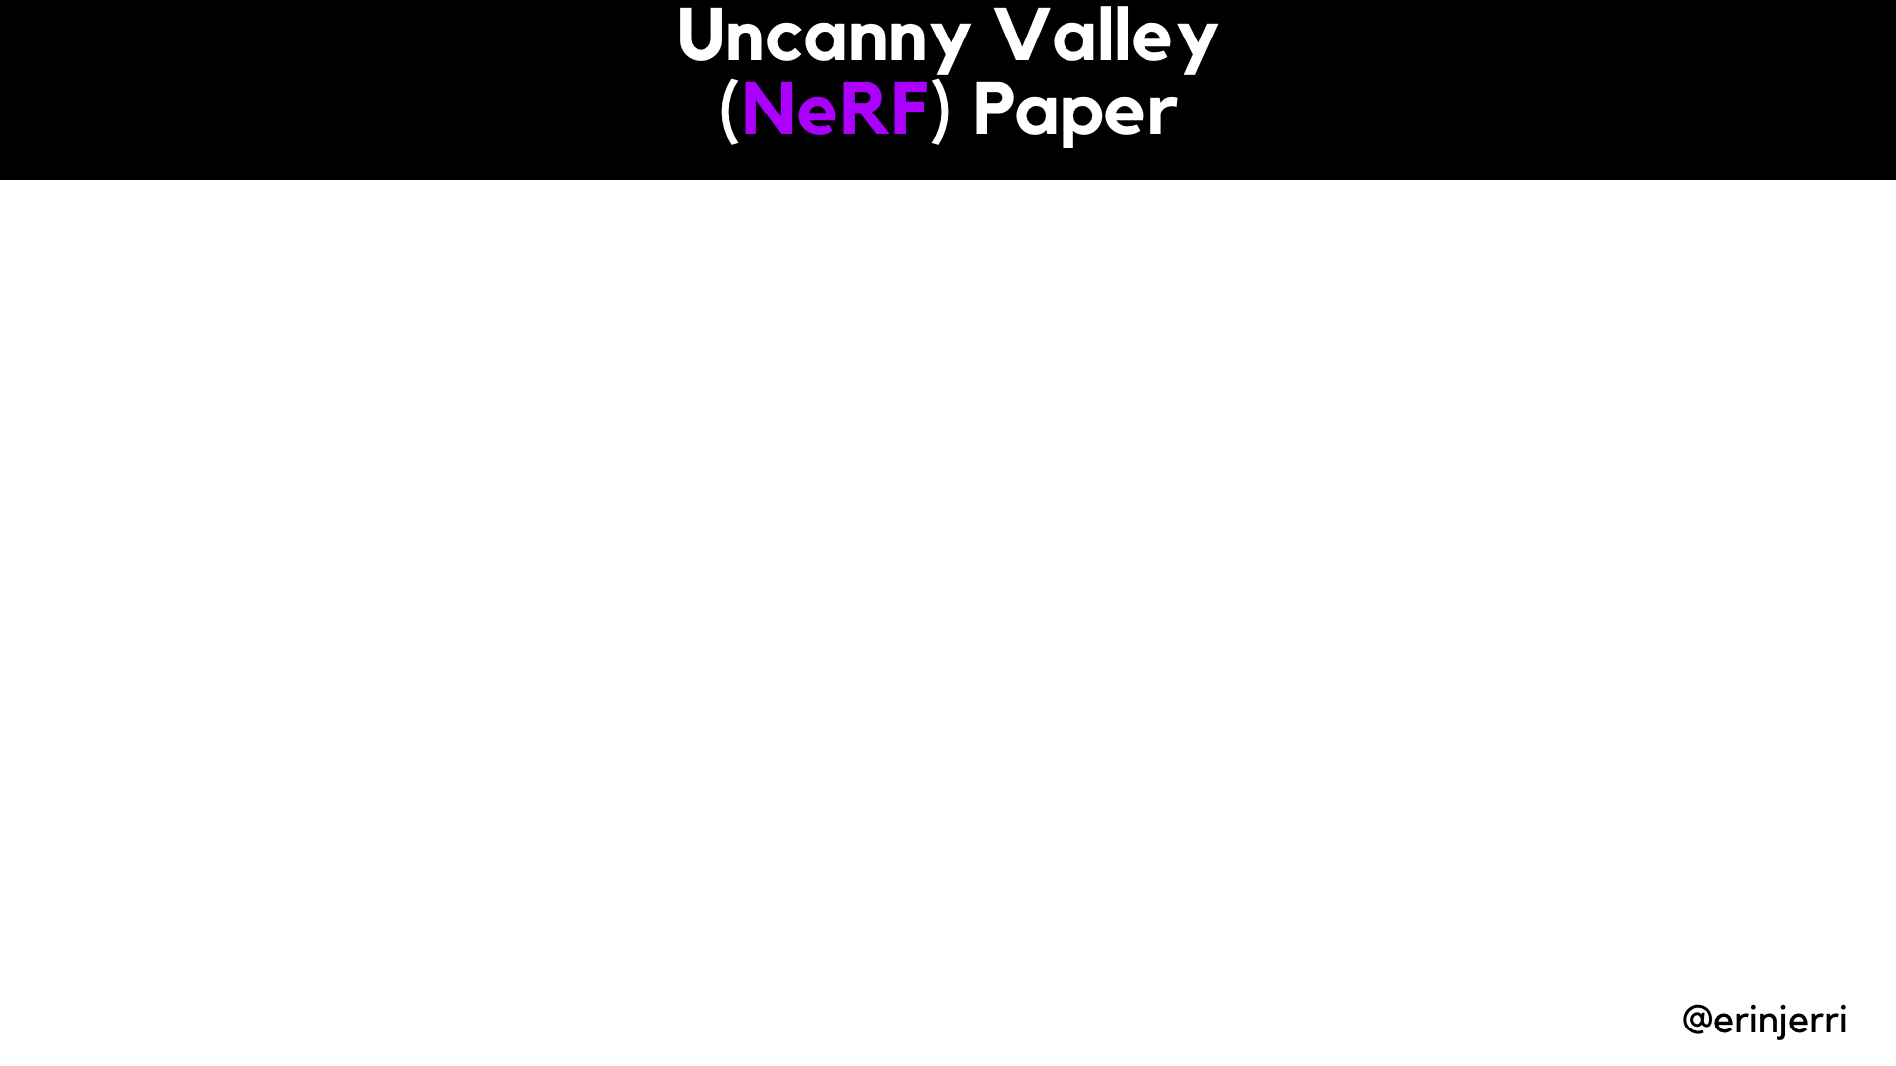

Notes:
AI further extends reality (SLAM/AR) - physical environment
AI extends the human body - physical body
GenAI expands human capability

Slide 46
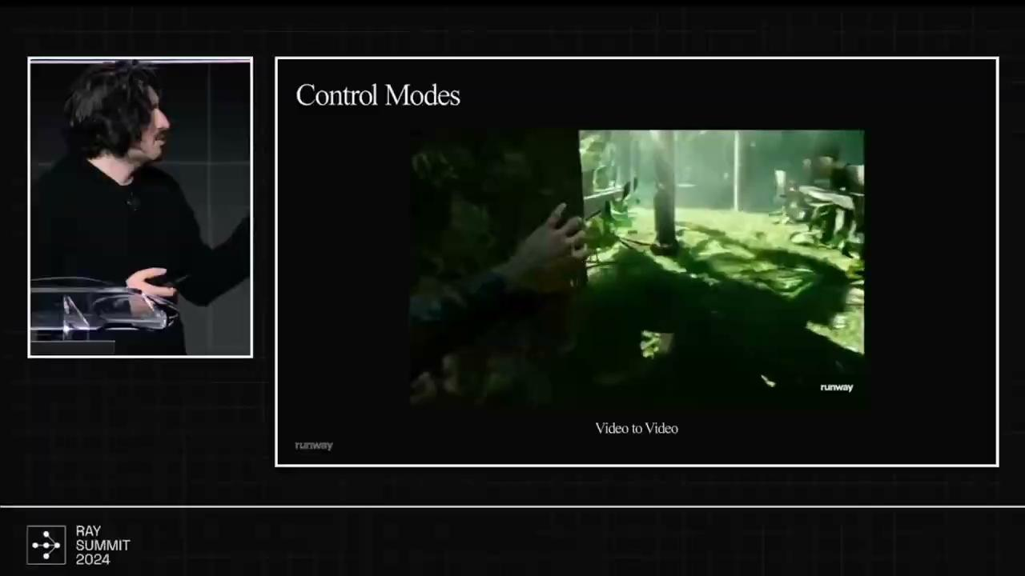
Notes:
Erin is still adding images/assets to this slide

Slide 47
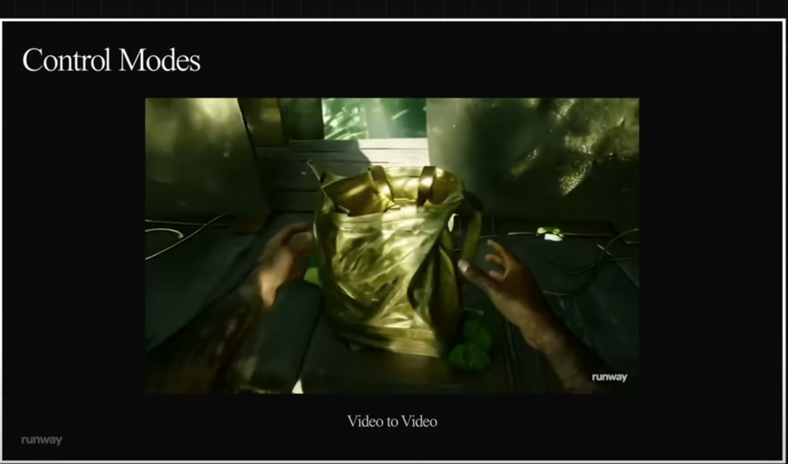
Runway at Ray Summit 2024

Slide 48
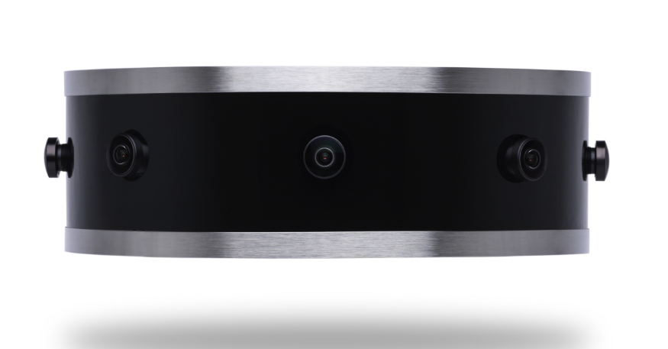
Remix’s Teleporter Device
(so instead of glasses, another physical device to scan your environment and let others directly manipulate the environment in Apple Vision Pro)
https://remix.ing/product

Slide 49
CHARACTERS, AVATARS, AND AGENTS

Slide 50
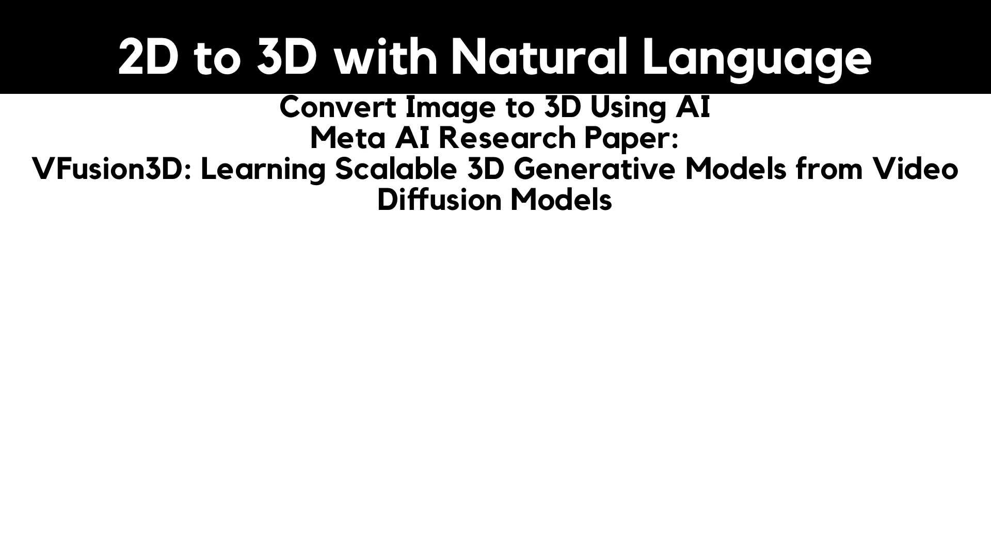
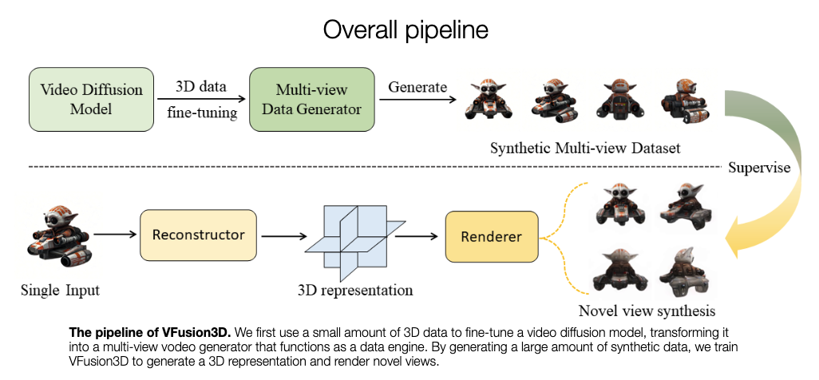
Notes:
Erin is still adding images/assets to this slide

Slide 51
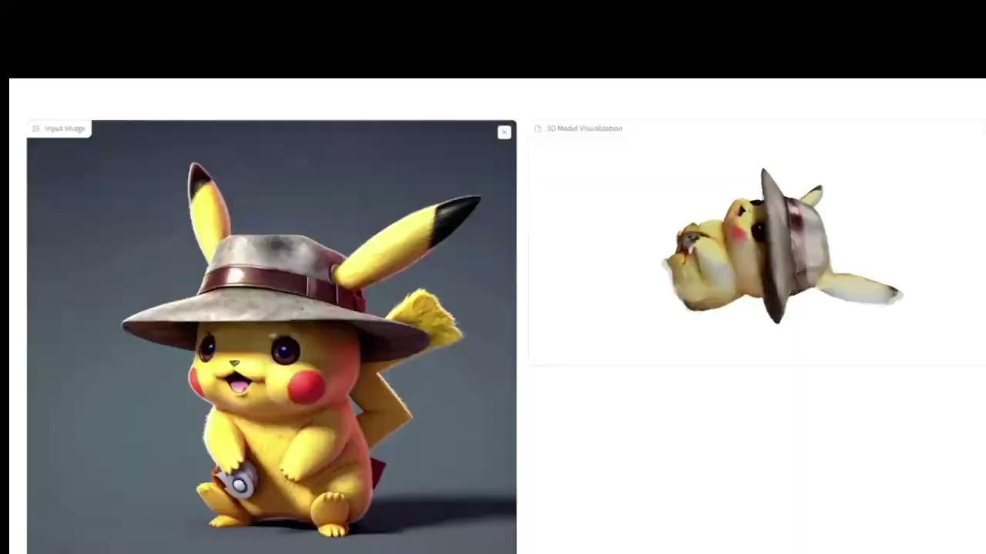
Notes:
Erin is still adding images/assets to this slide

Slide 52
Code Generation

Slide 53
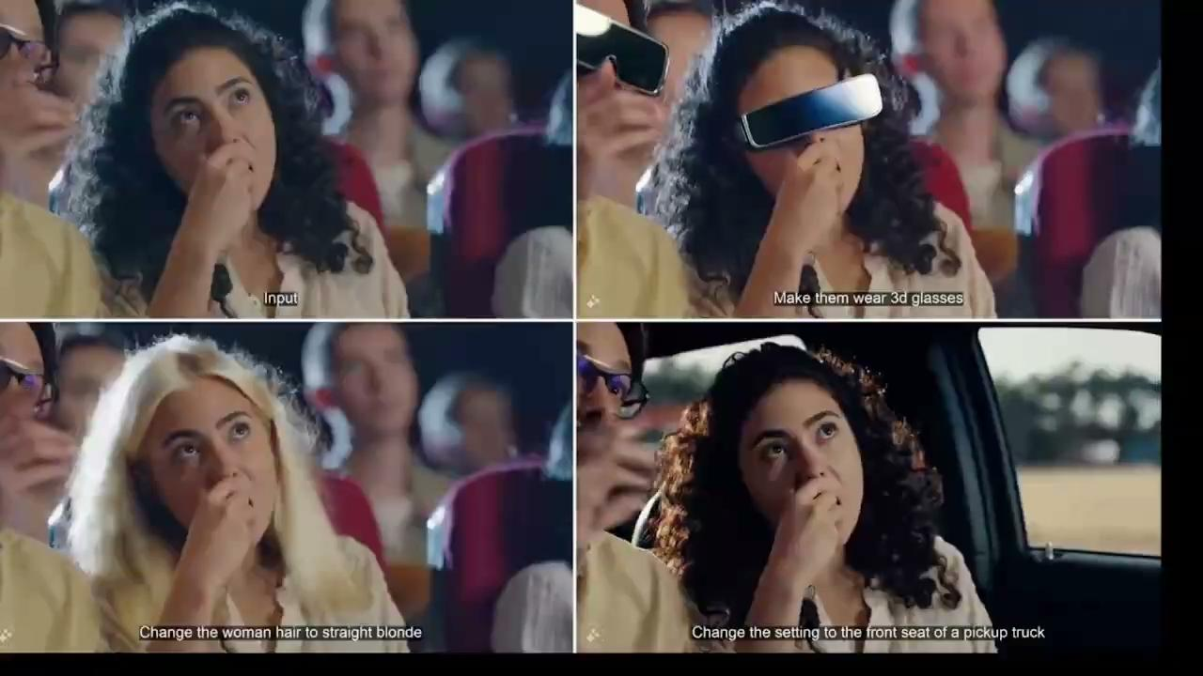
Notes:
Erin is still adding images/assets to this slide

Slide 54


Notes:
Erin is still adding images/assets to this slide

Slide 55
AUTOMATION

Slide 56

Notes:
AI Models
Explain Stable Diffusion and Style Transfer
Transformer Model
NeRFs
3D fit Model

Slide 57

Notes:
AI Models
Explain Stable Diffusion and Style Transfer
Transformer Model
NeRFs
3D fit Model

Slide 58

Notes:
AI further extends reality (SLAM/AR) - physical environment
AI extends the human body - physical body
GenAI expands human capability

Slide 59


Slide 60


Slide 61

Notes:
AI further extends reality (SLAM/AR) - physical environment
AI extends the human body - physical body
GenAI expands human capability

Slide 62

Notes:
AI further extends reality (SLAM/AR) - physical environment
AI extends the human body - physical body
GenAI expands human capability

Slide 63


Slide 64

Stanford Cypher Policy Center
https://hai.stanford.edu/sites/default/files/2024-02/White-Paper-Rethinking-Privacy-AI-Era.pdf
Stanford Human-Centered Artificial Intelligence
https://hai.stanford.edu/
Markula Center for Applied Ethics
https://www.scu.edu/ethics/
Fast.ai Data Ethics (2020)
https://ethics.fast.ai/
Notes:
AI further extends reality (SLAM/AR) - physical environment
AI extends the human body - physical body
GenAI expands human capability

Slide 65

Thank you!
Follow me
@erinjerri
https://www.linkedin.com/in/erinjerri

Slide 66
REFERENCES
Bar-Zeev, Avi.
Bye, Kent. “Privacy Pitfalls of Contextually-Aware AI: Sensemaking Frameworks for Context and XR Data Qualities.” Stanford Cyber Policy Center “Existing Law and Extended Reality: An Edited Volume of The 2023 Symposium Proceedings.” 2024 October.
https://fsi.stanford.edu/publication/existing-law-and-extended-reality
Bye, Kent. “Philosophical Frameworks for the Metaverse.” Stanford Cyber Policy Center. “https://www.youtube.com/watch?v=LzpbyRQ_GT4&t=919s
Gallagher, Tim. “Towards Design Guidelines for VR Training for the Chemical Industry.” Education for Chemical Engineers. 2021 Feb. https://www.researchgate.net/publication/349077963_Towards_Design_Guidelines_for_Virtual_Reality_Training_for_the_Chemical_Industry
Germanisdis, Anastasis. “A Brief History of Video Generation: Runway Co-founder Anastasis Germanidis | Ray Summit 2024. https://www.youtube.com/watch?v=iMttGrkgn5E&t=1105s
Han et al. “VFusion3D: Learning Scalable 3D Generative Models from Video Diffusion Models.” ECCV 2024. https://junlinhan.github.io/projects/vfusion3d.html
Video from Twitter: https://x.com/Gradio/status/1821944006730723482
Mildenhall, Ben et al. NeRF: Representing Scenes as Neural Radiance Fields for View Synthesis” CVPR 2020. https://arxiv.org/abs/2003.08934
Zhu, Jun-Yan et al, Berkeley AI Research (BAIR).“ Unpaired Image-to-Image Translation using Cycle-Consistent Adversarial Networks” Pix2Pix. 4 Aug 2020.. https://github.com/junyanz/pytorch-CycleGAN-and-pix2pix
Fan, Jim. UC Berkeley LLM Agents Course Berkeley RDI Center on Decentralization & AI. https://www.youtube.com/watch?v=Qhxr0uVT2zs&t=2284s 4 Nov 2024.
Nvidia. “NVIDIA & Inworld AI demo on-device capabilities for AI agents in video games”
https://www.youtube.com/watch?v=e6UF6j9LwZ0 2024 June 2.
Jerald, Jason. The VR Book: Human Centered Design for Virtual Reality. ACM. 2015.
Juliani, Arthur “AI Accelerationism is a Humanism Imagining a Future Without Computers” 2024, July 10. https://awjuliani.medium.com/ai-accelerationism-is-a-humanism-15e24c65810d
Milgram and Kishino. “Augmented Reality: A class of displays on the reality-virtuality continuum.” SPIE: Telemanipulator and Telepresence Technologies v2341. 1994.
Miesnieks, Silka,”Designing for Our Senses, Not Our Devices.” Creating Augmented and Virtual Realities: Theory and Practice for Next-Generation Spatial Computing. O’Reilly Media. 2018.
Roberts, Jasmin. Microsoft Research.
To, Meng. https://x.com/MengTo/status/1826955943311241611

